Slide 2
Hospital Emergency Operations Response:
Mass Casualty Response

Slide 3
Objectives
At the conclusion of this presentation the participant will be able to:
Facilitate discussion regarding disaster or medical emergency response operations
Review the epidemiology of disasters
Define the role of Public Health in a disaster
Review the phases of disaster response
Define the role of hospitals in disaster response
Notes:
Review objectives of presentation.

Slide 4
Disaster
Disaster
Crisis situation causing wide spread damage which exceeds ability to recover
Disaster Management
Actions taken by an organization in response to unexpected events that are adversely affecting people or resources and threatening continued operation of the organization; management of natural catastrophes
Natural or Man Made
Emergency Operations Response
Notes:
Review the definition of disaster.
Review with audience participation examples of natural events verses man-made events.
Define the new terminology for disaster is “emergency operations response”.

Slide 5
FEMA Declared Disasters By Year
http://www.fema.gov/disasters/grid/year
Notes:
Slides defines the historical overview of emergency response / disaster events from 2002 to 2011 in the United States.
Major disaster response is defined by the State Governor and he/she requests a declaration from the President as a major disaster.
Emergency disaster is defined as an event that was managed by the local response.
Information obtained from FEMA.org http://www.fema.gov/disasters/grid/year

Slide 6
FEMA Review
BY STATE | Major Disaster Declarations | Emergency Declaration
Total Disaster Declarations | 2054 | 344
Average | 34 | 6
Notes:
Total overview of the disaster declarations and emergency declarations compared to the average per state.

Slide 7
FEMA State Major Disaster Declarations
State |  | State
Alabama Alaska Arkansas California Florida Georgia Illinois Indiana Iowa Kansas Kentucky | 56 37 53 78 63 36 51 39 48 47 55 | Louisiana Maine Minnesota Mississippi Missouri Nebraska New York N. Carolina N. Dakota Ohio Oklahoma | 58 59 48 50 53 47 65 40 42 45 70
http://www.fema.gov/disasters/grid/state
Notes:
This data reflects the states that exceed the average number of major disaster declaration of 34 per state. More on next slide.
Information is available at http://www.fema.gov/disasters/grid/state

Slide 8
FEMA State Major Disaster Declarations
Pennsylvania 47
South Dakota 39
Tennessee 50
Texas 86
Virginia 45
Washington 44
West Virginia 46
Wisconsin 35
Notes:
Continuation of data reflecting those states that exceed the average number (34) of major disaster declarations.

Slide 9
Disasters in 2011
Total Weather Losses: $35 Billion
700 US Disaster Deaths
US - 10 Weather Catastrophes
5 Tornado Outbreaks
Two Different Major River Floods
Drought In Southwest
Blizzards in Midwest / Northeast
Hurricane Irene
East Coast Earthquake
Oppressive and Unrelenting Heat
Notes:
List of disaster events for 2011 in the United States.

Slide 10
Tornadoes of 2011
Wikimedia.org
Notes:
Map reflects the tornadoes of 2011 that produced fatalities. The point is to define tornadoes as a natural hazard in regions of the United States.

Slide 11
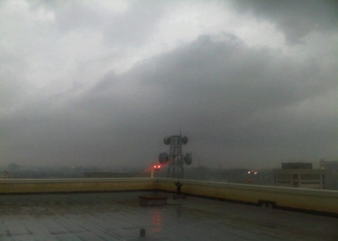
Notes:
Picture is of a tornado event passing over the roof of a hospital on April 3rd with 11 tornadoes on the ground in Dallas County. (2012 Parkland Hospital)

Slide 12
Tornado Hospital Impact
Notes:
Joplin, Missouri, is a community of approximately 50,000 citizens. On Sunday, May 22, 2011, at 5:41 an EF5 tornado with a wind of 250 miles per hour hit the community and took its first “direct hit” on Mercy-St. John Hospital. The tornado hit one side of the building, and blew out windows and walls. Power was lost, water, gas and sewer pipes were disrupted. Liquid oxygen tanks were damaged and spewing. The hospital was emergently evacuated.

Slide 13
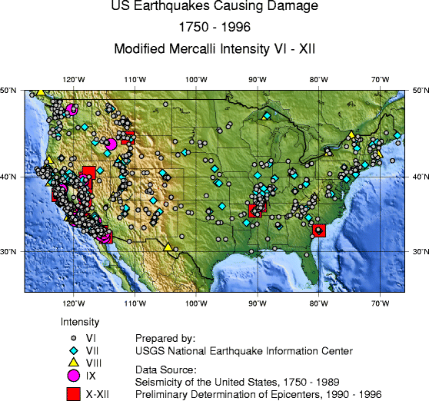
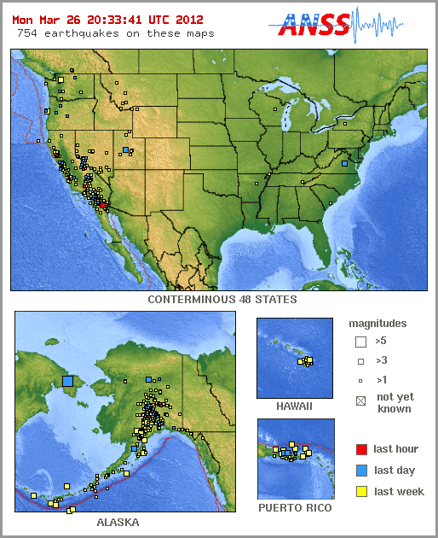
Earthquake Events
http://earthquake.usgs.gov/earthquakes
Notes:
Map defines the US earthquakes causing damage from 1750 to 1996. Maps on the right defines earthquakes to 2012. The point is to define earthquakes as a natural hazard in specific regions of the United States.
Information found on http://earthquake.usgs.gov/earthquakes/?source=sitenav

Slide 14
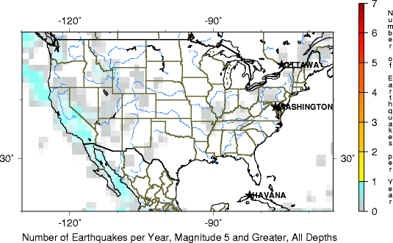
Earthquake Events
Notes:
Additional data reflecting earthquakes as a hazard by defining the number of quakes with a magnitude of 5 or greater per year.

Slide 15
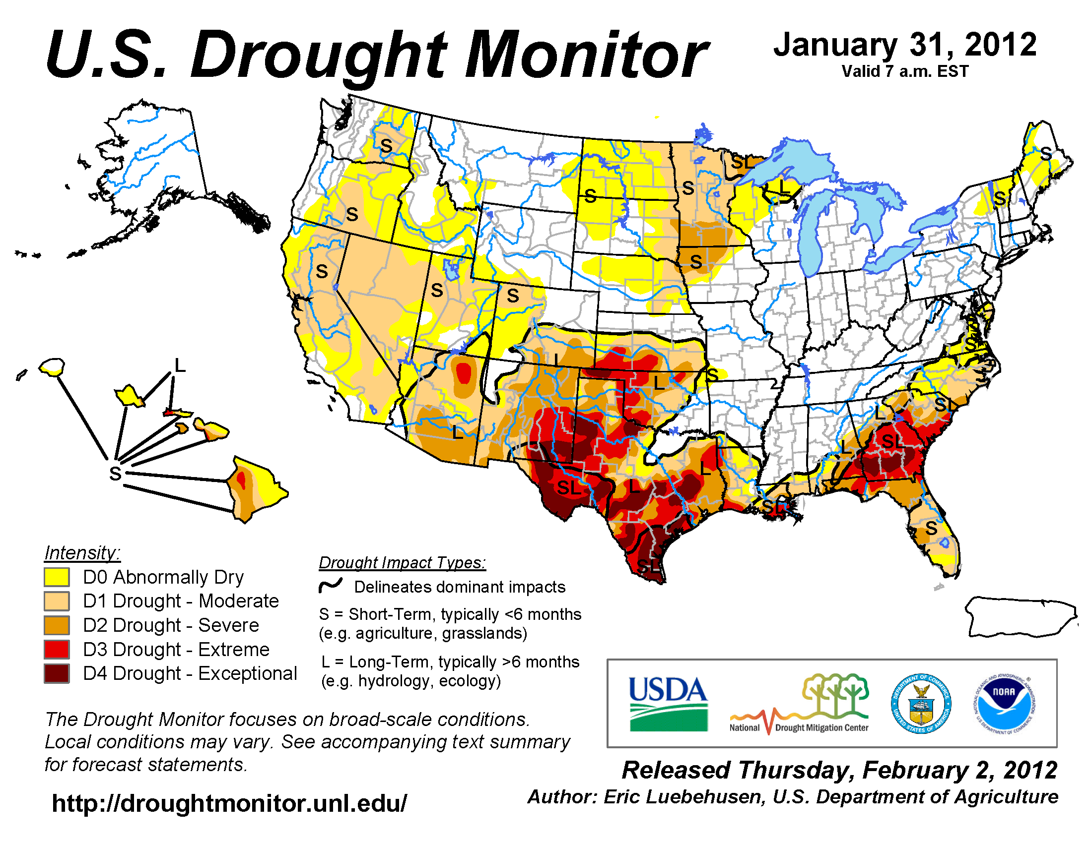
Drought: Potential Wild Fire
Notes:
Drought conditions worsened across parts of the Southeast, with Exceptional Drought (D4) developing across southern Georgia and Moderate (D1) to Severe (D2) Drought covering most of Florida. Drought conditions improved for Texas by several categories, where January brought above-normal precipitation to much of the state. The footprint of Moderate Drought (D2) expanded across the Western Great Lakes, and covered Minnesota by the end of the month. Drought conditions also worsened by one to two categories across much of the West which had been drier than average for several months.
Point to make is a drought is a natural hazard in regions of the United States.

Slide 16
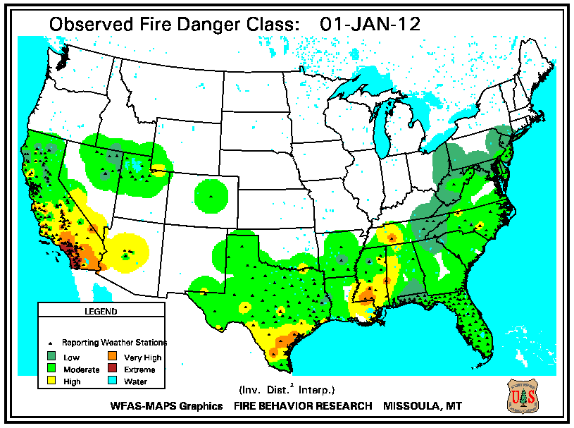
2012 Wild Fires Danger
Notes:
Map defines the potential wild fire danger in the United States. Information is from the Fire Behavior Research Center in Missoula, MT.
Wild fires are natural hazards or can me man-made.

Slide 17
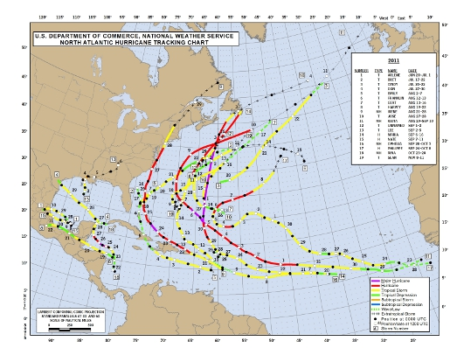
Hurricane Events
Notes:
Review of Hurricanes in 2011. Again, the point is to define hurricanes as a natural hazard in specific regions of the United States.

Slide 18
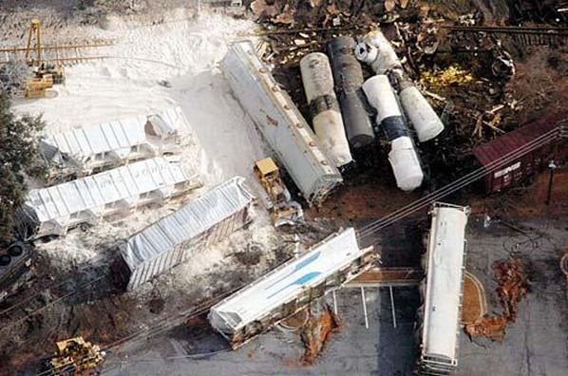
Train Events
Notes:
Data on train events provided on next slide

Slide 19
Train Events
2002 | 7 Events -1 Evacuation, 10 Killed, 259 Injured
2003 | 3 Events –1 Evacuation with Fire, 2 Killed, 48 Injuries
2004 | 4 Events –1 Evacuation, 6 Killed, 74 Injured
2005 | 8 Events –1 Evacuation, 23 Killed, 433 Injured
2006 | 7 Events – 5 killed
2007 | 7 Events – 2 Evacuations
2008 | 9 Events -27 Killed, 297 Injuries
2009 | 6 Events –2 Evacuations – 17 Killed
2010 | 2 Events
2011 | 5 Events –5 Evacuations
http://en.wikipedia.org/wiki/Lists_of_rail_accidents
Notes:
A few of the more significant events
January 6, 2005, Graniteville, S. Carolina: Forty-two car freight train collides head-on with a stopped local, sixteen cars derail. One tank with 90 tons of chlorine gas ruptures causing evacuation. 9 killed and 250 injured. (Photo on previous slide)
January 26, 2005, Glendale, California: suicide driver left car on tracks, then left vehicle. Metro double-decker commuter train hits vehicle, derails, hits northbound metro train and a parked train. Eleven are killed and 100 are injured.
September 17, 2005, Chicago, Illinois: Metro train derails. Two are killed and eighty-three are injured.
October 10, 2007, Painesville, Ohio: Train carrying ethanol and butane derails, causing evacuation and fire lasting for several days.
November 30, 2007, Chicago, Illinois: Train strikes a freight train causing multiple casualties.
March 25, 2008, Canton, Massachusetts: Runaway box car crashes into the Junction Station causing 150 casualties.
September 12, 2008, Chatsworth, California: Double-decker commuter train collides head on with a freight train. Twenty-five are killed and 135 are injured.
June 19, 2009, Rockford, Illinois: Train derailment with fourteen cars derailed and exploded. One killed and causing multiple burn casualties.
June 22, 2009, Washington, DC: Trains collide. Nine are killed.
July 9, 2009, Canton, Michigan: Train hits passenger vehicle trespassing crossing. Five killed.
May 13, 2010, Mebane, North Carolina: Train collides with truck. Eleven are killed.

Slide 20
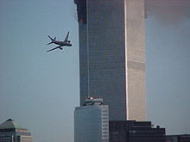
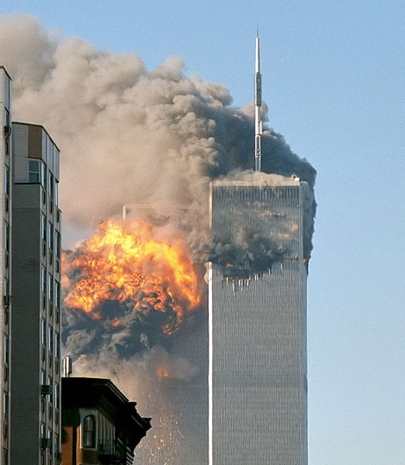
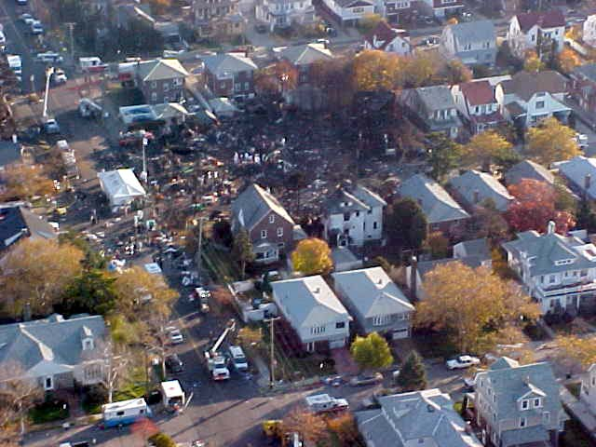
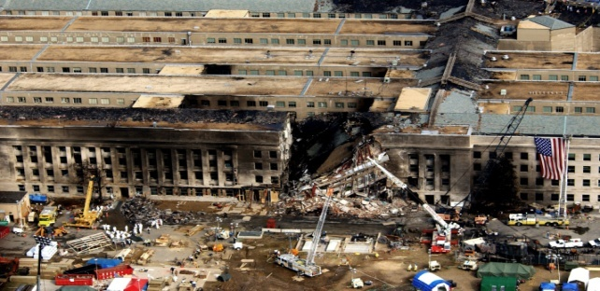
Commercial Aircraft Events
4
1
3
2
Notes:
American Airlines, September 11, 2001, Flight 77, crashes into the Pentagon, 66 fatalities on the plane.
American Airlines, Flight 587, crashes into the Queens apartment building, 260 fatalities on the plane.
US American Airlines, September 11, 2001, Flight 11, crashes into the World Trade Center, 92 fatalities on plane.
Airway, January 15, 2009, Flight 1404, ditches into the Hudson River, New York, due to multiple bird hitting engine.

Slide 21
Commercial Aircraft Events
2000 to 2011 – 209 Commercial Aircraft Crashes
2000 to 2011 – 13 Commercial Aircraft Crashes in the United States ( 753 Fatalities, 97 Reported Injuries)
2001 – Planes Used For Terrorism
Notes:
Point is to define aircraft crash events as a potential man-made hazard in the United States. Plans must address multiple or mass casualty response to include burns, trauma, casualty’s family needs as well as media)
In addition to events on previous slide….
1. Alaskan Airways, January 31, 2000, Flight 26, crashes into the Pacific Ocean, 88 fatalities.
2. Southwest Airlines, March 5, 2000, Flight 1455, runs off the runway in Burbank, California, 43 injuries out of 142 passengers.
3. Airjet Charter Flights, March 29, 2001, crashes on approach to Aspen, Colorado, 18 fatalities.
4. United Airlines, September 11, 2001, Fight 175, crashes into the World Trade Center, 65 fatalities on the plane.
5. United Airlines, September 11, 2001, Flight 93, crashes into field in Pennsylvania, 44 fatalities on the plane.
6. American Airlines, December 22, 2001, Flight 63, Richard Reid, Shoe Bomber. No fatalities.
7. Air Midwest, January 8, 2003, crashes on takeoff at Charlotte, NC, 21 fatalities.
8. American Eagle, May 9, 2004, flight 5401, runway event, 13 injuries.
9. Southwest Airlines, December 10, 2005, Flight 1248, slides off runway, no injuries on plane – one fatality on ground.
10. Conair Air, August 27, 2006, Flight 191, crash on take-off at Lexington, Kentucky, 49 fatalities.
11. Colgan Air, February 12, 2009, Flight 3407, crashes into houses in Clarence New York, 50 fatalities.
12. Northwest Airlines, December 25, Flight 253, man with explosive device causes fire on plane – 3 injuries.

Slide 22
School Shootings
2000 – 2001 | 19 Deaths
2001 – 2002 | 4 Deaths
2002 – 2003 | 14 Deaths
2003 – 2004 | 29 Deaths
2004 – 2005 | 20 Deaths
2005 – 2006 | 5 Deaths
2006 – 2007 | 38 Deaths
2007 – 2008 | 3 Deaths
2008 – 2009 | 10 Deaths
2009 – 2010 | 5 Deaths
2010-2011 | 6 Deaths
2011-2012 | 7 Deaths
January 1-December 21, 2012 | 35 Deaths
Notes:
There have been 201 deaths in school shootings since 2000.
First School Shooting- University of Texas in Austin, August 1, 1966 16 Killed (Man-made hazard)
Columbine High School – Littleton Colorado, April 20, 1999 – 13 Killed
Virginia Tech Shooting – Blacksburg, Virginia, April 27, 2007 – 32 Killed
Sandy Hook Elementary School- Newtown, Connecticut- 20 students, 6 teachers Killed
Since 1966, there have been over 117 documented schools shootings in the US.
Universities – 36 shootings
High Schools – 58 shootings
Middle Schools – 19 shootings
Elementary Schools – 14 shootings
Day Care Center – 1 shooting
Amish School – 1 shooting
Point - : Man-made hazard

Slide 23
Shooting Events in Hospitals
Event at Psychiatric Hospital, Pennsylvania
Event at Creighton University Medical Center, Illinois
Event at Physician’s Regional Medical Center, Florida
Event at John Hopkins Hospital, Maryland
Active Shooter Procedure – Code Silver
Johns Hopkins Hospital: Gunman Shoots Doctor, Then Kills Self and Mother
Notes:
Slide to point out that hospitals can be the site of single or multiple shootings and emergency operations plans must address the active shooter.
What is your active shooter procedure?
Newspaper clipping of event in Pittsburgh Psych Hospital
2 Dead and 7 Wounded
Creighton University Medical Center – One man shot by a shooter.
Physician’s Regional Medical Center – Shooter killed wife then turned gun on himself
John Hopkins – Shooter wounds doctor, kills mother then turns gun on himself
ENA Study
97.1 % - Physical Violence was perpetrated by patients and their relatives.
80.6% of physical violence occurred in the patients’ room, 23.2% in the corridors, hallways stairs and elevators, and 14.7% at the nurses’ station.
38.2% of physical violence against emergency nurses occurred while they were triaging patients, 33.8% while restraining or subduing patients, and 30.9% while they were performing invasive procedures.
15% of male nurses reported having been victims of physical violence compared with 10.3% of female nurses.
13.4% of violent acts occurred in large urban areas compared with 8.3% in rural areas.

Slide 24
Acts of Terrorism in USA
1900 – 1959 | 15
1960 – 1969 | 12
1970 – 1979 | 15
1980 – 1989 | 11
1990 – 1999 | 8
2000 – 2010 | 23
Notes:
Table reflects the terrorist events for the defined years. Information available through FEMA and online review.
Memorable Events
1983, November 7, U. D. Senate Bomb. The Armed Resistant Unit, a militant group bombs the US Capital in response to the US Invasion of Grenada.
1984, Rajneeshee bioterrorism attack: First bioterrorism in the US – the Rajneeshee cult spread salmonella in salad bars at 10 restaurants in the Dallas, Oregon, to influence elections.
1985 December 11: first fatality of the Unabomber’s neo-luddite campaign.
1993, February 26; First World Trade Center bombing killed six and injured 1000. Attached carried out by Al Qaeda.
1994 December 10; Second Unabomber fatality.
1995 April 19; Oklahoma City bombing; Alfred P. Murrah Federal Building – 168 fatalities.
1995 April 24; third Unabomber fatality.
1996 July 27; Centennial Olympic Park bombing by Eric Robert Rudolph occurred in Atlanta, Georgia, during the Atlanta Olympics. One person was killed and 111 were injured.
1997 February 24; Palestinian Ali Hassan Abu Kamal opens fire on tourist at observation deck atop the Empire State Building killing a Danish national and wounding visitors.
2009 November 5; Fort Hood shooting: Major Nidal Malik Hasan, a US psychiatrist, opens fire and kills 13 people at the Fort Hood Army Base.
2010 February 18; Austin suicide attack: Joseph Stack deliberately flew a small Piper Dakota aircraft into the government building in Austin, Texas, killing himself and an Internal Revenue Service employee.

Slide 25
Acts of Terrorism
1972: Attack at Olympics in Munich Germany
1979: 80 Iranian students invaded the US Embassy in Tehran and took 52 US Hostages
1983: Hezbollah suicide bomber crashed truck of explosives into US Embassy in Beirut; 63 killed
1983: Hezbollah suicide bomber bombed US and French military barracks in Beirut; 299 Killed
1983: Shiite suicide bomber crashed into the US Embassy in Kuwait; 5 killed
1984: Truck bomb explodes outside Aukar, Lebanon Annex of the US Embassy in Beirut; 24 killed
1984 and 1985 hijackers
1988: 757 Pan Am Flight 103 explodes; 270 killed
Notes:
Brief overview of the acts of terrorism toward the US in and out of the United States.

Slide 26
Acts of Terrorism
1993: 2 US helicopters shot down in Somalia; 18 killed
1993: First World Trade Center bombing
1995: Truck bombing of US National Guard Training Center in Saudi Arabia; 7 killed
1996: Truck bombing of Khobar Towers in Saudi Arabia; 19 killed
1998: Car bomb US Embassy Kenya, US Embassy Tanzania; 224 killed
2000: Suicide bombing of the U.S.S Cole in Yemen; 17 killed
Notes:
Continued list of terrorist acts toward the US.

Slide 27
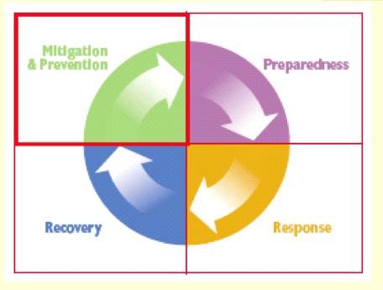
Public Health Disaster Response Phases
Notes:
Mitigation: Process of defining risks and potential vulnerabilities and then working to reduce the vulnerability and to strengthen society’s ability to endure and respond.
Preparedness: Process of developing a formal program of response. Preparedness includes training, staff development, classification of public health resources, development of standard operating procedures, developing emergency operations response procedures, developing communication procedures, and developing stockpiles and placement of key supplies and resources. This also includes participation in tabletop and functional exercises to test the response procedures. This is also the phase where community memoranda of understanding and external contracts are established.
Response: Phase in which each agency activates its emergency operations response plan to the specific threat, which can integrate local, regional, state and federal response. Picture is of an emergency department preparing for a hazardous materials event.
Recovery: Phase that identifies resources that can assist in restoring daily function as well as other resources that can address physically and emotional needs of the population. This is multidisciplinary and may include law enforcement, public schools, public works, EMS providers who are not 911 providers, and the business community.

Slide 28
Disaster Policy
First Response – Local Response
Major Disaster – President Determines Warrants Supplemental Federal Aid, Provides Disaster Relief Funds Managed by FEMA
Presidential Major Disaster Declaration – Long-Term Federal Recovery For Disaster Victims, Businesses and Public Entities
Notes:
This process reflects the sequence of events to declare and event a major disaster.
The event occurs which initiates a cascade of responses from the local to the regional responders. This process will escalate from the local, regional response to the district to the Governor of the State. The Governor requests major disaster assistance – FEMA Assistance. The President will define or declare if major disaster assistance is granted and if long-tern recovery assistance is granted.

Slide 29
Disaster Policy: Major Disaster Process
Local Government Responds
State Responds
Damage Assessment
Major Disaster Declaration is Requested By Governor
FEMA Evaluates Request
President Approves
http://www.fema.gov/media/fact_sheets/declaration_process.shtm
Notes:
Local Government Responds with supplementation through mutual aid agreements, neighboring communities and volunteer agencies. Regional partnerships through the trauma system and other agreements assist in mutual aid agreements.
Comprehensive information about Disaster policy and response can be found : http://www.fema.gov/
The State responds with state resources, such as the National Guard and state agencies.
The damage assessment by local, state and federal organizations determines losses and potential recovery needs.
The Major Disaster Declaration is requested by the Governor, based on assessments of damage and recovery needs and an agreement to commit state funds and resources to the long-term recovery.
FEMA completes an evaluation of the request and recommends actions to the White House based on the disaster, local community impact and the state’s ability to recover.
The President approves the request of FEMA informs the governor that the request has been denied. This decision process could take hours to weeks depending on the nature of the event.

Slide 30
National Response Plan
Align Federal Coordination
Unified, All-Discipline, All-Hazard Approach to Domestic Events
Standardize Operations
Establish National Framework
Streamline Disaster Policy Directives / Protocols
Guidelines For Long-Term Community Recovery
Notes:
The President, declared Homeland Security Presidential Directive 5, following the September 11 terrorist attacks. He requested the development of a new National Response Plan to align Federal coordination structures, capabilities, and resources into a unified, disciplined, all-hazards approach to manage a domestic event. The goal was to standardize operations for all levels of disaster response fro local federal, public to private entities. The NRP established a national framework, standardizes coordination, communication, incident management, and information sharing as well as disaster protocols. The NRP provides for guidance to initiate long-term community recovery.
The National Response Plan will supersede and integrated the following:
Initial National Response Plan
Federal Response Plan
US Governmental Interagency Domestic Terrorism Concept of Operations Plan
Federal Radiological Emergency Response Plan

Slide 31
National Response Framework
Emergency Support Function #8
Public Health and Medical Services
Supplemental Assistance to State, Local and Tribal Government
Assess Public Health/Medical Needs
Public Health Surveillance
Medical Care and Personnel
Medical Equipment and Supplies
Coordinator and Primary Agency is the Department of Health and Human Services
NDMS
http://www.fema.gov/national-response-framework
Notes:
Emergency Support Function #8 is to assist in Public Health and Medical Services. The support may be provided in response to multiple public health and medical events:
Natural and man-made disasters creating public health and medical emergencies
Terrorist threats using chemical, biological, nuclear/radiological material or large explosive devices
Infectious disease outbreaks and pandemics
Animal health emergencies
Other event that creates an actual or potential public health or medical emergency where Federal assistance is needed.
ESF #8 of the NRP may be categorized according to the functional areas:
Assessment of public health / medical needs
2. Health surveillance
3. Medical care personnel
4. Health/Medical equipment and supplies
5. Patient evacuation
6. Patient care
7. Safety and security for human drugs, biologics, medical devices, veterinary drugs
8. Food safety and security
Blood and blood products
Agriculture safety and security
Worker health and safety
All-hazard consulting
Behavioral consulting
Public health and medical information
Vector control
Potable water, waster water and solid waster disposal
Victim identification / mortuary services
Veterinary services
National Disaster Medical System (NDMS) is another source of public health and medical personnel under ESF #8. The NDMS is a nation wide partnership designed to deliver quality medical care to the victims and responders to domestic disasters.
Disaster Medical Assistance Team
Disaster Mortuary Operational Team
Veterinary Medical Assistance Team
National Medical Response Team

Slide 32
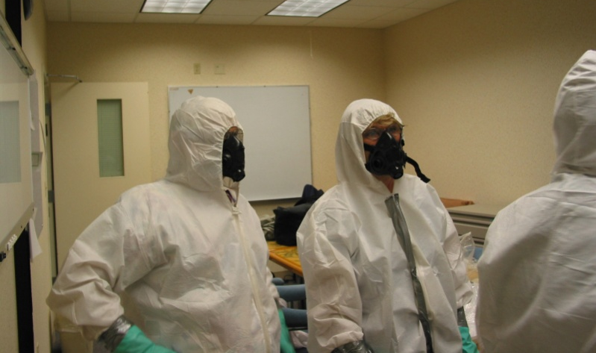
Disaster Role: Health Care System’s Role
First Responders: EMS, Police, Fire, Hospitals
First Receivers: Hospitals
Hospitals: Preparedness In Direct Odds With Productivity
Regional Integration
Collaborative Partnerships
Notes:
The September 11th attacks created a change in how hospitals and health care systems were viewed in regards to disaster response. The health care system is now viewed as a component of our national response system. EMS, law enforcement and fire have long been recognized as first responders for a number of years. Recent paradigm shifts now include hospitals and health care systems as first responders and first receivers. Hospitals are now viewed as a component of national security. Hospitals are recognized as safe havens in communities. The public expects hospitals to be prepared to care for their needs during and event. However in most hospitals daily operating requirements stretch hospital resources. Funding to enhance disaster response is a low priority in today’s health care facilities. Community integration and collaborative partnerships are now necessary but competition for the health care dollar creates a negative impact on integrations.
This is in direct contrast to what the public expects. Hospitals are expected to handle whatever they receive and do it right the first time.
Hospitals provide complex services: healthcare services, laundry services, hotel services, food services, building services, and warehouse services
Hospitals depend on public services for water, sewer, power, medical gases, communications, fuel, and waster collection. Back-up provisions for must be well planned and tested to prevent interruption of services and in major catastrophic events, event the back-up supply sources may be impacted.
Hospitals have within their infrastructure and environment hazardous materials: toxic agents, poisonous liquids, gases, and combustible agents. Items such as heavy medical equipment, storage shelves or supplies can cause harm during events such as earthquake, tornado or situations of violence. These items create their own potential threat to the hospital. These and the previously mentioned issues must be taken into consideration during the preparedness and planning phases.

Slide 33
Hospital Response
The 7 phases of Readiness:
Preparedness
Planning
Integration with Pre-Hospital
Emergency Operations Response Plan
Regional Integration
After Action Review
Plan Revisions
http://www.phe.gov/preparedness/planning/hpp/reports/documents/capabilities.pdf
Notes:
Hospital response can be reviewed in very defined phases.
Preparedness
Planning Integration with Pre-Hospital Agencies
Emergency Operations Response Plan
Regional Integration
After Action Review
Plan Revisions
These phases will be covered individually.

Slide 34
Hospital Preparedness
Phase Of Information Gathering
Hospital Leaders Define Federal & Regulatory Requirements
Education
Review of Lessons Learned
Organizational Structure
Notes:
The preparedness phase of the hospital response begins with data collection. Data to be reviewed begins with Federal and hospital regulations. These regulatory guidelines will define the minimal requirements for the hospital but does not necessarily define all components of successful responses. It is important that hospitals leaders commitment to needed educational needs such as Incident Command System training as well as training for triage, medical decontamination and special considerations for casualty management. Previous disaster exercises and after action reports must be reviewed to define status of corrective action plans and on-going weakness. Lessons learned for other events need to be reviewed. Regional and system response capabilities must be reviewed. The hospital must create an organizational structure that establishes emergency response as a priority and not bury the efforts under layers of bureaucracy of the hospital.
http://www.fema.gov/national-incident-management-system

Slide 35
National Incident Management For Hospitals
Adopt NIMS | Organization Wide
Command Management | ICS, MACS, PIS
Preparedness Planning | NIMS Tracking, Funding, Plan, MOU
Preparedness Training | 800, 700, 100, 200, 300
Preparedness Exercise | All Hazard, AAR, CAP
Resource Management | Inventory, Acquisition
Community and Information Management
Standard Terminology
Notes:
Hospitals receiving Federal preparedness and response grants, contracts or cooperative agreement funds must implement all seventeen NIMS elements. The seventeen are listed.
The hospital must adopt the NIMS infrastructure. Create a specific committee to address emergency operations response that had defined medical leaders and administrative leaders.
Command structure that follows the Incident Command System
Participate in Multi-agency Coordination System
Integrate Public Information System
Maintain a NIMS tracking process.
Track preparedness funds to demonstrate alignment with preparedness, planning, response and recovery efforts.
Revise and update emergency operations response plan to follow ICS and all NIMS elements.
Maintain documented and signed mutual agreements and mutual sharing agreements.
Define the hospital leaders that must complete the ICS 800, 700, 100, 200, 300 and 400 and track completion.
Integrate ICS training into all exercises and after action reviews.
Maintain an all-hazard response plan that integrates ICS and NIMS elements.
Complete an after action report with corrective action plans that is tracked for implementation.
Maintain an inventory assessment.
Ensure the resource acquisition aligns with the ICS standards.
Ensure communication plan and system aligns with ICS standards.
Ensure information management and tracking are processed through the ICS standards.
Plan defines standard and consistent terminology.

Slide 36
Preparedness
CMS Provisions of Participation
Joint Commission – Chapter 12 Standards for Emergency Management
Six Essential Elements
Communications
Resources and Assets
Safety and Security
Utilities Management
Patient Clinical and Support Activities
Notes:
The hospital leaders and the committee responsible for the emergency operations response planning must be very knowledgeable of the regulatory requirements specific to emergency operations response. All members of the committee must fully understand their role and the regulations specific to the committee and their departments.
Joint Commission’s Emergency Management standards identify six critical areas;
Communications
Resource and assets
Safety and security
Staff responsibilities
Utilities management
Patient clinical and support activities

Slide 37
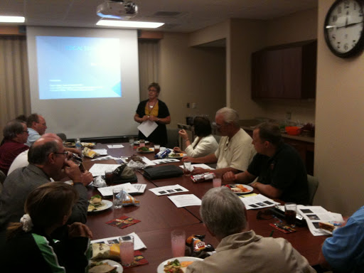
Planning
Planning Phase Is A Critical Element
Follows Review Of What As Happened
Hazard Vulnerability Assessment
Review Response Plans
Define Resources Needed
Community Integration
Prioritize Exercise Events
Special Populations
Specific Risks: Chemical, Biological, Blast
Planning For Staff Needs
Notes:
The planning phase follows the preparedness phase. Planning begins with the a review of the planning committee members, their role in response, commitment to participation and resources they bring. The planning committee must include acute care physicians, nurses and administrative leaders. Areas that play a key role in response must have a committed participant. Other criteria may drive participation as well. Example: trauma center criteria requires the trauma medical director and the trauma program manager must participate in hospital response as well as regional response planning. The committee will assign a task force to work with other community / regional leaders to complete a HVA. The previous years response plan, exercise after action reports and corrective action plans are reviewed by the committee. The outcome of these events will define the priorities for planning for the next twelve months. Special populations must be reviewed and have appropriate provisions in the response plan. These populations include but are not limited to pregnant individuals, pediatric, psychiatric, dialysis and geriatric patients. Patients who are homebound on ventilators and special needs must also be taken into consideration. Specific risk patterns such a chemical, biological, blast and burns treatments must be included in the response plan.
Planning for staff will include 1) staffing model changes for the disaster response, 2) length of shift for the response, 3) how to provide meals and breaks for the response, 4) provisions for rest, potential for sleep arrangements depending on type of event, 5) provisions for child care / dependent care/ pet care and 6) health care / mental health provisions. Measures to notify staff of the event and of their need to respond need to monitored for time delays and communication breakdowns. Measures to accurately track time must be in place. Plans must ensure the safety and welfare for staff.

Slide 38
Planning Phase
Brings Together Individuals of Interest, Resources and History
Creates a Score For Each Hazard
Assists in Defining Priorities For Next Twelve Months
Integrated with EMO / Community / Region
Notes:
The planning phase brings together hospital individuals that are interested, represent departments needed for response, have resources that are needed and provides history of what has happened as well response actions taken. These individuals need to reach out to the community representatives from Fire, EMS, Public Health and Emergency Management Office (EMO) to collectively complete a Hazard Vulnerability Assessment. Geographic regions and climate conditions impact the HVA.

Slide 39
Planning Phase [cont’d]
Hazard Vulnerability Assessment (HVA)
Define Hazard
Likelihood of Happening
Impact on Individual
Impact on Community
Impact on Society
Response Plan
Effective Plan
Resources/Equipment to Response
Staff Know What To Do
Notes:
The HVA tool utilized will assist with defining a specific score for each hazard. These scores and then used to prioritize planning efforts and exercises. Planning efforts should be integrated with the local and regional planning efforts. The region needs to understand what the hospital plans are and the hospital needs to understand the region’s plan and expectation of the hospital.

Slide 40
HVA
Natural | Man Made
Tornado | Transportation
Flooding | Industrial Hazmat
Hurricane | Structure Collapse
Earthquake | Weapon Violence
Landslide | Fire
Mudslide | Explosion
Wildfire | Terrorist Chemical
Extreme Temp | Terrorist Biological
Volcano | Terrorist Radiation
Notes:
Hazard Vulnerability Assessment (HVA)
To include audience participation, you may ask for other examples of Natural or Man Made hazards that might be included as a hazard in their community that is not listed. Another category to consider is technology when completing an HVA.

Slide 41
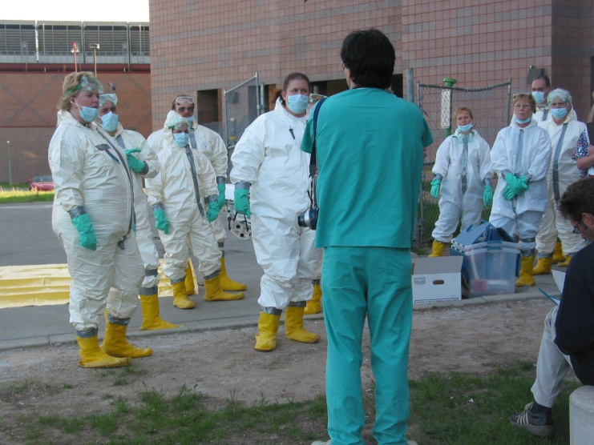
Planning
ICS / Command Center
Medical Decontamination Training
EMS Traffic Routes / Triage
Medical Care
Unidirectional Flow
Minimal Standards
Staffing Patterns
Evacuation of ED / Trauma Areas
Surge
Staff Notification / Staff Traffic Routes
Communication – Redundancy
Security
Notes:
The emergency operations response plan must be reviewed annually and have an annual evaluation. This is a Joint Commission requirement. These activities are typically completed in the first quarter of the calendar year and sets the stage for the committee activities for the next three quarters. The plan must define the Incident Command System structure and implementation. In addition, the location for the command center must be defined and prepared. This will include being aligned with back up emergency power, communication systems, access to media outlets, fax machines, printers, and appropriate equipment. HICS forms, job action sheets, tracking boards and identification vests must be readily available. Job action sheets and HICS forms for the various departments but be developed and standardized to ensure alignment. Security to secure and protect the command center must be addressed. The Incident Commander must be aligned and integrated with the community and regional response. Individuals assigned to the Incident Commander job function must have appropriate training, leadership and communication skills.
Procedures for medical decontamination must be in place and ready to be operationalized. Training, equipment, storage and team notification for medical decontamination must be defined and provided. The facility must define its operational capacity to decontaminate the ambulatory, ambulatory with assistance and non-ambulatory patients.
Medical care guidelines must be defined. The location for triage during a mass casualty must be defined and be tested through various exercises. Security needs must be addressed. Individuals targeted to staff the triage area should have appropriate training. Tools for triage and the triage system to be utilized are defined in the planning phase. In addition, integration with EMS agencies will assist in identifying how to utilize the EMS field triage tag, and how EMS will identify the mass casualty triage area and the expectations of EMS. EMS traffic routes to the hospital will need to be protected and secured. Individuals targeted as the triage officer must have a strong clinical knowledge and understanding of expected outcomes. Triage staff should have appropriate safety gear and PPE protection. If decontamination needs are not ruled out the triage team may need to be suited in decontamination equipment. Staff receiving the patients must build in successive triage to decrease over triage.
Plans for where and how to relocate the patients in the emergency department and if the facility is a trauma center, relocation of the trauma patients needs to be defined. Patients for admission should have their admission expedited. Patients who are in the work-up queue should relocated. Stable patients may be relocated. This maximizes capacity for the arriving casualties. Minimal standards of care should be defined through the planning process with provisions of how to implement. Patients who meet criteria for a head CT, will have a head CT performed, but the patient can not be moved back t their original resuscitation room. This patient may be held in the radiology recovery room until films are read and disposition priorities are defined. Planning for surge capacity (space) and capabilities (specific medical resources) is a priority. Areas to establish alternate intensive care beds, alternate areas for managing the delayed and immediate casualties again will maximize surge capacity and capabilities.
Medical care from triage through resuscitation/evaluation to inpatient bed assignment must be defined. This includes defining areas for surge and alternate treatment areas. Measures to ensure unidirectional flow of the casualties and minimal standards of care are defined during the planning phase. Staffing pattern will be altered during a mass casualty response. Small stretcher teams are recommended for resuscitation areas. ICUs and inpatient units must review their response staffing options. Treatment areas that will need security must be defined and addressed in the plan. Staff education to ensure they understand these processes also need to be planned.
Procedures and mechanisms to notify staff must be addressed. Traffic routes for staff to return to the hospital need to be defined. These routes need to communicated to other agencies and secured. Staff need to be educated regarding how they will be notified of an event, the traffic route and where to report.
Communication is one of the most common failures in a disaster response. There must be planned tiers of redundancy for communication. It is recommended that there be at least three backup systems for communication and the forth system be the HICS form 213 and a ham radio operator.
Security is another common failure point in effective mass casualty response. Each element of planning should take into consideration the security risk and needs. These issues need to identified and addressed in the planning phase. They need to be incorporated into the emergency response plan and tested through the defined exercises.

Slide 42
Planning
Just-In-Time Inventory
Medication Distribution
Infrastructure Contingency
Business Continuity
Casualty Tracking
Notes:
Most hospitals have implemented systems such as pyxis systems or “just-in-time” inventory to maximize resource, utilization and decrease cost. Planning must review resources available and make provisions to ensure needed medical supplies, equipment, and medications are available for surge and mass casualty. The response must be timely and coordinated. This must be addressed in the planning phase to ensure needed agreements and operational issues can be defined prior to an event.
Planning efforts must review measures to ensure the building infrastructure can be maintained during the identified hazards. In addition, back up systems for fuel, water, power, HVAC, medical gases, oxygen, and waste management need to be reviewed to ensure sustainability. Contracts and agreements may need to be renewed annually as defined by the hospital contract management system or the vendor. In addition, the hospital may need to expand services and capabilities during a response, planning efforts need to address how the hospital engineering and facility departments will meet the demands.
Many hospitals have moved from the paper medical record and scheduling systems to electronic systems. Planning phases must review how these critical issues will be managed during and emergency response. In addition, patient registration processes will be altered to expedite casualty care. Plans need to identify how the patients will be identified and tracked. Business continuity planning may also identify areas of the hospital that are not critical to mass casualty response and define procedures to re-locate those resources. Picture is of registration clerks in a disaster drill, learning the paper tracking method as adjunct to electronic registration when rapid influx of victims or electrical or IT issues does not allow for electronic registration.
Casualty tracking is critical in emergency operations response mass casualty events. Individuals arriving from the disaster event are called casualties. Individuals that were in the hospital prior to the event are referred to as patients. This helps keep them separate in tracking systems. Casualty tracking can completed through electronic systems or on paper using the HICS form 254. The critical issue is that there is a plan for tracking that is written, individuals are trained how to do this and this is tested in exercises.

Slide 43
Planning
Written Emergency Operations Response Plan
Input of Medical Leaders, Administration, Nursing, Trauma Program, and Representatives From all Key Departments
All Hazard Response Plan
Job Action Sheets
Leadership Training
Departmental Training
Notes:
The final product of the planning phase is the written emergency operations response plan. This plan should be an all-hazard response plan. The HVA will define response procedures that need revisions, staff educational needs and if resources for mitigation are needed. These issues need to addressed and incorporated into the writing of the emergency operations response plan. This process is done with the input of all key stakeholders and departments. The plan should be reviewed and approved by the committee and moved through the leadership organization of the facility. The next step is to address resources needed to carry out the plan.
Job action sheets need to align with job functions through out the plan. Education for all leaders is necessary to ensure everyone is aware of the response plan and their role in the plan. The last phase of planning is to align the various departments with the plan. Most facilities have moved from having each department develop a response plan to having each department develop job action sheets that align with the emergency operations response plan. This ensures that all departments align with one all-hazard response plan. Department directors are responsible to educate all departmental employees on their role and use of the job action sheets and HICS forms.

Slide 44
Hospital Response
Event Recognition
Situational Awareness
Activation of Response – Level of Response
Notification
Establish the Command Center
Incident Command System
Incident Command
Logistics Section
Operations Section
Planning Section
Finance Section
Communication
Incident Action Plan
Notes:
Hospitals must be integrated with EMS and local Emergency Management Offices and be included in event notification systems to ensure they are aware of all developing issues within the community. Hospitals need to identify who within the system is to be notified and how information is to be processed. One hospitals are made aware of an event, hospital staff can evaluate the event, potential impact and current status in the ED, trauma, Ors, ICUs and general units as well as staffing issues. This is called the situational awareness. This process will validate an event and define the level of response needed to manage the event. This process should be done in a timely through manner.
The emergency operations response plan defines who has the authority to activate the levels of response. The level of response will define the number of individuals and resources committed to managing the event. Response levels should be integrated and standardized within the community for clarity and communication. Once the response procedures are activated, notification of staff and community partners must rapidly be initiated. Notification of the individuals selected and trained to respond to the command center must be a priority to ensure operational readiness. Procedures must outline who and how the command center will be established. The Incident Command System should align with the NIMS ICS training to foster integration and communication with other community responders.
The Incident Commander has the authority to define the scope of response, duration of response and to manage the event. The Incident Command will define the incident objectives and operational time-period. The Incident Commander has the authority to change business priorities and operations to manage the event. The Incident Commander is supported by the command staff: Liaison Officer, Public Information Officer, Safety Officer. Some hospitals have added the role of the Disaster Medical Director to oversee all patient care activities in the planning phase as well as the response phase. This individual would serve as an advisor to the Incident Commander and be included in the general staff. The Incident Commander role is one that is assigned in all events, regardless of how minor. The Incident Commander may be mobile in small events. Incident Command is supported by the Logistics Section, Operations Section, Planning Section and Finance Section. Each section has a defined job function and is led by a section chief. Individuals assigned to these roles must have completed the ICS 700, 100 and 200 at minimum to be successful in their role.
Communication systems must be implemented simultaneously with the Incident Command System. The Incident Commander must develop an initial message for all staff regarding the event and the Public Information Officer will execute the message. A communication plan must be defined and implemented. The Liaison Officer will establish communication with the local EMS and other agency responders. The Safety Officer is responsible to complete a safety analysis (HICS form 261) and communicate findings to the Incident Commander.
The incident objectives, safety analysis, communication plan and the plan to care for staff if they are ill or become injured are combined into the Incident Action Plan (IAP). The IAP is communicated to the Section Chief and monitored by the Planning Section Chief.

Slide 45
Incident Command System Organization Chart http://www.fema.gov
Community
Central Command
Incident Commander
Public Information Officer
Safety Officer
Liaison Officer
Logistics
Section
Operations Section
Planning Section
Finance Section
Notes:
45
Organizational review of the Incident Command System. The concept of the Incident Command System focuses on command and control. The maximum number of direct reports should never exceed seven. The target is between five to seven.
Incident Command – Authority to manage the event
Logistics Section is responsible to get the supplies and resources to manage the event. Logistics is often referred to as the “Getters”, they get the space, staff and stuff needed to respond to an event. Supply Branch Director is responsible for all supplies and equipment to respond to the event. The Service Branch Director is responsible for staff. This includes oversight of the Labor Pool, staff wellness, and staff needs such as child care, pet care, transportation, food and sleep. Logistics is responsible for all communication equipment resource needs.
Operations Section is responsible for the taking care of business. They are the “Doers”. The Section Chief will assign a Infrastructure Branch Director, Business Continuity Branch Director, Staging Branch Director, Hazmat Branch Director and a Medical Branch Director. The Medical Branch Director is responsible for all casualty care and patient care during the event. The Security Branch Director is responsible for all security needs of the facility during the event.
The Planning Section is responsible for data collection, processes and situational review. They are responsible for developing the strategy and action plans with the Incident Command that the other sections follow. The Planning Section Chief will maintain resource status and looks ahead to define what will be needed. Most hospital disaster drill do not last long enough to fully utilize the Planning Section and therefore is not fully appreciated or understood.
The Finance Section is responsible for the documentation and tracking all expenditures and mutual sharing agreements. They analyze potential risks, staff compensation, and claims for injury.
Organizational structure titles:
Incident Commander – Leader
Command Staff – Officers
Sections – Section Chiefs
Branch – Branch Director: May have Deputy(ies)
Divisions or groups – Supervisors
Unit – Unit Leader
Additional information is available at the website listed. http://www.fema.gov

Slide 46
Hospital Response
Initial Response Procedures
Security / Lockdown
Reorganization to ICS – Job Action Sheets
Unit Priorities
Emergency Department
Trauma
OR
ICU
General Units
Alternate Care Sites
Elective Procedures
Notes:
The response procedures must be initiated at the same time the Incident Command System is being implemented. Critical timely functions include establishing the security perimeters, hospital access and hospital lockdown. These are managed by the Security Branch Director in the Operations Section. While this is being done, all units must realign to follow the Incident Command System chain of command. Job action sheets will be implemented and communication systems established in each department and each unit. Each unit will implement procedures listed on their job action sheet. The Emergency Department must immediately begin to evaluate all patients for their plan of care and movement out of the ED. Areas targeted for holding and staging in the planning process must assist in the movement of these patients to create capacity for the casualties. All visitors and family members must be relocated to clear the ED. Staffing assignments must be reassessed. Small stretcher teams are an effective way to decrease chaos, define responsibility and manage control. If the facility is a trauma center, the operational status of trauma must be defined as most events are trauma related. The trauma staff will be instrumental in helping expedite care. All units need to define patients that can be moved to a less acute unit or discharged home. The triage team must be established. Alternate care sites must be considered and evaluation of all elective procedures. Considerations for medical decontamination must be evaluated. Decontamination must be implemented early to protect the facility and can easily be stood down if not needed.
Picture is of security guard outside ED ambulance bays directing EMS traffic.

Slide 47
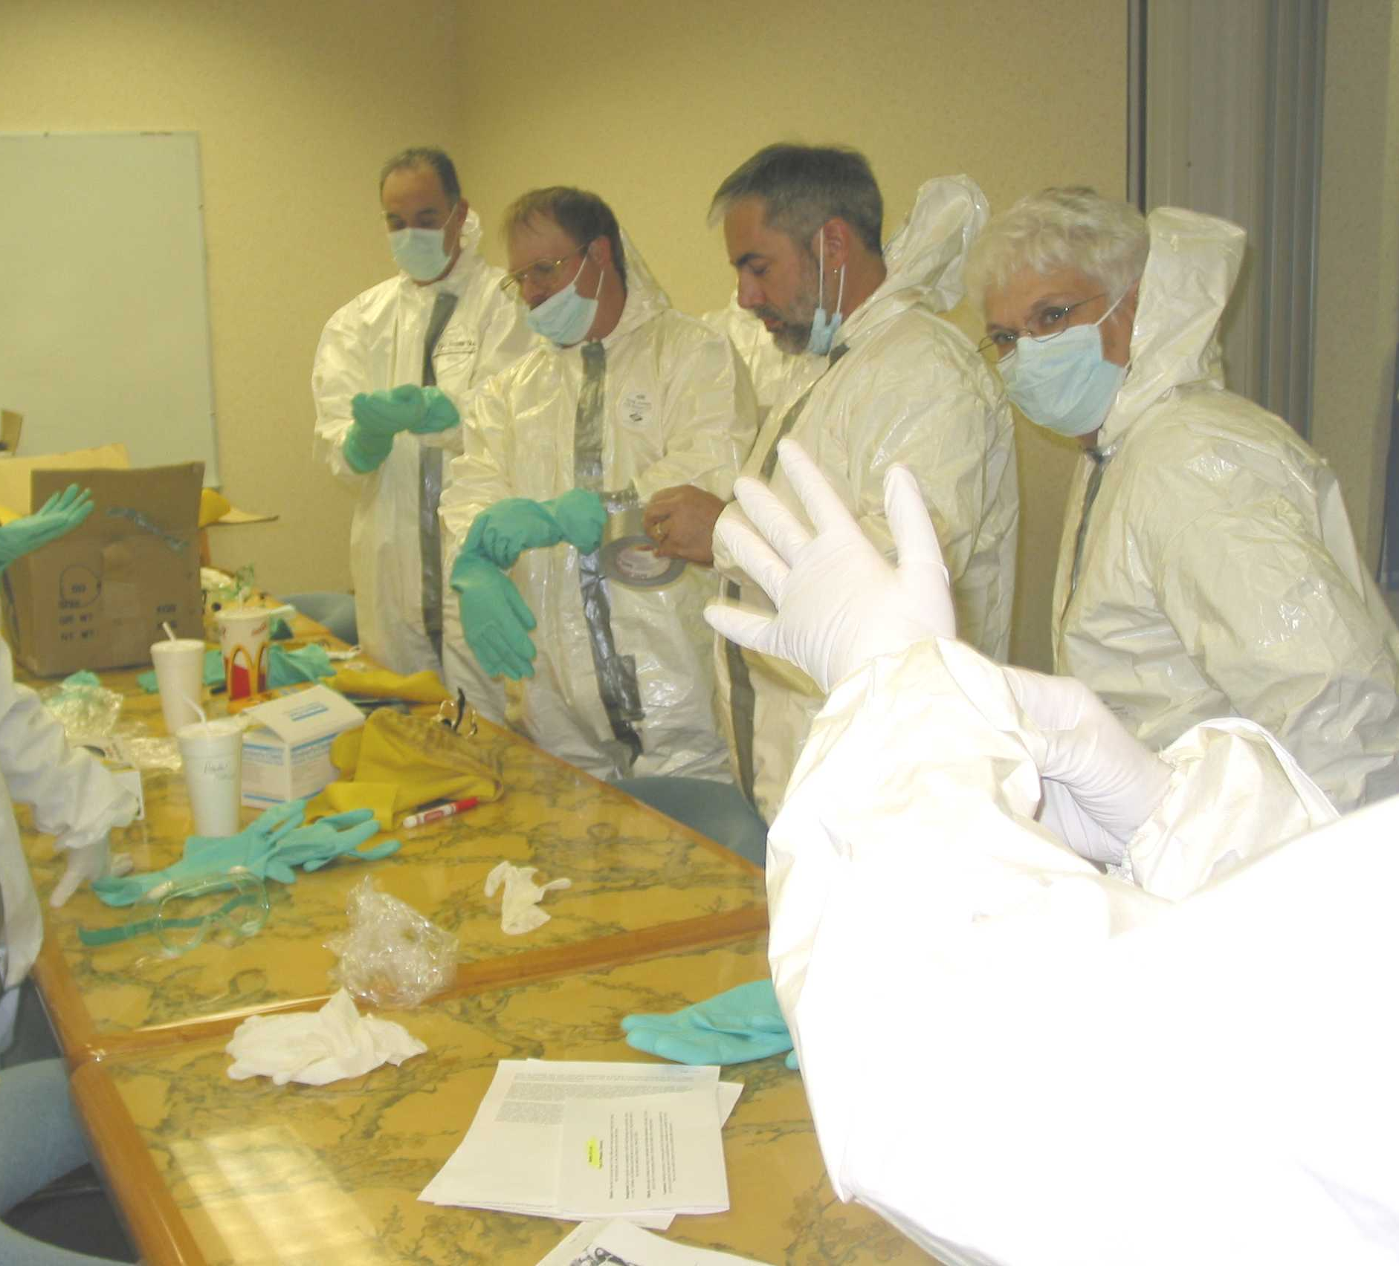
Hospital Response
Medical Decontamination
Security / Access
Triage
Echelon of Triage
Disaster Standards of Care
Patient Tracking
Special Populations
Unresponsive Casualties
Morgue
Casualties’ Families
Media
Notes:
Hospitals must have defined medical decontamination teams that are comprised of individuals that have the appropriate training, competencies and skills to protect the hospital and hospital staff while managing the event. Equipment and where to store these items are critical to the success of an emergency response. Supplies must be readily available for staff to “don” and implement decontamination (See picture). Medical decontamination areas require security and defined access routes for patients and staff.
In addition, areas of the hospital may need security measures during a mass casualty event. The Incident Command Center, EMS routes, staff routes, Triage, ED, OR, ICU and casualty family centers require security measures.
Mass Casualty triage requires training in disaster principles. The mass casualty triage goals are to screen for the salvageable critical casualties and keep them moving forward in the treatment echelon of care. The triage team must focus on the “greatest good for the greatest population”. All areas receiving the mass casualties will evaluate the patient and provide a sequenced echelon triage to meet the care needs of the casualty. This is done to reduce under-triage and over-triage of casualties. Over-triage will deplete resources. Under-triage puts the salvageable critical casualty at risk. As the patient moves through the system, altered standards of care or disaster standards of care are defined.
Example of disaster standards of care:
Treatment by clinical exam without diagnostic adjuncts.
CT Head GCS>13
Chest Film / Pelvic Film for Penetrating or Blast Injuries
FAST Procedure
H / H, Blood Typing, ABG
Suturing / Splinting – Moved to Inpatient Setting or Out of Resuscitation
OR – Damage Control Only
ICU Admission – Avoid Long-Term Chronic Illnesses with Poor Prognosis
Special Populations
Pediatric
Geriatric
Morbidly Obese
Patients With Language Barriers
History of Behavioral Health Issues
Provisions to address the casualties’ family must be in place.
The Public Information Officer is responsible for coordination of all media request. Staff must know how to refer all media request to the Public Information Officer. Individuals commonly targeted for interviews should attend a media training class to develop their interview skills.

Slide 48
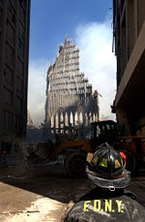
Exercise & Training
HVA Utilized to Define Exercises
Table Top, Specific Exercises – Communication, Medical Decontamination
Full Function Exercises
Exercise Controllers
Regional Exercises
After Action Reviews
Emergency Operations Response Plan Revisions
Notes:
Each facility should define their annual exercises and emergency response training bases on their annual HVA. This is a regulatory requirement. Exercises can be a table top that brings disciplines together to walk through how they would respond to an event or it can be a specific exercises targeting a specific response such as communication systems or medical decontamination response. Defined scenarios should be realistic. Full functional exercises that included an influx of casualties that overwhelm the resources must be tested annually. A full functional exercises test a hospital’s response to a full scale exercise that includes casualty influx and injects that test the system’s response must be completed once a year. This exercise may test the hospital’s ability to sustain itself for a period of time without community assistance or it may test integration with the regional response system. Exercises that provide opportunities to evaluate each area of operation have defined controllers that have a specific task to evaluate. These controllers do not participate in the event, but observe the responses and information onto an evaluation log. This information is then reviewed through the after action review of the response. This process will define areas that need response plan revisions, additional education or resources. These issues then become performance improvement items for the emergency operations response committee. Once the actions are completed they are integrated into the revisions of the plan.

Slide 49
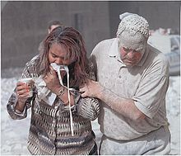
Special Considerations
Blast Injuries
Chemical Exposure
Radiation Exposure
Biological Exposure
Notes:
Hospital need to consider blast or explosion events, chemical, radiation and biological event when completing their HVA. The emergency operations response plan needs to be an all-hazard response plan. This means the response procedures and Incident Command System structure will remain the same but the safety officer/technical expertise and mitigation procedures will change based on the type of event.

Slide 50
Blast Injuries
Blast – High Speed Chemical Decomposition of Explosive Materials
Shrapnel Fragments
Incendiary Material
Surrounding Materials
Conventional Materials
Ammonium Nitrate
Fuel Oils
Gun Powder
Plastics / Others
Characteristics Dependent on Composition and Components
Notes:
“Blast” is a high –speed chemical decomposition of explosive material. It is often arranged to produce shrapnel fragments and incendiary materials to increase injury impact on humans. The blat typically blows out windows or building structures which become dispersed by the explosive force and cause additional injury. Most detonations are caused by conventional explosive materials such as ammonium nitrate and fuel/oil mixtures. The size of the blast and characteristics are defined by the explosive composition and mixtures in the composition.

Slide 51
Blast Effect
Caused by High Pressure Shock Waves – Radiates Outward From Explosion
Size and Type of Explosive
Distance From Explosive
Transmittal Medium
Reverberations of Blast
Negative Waves
Followed by Shrapnel, Fragments, Heat, Smoke and Fire
Concern for Toxic Fumes / Dust
Potential Structural Collapse
Notes:
The primary blast effect is caused by the pressure wave hitting the human body. The distance the individual is from the explosion, size and type of explosive device will define the force that strikes the human body. In addition, the medium or environment the human body is in will impact the wave. Examples: Open air, under water. A blast wave in water is more effective and powerful than in open air. Reverberations off of structures and over-pressurization of and enclosed space can cause more impact to the human body than the initial blast. The initial flow of gases from the explosion will then flow backward into a vacuum. This can cause rapid displacement of objects. The human body is subject to acceleration and deceleration injuries as well as penetration of foreign bodies. The fire and smoke from a blast can cause injury as well as the toxic fumes from the event. Dust from the explosion has the potential to cause further injury and pulmonary implications.
Potential Injuries:
Blunt Injuries
Penetrating Injuries
Burn Injuries
Ears: Tympanic membrane rupture / hemorrhage with possible ossicular disruption or fracture
Lung: Pulmonary lung contusions, PTX/HTX, and meditational air - These may lead to acute ventilatory insufficiency.
Bowel: Bowel wall contusions and potential acute rupture
Circulation: Air embolism in blood vessels due to a tear in the lungs – may lead to catastrophic organ collapse

Slide 52
Chemical Exposure
Agent | Effect | Onset | Treatment
Nerve Agents: Vapor Liquid Both | Miosis (pinpoint pupils) Rhinorrhea SOB, LOC, Seizures Excessive Sweating GI Distress | Vapor – seconds to minutes Liquid- minutes to hours | Atropine Pralidoxime (2-PAMCI) Benzodiazepines ABC Support
Cyanide (Smells like bitter almonds) | Cherry Red Skin Nausea, LOC Dizziness Metabolic Acidosis Transient Rapid Breathing, LOC, Apnea, Cardiac Arrest | Seconds to minutes | Cyanide Kit Amyl Nitrate Sodium Nitrate Sodium Thiosulfate ABC Support
Blister Agents: Mustard Lewisite (Smell of mustard, onion or garlic) | Redness of skin. Blisters, Irritation of Eyes, Cough, SOB, Airway Injury Pulmonary Edema Mustard: Bone Marrow Suppression | Mustard: Hours Lewisite: Minutes | Lewisite: British Anti-Lewisite
Notes:
Events that involve the dispersal of chemical agents pose a challenge to the trauma / emergency health care worker. Systems must be in place to detect these chemicals and system to decontaminate the casualty must be ready to deploy in a moments notice. Too often hospitals assume the emergency medical system will provide all decontamination and have inadequate planning.
Priorities Are:
Protect Staff and hospital as a resource to the community
Provide immediate care of the casualty by providing decontamination in a timely manner and access to emergent care.
Hospital must be able to address contaminated individuals of all ages, ambulatory as well as non-ambulatory casualties.

Slide 53
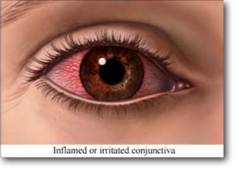
Chemical Exposure
Agent | Effect | Onset | Specific Treatment
Pulmonary Agents - Phosgene Chlorine (Smells like fresh cut grass or hay) | SOB, Coughing, Chest Tightness, Laryngeal Spasm, Delayed Non-Cardiac Pulmonary Edema Urticaria or wheel skin Irritation | Symptoms Immediate Delayed Pulmonary Edema | No Antidote ABC Support
Riot Control Agents - Pepper Spray Tear Gas | Pain, Tearing, Redness of Eyes, Burning of Nose / Throat, Sneezing, Rhinorrhea SOB, Bronchospasm, Respiratory Distress Skin Erythema, Possible Conjunctivitis | Seconds | Irrigate Eyes Copiously With Water / NS Wash Skin With Sodium Bicarbonate, Alkaline Soap, or Large Amounts of Cool Water Bronchodilators
Notes:
Appropriate decontamination equipment must be readily available. Consultation with the local Poison Center can assist in defining specific treatment options.
Hospital emergency operations response plans must have resources and guidelines specific to the chemical exposure and mass decontamination. Medical decontamination training to ensure staff competency will decrease the risk of hospital exposure and exposure to hospital staff. Training must include security, reception of the exposed, use of screening devices, and triage coordination into the hospital. This will require pre-planning and coordination with local EMS and law enforcement agencies. Hospital security providers should be trained in decontamination and how to don the suits for appropriate security and control at the hospital.
Issues to consider include but are not limited to:
Hospital perimeter control
Decontamination area security
Decontamination safety measures and briefing of event
Decontamination flow
Primary triage
Decon team set up, coordination and support
Patient clothes / valuables
Communication
Patient privacy
Secondary triage
Staff relief
12 Documentation
13 Debriefing

Slide 54
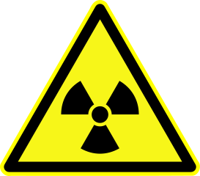
Radiation Exposure
Potential Terrorist Events
Nuclear Explosion
Meltdown of Nuclear Reactor
Dispersal of Material Through Conventional Explosives: Radiation Dispersal Device (RDD or Dirty Bomb)
Placing Radioactive Material In Public Areas
Notes:
Hospitals must have procedures in place to screen for radiation exposure and decontamination. This is a regulatory requirement. Staff must know their role and be able to quickly implement procedures.

Slide 55
Radiation Exposure
Alpha Particles
Beta Particles
Gamma Rays
Neutrons
Notes:
Hospital emergency response plans must include plans for radiation exposure. The hospital radiation safety officer typically leads the development of response procedures and exercised regarding radiation exposure.
Alpha Particles are large positively charged particles containing 2 protons and 2 neutrons. They only travel centimeters from source and are highly destructive if inhaled, injected or absorbed into open wounds.
Beta particles are small negatively charged electrons that are released from the nucleus of a radioactive substance. The only travel several meters in air and may cause burns to skin, eye cataracts. They can be ingested or absorbed in open wounds and the impact is dose dependent.
Gamma Rays are an energetic form of electromagnetic radiation that can pass through body tissues and deposit energy into tissues. They can travel kilometers in air at speed of light and are an internal and external irradiation hazard. They may cause acute or delayed injury and can be carcinogenic depending on dose.
Neutrons are uncharged particles that pass through body tissues and deposit their energy in tissues. They are the result of nuclear fusion only and can travel many meters in the air. They are an internal hazard through collision with molecules in tissue and are captured by atoms in tissue and subsequently released as gamma radiation.

Slide 56
Radiation Exposure
External Contamination
Radiation Debris Is On The Body and Clothing
Contamination Is Removed By Medical Decontamination
Prevent Internal Contamination By Inhaling, Swallowing or Through Open Wounds
Internal Contamination Caused By Inhalation, Ingestion or Absorbed By Open Wounds
Potential Thyroid Gland Injury
Unit Measures
100 Rad = 1 Gray (Gy)
100 Rem = 1 Sievert (Sv)
Amount of Radiation Human Absorbs Measured in RAD
Biological Effects of the RAD Exposure is Measured in REM
Notes:
Patients exposed to radiation are not a risk to medical personnel who utilize normal personal protective equipment. Once decontamination has occurred, the patient is not a risk to the health care workers. Care for the injured patient exposed to radiation will follow the ABCs of resuscitation. Care should not be delayed once clothing has been removed. Toxicologist and Radiation Safety officers should be consulted for patients who have suspected internal contamination. Individuals on the medical decontamination team need specific guidelines regarding decontamination of the individual exposed to radiation.

Slide 57
Radiation Exposure: Prodromal Symptoms
Symptoms | Time of Onset | Approximate Whole-Body Radiation Dose | Physiological Illness
Nausea, Vomiting | First 48 Hours | 1 Gray 100 Rad | Decrease In White Blood Cells and Platelets
Nausea, Vomiting | First 24 Hours | 2 Gray 200 Rad | Hematopoietic Syndrome Marked Decrease in White Blood Cells and Platelets
Nausea, Vomiting, Diarrhea | First 12 Hours, 8 Hours for Diarrhea | 4 Gray 400 Rad | Gastrointestinal Damage 50% Mortality in Absence of Treatment
Nausea, Vomiting, Diarrhea | Within 5 Minutes | 10-30 Gray 1,000 – 3,000 Rad | Severe Gastrointestinal Damage Very Poor Prognosis
CNS Impact, Mental Status Changes | Within Minutes | 30 Gray 3,000 Rad | Neurovascular Syndrome Severe CNS Damage, Cardiovascular Collapse Lethal
Notes:
Acute Radiation Syndrome (ARS) is defined by the clinical syndrome that develop after the exposure to the radiation. ARS affects human body functions different, depending on the total dose of radiation received. The dose, duration of exposure and potential internal contamination through open wounds are factors in predicting ARS Outcomes.
Acute Radiation Syndrome progresses through four phases.
Prodromal Phase – often used to predict outcomes and survival
Latent Phase - Last longer with less exposure and shorter with higher exposure, Symptoms include fatigue, hair loss, weight loss
Manifest Illness Phase – Clinical symptoms of major organ systems.
Recovery or Death Phase - Defined by level of exposure.
Exposed to greater than > 10 Gy (1,000 RAD) generally die within 72 hours without medical treatment
Exposed to 4 Gy to 10 Gy (4,000 to 10,000 RAD) are likely to die without medical treatment
Exposed to less than 4 Gy (4,000 RAD) typically recover if given effective hematopoietic stimulation and appropriate protection from secondary infection

Slide 58
Biological Exposure
Biological Terrorism
Epidemic / Pandemic
Potential Biological Exposure
Disease Unusual Or Does Occur Naturally
Multiple Diseases
Large Numbers of Military and Civilian
Massive Point-Source
Aerosol Route
High Morbidity / Mortality
Disease Limited To Localized Geographic Area
Low Exposure in Air Filtered Locations
Dead Animals
Absence of Natural Vector
Notes:
Biological exposure is the use of microorganisms or toxins derived from living organisms that produce death or disease in humans, animals and/or plants. Biological terrorism is a growing threat.
Routes of Exposure:
Inhalation – Exposure of most concern due to potential aerosol of the disease agent that would be inhaled deep into the lung
Oral – Direct contamination after an aerosol attack by ingestion.
Dermal – Mucus membrane and open lesions allow passage of disease agents. The intact skin is a an effective barrier in most cases.
Listed are the indications of a potential biological exposure:
Disease agent that is normally not present in a geographic location is present or in combination with other disease agents in the same population.
There are multiple disease agents in the same patients.
Large number of civilian and military casualties in a focal area.
Data defines a massive data point-source outbreak with an agent that is non-contagious.
Aerosol route of infection is evident.
High morbidity and mortality related to those at risk.
Illness is limited to fairly localized geographic areas.
Low exposure rates in individuals with filtered air supply or those with closed ventilation systems.
Death of livestock or animals in conjunction to human exposure.
Natural vectors in the area of outbreak is absent.

Slide 59
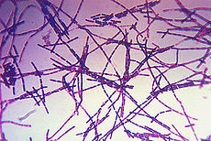
Biological Agents
Anthrax
Tularemia
Plague
Smallpox
Botulinum Toxin
Viral Hemorrhagic Fevers
Notes:
Listed are the disease agents that are believed to have the greatest potential for bioterrorism.
The most effective and most important prophylaxis against a biological agent is personal protection equipment.
Full face respirator – prevent respiratory exposure, mucus membranes, and conjunctivae – may be impractical
Decontamination – wash with soap and water
Prophylaxis – Precise Efficacy of available medical countermeasures has not been evaluated in actual events. Lab studies do support the use of vaccines and drugs at large exposure levels for some biological agents.
Hospital emergency response plans must have surveillance systems in place to detect developing trends. These systems should be integrated with regional public health systems. Hospitals should define lab capabilities for testing for agents and lab report turn-around times. Infections Disease staff are integrated into the command center and advise the Incident Commander in the role of the “safety-officer” during a suspected biological event. Systems to address decontamination and

Slide 60
Ethical Consideration
Autonomy
Nonmaleficence
Beneficence
Justice
Notes:
Four common bioethical principles in health care:
Autonomy – decisions are informed and voluntary and when possible made by the patient.
Nonmaleficence – No harm by omission or commission
Beneficence – Treatment provides direct impact
Justice – Implies fairness and equal care
Image is of the Scales of Justice
Mass Casualty Considerations
Autonomy – Many patients will not have the ability to make informed decisions
Nonmaleficence – Mass casualty triage defines patients that will receive limited or comfort care
Beneficence – Not every patient will have equal care based on resources available
Justice – Mass casualty goals – greatest good for the greatest population
Preplanning and preparation that defines disaster standards of care or altered standards of care in advance will assist in creating “fair” care during an emergency response.

Slide 61
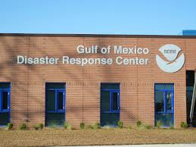
Regional Integration
Regional Hazard Vulnerability Assessment
Regional Coordination
Regional Communication
Patient Tracking
Mutual Sharing
Exercise Development
After Action Review
Notes:
Hospital facilities must participate in and be integrated into the surrounding regional system that is responsible for preparedness and system response. This will ensure they are aware of infrastructure that exist in the region to support an emergency response as well as the strengths and weaknesses of the system.

Slide 62
Regional Medical Operation Centers
Notes:
See notes next slide

Slide 63
RMOC
Foster Agency Collaboration / Involvement
Provide Educational Resources
Integration of Multi-Agency
Health / Medical Professionals / Public Health
EMS Providers / Medical Control / Medical Directors
Medical Examiners Office
Community Leaders
School Systems
City / County / Emergency Managers
Law Enforcement Agencies
Business Community
Notes:
Some regions have developed sophisticated Regional Medical Operations Centers (RMOC) that work in collaboration with the local, county, district and state emergency management offices. The purpose of the RMOC is to coordinate all casualty medical care while the emergency management infrastructure manages the event. The RMOC fosters communication and agency collaboration from all disciplines with the intent of focusing on health care needs. Picture is an example of training being done in the Dallas / Ft. Worth area by the Executive Director of the South Texas Regional Advisory Council, Eric Epley.

Slide 64
Questions
What is the definition of disaster management?
What are the four public health disaster response phases?
How does the hospital’s response to a disaster reflect preparedness of the seven phases readiness?
Notes:
Disaster Management – Actions taken by an organization in response to unexpected events that are adversely affecting people or resources and threatening continued operation of the organization; management of natural catastrophes
PH Phases: Mitigation, Preparedness, Response and Recovery
3. Hospital response can be reviewed in very defined phases.
Preparedness
Planning Integration with Pre-Hospital Agencies
Emergency Operations Response Plan
Regional Integration
After Action Review
Plan Revisions
.

Slide 65
Summary
Define the Hazards That Impact Your Community and Complete an HVA
Define Members of Your Emergency Operations Response Committee
Define Response Priorities
Develop Emergency Operations Response Plan – Educate
Define Special Response Needs
Define Realistic Exercises To Test Response Plan
Complete After Action Reports
Define Performance Improvement Needs
Revise Plan

