Slide 2
Pregnancy in Trauma

Slide 3
Objectives
At the conclusion of this presentation the participant will be able to:
Discuss the epidemiology, incidence and prevention of trauma in pregnancy
Identify physiologic & anatomic changes in pregnancy pertinent to trauma care
Discuss resuscitative management unique to the pregnant trauma patient
Notes:
Most unique about the pregnant trauma patient, is the fact that the provider is caring for two individuals, mother and fetus. Although the initial assessment and care of the pregnant trauma patient will follow the advanced trauma life support guidelines, there are variations to both assessment and treatment which will impact the outcome for both the mother and fetus. The knowledgeable trauma provider understands that care must focus on expedient resuscitative efforts for the mother, thus giving the fetus the best chance of survival.

Slide 4
Epidemiology
Leading cause non-obstetric maternal death
7% of pregnancies experience trauma
Most common:
Motor vehicle crashes (MVC)
Falls
Battering or physical abuse
Notes:
Trauma poses a serious and preventable risk to the pregnant woman and her fetus. Although, the exact incidence remains uncertain, trauma accounts for approximately 46% of all maternal deaths. Many of these deaths are avoidable with education about proper safety restraint use and the avoidance of intoxicating substances and distracted driving.
It is estimated that between 34% and 64% of pregnant trauma patients involved in a motor vehicle crash (MVC) were unrestrained. Additionally, in one study 45% of pregnant trauma patients were found to be positive for an intoxicant.
Non-accidental trauma, such as domestic violence and suicide are common in pregnancy. Statistics are likely, grossly underreported by victims. Homicide rates of pregnant and post-partum women in New York City showed that homicide was the 2nd most common cause of death among pregnant and post-partum women. Further, suicide was responsible for 10% of all maternal deaths.

Slide 5
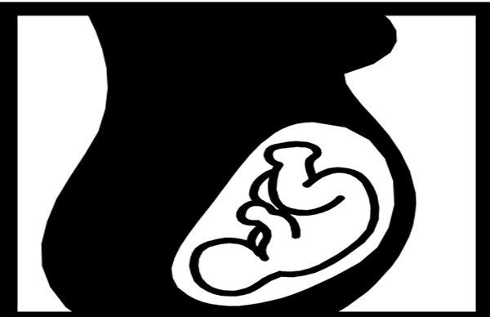
Who is at Increased Risk for Injury During Pregnancy?
Young
Non-Caucasian
Driving unrestrained
Intimate partner abuse
Drug and/or alcohol abuse
Low socio-economic status
Pregnancy alone - independent risk factor!
Notes:
13-19% of trauma in pregnancy is related to alcohol or drug use.
Between 34 and 64% of pregnant patients involved in MVC, are unrestrained.
Substance abuse is a factor in traumatic injuries of pregnant patients. One institutional study showed that 45% of pregnant trauma patients were under the influence of an intoxicating substances. Further, intoxicant use lowers compliance with restraint usage. Education about the use of drugs and alcohol and their connection to trauma should be provided to women of childbearing age and during pregnancy. Additionally, social services should be offered to high risk women in particular to provide additional support during pregnancy.

Slide 6
Mechanism of Injury
Notes:
The top 3 causes of injury in pregnant woman remain:
MVC
Falls
Abuse (intimate partner violence)
The CDC and WHO now use the term: Intimate Partner Violence (IPV) which is the same as Domestic Violence
Statistics vary among studies and geographic areas, yet motor vehicle crashes remain the number one cause of trauma in women of childbearing age.
Intimate partner violence is suspected to be under reported and may be significantly higher than 20%.

Slide 7
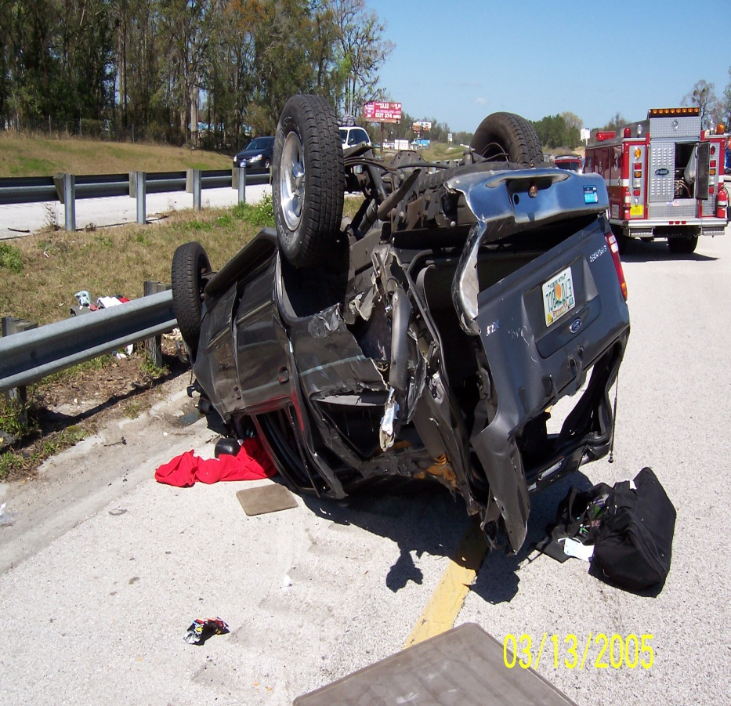
Mechanism of Injury: Motor Vehicle Crash
Seatbelt Safety in Pregnancy Misinformation Common
Only 46% of pregnant trauma patients use restraints
Airbags are supplemental
Protective if patient restrained
Unrestrained Preg Trauma
2.3 times more likely to give birth < 48 hours
Fetal death 4 times more likely
Notes:
Providers should educate on the proper use of restraints. Many women are misinformed that seatbelts may harm the fetus. Further many women find seatbelts to be uncomfortable. Seat belt use has decreased maternal mortality from MVC from 33% to 5%.
Airbags detonate at 1200 lbs. of force with speeds approaching 230 mph and were designed for 5’8” males, weighing 180 lbs. Although not designed explicitly for pregnant women, studies demonstrate that they do provide a net protective effect for the woman, particularly when travelling at speeds over 32 mph.
Pregnant women should make an effort to have their sternum at least 10 inches from the steering wheel or dashboard.
No statistics were found regarding distracted driving in the pregnant population. However, of the general population, age 18 to 29, 52% report regularly texting and emailing while driving. This comprises a substantial portion of childbearing age women.
In 2009, over 5,400 people died in crashes were there was a distracted driver and 448,000 people were injured. Crash dynamics are important in evaluating maternal and fetal injuries and will assist one in anticipating injuries.
Proper use of seatbelts help to prevent ejection from vehicle, severe head injury, and lowers mortality for both the mother and the fetus.

Slide 8
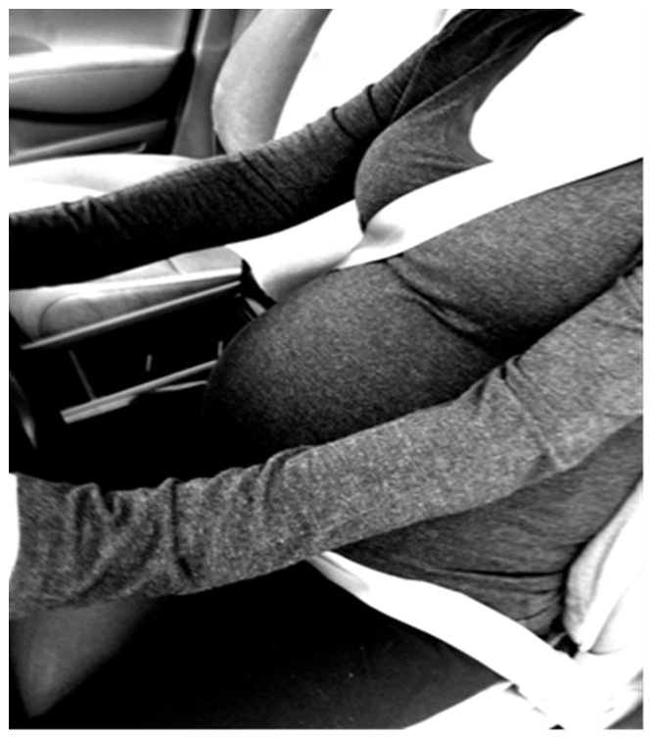
Proper Seat Belt Positioning
Shoulder belt- mid-clavicular between breasts
Lap belt- under abdomen
Notes:
Proper seatbelt placement is vital to protecting the fetus and mother. The National Highway Traffic Safety Administration advises that the belt be placed between the breasts and mid-clavicular and positioned under the dome of the abdomen, low on the hips and across the upper thighs. Wearing the lap belt too high on the abdomen may be the cause of over half of fetal losses resulting from MVC.
Ethnic minorities may be less likely to use restraints and thus education should be stressed among this population.
Proper restraint use will be a primary predictor of survival of the mother and fetus, as ejection from the vehicle and head trauma are known to have likely bad outcomes.

Slide 9
Mechanism of Injury: Falls
Related to anatomic and physiologic changes
Fall details give clues to possible injuries
High suspicion for abuse
Notes:
Due to the physiological and anatomical changes of pregnancy, pregnant women are likely to be at higher risk for falls. Falls occur more in the second and third trimester, as the center of gravity shifts forward with the growing fetus. The increase in relaxin production and secretion, causes joint hypermobility in the pregnant woman to prepare her body for delivery, however this loosening of joints puts stability at risk. The nerve roots of the lumbar and sacral spine, which become the sciatic nerve, are stretched. This may result in some altered sensory to the pelvis and lower extremities. Finally, two recent studies have shown an increase in postural sway which further adds to instability.
27% of women reported falling at some time in their pregnancy, and younger women were twice as likely to fall as those over 35 years of age. Most falls occurred in the 6th through 8th gestational months and over 72.5% were found to have been caused by stairs and slippery floors.
A woman seeking medical care for a fall should be assessed for the possibility of domestic violence. Suspicious indicators are: healing bruises of different ages, injuries to the breasts, back, and thighs, story that is inconsistent with the injury pattern and an overly intrusive significant other.

Slide 10
Mechanism of Injury: Intimate Partner Violence (IPV) (Domestic Violence)
Risk Factors:
Young
Single
Non-Caucasian
↓ Socioeconomic Status
Frequently underreported
National Domestic Violence Hot Line
1-800-799-SAFE (7233)
1-800-787-3224 (TDD)
Notes:
Intimate partner violence or domestic violence in pregnancy, is thought to be greatly underreported. No other time in a woman’s life, is she more likely to be battered by an intimate partner. Domestic violence is about power and control. Be mindful for signs of the following: coercive behavior, intimidation, emotional abuse, economic abuse, and isolating the patient from friends and family.
The patient may present for falls or other home related accidents. Examine breasts, abdomen, back and genitals and look for injuries at different stages of healing.
Abused women are significantly younger and single, lower income and with a lower level of education compared to those who are not abused.
Homicide resulting from intimate partner violence was then most common cause of maternal death in a statewide study in North Carolina, with non-whites being at much greater risk. Further, teens are shown to be at 2.6 greater risk of being the victim of homicide during pregnancy as compared to adult women
Most common fetal injuries are abruption, early delivery and low birth rate.
Pregnant women who are abused, suffer greater complications during their pregnancy. They tend to gain less weight and have a higher incidence of anemia, infections and bleeding. Also, rates of maternal depression, suicide, tobacco, alcohol and drug use are higher.

Slide 11
Intimate Partner Violence Progression During Pregnancy
First incidence may occur during pregnancy
Frequency
Intensity
Notes:
The first incidence of abuse may come during pregnancy. Further, an existing abusive relationship, will intensify and the incidents of abuse may become more frequent.
Nurses should encourage and guide women to create a safety plan, a personalized plan for getting to safety. Such a plan may include safekeeping of important documents, extra keys, telephone numbers, securing money and a physical plan for escape. A comprehensive safety plan, in the public domain can be found at:
http://www.ncbi.nlm.nih.gov/books/NBK64443/ (Center for Substance Abuse Treatment. Substance Abuse Treatment and Domestic Violence. Rockville (MD): Substance Abuse and Mental Health Services Administration (US); 1997. (Treatment Improvement Protocol (TIP) Series, No. 25.) Appendix D—Sample Personalized Safety Plan For Domestic Violence Survivors.)
More information can be found at the National Domestic Violence Hot Line. (Phone number verified 9/12/12)

Slide 12
Intimate Partner Violence Screening Tool (performed in absence of patient partner)
Within the past year -- or since you have been pregnant -- have you been hit, slapped, kicked or otherwise physically hurt by someone?
Are you in a relationship with a person who threatens or physically hurts you?
Has anyone forced you to have sexual activities that made you feel uncomfortable?
(ACOG, 2012)
Notes:
When patients present with trauma during pregnancy, nurses must maintain a high index of suspicion.
One recent study found that 3 screenings throughout pregnancy, with a single direct question (“Have you been hit, slapped, kicked or otherwise physically hurt during this pregnancy?”), were statistically significant, in increasing the reporting of prenatal violence. Reporting rose from 6.3 to 14.1 percent compared to routine screening. It is also recommended that the physical exam and DV screening be done in absence of the partner.
Be prepared to provide referrals for women and seek assistance from social work.
The ACOG recommends use of the following questions:
1. Have you ever been emotionally or physically abused by your partner or someone important to you?
2. Within the last year, have you been hit, slapped, kicked or otherwise physically hurt by someone? If yes, by whom and number of times.
3. Since you’ve been pregnant, have you been hit, slapped, kicked, or otherwise physically hurt by someone? If yes, by whom and number of times.

Slide 13
Hemodynamic Changes in Pregnancy
Heart rate 10-15 bpm
Blood volume by 45%
Cardiac output by 30-35%
B/P by 10 mmHg
Systemic Vascular Resistance
HCT (dilutional)
Net EffectMay
Mask
Shock
Notes:
The growth of the fetus increases the demand for oxygen delivery and tissue perfusion. An increase in blood volume (40-50%) occurs, yet RBC only increase by 30% resulting in a dilutional anemia (average hct 35%).
HR increases 10-15 over baseline, CO increases by 30-50% and plateaus in the 2nd trimester. There is a decrease in the SVR and PVR from progesterone release, this results in a gradual decrease in B/P in 1st and 2nd trimester with an increase in the 3rd to pre-pregnancy level. These mechanisms help cope with the blood loss of 500-1000 which occurs during delivery.
During pregnancy the uterine arteries are maximally vasodilated, to provide adequate blood supply for the maintenance of the placenta and growth of the fetus. The weight of the uterus and growing fetus will cause aortocaval compression, compromising blood flow to the fetus and abdominal and pelvic organs. Use the left lateral tilt position (shown later) to reduce this effect.
Due to the increase in blood volume, there may be little change in vitals with a blood loss of up to and exceeding 2000ml.

Slide 14
Pulmonary Changes in Pregnancy
Engorged mucosa
Oxygen consumption 15-20%
Minute ventilation
Tidal volume
O2 reserve
Buffering capacity
Total lung capacity
Functional residual capacity
Resp
Alkalosis
Intubate Early
High risk:
-Hypoxia
Notes:
The mucosa of the nasal passages, oral pharynx, larynx and trachea become engorged. This can result in SOB, epistaxis, and a difficult intubation. The airway should be secured early in a pregnant trauma patient. It has been recommended that an endotracheal tube 0.5 to 1 mm smaller than in a comparable non-pregnant patient. This will allow easier tube passage and avoid possible intubation trauma.
Oxygen consumption increases 15-20% and there is a diminished O2 reserve and buffering capacity. This results in rapid hypoxia and inability to compensate for the acidosis which follows. As acidosis can cause life threatening derangements in trauma, it is vital that the practitioner recognize and treat the increased risk of acidosis in the pregnant trauma patient.
Total lung capacity in decreased by the expanding uterus and will peak during the 3rd trimester of the pregnancy. Decrease in functional residual capacity can increase the risk of hypoxia. Hypocapnia (Paco2 30mmHg) is common in late pregnancy due to increased minute volume. A Paco2 of 35-40mmHg should be considered abnormal for a pregnant patient in late pregnancy.

Slide 15
Neurological Changes in Pregnancy
Normal Changes
Neurologic Complications
Dizziness
Syncope
Balance changes
Gait changes
Pre-eclampsia / Eclampsia
Hypertension
Headaches
Vision changes
Hyperreflexia
Seizures
Can mimic head injury!
Notes:
Vasodilation may cause postural hypotension in the pregnant woman. This may lead to feelings of dizziness and possibly fainting.
A change in center of gravity may alter balance and gait as the pregnancy progresses. This alteration adds to the risk of falls during pregnancy.
The presentation of pre-eclampsia and eclampsia can mimic a traumatic brain injury. Thus it is important to quickly distinguish between the two. Pre-eclampsia, an abnormal condition in pregnancy, presents as acute hypertension, proteinuria, and edema.
In it’s severe form, eclampsia, the disease progresses to grand mal seizures, loss of consciousness and can be fatal. Imaging of the head should be used to rule out a head injury in the mother. A team which can manage the prenantal complication of preeclampsia should be assembled.

Slide 16
Gastrointestinal Changes in Pregnancy
Decreased gastric motility
Relaxed gastric and esophageal sphincters
Bowel displaced, cephalad and anterior
Notes:
The increased release of progesterone decreases gastric mobility which relaxes esophageal and gastric sphincters. This leads to an increase risk in aspiration. Care should be taken to protect the airway and decompress the stomach.
As the uterus becomes an abdominal organ in the second trimester, it displaces the bowel towards the upper and anterior portion of the abdominal. This decreasing space in the abdominal cavity also places increases pressure on the hollow viscous organs, placing them under more risk for rupture. Additionally, solid organs are at greater risk for fracture.
This stretching and increase in intrabdominal pressure can result in a de-sensitivity to peritoneal irritation, which occurs from free fluid or blood in the cavity. Thus the physical exam may show a lack of tenderness, rebound tenderness or guarding.

Slide 17
Urologic Changes in Pregnancy
Increased pelvic blood flow
Bladder
Displaced anterior and superior (> 12 wks)
Increased glomerular filtration rate
Low: BUN
creatinine, calcium
and magnesium
Notes:
During pregnancy there is an increase in pelvic blood flow to the pelvis thus pelvic fractures are more likely to result in hemorrhage.
Due to the position of the uterus, the bladder is placed anteriorly and superiorly. This position in the pelvis placed the bladder at higher risk for injury.
Because of the higher GFR and decreasing room for the bladder in the pelvis, the bladder is likely under more tension and more vulnerable to rupture. Creatinine and blood urea nitrogen (BUN) will decrease to about half the normal pre-pregnancy rate. Additionally, glycosuria is often considered physiologic during pregnancy.

Slide 18
Triage
Pregnant Trauma Patient
> 20 wks
Trauma
Center
With Obstetric and Neonatal
Capabilities
2011 Trauma Field Triage Guidelines, CDC
Notes:
Pregnant trauma patient > 20 weeks gestation should be preferentially transferred to a trauma center equipped to diagnose and manage obstetric and neonatal emergencies.
EMS should provide:
Oxygen
Anticipate shock
Notify the ED early
Transport the injured mother in left lateral position to avoid supine hypotension.

Slide 19
Assessment and Management of The Pregnant Patient with Trauma
Notes:
This section begins the assessment and management of the pregnant trauma patient

Slide 20
Team Work
Trauma Team
Obstetrician
L&D Nurse
Consult radiologist for radiation exposure
Neonatologist
imminent delivery
Notes:
Trauma is a team sport. With 2 patients to take care of there is even a greater need for teamwork. The trauma team must work in coordination with the obstetrician, L&D nurse, as well as radiologist and possibly the neonatologist and NICU nurse if delivery is imminent. Planning ahead for this event is necessary for the rare times that it will be needed.

Slide 21
Initial Assessment
Transport to trauma center
ATLS management
Assess and stabilize mother FIRST
Identify pregnancy
Assess during secondary survey
Notes:
Any trauma patient, who has been identified as pregnant, should be transported to the closest recognized trauma center.
Upon arrival to the trauma center, the mother’s condition should be assessed and stabilized before moving to assessing the fetus. Primary maternal assessment--assess fetus—secondary maternal assessment.
Aggressive care for the mother gives the fetus the greatest chance of survival.
All women of child bearing age should be tested for pregnancy.
Optimize cardiac output by displacing the uterus to the left, by left lateral tilt or manual displacement, thus decreasing pressure on the inferior vena cava.
A trauma surgeon and obstetrician should be available at the initial assessment stage.

Slide 22
Pregnancy Test
All female trauma
Childbearing age
Treatment decisions based on gravid status
Notes:
All women presenting for traumatic injury should be administered a pregnancy test.
Females between the ages of 10 and 60 have the potential to become pregnant.
As trauma centers are making an effort to avoid indwelling urinary catheters, a serum HCG may be required to determine pregnancy in a timely manner.

Slide 23
Primary Survey
Airway/breathing
C-spine control
Oxygen
Prevent aorto-caval compression
If bleeding, aggressive volume resuscitation
Displace uterus to left - Log roll
15-30 degree tilt
Notes:
Uterine compression of the vena cava presents an obstacle to the resuscitation of the pregnant trauma patient. The weight of the fetus reduces venous return to the heart and thus decreased cardiac output, worsening shock. Maintain spinal precautions as is indicated by mechanism of injury. However, ensure patient is immobilized with a 15 to 30 degree tilt (4 to 6 inches) to the left. Use a towel or blanket under long spine board and bolster to support left side. Ensure side rail is up on left to maintain patient safety, as able. Reassure patient as position may be unsettling.

Slide 24
Cardiac Output in Pregnancy and Effect of Left Lateral Position
Lateral
Change in cardiac output, %
Weeks gestation
Notes:
This slide demonstrates the incremental change (increase) in cardiac output in the pregnant patient and illustrates the benefit of displacement of the uterus through use of the left lateral position. In the pregnant trauma patient, maximizing cardiac output is vital to the wellbeing of both patients.

Slide 25
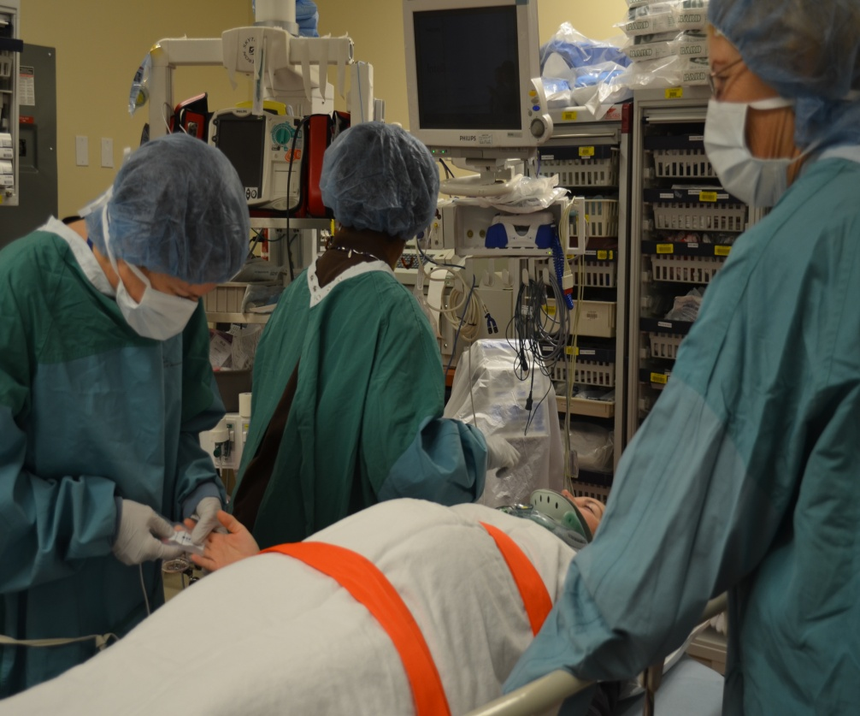
Resuscitation Tube Tips
Airway edema common →
difficult Intubation
Consider smaller ETT
Delayed gastric emptying ↑ risk of aspiration →
Consider early NGT
Elevated diaphragm
Consider higher Chest tube placement
Notes:
Clear airway per standard ATLS. However remember that airway edema is more common in the pregnant trauma patient and therefore intubation may be difficult. Some authors recommend intubating with one size smaller endotracheal tube.
Early NGT placement may be required because of increased risk of aspiration due to more relaxed lower esophageal sphincter and delayed gastric emptying.
Chest tube placement should be 1-2 interspaces higher than usual, because of elevation of the diaphragm.
Resuscitation with packed cells is preferred over crystalloid in the continued hemodynamically unstable patient. Vasopressors should be avoided as they decrease blood flow to the uterus and placenta. If vasopressors are necessary to save the mother’s life: levophed and epinephrine compromise uterine perfusion, while ephedrine and mephentermine do not.
If resuscitation of the mother looks unlikely, the decision to do a peri-mortem C-section must be expedited. Initiate peri-mortem C-section within 4 minutes of malignant maternal rhythm for the greatest chance of fetal survival. A midline, vertical incision allows the greatest exposure, while minimizing bleeding. The procedure from skin to fetus should take no longer than 1 minute to perform. Neonatology should be at the bedside.

Slide 26
Fetal death more common than maternal death. What is the #1 cause of fetal death in trauma?
Notes:
Trauma is the leading cause of maternal death, accounting for up to 46% of cases. Fetal death, however, is a more common occurrence than maternal death.
Direct fetal injury is relatively uncommon because of the maternal soft tissues, uterus, placenta, and amniotic fluid all tend to absorb and distribute the energy of the blow.
The most common cause of fetal death is maternal shock, which is associated with a fetal mortality rate of 80%.
This explains why efforts to assess fetal well-being are secondary to resuscitation of the mother.

Slide 27
Resuscitation Guiding Principle
Resuscitating the mother will resuscitate the fetus

Slide 28
Resuscitation – Maternal Shock Adaptations to blood loss
Severe >2000ml
Moderate 1500-2000ml
HR 95-105, cold pale extremities, MAP 70-75mm Hg
HR >120 hemorrhagic shock, tissue hypoxia, MAP <50mm Hg, altered LOC, anuria, DIC
HR 105-120, restlessness, tissue hypoxia, MAP 50-60mm Hg, oliguria
Mild
1200-1500ml
Notes:
Maternal physiologic adaptations to blood loss:
Mild: 20-25% of maternal blood volume (1200-1500ml) tachycardic with HR 95-105, peripheral vasoconstriction – cold pale extremities, MAP drops 10-15% (70-75mm hg)
Moderate: 25-35%, (1500-2000ml) tissue hypoxia will occur, tachycardia with HR 105-120, restlessness, MAP drop 25-30% (50-60), oliguria.
Severe: >30% (>2000ml) hemorrhagic shock, tissue hypoxia continues, tachycardic with HR >120, hypotension with a MAP <50, altered LOC, anuria, disseminated intravascular coagulopathy (DIC).
Uterine arteries are typically vasodilated, however during a shock state, vasoconstriction and decreased MAP may result in decreased uterine blood flow. Maintaining maternal mean arterial pressure is vitally important to both mother and fetal survival.
Signs of fetal compromise: bradycardia, tachycardia, loss of beat to beat variability, or recurrent decelerations. When mother hemorrhages the body will shut blood from the placenta. FHT instability may be the first sign of impending maternal hemodynamic instability.
Evidence links maternal acidosis to decreased fetal survival.
Some fetal physiology may protect against hypoxia. In third trimester the fetus may shunt blood distribution to the heart, brain and adrenals. Additionally, fetal hemoglobin has a greater affinity for oxygen than adult hemoglobin therefor fetal oxygen consumption does not decrease until oxygen delivery decreases by 50%.

Slide 29
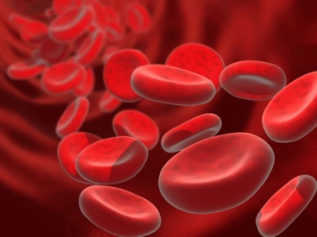
Two Different Patients!
Mother may lose up to 1500 cc of blood without hemodynamic instability WHILE the fetus may be in shock!
Notes:
With a 40% increase in blood volume and 25% increase in red cell mass, the mother may lose significant blood without any signs of hemodynamic instability BUT the fetus may be in shock!

Slide 30
Caution!
The hemodynamically stable mother may be compensating at expense of the fetus!
Notes:
Caution, just because the mother is stable does not mean the fetus is not at risk! Initiate fetal monitoring immediately.

Slide 31
Secondary Survey
Head to toe assessment
Obtain obstetrical history:
Last menstrual period (LMP)
Due date
Previous pregnancies:
miscarriages
premature deliveries
abortions
Delivery history
type, complications
Notes:
Definitions of childbearing age vary among trauma centers, but a common rule is ages 10-50.
Obstetric history includes parity which indicates any previous abortions or premature deliveries.
Dating the pregnancy will assist in directing the management of care, once the mother has been stabilized.
Further, prior pregnancy and delivery histories will alert team to potential problems with the current pregnancy and also may raise concern regarding rare complications, such as uterine rupture, which is more common with prior cesarean section.
Special attention will need to be given to women who are known to be Rh positive. This issue will be addressed in a future slide. All pregnant women involved in trauma should be tested for their Rh status.

Slide 32
Parity: # births to fetus > 24 weeks
Parity and Gravidity
Review
Gravidity: # of times pregnant
5 Digit System | A-B-C-D-E Example: 3-2-0-1-3
A | Times the uterus is pregnant (3)
B | Number of deliveries (2)
C | Number of premature deliveries (0)
D | Number of abortions (spontaneous & therapeutic) (1)
E | Number of living children (3)
Notes:
A 5 digit system is used to clearly communicate the number of pregnancies and births.

Slide 33
Fetal Assessment
Fetal heart tones
120-160
Continuous >24wks
Abdominal exam
Gestational age
Contractions
Vaginal exam
Bleeding
Ruptured membranes
Notes:
Fetal heart tones should be assessed as soon as possible after the primary assessment. 120-160 normal. They should be audible by Doppler at 10-14 weeks. Only use a Doppler designed for obstetric evaluation as an Adult Doppler used for vascular studies has insufficient range. The FHR will not be heard even though the fetus is viable and the clinical picture will be confused.
Fetal monitoring should be continuous for any fetus age greater than 23 weeks. Even if no significant maternal injury is identified, fetal monitoring should be continuously monitored for 4-6 hours. Bradycardia, tachycardia, loss of beat to beat variability, or recurrent decelerations are all examples of non-reassuring patterns in fetal heart tones. When the mother is actively hemorrhaging, her body will shut blood from the placenta to supply her vital organs (brain, heart, lungs). Thus FHT instability may be the first sign of impending maternal hemodynamic instability.
The abdomen should be examined for gestational age, the presence of contractions or rigidity, and any signs of bruising. Fetal viability typically occurs when the fundus is 3-4 cm above the umbilicus. Contractions of the uterus may indicate preterm labor. A rigid uterus/abdomen may indicate a placental abruption.
Some resources recommend a sterile speculum exam to look for ruptured membranes or bleeding. At least, a visual exam of the external perineum and the introitus should be done to look for frank bleeding or the presence of amniotic fluid. If there is any concern for ruptured membranes, sterile gloves should be used for the exam. If preterm labor is suspected, the cervix should be examined for changes (effacement and dilation)

Slide 34
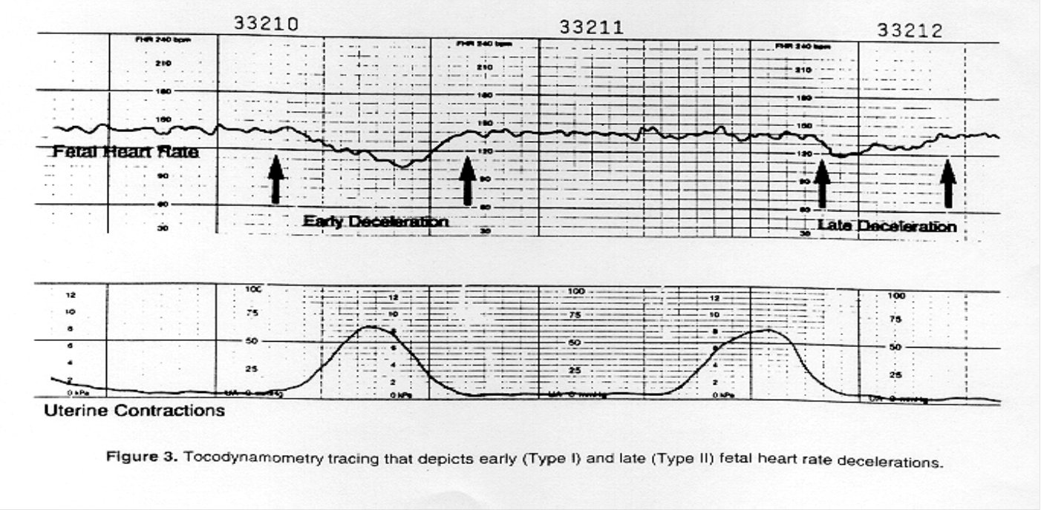
Fetal Monitoring
All pregnant trauma > 20 weeks’ gestation
Minimum of 6 hours continuous fetal monitoring
Further continuous monitoring and evaluation if:
uterine contractions
non-reassuring fetal heart rate pattern
vaginal bleeding
significant uterine tenderness or irritability
serious maternal injury
rupture of the amniotic membranes
EAST 2005
Notes:
The electronic fetal heart monitor is primarily used to detect fetal hypoxia (lack of sufficient oxygenation) in hopes of catching it early enough to prevent neurological damage in the unborn baby. Indications of fetal hypoxia are represented by prolonged deviations from a normal baseline pattern of the fetal heart rate. The normal fetal heat rate range is between 120 and 160 beats per minute.
FHT can be heard with conventional stethoscope at about 20 weeks gestation. With doppler they can be detected between 12-14 weeks gestation.
The fetal heart rate is controlled by the autonomic nervous system, with an inhibitory influence coming from the vagus nerve, and an excitatory influence coming from the sympathetic nervous system.
Stimulation of the peripheral nerves of the fetus by its own activity (such as movement) or by uterine contractions causes acceleration (rise) of the fetal heart rate.
A deceleration (drop) of the fetal heart rate usually indicates that the fetus is under some sort of stress, which may be a good healthy sign if it corresponds with movement or uterine contractions, but may be a bad sign if it happens apart from movement of uterine contractions.
Assess for:
Rate (120-160 Beat to beat variability
Baseline variability Decelerations, esp. late

Slide 35
Unit Placement
Admit to the most appropriate unit
Matched to patients needs
Standard of care must be maintained regardless of unit selected
Notes:
Place the patient where the resources best meet the patients needs the most (both mother and fetus).
The standard of care must be maintained for both mother and fetus.

Slide 36
Who Admits & Where?
To Trauma ICU
To Obstetric Unit
Mother severely injured & viable fetus
Admit to trauma
Double teamed
Trauma Nurse
L & D Nurse
At minimum remote continuous fetal monitoring
Mother less injured, stable & viable fetus
Initially admitted to trauma surgeon with OB on consult
Care may be transferred to OB after 24-48 hrs
Notes:
The trauma surgeon and obstetrician should consult on the best place for the patient.
If the mother is severely injured the best place is the trauma intensive care unit with OB nurses in attendance.
If the mother has minor injuries, the patient can be admitted safely to the obstetric unit with frequent checks by the trauma nurse.
Will vary by hospital protocols. Have protocol established in advance.

Slide 37
Labs Specific to Pregnancy
Blood & Antibody Status
Mother Rh neg & no antibodies:
give Rh immunoglobulin therapy (Rhogam)
Kleihauer-Betke (KB) Test
(detects feto-maternal hemorrhage)
Draw in all pregnant trauma patients > 12 weeks gestation (EAST, 2005)
Guides Rhogam dosage Rh- mothers
Controversial as correlate to risk for preterm labor
Notes:
Rh immune globulin contains antibodies to the Rh factor in blood . The antibodies come from donors who have become sensitized to the Rh factor. Giving these Rh antibodies to an Rh-negative pregnant woman prevents her immune system from producing its own Rh antibodies, which would attack her Rh-positive fetus’s red blood cells.
When introduced into an Rh-negative mother's bloodstream, Rh immune globulin antibodies locate any Rh-positive fetal red blood cells that are present. The antibodies attach to the Rh-positive red blood cells, masking their presence from the mother's immune system. Although the Rh immune globulin antibodies destroy fetal red blood cells, not enough are destroyed to harm the fetus.
Rh immune globulin is given by injection into a muscle (intramuscular, or IM).
Rh immune globulin is given to all Rh-negative women who may be carrying an Rh-positive fetus.
While it prevents Rh sensitization, Rh immune globulin cannot prevent damage to an Rh-positive fetus if the mother is already sensitized to the Rh factor.
Rh immune globulin should be given to all Rh-negative woman to prevent sensitization.
In maternal trauma, the Kleihauer-Betke (KB) test has traditionally been used to detect transplacental hemorrhage (TPH), so that Rh-negative women could receive appropriate Rh immune prophylaxis. Kleihauer-Betke testing accurately predicts the risk of preterm labor (PTL) after maternal trauma. Clinical assessment does not. With a negative KB test, posttrauma electronic fetal monitoring duration may be limited safely. With a positive KB test, the significant risk of PTL mandates detailed monitoring. KB testing has important advantages to all maternal trauma victims, regardless of Rh status.

Slide 38
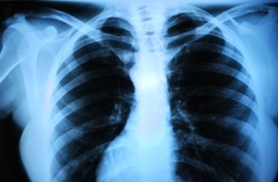
Radiology in Trauma and Pregnancy
Benefits to the mother outweigh small risks to the fetus!
Notes:
While caution is necessary to reduce radiation exposure, it should never be done at the expense of the mothers welfare. All injuries should be identified during the primary and secondary assessment with the use of radiography when necessary.

Slide 39
Radiation Exposure Risks
Greatest risk first 25 weeks
Week 1-3: embryo death
Week 8-25: CNS effects (↓ IQ)
Week > 25: childhood cancer
CT highest rad dose
Weigh risks & benefits
Notes:
Multiple injured trauma patients receive a substantial dose of radiation. Radiation exposure is cumulative. The low individual risk of cancer becomes a greater public health issue when multiplied by a large number of examinations and over the life time of the patient.
Though CT scans are an invaluable resource and are becoming more easily accessible, they should not replace careful clinical examination and should be used only in appropriate patients.

Slide 40
Radiologic Studies
Ultrasound
Preferred test for mom & fetus
Plain films
useful
exposure low
CT
↑ radiation dose
Provide shielding
when possible
18 week old fetus on CT
No needed study should be deferred if the mother’s life is at risk
Notes:
Ultrasound is safe, but has fairly poor sensitivity for diagnosing abruption. However, if a clot is visualized, prediction of abruption is high. The FAST exam becomes less accurate with increased gestational age, as the uterus crowds the abdominal cavity.
Use of plain films typically outweigh the risks of radiation exposure and
In mid to late pregnancy there is no single study that carries enough radiation to harm a fetus. The highest radiation dose occurs with CT, thus only indicated studies should be ordered. CT scan is noninvasive and provides additional information related to the retroperitoneum and GU tract. More specific uterine and fetal injuries can be determined.
Magnetic resonance imaging has not been associated with adverse fetal effects.
Other than a brain flow study, there is little indication for nuclear medicine imaging.

Slide 41
Medications FDA Pregnancy Categories
Risk Description
A | Safety established by human studies
B | Presumed safe established by animal studies
C | Uncertain safety: animal studies show risk, weigh benefits of use
D | Unsafe: human studies show risk, weigh benefits of use
X | Highly unsafe: positive evidence of harm
Notes:
FDA pregnancy categories should be noted for every medication given
Few medications are known to be safe
Weigh the risks and benefits
Tetanus is NOT contraindicated, administer as appropriate
Do not withhold analgesics
Anesthesia drugs fall in Category C

Slide 42
Placental Abruption
Placental uterine separation
Blood Loss:
External: vaginal bleeding
Occult: accumulates behind placenta, bleeding may not be seen
Case study: Hypo-perfused regions of placenta = abruption. No vaginal bleeding, normal fetal heart tones, frequent uterine contractions. C-section performed. Fetus survived.
Notes:
Placental injury is a threat to both patients. The early separation of the placenta deprives the fetus of oxygen, leading to hypoxia and death if the fetus is not delivered quickly. Further, the uterus is unable to contract to constrict bleeding vessels in the uterine wall, as the fetus remains within the uterus. Thus the mother is at risk for significant blood loss. Additionally, the thromboplastin which is released as a result of the abruption can cause or worsen disseminated intravascular coagulopathy (DIC).
*The uterine cavity can hold the entire blood volume of an adult.
*If abruption is occult, the first signs of fetal and maternal compromise may be non-reassuring fetal heart tones. Thus early fetal monitoring is important.
Abruption is the cause of at least 50% of fetal death.
Even without outward signs of trauma a sudden deceleration can create a shearing force which may result in abruption.

Slide 43
Placental Abruption
3% of minor trauma
50% of severe trauma
Cannot predict based on ISS
Signs and Symptoms: rigid abdomen, abdominal tenderness, tetanic contractions, fetal distress, may or may not have vaginal bleeding
Fetal monitoring early warning system!
Notes:
The placenta does not have the ability to contract and expand, and thus cannot vasoconstrict to control bleeding like the uterus. With deceleration and acceleration injuries, a shearing will occur within the tissues of the placenta. This shearing causes separation of the placenta from the uterine wall. In severe blunt trauma, abruption is very common, occurring in 40% of cases. Of these cases, fetal death occurs 60% of the time.
Of all fetal deaths from trauma, abruption is the cause of at least 50%.
Although there is a greater likelihood of abruption with severe blunt trauma, the occurrence of abruption can not be predicted with use of severity of injury measures, such as ISS.
In patients beyond 23 to 24 weeks tocodynamometry (measuring uterine contractions), is the most sensitive predictor of abruption. Monitoring should begin as soon as the mother is stable.
Most cases of abruption will exhibit frequent contractions, >8/h and will normally occur within the initial 4 hours after the trauma. Thus 4-6 hours of FHT and tocodynamometry monitoring has become standard as a minimum for pregnancies greater than 23 weeks.
If there is no uterine tenderness, bleeding, fetal distress, serious maternal injuries and fewer than 1 contraction every 10 minutes the risk of abruption is small. However, the literature shows rare cases of abruption occurring up to 6 days post trauma. Pregnant women involved in a trauma should be educated on what to look for after they are discharged. (vaginal bleeding, abdominal pain and/or rigidity, frequent contractions).

Slide 44
Uterine Rupture
Rare and catastrophic
High maternal and fetal death
May result from: uterine avulsions, disruptions of placenta, fetus or umbilical cord
Presents with: shock, poor FHT, distention, rigidity, guarding, peritoneal irritation
Notes:
Uterine rupture: Uterine rupture may result from a serosal hemorrhage, uterine avulsions, disruption of the uterine wall, placenta, fetus, or umbilical cord. 75% of uterine ruptures involve the fundus. Signs and symptoms of uterine rupture are: uterine tenderness, nonreasuring fetal heart tones, rapid hypovolemic shock, peritoneal irritation, distention, rebound tenderness, guarding and rigidity.
Risk factors: prior cesarean section, other uterine surgeries or malformations, uterine over-distention (polyhydramnios) and multiple gestation.

Slide 45
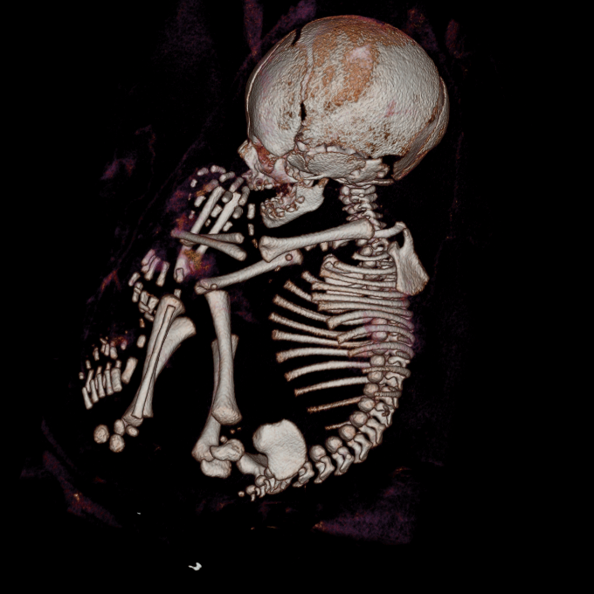
Direct Fetal Injury
Rare - 1% of blunt trauma
Maternal tissues protective for the fetus
Fetal head injury
most common
CT scan to assess fetus
Prepare for cesarean section if indicated
3D reconstruction of 37 week fetus after MVC
Notes:
Fetal head injury most common occurs with maternal pelvic fractures, especially if the head is engaged in the pelvis
For blunt trauma, the injury pattern will differ depending on gestational age.
Because of increased vascularity increase in splenic and retroperitoneal injury.
In blunt trauma: most frequent injuries are head trauma, intraabdominal bleeding, visceral rupture and pelvic fractures. Higher incidence of hepatic, splenic and uterine. Gastro less common.
Direct fetal injury = less than 1% of severe blunt trauma. Maternal tissue is protective. Most common is head injury, more common when engagement has occurred and there are pelvic fractures.
Maternal and fetal deaths were highest with internal injuries to the thorax, abdomen and pelvis.
Don’t embolize vessels which feed the uterus. But useful with pelvic fractures. Use with caution due to radiation exposure but use if indicated.

Slide 46
Pelvic Fractures
Most common in MVC
Anticipate hemorrhage from engorged pelvic vessels
Fetal mortality 35% Maternal mortality 9%
Associated bladder or urethral trauma
Fetus
Pelvic Fractures
Notes:
Pelvic fractures: Maternal mortality is approximately 9% compared to a fetal mortality rate of 35%. Fetal deaths are more common with maternal vascular injuries, due to the high risk of disrupted blood flow to the uterus.
Outcomes depended on DEGREE OF INJURY, unlike in abdominal trauma.
Fetal head and clavicle injuries are more common in pelvic fractures.
Due to the close association between pelvic fractures and urethral and bladder injuries, care should be taken to observe for blood at the urethral meatus before inserting a urinary catheter.
In the diagnosis of pelvic fractures CT can be used sparingly, plain x-rays are often sufficient.

Slide 47
Pelvic Fractures
Management :
internal fixation
non-operative approach
Angiography & Embolization:
may be used with caution
Vaginal delivery:
not completely contraindicated
Repair after birth by cesarean section
Notes:
Care should be used with angiography due to the high levels of radiation associated with the procedure. Additionally, embolizing vessels feeding the uterus will compromise the fetus. However, to save the mother’s life, no therapy should be withheld. Provide lead shielding for fetus.
Pelvic fractures are not a complete contra-indication to a vaginal delivery, but severely dislocated fractures or large areas of healing bone, may prevent it
One study showed that 75% of women who had pelvic fractures in their 3rd trimester, were able to give birth vaginally.

Slide 48
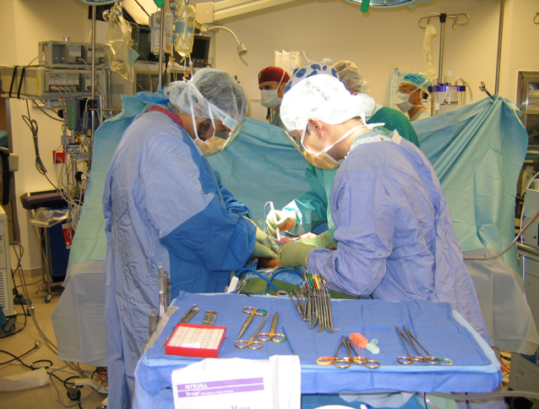
Penetrating Abdominal Trauma
Uterus is the dominant organ and likely target
Fetal demise 40-70% due to:
direct fetal injury and early birth
Risk for massive hemorrhage from uterine injury
Notes:
Penetrating trauma: Depending on source and type of injury there is a 40-70% fetal demise rate and 5-10% maternal death rate. Pregnancy may be protective for the mother due to the displacement of internal organs, deflecting injury to the fetus. It the upper abdomen is injured there is more likely to be a bowel injury and lower abdomen is more likely to injure the fetus.
The decision to take the patient to surgery should depend on the location of the injury, size of the uterus and maternal and fetal vitals. Injuries in the upper abdomen will usually be handled with surgery. If both mother and baby are stable and the injury is in the lower abdomen a conservative approach may be appropriate.
Massive hemorrhage can occur from uterine injuries due to the blood that is shunted to uterus. Quick control of bleeding must be achieved. With GSW this requires exploratory surgery almost exclusively.
Administer antibiotics for anaerobic and gram negative if bowel involvement.

Slide 49
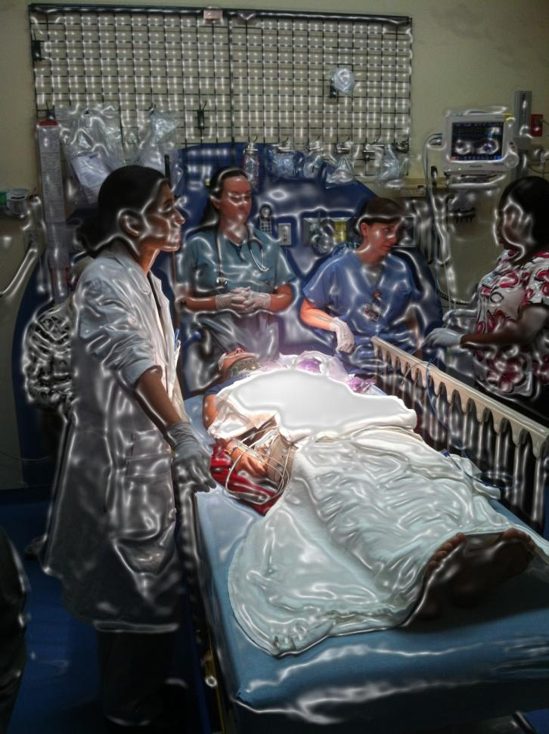
Perimortem Cesarean Section
Indications:
Fetus > 23 weeks gestation
Reasonable certainty of maternal demise
Knowledge of operative technique
Available resources to resuscitate neonate
Presence of fetal heart activity
Notes:
In the event of a cardiac arrest in a gravid patient, a perimortem cesarean section should be considered as a potential lifesaving procedure for the mother and fetus. Despite the attempt to displace the uterus and decrease aortocaval compression, attempts to restore circulation may be unsuccessful. Both obstruction of the abdominal aorta and decreased compliance of the thoracic cavity, make CPR inadequate in the pregnant patient. A cesarean delivery may be the best option for saving both patients.
The minimal gestational age for a perimortem cesarean is a controversial issue. Compression of the aorta can occur as early as 20 weeks, it is unclear whether it is truly an impact of perfusion until 24 weeks. Further, viability of the fetus typically occurs around 23-24 weeks. Although there are some facilities that will care for a fetus as young as 22 weeks. Thus a perimortem cesarean section could be done at 22-24 weeks of gestation and above.
Quick rule of thumb: If fundus is greater than or equal to 4 fingerbreadths above the umbilicus the fetus is likely 24 weeks old.
That patient should not be transported to the OR. An emergency C-section delivery kit should be available for immediate use in the emergency department. Neonatal resuscitation supplies and equipment (suction, intubation equipment, warmer, Braselow tape etc.) should be in the resuscitation room.
Team should include trauma team, obstetrician, neonatologist and neonatal ICU nurse.

Slide 50
Perimortem Cesarean Section
EAST 2005 Guideline
Delivery should be carried out within 4 minutes of unsuccessful maternal arrest
Maternal CPR
Begin cesarean section
0 min - ACLS - - - - - - - - - 4 min
Delivery
By 5th min
Notes:
Case reports of perimortem cesarean sections, show that neonatal neurological outcomes are better if delivery occurs within 4 minutes of arrest.
Further, maternal return of circulation was found to improve when the uterus is emptied.
EAST recommends that a perimortem cesarean section be performed within 4 minutes of maternal arrest.
Rationale:
Brain damage occurs in nonpregnant patients in 4 -6 minutes of anoxia.
Pregnant women become anoxic sooner, due to decreased functional residual capacity.
If the fundus is 4 fingerbreadths above the umbilicus, CPR is ineffective for resuscitation. Emptying the uterus will improve chance of maternal survival.
Fetal survival diminishes in the time between maternal death and delivery.
Chest compressions should be continued throughout and broad spectrum antibiotics should be given to decrease the risk of postpartum infection.

Slide 51
Family Support
Keep informed
Explain treatment
Control pain
Support services early (social work, chaplain)
Notes:
Provide comfort to the mother and family by allowing them to be together at every opportunity
Allowing patient to hear the fetal heart beat and see ultrasound images may lessen anxiety.
In addition to concerns about the baby, the patient and/or family may be experiencing guilt about events leading to the injury.

Slide 52
Future Considerations
Duration of fetal monitoring
Domestic violence screening
Airbag safety
Notes:
Recommendations for fetal monitoring after trauma vary. However, a minimum of 6 hours is the current recommendation by EAST although some research suggests that 4 hours is acceptable.
Domestic violence is epidemic in this population of patients and is often under reported. Further investigation of effective screening methods in the pregnant population should be a priority.
Because airbags were designed to protect an average sized male who is restrained, further research and development should be conducted to ensure that the pregnant woman and her fetus are protected and not harmed by airbags. Research is ongoing in this area.

Slide 53
Virchow’s Triad in Pregnancy
Stasis
Hypercoags
Trauma
Notes:
Virchow’s Triad refers to the three factors which play a role in thrombus formation.
Stasis: In pregnancy venous stasis occurs from compression of the iliac veins as a result of the right iliac artery overlying the left iliac veins, the gravid uterus, hormonally mediated venous dilation and decreased activity.
Hypercoagulability: Changes in procoagulant factors and anticoagulant and fibrinolytic activity, from the release of estrogen, result in more thrombin generation and less clot dissolution activity.
Trauma: A trauma leading to endothelial injury, is the final factor of Virchow’s triad. Thus traumatic injury in pregnancy puts the pregnant patient at an even greater risk for venous thrombus and it’s sequela.

Slide 54
Thrombotic Disease in Pregnancy
Pregnancy → hypercoaguable state
Incidence of DVT of 0.1-0.2%
Recommended treatment:
Sequential compression devices
Heparin
Low molecular weight Heparin
CONTRAINDICATED:
Coumadin (severe fetal malformations)
Notes:
Pulmonary embolism is the main cause of death of pregnant women in developed countries. An increased prothrombotic activity is observed during pregnancy. Moreover, the risk of venous thromboembolic disease can be elevated in cases of inherited thrombophilia, antiphospholipid syndrome or previous venous thromboembolic events.
According to presented guidelines of The American College of Chest Physicians, the risk stratification of venous thromboembolic disease during pregnancy and puerperium is a vital condition and proper antithrombotic prophylaxis should be implemented.

Slide 55
Summary
A&P changes greatly impact assessment and management of the pregnant trauma patient
Initial evaluation & treatment should focus on the mothers hemodynamic stability
Implement widespread domestic violence screening
Injury severity is not a predictor for abruption, it can occur with mild injury.
Education regarding substance abuse, restraints and distracted driving can save lives

