Slide 2
General Concepts in Pediatric Trauma Care

Slide 3
Objectives
At the conclusion of this presentation the participant will be able to:
Describe at least one difference in the respiratory and cardiovascular system between children and adults
Discuss assessment of Traumatic Brain Injury in the pediatric patient
Identify the differences in spinal, thoracic, and abdominal injuries in the pediatric patient relative to adults
Identify physical differences and specific developmental stages for different age groups and apply assessment and intervention strategies
Discuss at least two important considerations in the approach to victims of child abuse

Slide 4
Pediatric Trauma : A major threat to the health and well-being of children
Injury is the leading cause of death among children older than 1 year
Injury exceeds all other causes of death combined for children
Approximately 12,000 children and teenagers die as a result of injury annually
In 2010 8,801,396 injuries were recorded in children and teens
Notes:
Statistics from CDC, National Center for Injury Prevention and Control

Slide 5
Erickson’s Developmental Stages
Trust versus mistrust (birth to 2 years)
Autonomy versus shame (2-4 years)
Initiative versus guilt (preschool)
Industry versus Inferiority (grade school)
Identity versus identity diffusion (adolescence to young adult)
Intimacy versus isolation (young adult)
Generativity versus self-absorption (adult)
Integrity versus despair (mature adult)
Notes:
It is important to understand and integrate the child’s development stage and goals of that stage into assessment and interventions to most effectively interact with children.
While the general ages noted on this slide for the various stages are the norm, age doesn’t always equate with developmental stage. A big challenge in nursing is to effectively deal with the developmentally delayed child; to understand what their baseline is and to deal with them from that perspective.

Slide 6
Assessment of Children
“Quick look”
Parental presence
Verbal cues
Non-verbal cues
Compensatory mechanisms
Notes:
Don’t be distracted by the fact that the patient is a child. Approach assessment systematically with the TNCC/ATLS primary and secondary survey.
Initial “quick look” before approaching or touching the child, especially the fearful or young child
If possible, keep parent with the child during assessment Parental involvement is very helpful, when available, to help establish normal behavior and response. “Family presence” guidelines especially important in pediatric settings. Helps to calm both parent and child.
Observe verbal cues
Observe non-verbal
Significant compensatory mechanisms present in children
Use special vigilance in establishing normal baselines and doing assessments children with developmental delays.
Falling blood pressure is a late sign of shock in children. Focus on evaluating skin signs and end organ perfusion in assessment.

Slide 7
Physical Differences in Children that influence injury patterns and care…
Large head and higher center of gravity
Ligamentous laxity and incomplete fusion of vertebrae
Bones are more compliant than an adults
Notes:
Physical differences that affect the types of injuries that should be suspected when the child is being evaluated:
the child’s larger head and the consequent higher center of gravity is the most important feature of children when you consider mechanism of injury and the types of injuries to be alert for. A child will always lead with their head… in bike crashes, pedestrian injuries and car crashes, the most likely area to be injured is the head. Head/body proportion begin to be similar to adults at around age 12
Ligamentous laxity and incomplete fusion of the vertebrae is particularly important to consider for the young child’s neck. Not only do they have a larger, heavier head but their necks are weaker. This is why it is recommended to keep children up to the age of 2 rear facing in an automobile. C-spine assumes adult characteristics at approximately age 8
Their bones are more compliant than adults. They are less likely to sustain a fracture than an adult and the fractures they do sustain tend to be less complex. Although this is beneficial at times, it may also lead to more organ injuries since the energy of a crash continues to travel… for example, in the case of chest trauma it is extremely rare to see a flail chest or even multiple rib fractures however pulmonary contusions are more common than in adults. Even though fractures may be less complex they can also be more serious due to possible growth plate damage which is covered later in this lecture.

Slide 8
Physical Differences in Children that influence injury patterns and care…
Keep Me Warm
Notes:
It is important to be very alert to keeping children warm especially during resuscitation. They are prone to lose body heat quickly.
Relative body surface area is much larger in children.
More body weight invested in visceral organs and less in muscle mass
Solid organs are larger compared to size of abdominal cavity
A child’s visceral organs such as the spleen, liver and other abdominal organs are more vulnerable to injury due to the relative size and lack of muscle protection.

Slide 9
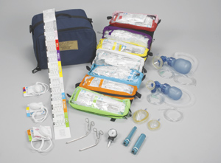
Vital signs, medication doses and equipment needs highly variable dependent on age/size/weight
Notes:
Even if you care for large numbers of children, have corresponding resources readily available for your team members including reference posters and drug dose guides for various sizes of children.
Provide simple, readily accessible reference charts and guides for clinicians to refer to help them calculate drug doses and select appropriate equipment sizes.
The Broselow System© provides an organized approach to assessment of size and weight, medication dosing and equipment selection
Caution clinicians on relying on memory for drug doses or calculations—use approved references.
Helpful vital sign grids are available in the American Heart Association’s Pediatric Advanced Life Support manual.

Slide 10
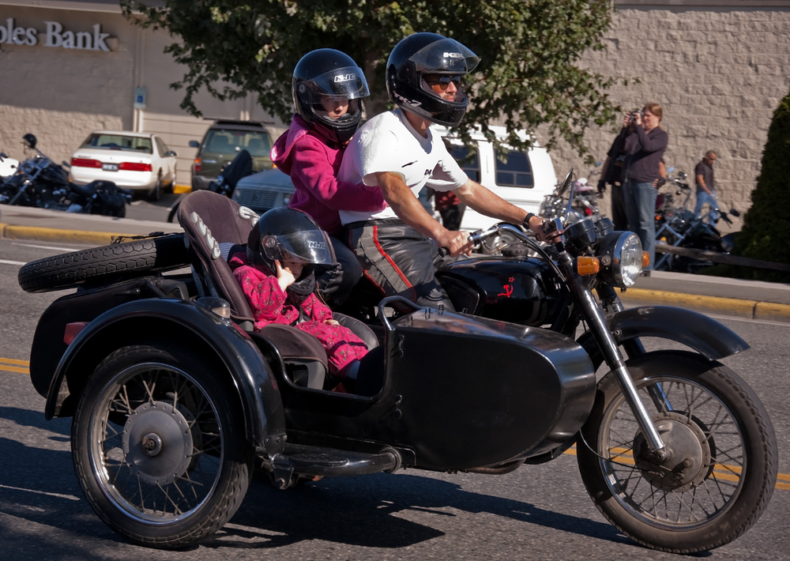
Kids in Cars - Motor Vehicle Crashes Specific Children
In the U.S. in 2008, an average of 4 deaths and 529 injuries per day of children 14 year of age and younger were reported
46% of children killed in MVC were unrestrained
Joyful designs Shutterstock.com
Notes:
Factors influencing injury patterns
Correct use of restraints
Location of child in vehicle
Common mechanisms:
Unrestrained children become missiles because of the size of the head and high center of gravity. They are even more likely than adults to be thrown out of a vehicle and land on their heads causing major head injury.
Statistics are from (http://www-nrd.nhtsa.dot.gov/Pubs/811157.pdf; accessed (11/12)

Slide 11
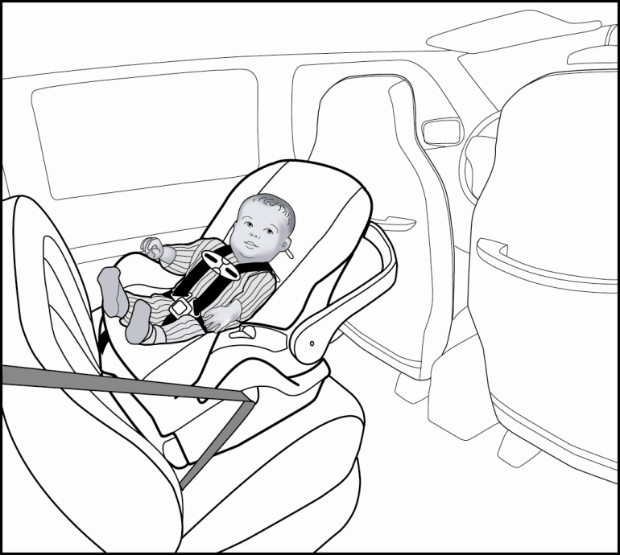
Improper Seating and Restraints
Children need to be rear facing in the back seat until the age of 2 or until they reach the highest height & weight allowed by the car seat
Also avoids the airbag!
Notes:
The safest location in a vehicle is in the back seat. For young children this is particularly important since it also protects them from the airbag.
Children need to be rear facing in the back seat until the age of 2 or until they reach the highest height & weight allowed by the car seat due to :
Ligamentous laxity & incomplete fusion of cervical vertebrae
Large head
Generally, children should be in a car seat between the ages of 0 and 8. New AAP recommendations state that children should be rear facing until aged 2 or until they reach the highest height and weight allowed by the car seat. Some parents worry about the child’s legs as they grow longer but this has not been found to cause increased injury. In fact, leg fractures have been found to occur more frequently when the child is front facing.
In addition, a front facing child is much more likely to sustain a high cervical injury. The combination of the weak neck muscles and large, heavy head causes the head to whip forward in a sudden deceleration. Sitting rear facing cradles their head and neck, thus protecting them from injury.
Care givers should always attempt to ascertain the seating position of a child who arrives following a car crash, no matter how minor the crash.
Children rear facing in a car seat in the front seat of a vehicle with active airbags have sustained massive head injuries from being slammed into the seat back. This has occurred even with relatively minor crashes. Even though new cars have safety devices to turn the airbags off if a certain weight is sensed in the front seat, not all patients own a newer vehicle or have vehicles in good repair.
Children in the back seat of a vehicle but front facing at too young of an age can sustain serious high cervical spine injuries and should always be assessed for these injuries.

Slide 12
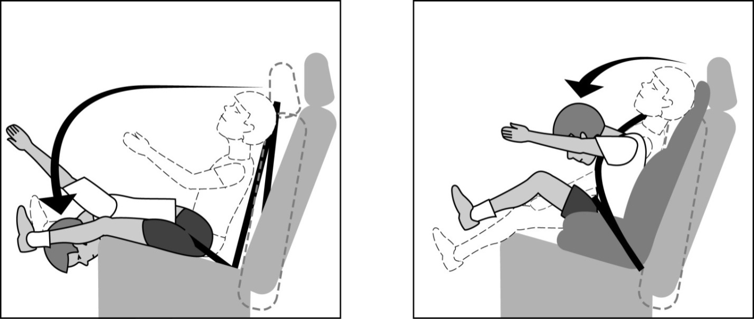
Improper Seating and Restraints The Need for Booster Seats
Children under 4 ft 9 inches without a booster seat tend to place the shoulder strap behind back and sit towards the front of the seat.
The child’s higher center of gravity & poorly developed iliac crests contributes to head and seat belt injuries
Child in without a booster
Child in a booster seat
Notes:
Seats are designed to fit adults!
Children who have outgrown a car seat are not big enough to sit in the car with only an adult lap shoulder belt. They tend to move towards the front of the seat so that they can bend their legs. Also the shoulder belt rubs against their necks so they frequently place the shoulder belt behind their backs. Since their heads are still large, when the child is not in a booster seat, any deceleration of the vehicle can cause the child to jackknife over with great force as shown in the picture.
Care givers should always ask how the child was restrained and in what position in the vehicle. They should be alert for abdominal injures in cases where the child is not in a booster seat. They should also be alert for head injuries. In the front seat the child’s head may be injured by an air bag, the dash board or the side of the vehicle. In the back seat the head can be injured by hitting the front seat, other passengers in the back seat or the side structure of the vehicle.

Slide 13
Bicycle Crashes Childhood Risk Factors
25% of all bike related deaths and 50% of all injuries occur in children between the ages of 5-14
The crash usually takes place:
At non-intersections
Close to home/minor roads
Summer/late afternoons
www.safekids.org

Slide 14
Bicycle Crashes
70% of the time child’s head hits the ground first
Helmet use can reduce the risk of injury by 85%
45% of children always wear a helmet while bicycling

Slide 15
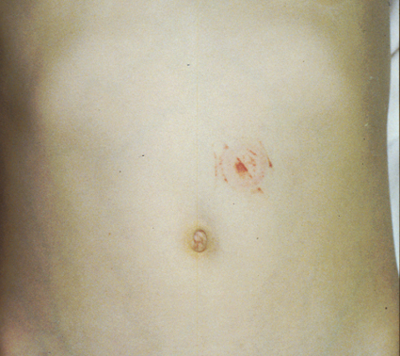
Bicycle Mechanisms
Over the handlebars
Collisions with motor vehicles
Handlebar injuries
Notes:
Over the handlebars
When a child is in a bike crash and travels over the handlebars they are most likely to land on their heads. If they are not wearing a helmet they are most likely to receive a severe concussion or a more severe head injury.
Head and neck injuries
Chest, abdominal or extremity injuries
Collisions with motor vehicles
Collisions with motor vehicles can cause a number of severe injuries including head, extremity and organ injuries. Children are most likely to die with this mechanism.
80% of deaths
Handlebar injuries
One of the most insidious injuries is caused by the spearing of the abdomen by the handlebars. The child loses control of their bike, the bike tips over sideways, the distal end of the handlebars hits the ground vertically. The child will land on the proximal end of the handlebars with all of his weight. The only injury may be a small subtle bruise on the abdomen however, since children have weak musculature and the force in that one area is so great it can cause remarkably severe organ injuries.
Injuries to Pancreas, intestine, kidney, liver, spleen may occur

Slide 16
Pedestrian Injuries
The number of pedestrian deaths in children 14 and under has decreased but in 2008 there were still 270 deaths in the U.S.
During 2008, the highest % of fatalities among pedestrians, age 14 and below, occurred between 4PM and 7:59PM (43%). 21% occurred between 8 PM and 11:59PM.
76% of deaths occurred at non-intersections
Notes:
Statistics from http://www-nrd.nhtsa.dot.gov/Pubs/811157.pdf accessed 11/12
What are the statistics in your trauma center?

Slide 17
Waddel’s Triad
Classic pediatric injury pattern
Vehicle impacts
Upper leg
Chest and/or abdomen
Child is then thrown hitting head
Notes:
Waddel’s Triad is the classic pattern of injury for children when they are hit by a vehicle. Generally they are impacted in the upper leg and the chest/abdominal area. They are then thrown and hit their head. It is also possible that they will be thrown up onto the car and hit their head on the windshield before being thrown away from the car.
Higher vehicles such as SUVs and small trucks can change this injury pattern since the initial impact can also be around the head area.
Children can be hit at a higher rate of speed since they are more likely to run out between parked cars and they are more difficult to see because of their height. The driver of the vehicle may also be breaking suddenly so that the bumper may be lower to the ground.

Slide 18
Falls from a Height Differences Between Age Groups
Birth to 2 yrs fall head first
3 to 10 years tend to fall on hands and feet
11 and older fall feet first
Notes:
Study of 110 pts who fell more than 10 feet
In general, younger children who fall from a height tend to fall on their head and sustain head injuries.
Older children and adolescents fall the same way that adults do, on their feet. They sustain the usual calcaneous, long bone and vertebral fractures since the energy force travels up. Then they sustain hand injuries since they fall forward when they land.
Interestingly, according to this study, the group in between, 3-10 year olds, tend to sustain mainly long bone fractures. The research team concluded that these children no longer had the same large size head as infants but were still not as proportioned as the older children. Consequently they tend to fall on all 4 extremities.

Slide 19
Traumatic Brain Injury (TBI)
Significant cause of death in children
Hypoxemia and hypotension significantly increase morbidity and mortality
Secondary to:
Motor Vehicle Collisions (MVC)
Falls
Sports
Bicycles
Non-accidental trauma
Notes:
Hypoxemia and hypotension increase risk of secondary injury.
The primary goal should be to preserve cerebral functionality.
Preventive intubation may be considered to provide a secure airway and sedation.
Falls are the primary source of injuries in children with MVC’s creating the second most common.
On the rise are penetrating injuries, such as weapons use, dog bites and impaled objects.
Protective gear with other injury prevention strategies decreases morbidity and mortality.

Slide 20
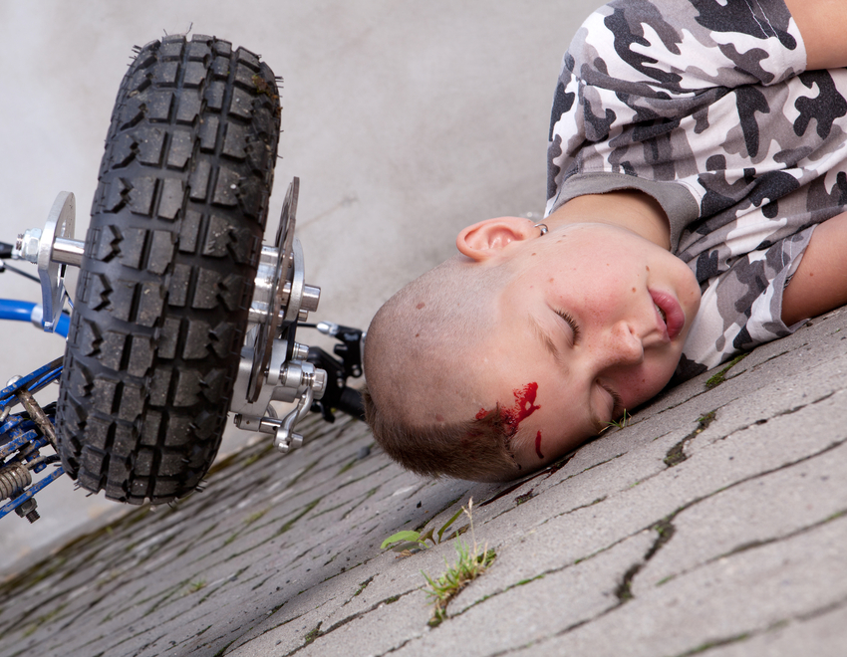
Traumatic Brain Injury Classification
Mild (GCS 13-15)
Do well; may have radiographic abnormalities
May have headaches, seizures, vomiting
Moderate (GCS 9-12)
Severe (GCS 3-8)
LOC, posturing, combative, abnormal neuro exam
Notes:
Use of GCS modifiers and consideration of psychomotor and cognitive development essential for non-verbal and applicable developmental stage
Life threatening condition may exist despite benign presentation
May have delayed deterioration
Normal neuro exam and normal head CT rarely deteriorate and may be able to be discharged home
GCS <8 are indications for intubation and ICP monitoring. Normal ICP in adults is <10 mm Hg and is lower in children and infants.
Presence of certain reflexes not found in adults/older children
Flexion posture normal in infants
Better GCS on initial presentation may indicate improved outcome.

Slide 21
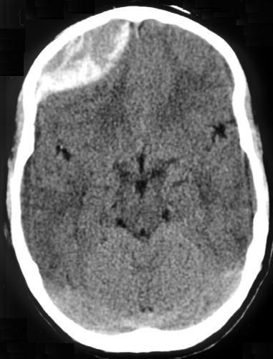
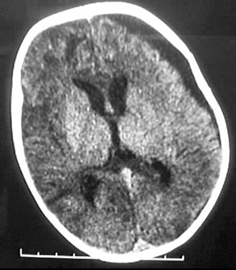
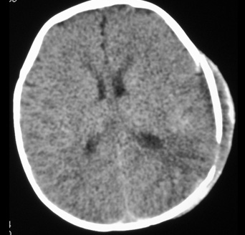
Types of Traumatic Brain Injuries
Epidural Hematoma
Subdural Hematoma
Shaken Baby Syndrome
Notes:
Children may have radiographic abnormalities despite appearing well. Thus, a life-threatening process may be occurring despite the benign presentation or delayed deterioration.
Epidural Hematoma
57% of children and 85% of infants have no loss of consciousness at time of injury
7% have no alteration in mental status
Skull fracture in suture line, consider epidural
Subdural Hematoma
Presentation may be subclinical
Shaken Baby Syndrome
Retinal hemorrhages, seizures
Those with a normal CT and neurological exam may be discharged home as deterioration at a later point is rare.
Evaluation of abusive head trauma (AHT) are best done by those with expertise in child abuse evaluation. AHT requires evaluation of social, psychological, and physical findings. Physical exams may include imaging, retinal evaluation, lab studies, and follow up. Common findings include retinal hemorrhages and seizures with or without outward physical signs of abuse. Previous history significantly impacts the entire investigation.

Slide 22
Traumatic Brain Injuries Considerations
No Steroids
Monitor CPP
Control ICP
Open Fontanels
Notes:
Open fontanels maybe protective in intracranial hypertension but an inelastic dura mater and smaller space limits expansion of the intracranial compartment.
Monitor Cerebral Perfusion Pressure (CPP) Reducing the MAP by >25% of baseline may increase risk of ischemia
Acutely decreasing ICP by hyperventilation may increase risk of ischemia by decreasing cerebral blood flow. Hyperventilation may be indicated with impending herniation.
Other methods of decreasing ICP are:
Use of hypothermic therapies
Use of ventilation strategies
Medication administration
Positioning of head of bed
Sedation
Titration of serum osmolarity
Intracranial pressure monitoring allows for continual assessment.
Recent literature not supportive of steroid use for TBI due to the negative sequelae post treatment and unclear improvements in outcomes.

Slide 23
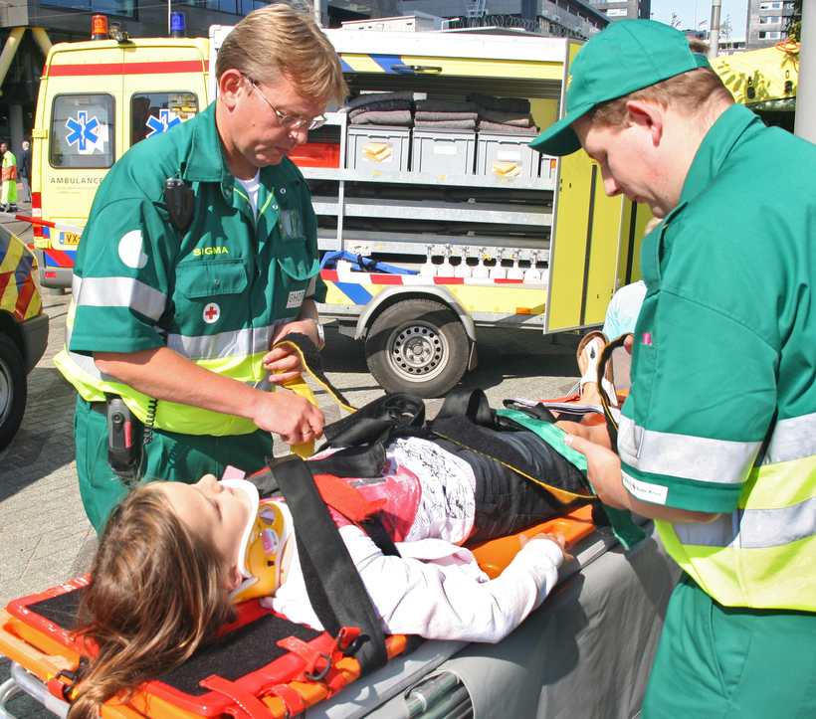
Pediatric Spinal Injuries
Cervical Spine
Uncommon in younger children
Higher risk in those > 11years
Mortality is 15-20% usually due to secondary brain injury
Jan kranendonk Shutterstock.com
Notes:
Uncommon in younger children
Mechanisms: MVCs, Falls, pedestrian accidents
Greater risk for high cervical, pseudosubluxations/dislocations
Anterior displacement
Spinal cord injury without radiographic abnormality (SCIWORA)
Larger head and weak neck muscles lead to flexion/extension injuries and rapid acceleration/deceleration
Higher risk in those > 11years
Greater risk for low cervical injuries and fractures
Transition to adult like injuries between 10-11 years
Vertebral bodies ossified, ligaments less elastic
Spinal cord may rupture with 5-6 mm of traction
Mortality is 15-20% usually due to secondary brain injury
Outcomes dependent on area of brain injured
SCIWORA: stretching of spinal cord. May result in partial or complete spinal cord injury
Considerations of immobilization techniques
Mortality is associated with the associated brain injury.

Slide 24
Extremity Injuries
Incomplete calcification contributes to injury patterns
Growth plate injury
Strong ligaments result in fx vs. ligamentenous injury
Fracture type determines treatment and outcomes
Antibiotics for open fractures
Assessment of joint above and below fracture
Notes:
Non-ambulatory children may require spica casts
Considerations for transport, skin care and pain management
Growth plate injuries may create long term disability. Growth is generally completed for boys at 16; girls at 14
Consider growth and developmental stage with corresponding history to rule out non-accidental trauma
Various treatment modalities exist dependent on type of injury, age of patient and other considerations such as past medical history and eligibility for surgical intervention.

Slide 25
Thoracic Trauma
Accounts for 5-26% of pediatric trauma admissions
Primarily blunt mechanisms though children can have penetrating injuries form GSW or stabbing
~5% mortality as stand alone injury
Mortality increases to 25% with concomitant head or abdominal injuries and 40% with all 3 body regions
Notes:
Thoracic injuries occur infrequently in children with 85% of thoracic injuries related to blunt MOI – mostly MVC and pedestrian struck. There is some incidence of thoracic penetrating trauma injuries in the pediatric population related to GSW and stabbing MOI. The incidence of pediatric thoracic injury is reported to be as low as 5% (Bliss and Sillen, 2002) and as high as 26% (Crankson, Fischer, Al-Rabeeah, and Al-Jadden, 2001).
Bliss and Silen (2002) note that the mortality associated with thoracic injuries as stand alone injuries is about 5% but increase to about 40% with concomitant head and abdominal injuries.

Slide 26
Why are pediatric thoracic injuries different than adult thoracic injuries?
Smaller blood volume
Smaller body mass
Thorax compliance
Gastric distention
Concomitant injuries
Mediastinum is not fixed
Few require thoracotomy
Higher metabolic demands
Notes:
Children are not little adults. There are several physical differences that make thoracic injuries different than thoracic injuries in an adult.
Children have smaller body masses and this equates to greater forces applied per unit body area. The child’s body also has less fat, less elastic connective tissue, and vital organs are closer to the force
Children can appear hemodynamically stable with up to a 40% blood loss but the pediatric patient has a blood volume of about 7-8% of their total body weight.
The child’s thorax is much more complaint than the adult thorax. The child’s chest can absorb a large amount of kinetic energy due to the pliability of the cartilage and boney structures. Children can sustain significant underlying organ injury without boney injury (rib fractures).
A child’s vital capacity can be significantly compromised related to gastric distention which causes diaphragm elevation. A child can quickly become fatigued causing apnea which can cause significant secondary injury.
Because the chest area is smaller in children, a significant MOI can cause other system injuries. This injury to other body systems can significantly increase mortality and morbidity.
The pediatric mediastinum is not fixed in the pediatric patient and this can mean that a tension pneumothorax will be very poorly tolerated in the pediatric patient. The trachea and heart can easily be displaced causing decreased venous return to the heart (Mendez (2011))
The good news is that less than 15% of pediatric thoracic trauma requires thoracotomy
Sharma (2008)
Finally, although children have significant reserves, their increased metabolic demands can cause a hypoxic child to deteriorate quickly

Slide 27
Thoracic Injuries
Pulmonary contusions
Pneumothorax
Rib fractures
Traumatic
asphyxia
Hemothorax
Notes:
Thoracic injuries themselves are not different than they are in adults other than few children sustain significant chest wall injuries even with significant underlying organ injury (i.e. rib fractures are less common but pulmonary contusions are much more common).
Mendez (2011) notes the incidence of pulmonary contusion as 49%, pneumothorax/hemothorax at 38% and rib fractures at 35%.Other injuries possible: flail chest (1%), bronchial disruption (<1%), intrathoracic injury (3%) myocardial contusion (3%), diaphragmatic rupture (4%), and esophageal injury (<1%).
Children can sustain traumatic asphyxia as a result of their chest wall compliance. A direct compression of the chest can cause marked increase in intrathoracic pressure.

Slide 28
Evaluation of Thoracic Injuries
MOI
Vital sign trends
Signs and symptoms of thoracic injury
Notes:
A high index of suspicion will serve the pediatric provider well in the evaluation of thoracic injuries. Children who have been involved in MVC and are pedestrians struck have the highest incidence of thoracic injuries. Other children at risk are those who have fallen more than 8 feet or sustain direct impact to the thorax.
Changes in vitals signs over time is indicative of significant injury. Abnormal respiratory rates have been shown to be associated with thoracic injuries.
The signs and symptoms of thoracic injury are not different from the adult population. Signs and symptoms of flail chest, cardiac tamponade, and great vessel injury are not all that different than you would see in an adult with the same injuries Mendez, 2011

Slide 29
Diagnostics
CXR
CT
EKG
Echo
Labs
Notes:
A CXR is an inexpensive, easy to obtain, and can identify many life threatening injuries including significant pneumo or hemothorax.
Although CT is an adjunct for thoracic trauma diagnosis, the use of CT and what it tells the provider versus the risk of radiology exposure must be considered. When in doubt, scan but use CT prudently in the pediatric population. Indications for thoracic CT include concern for aortic injury, signs of great vessel injury, or suspicion for tracheobronchial injury
An EKG should be done on every child with anterior chest trauma, a sternal fracture, or has an arrhythmia (including unexplained tachycardia)
An echo should be performed with any concern for cardiac injury
Minimum labs should be hematocrit, type and screen, and urinalysis. Troponin levels can be drawn when there is a concern for cardiac injury
Mendez (2011)

Slide 30
Abdominal Trauma
8-10% of all trauma admissions
80% blunt mechanism
Liver most commonly injured followed by small bowel, colon, stomach and spleen and kidneys
Notes:
Abdominal injuries account for 8-10% of all trauma admissions. The cause of abdominal trauma in kids is primarily blunt MOI (80%). Saxena (2010) notes the following injuries: lever (22%), small bowel (18%), colon (16%), stomach (10%), spleen (9%) and kidneys (9%).

Slide 31
Why are pediatric abdominal injuries different than adult abdominal injuries?
Thinner musculature
Rib compliance
Relative size of intra-abdominal organs
Lower fat content
Intestinal attachment
Bladder position
Hypothermia
Notes:
Children are still not little adults. Their musculature is thinner and provides less protection, especially in the younger child (under 2 years).
The ribs are less likely to fracture but their compliance makes them less protective in providing protection to the abdominal organs.
The relative size of the abdominal organs makes them a high risk for injury. They are less protected.
The pediatric patient has less body fat and more elastic attachments which contribute to the body’s ability to absorb energy and protect the abdominal organs.
The intestine is not fully attached making it more vulnerable to acceleration/deceleration/compression mechanisms
The bladder in the pediatric patient extends to the umbilicus at birth. As a child ages the bladder does descend to the retropubic position but it is at high risk of injury in the younger pediatric patient.
Finally, a disproportionate large body surface and less thermoregulation makes the pediatric patient at very high risk for hypothermia and secondary injury.

Slide 32
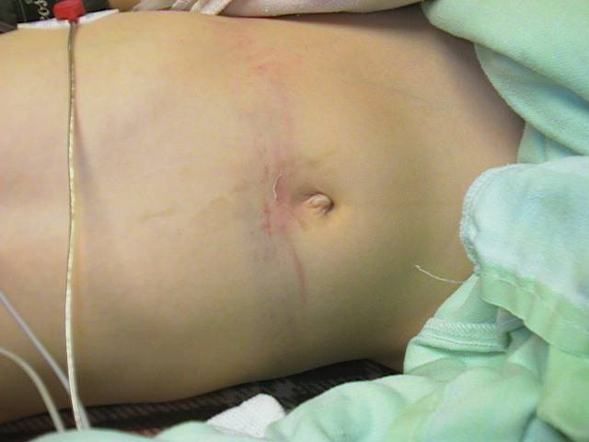
Abdominal Injuries
Lap belt syndrome
Solid organ injury
Hollow organ injury
Notes:
Children restrained in lap belts only are at very high risk for lap belt syndrome which is abdominal injuries and lumbar spine fractures. This is caused by the poor fit of a lap belt and the compression exerted during MVC.
Most solid organ injury in the pediatric population is managed non operatively with close monitoring for change in hemodynamic stability.
Hollow organ injuries are often missed and require operative intervention.

Slide 33
Evaluation of Abdominal Injuries
Inspection, auscultation, palpation
Presence of distention
Tenderness on palpation requires further diagnostics to determine presence of injuries
Notes:
Inspect for signs of abdominal injury. Bruises and abrasions may indicate underlying abdominal injury.
Distention may be indicative of intra-abdominal bleeding. A scaphoid abdomen may indicate traumatic diaphragmatic rupture.
Tenderness on palpation requires further diagnostics to determine presence of injuries.

Slide 34
Diagnostics
CT
FAST
Labs
Notes:
CT is the gold standard for evaluation of pediatric abdominal injury. Both oral and IV contrast should be administered for the best evaluation though oral contrast should be used judiciously related to the delay to exam as well as the risk of aspiration.
The use of FAST in the pediatric patient is still unclear. Although highly sensitive for free fluid, the exam lacks specificity and is therefore not particularly useful in pediatric abdominal trauma as most abdominal trauma is nonoperative in the pediatric population.
Labs appropriate for abdominal injury include CBC and urinalysis. LFTs and pancreatic enzymes may be useful but not usually in the initial evaluation of abdominal injury.

Slide 35
Resuscitation of Children
-Airway/respiratory differences
-Cardiovascular differences
-Body surface area differences
-Burn resuscitation formula
Notes:
-Airways are smaller and more easily occluded with secretions. Respiratory rates are higher. Tidal volumes are lower.
BVM ventilation requires practice.
-Heart rates are higher and ability to compensate for fluid/blood loss is significant by increasing HR and increasing peripheral vascular resistance. Skin signs a better gauge of perfusion than blood pressure in shock. Circulating blood volume is 75-85ml/kg.
-Body surface area is higher in small infants and children. Significant potential for heat and fluid loss with burns and for hypothermia with exposure.
-Burn resuscitation formulas are different for children. Rule of 9’s, Parkland Formula for estimate percentage of burns based on weight and body surface area burned.

Slide 36
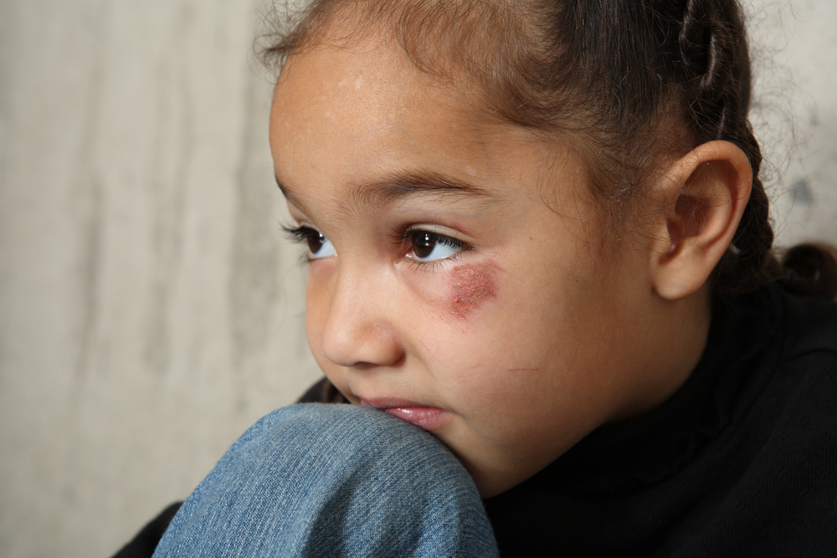
Child Abuse Considerations
High index of suspicion
Advocacy
Multidisciplinary Team
Fatality rates
Notes:
-Suspicious injuries in children, especially young infants and toddlers, need to be investigated by a knowledgeable team.
-Advocacy must be provided both to the patient and to any other children in the patient’s home or environment of injury.
-Multidisciplinary teams of front-line clinicians, child protection teams and local/regional child protection services collaborating together are key to protecting this vulnerable population.
-The fatality rate in abused children is disproportionately higher than any other mechanism of injury group. (Chadwick,Castillo,Kuelbs, et al, 2010)

Slide 37
Assessing and Treating Pain in Children
Neonates and children experience pain and long term consequences can result from exposure to repeated painful stimuli
Assessing pain in infants and children require special, age appropriate scales
There are many validated pain scales available for use but an organization should select one for each specific population

Slide 38
Assessing and Treating Pain in Children
Most children three years old and older can rank their pain using one of several validated tools.
Wong-Baker Faces Pain Scale
Notes:
In infants, children less than 3 years old and developmentally disabled patients, appropriate pain scales focus primarily on assessment of crying, vital signs, facial expression, sleep, and consolability.
Examples of pain scales for infants and children less than 3 include: CRIES Scale-Pain Assessment Tool; NIPS Neonatal/Infants Pain Scale; and FLACC Face, Legs, Activity, Crying and Consolability Scale.
Self reporting tools include the Wong-Baker Faces Scale, the Bieri Modified Faces Scale and a Visual Analogue Scale.

Slide 39
Trauma Complications in Children
Complication rates much lower in children than adults but still occur
Special vigilance with non-ambulatory children or toddlers
Radiation exposure
Notes:
-Special attention needed to assess and treat pain in all ages of children.
-Much lower rates of DVT, pneumonia and decubitus in children. Need special vigilance with non-ambulatory children or toddlers to rule out lower extremity injuries with significant mechanisms of injury
-Ambulate all ambulatory children prior to discharging from the ED to assess for occult orthopedic injuries.
-Be judicious in the use of CT scanning and doses used for scanning. There are commercial software products available for CT scanners to decrease the level of radiation exposure on children based on size/weight.
Do you know if your hospital has this software….does your radiology have pediatric protocols for CT? For radiation exposure?

Slide 40
Transfer to Pediatric Trauma Center
Depressed or worsening neurologic status
Respiratory distress or failure, Intubated children
Shock; any child requiring a blood transfusion
Hemodynamically unstable children requiring vasopressors, ICP monitoring or invasive monitoring
Fractures with neurovascular compromise
Spinal cord injuries
Traumatic amputations
Significant MOI with associated injuries
Whenever the primary caregiver believes the child requires specialized pediatric care

Slide 41
Transfer Considerations
Transport Mode
Diagnostics
Airway, Breathing, Circulation, IV access, sedation, pain control, cervical spine immobilization
Family centered care
Notes:
Transport Mode – specialty transport team? Air versus ground transport? What are your protocols?
Diagnostics – what should I do before the patient leaves?
Airway, Breathing, Circulation, IV access, sedation, pain control, cervical spine immobilization
Family centered care

Slide 42
Suggested Projects for Trauma Centers Caring for Children
Development of a weight-based Massive blood transfusion protocol (MTP)
Revision and update of brain death determination guidelines for infants and children
Donation after Cardiac Death Organ Donation protocol revisions based on changing theory and practices in warm ischemic organ retrieval
Notes:
See referenced articles.

Slide 43
Summary
Pediatric trauma care should be based upon the developmental and anatomic differences in children.
All trauma centers should have equipment and protocols specific to pediatric resuscitation.
Transfer to Pediatric Trauma Center when indicated.

