Slide 2
General Principles in the Care of the Obese Trauma Patient

Slide 3
Objectives
At the conclusion of this presentation the participant will be able to:
  Describe how the obesity epidemic impacts the delivery of trauma care.
  Discuss considerations needed in the initial assessment of the obese trauma patient
  Describe the management of blunt, penetrating, and burn injures in the obese patient
Notes:
In this lecture, we will be discussing the
Prevalence of obesity and trauma
Challenges to performing a thorough initial assessment
Management of blunt and penetrating injuries

Slide 4
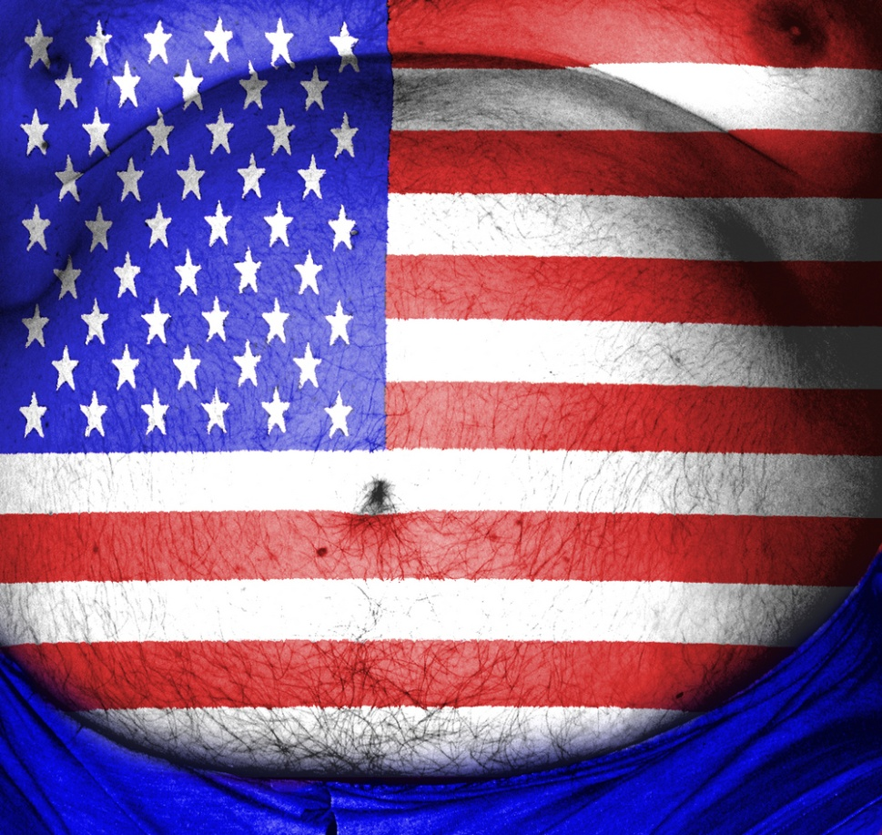
US Most Obese Country in World
1. United States
2. Kuwait
3. Croatia
4. Qatar
5. Egypt
6. United Arab Emirates
7. Trinidad and Tobago
8. Argentina
9. Greece
10. Bahrain
Notes:
Note that we are indeed the most obese nation in the world.
articles.nydailynews.com/2012-06-18/news/32303200_1_obese-adults-global-population-researchers

Slide 5
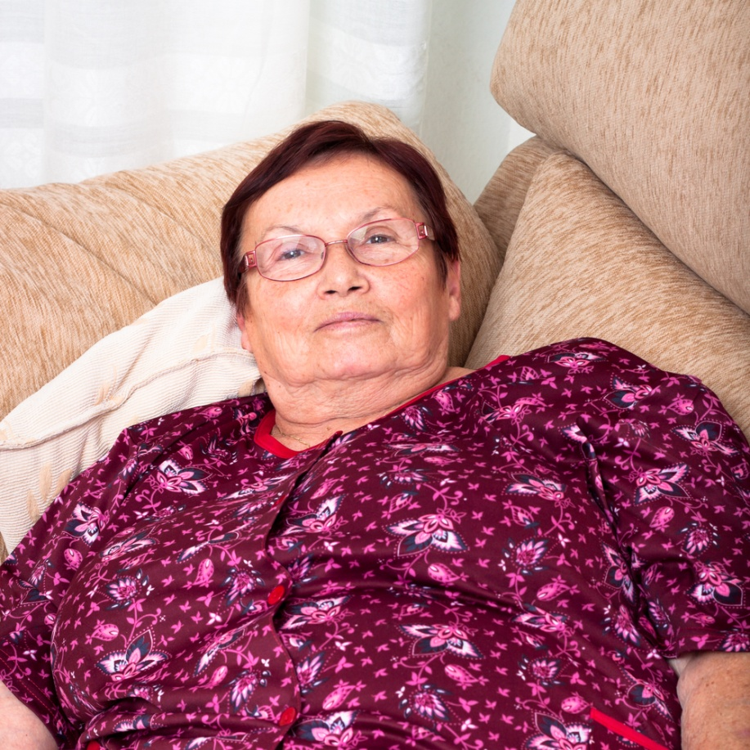
Epidemiology
(BMI>30)
33.8% of the population
Comorbidities
  Hypertension
  DM
  Stroke
  Cancer
  Asthma
  Sleep apnea
Notes:
Obesity is defined as a body mass index of >30%
In 2010, according to the Centers for Disease Control (CDC), 33.8% of the US adult population is obese …a 45% increase since 1988 (22.9%).
17% of children and adolescents are obese (1-19 years of age).
Comorbidities in the obese population include:
Hypertension
Diabetes
History of stroke
Increase risk of cancer
Respiratory problems

Slide 6
Definition of Obesity
Overweight with BMI over 25 to 29.9
Obese with a BMI of 30 to 39
Morbid Obesity with a BMI of 40 or more
BMI= ratio of weight (kilograms)
to height (in meters)
Notes:
This is the NIH definition

Slide 7
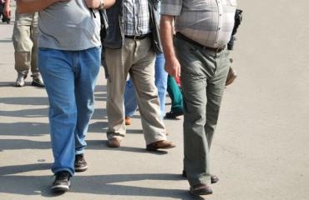
Cost of Hospital Care Higher
  Infection rate
  Ventilator days
  CVP days
  ICU LOS
  Hospital LOS
  Mortality rate
  Long term disabilities
http://www.nydailynews.com/polopoly_fs/1.1097737!/img/httpImage/image.jpg_gen/derivatives/landscape_370/image.jpg
Notes:
In the hospital setting, cost of care increases due to
Higher infection rates (2 fold)
Increased ventilator days (+8 days)
Increased CVP days
Increased ICU LOS
Increased hospital days
Higher mortality rate (6.2% higher)
The obese patient is at a higher risk for long term disabilities due to impaired mobility and limited access to healthcare.

Slide 8
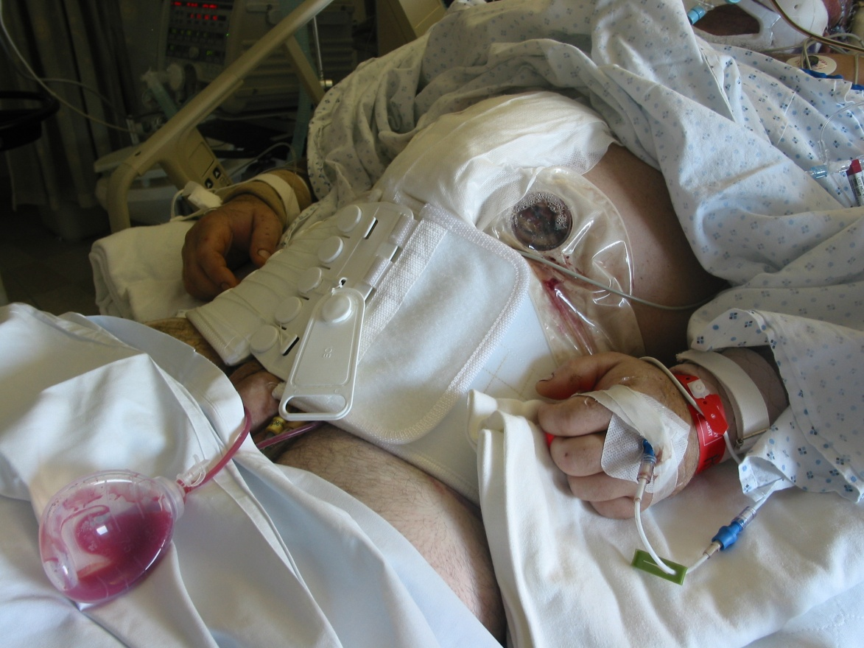
Epidemiology
Trauma is leading killer:
1-44 years old
Mortality 8x higher in the obese population
MVC
  $200.3 billion
Costs
  $478.3 billion
Notes:
Trauma is the 5th leading cause of death for all ages.
#1 killer for children and young adults (1-44 years of age)
Head, chest, and abdominal trauma are the 3 leading causes of traumatic death. Mortality rate among the obese population from trauma is 8 times higher than that of the normal weight population.
MVC is the leading mechanism of injury.
Overall, unintentional injuries cost approximately $478.3 billion. MVC account for $200.3 billion.
These costs include loss of wages losses, medical expenses, insurance costs, property damages, and property damages.
Image is of obese young man with multiple injuries after a MVC rollover.

Slide 9
Challenges/Considerations
Pre-hospital care
Personnel
Equipment
Transport
  Ground/air
  POV
  Intrafacility
Patterns of injury
Assessment
Adjuncts
Mortality/morbidity
Pharmacology
Heavy Lifting For Ambulance Crews, Obesity Epidemic Is Changing Emergency Medical Transport
Headline in Hartford Courant Oct. 20, 2012
Notes:
Quality trauma care and improved outcomes depends on the use of basic assessment skills and procedures. Obesity challenges:
skill of the providers
transport
processes for ensuring highest quality of care and safety of the patient
Obesity challenges skill, equipment, and resources due to:
Size
Missing landmarks
Chronic underlying health conditions
Transport from the scene to the hospital may require larger stretchers and ambulance.
Additional personnel may be needed to move the patient or roll the patient.
Verifying weight limits for gurneys and beds to ensure patient safety.
Basic equipment may not accommodate the obese patient.
Use of air transport may not be an option due to weight limits.
Considerations must be made in evaluating and understanding patterns of injury.
Lack of landmarks can hamper physical assessment.
Medication dosing may need to be altered due to the patient’s weight.

Slide 10
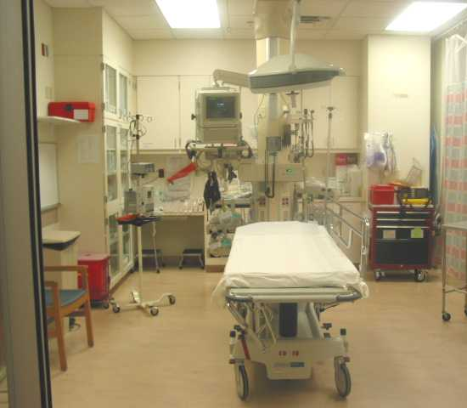
Principles
Primary Survey
Focused Adjuncts
Secondary Survey
Tertiary Survey
Coordination of care
Notes:
Regardless of the patient’s weight, the core trauma assessments remain the same:
Primary assessment and interventions
Secondary assessment and interventions
Adjuncts
Tertiary survey
Coordination of care necessary to facilitate the best and safest care.
How these assessments and procedures are performed will require some alterations.

Slide 11
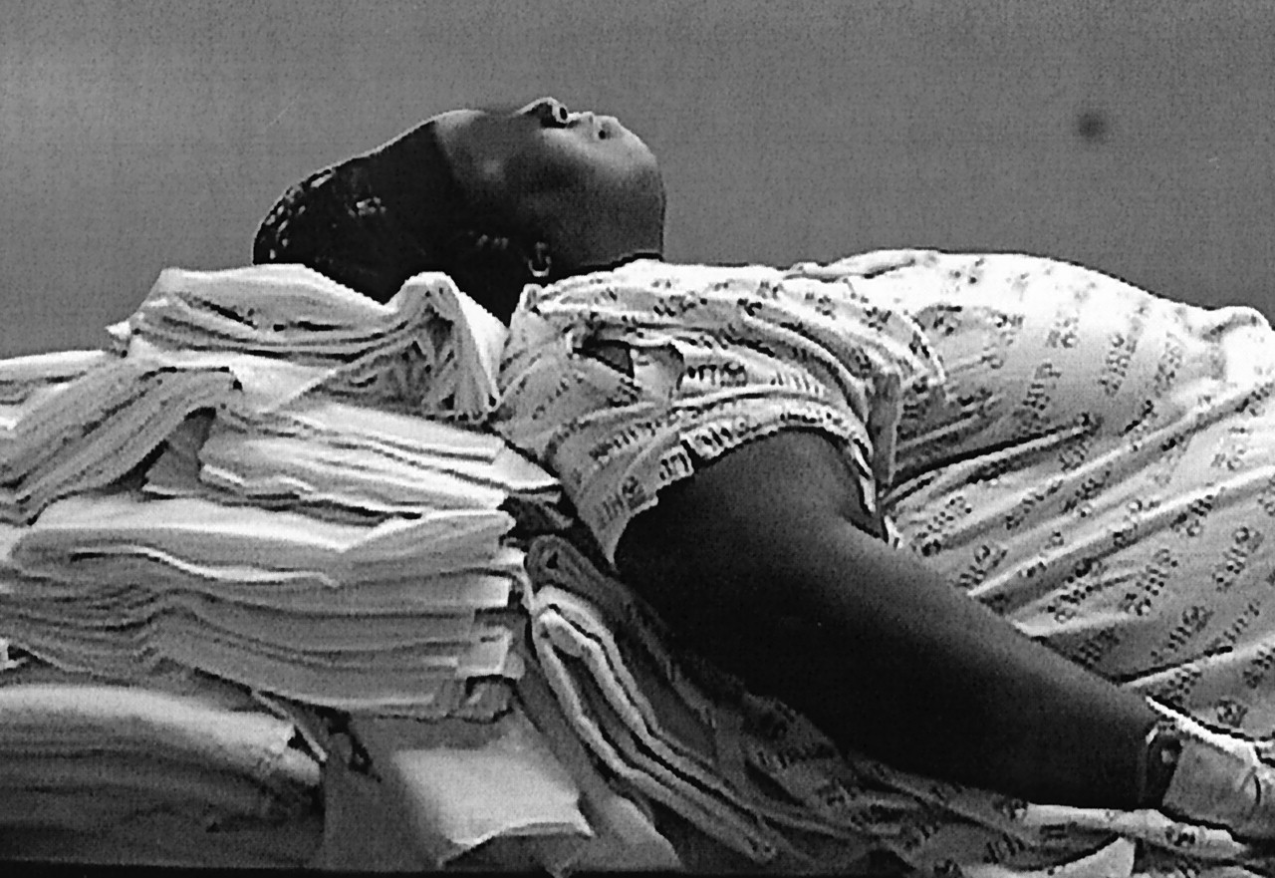
Airway (C-Spine Protection)
Notes:
Simultaneous airway management and c-spine protection can be challenging.

Slide 12
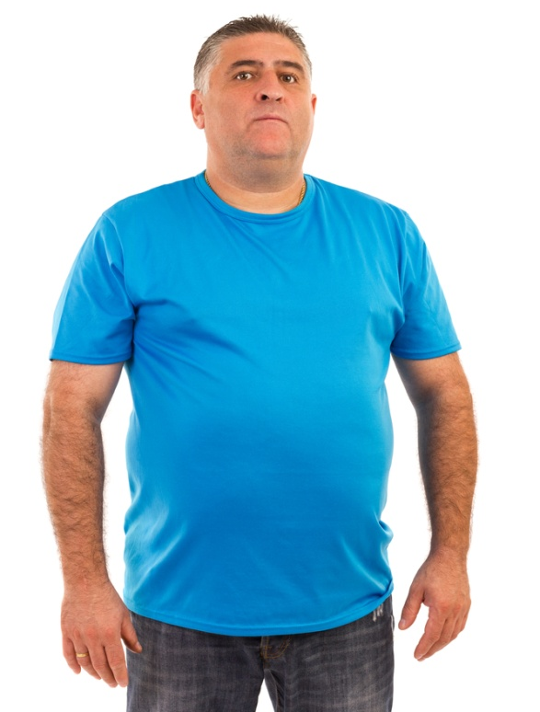
Airway (C-Spine Protection)
Challenges
Short thick necks
Poor extension
Loss of landmarks
Adipose tissue
Fat deposits in pharyngeal tissue
Gastro-esophageal reflux
Backboard weight limits
Increased airway resistance
Notes:
Challenges to assessing and managing the airway while protecting the c-spine in an obese patient may include:
Short thick necks may negate the use of the traditional c-collar
Poor neck extension
Loss of landmarks needed for interventions such as airway adjunct measurements, cricoid pressure, endotracheal intubation
Pharyngeal fat deposits predispose patient to pharyngeal wall collapse during intubation
Supine position causes the weight of the abdomen to press on the diaphragm increasing the risk for aspiration.
Backboard weight limits
Increased body mass leads to decreased functional reserve capacity which rapidly contributes to hypoxia

Slide 13
Airway (C-Spine Protection)
Considerations
Position with head of bed slightly elevated
Use of sandbags and tape for immobilization
Gastric tube insertion
Dedicated member to maintain c-spine control
Early surgical cricothyrotomy
Optical equipment (i.e.: video laryngoscope)
History of gastric banding
Notes:
Considerations to be taken would include:
Elevating the head of the bed slight to assist with manual opening of the airway
Use of sandbags on either side of the head and tape to immobilize the c-spine if the use of a c-collar is not an option
Facilitate early gastric tube placement to prevent aspiration
Use of advanced intubation equipment
Advocating early surgical cricothyrotomy for cuffed endotracheal or tracheotomy tube placement when normal intubation maneuvers are unsuccessful
Surgical cricothyrotomy for cuffed endotracheal or tracheotomy placement may be difficult as well due to loss of landmarks and excessive adipose tissue
If the patient has a known history of gastric banding, band deflation via access port may be needed to prevent aspiration.

Slide 14
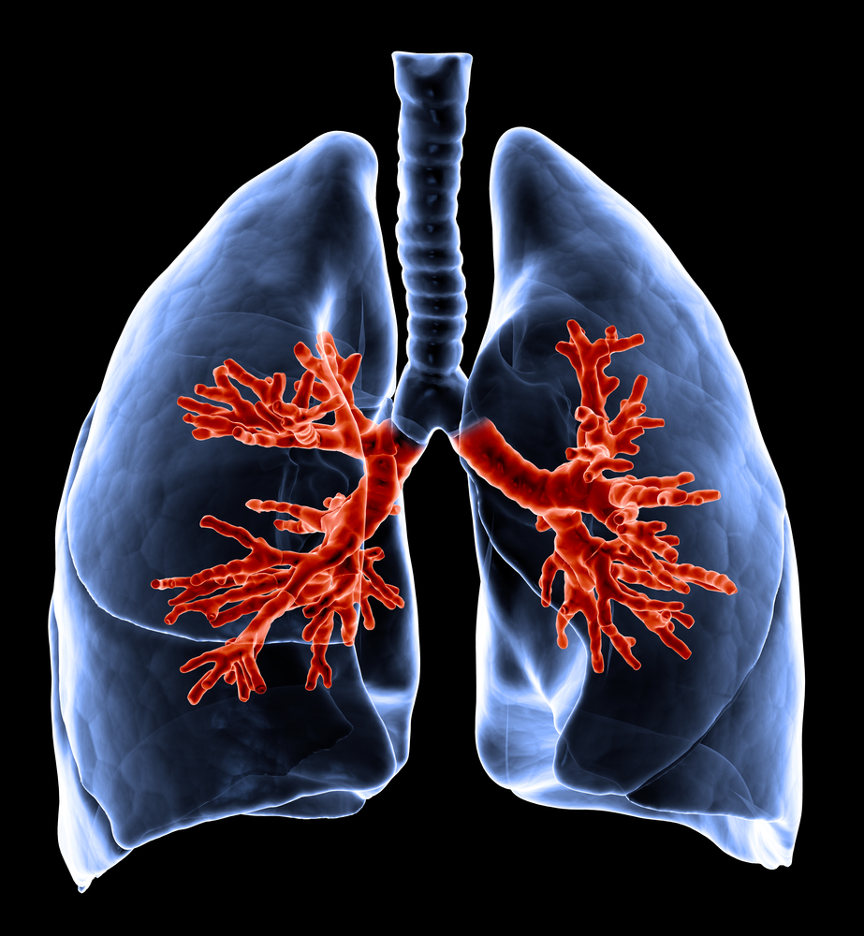
Breathing

Slide 15
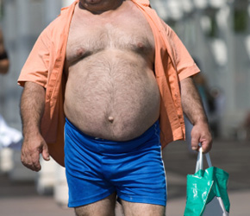
Breathing
Challenges
Fat deposits in diaphragm and intercostal muscles
Elevated diaphragm
Rapid desaturation
Chest weight
Skin folds
Increased work of breathing
Sleep apnea
Impaired lung compliance
Tension pneumothorax
Notes:
Challenges to assessing and managing breathing effectiveness may include:
fat deposits in the diaphragm and intercostal muscles which decrease effective gas exchange
Elevated diaphragm due to enlarged abdomen which affects landmarks
Increase body mass decreases the functional reserve capacity leading to hypoxia. Recovery takes much longer.
Skin folds make auscultation difficult
Increased work of breathing especially in the supine position
Excessive soft tissue makes BMV ventilations more difficult
Sleep apnea which requires consideration of non-invasive positive pressure ventilation
Impaired lung compliance
Effectiveness of adjunct devices is user dependent.
Lack of landmarks and increased adipose tissue complicate needle decompression and chest tube insertion

Slide 16
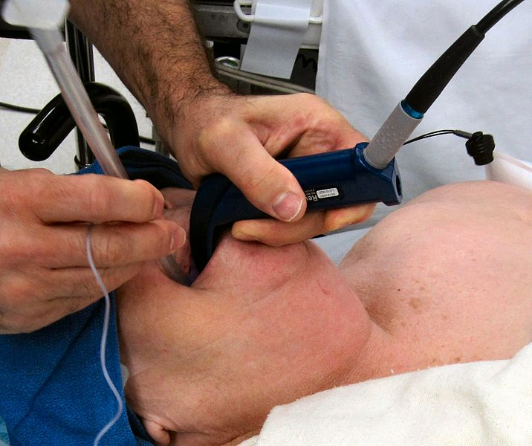
Breathing
Considerations
CPAP
Reverse trendelenburg
Move all skin folds
2-person bag-mask ventilation
Needle decompression/chest tube placement
“Awake” intubation vs.. RSI
Wikimedia.com
Notes:
Considerations to be taken would include:
Use of non-invasive positive pressure ventilations vs.. NRB
Early intubation
Reverse trendelenburg to facilitate lung expansion
Moving all skin folds to facilitate a flat surface for the stethoscope diaphragm
2-person bag-mask ventilation to ensure secure fit and to accommodate the increase intrathoracic pressure created due to the weight of the chest wall and intrabdominal pressure on the diaphragm
Needle decompression landmarks and size needle would be different (needle insertion in the traditional MCL 2nd intercostal space)
Facilitation of “awake” intubation may not be the best option considering the need for patient cooperation and c-spine protection.
Close monitoring of oxygen saturation by monitoring level of consciousness, capnography, BiPap, mental status changes, and restlessness
Breathing may take 2-4 times more effort so tidal volume at 10mL/kg of ideal weight and titer
Anesthesia will make respiratory capability worse due to decreased lung and chest wall compliance
Image is intubation of large patient with a glide scope.

Slide 17
Intubation
Indications
Positioning
Pre-oxygenation
Rapid Sequence Intubation
Ventilator Settings
Alternatives
Notes:
Intubation should be considered early in the assessment to avoid hypoxemia.
Indications for intubation include:
Neck circumference greater than 43 cm
Mallampati classification of III or IV Details on next slide
Limited neck ROM
Prolonged supine positioning increased the risk of hypoxemia due to the increased effort to breath from chest weight and intra-abdominal pressure on the chest cavity limiting movement of the diaphragm.
Positioning for intubation may require significant elevation of the torso to accommodate the horizontal alignment of the external auditory meatus and sternal notch.
Effective pre-oxygenation may be difficult or impossible if performed by one-person. Obtaining a sufficient seal for BVM ventilations may be impossible due to excessive fatty tissue.
Medications may need to be adjusted based on ideal body weight, true body weight, and lean body weight.
Induction agents – LBW
Rocuronium – IBW
Succinylcholine - TBW
Variations in ventilator settings need to be considered to meet the physiological needs of the patient.
Tidal volume based on IBW then titer based on inflation pressures and ABGs
PEEP 10cm/H2O
Challenges to alternatives to endotracheal intubation may be challenging as well. Lack of landmarks and excessive adipose tissue must be considered.
Surgical cricothyrotomy
Tracheostomy
“Awake” intubation
“Awake” intubation may not be an alternative due to patient cooperation and 10
spine protection.

Slide 18
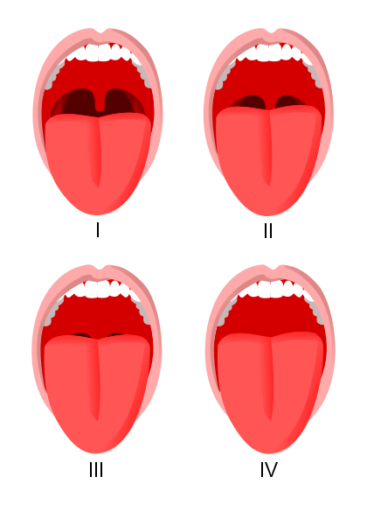
Mallampati Scale
Wikimedia.org
Notes:
A clinical instrument used to assess the ease of obtaining an airway
Class I Visualization of the soft palate, fauces, uvula, and both anterior and posterior pillars
Class II Visualization of the soft palate, fauces, and uvula
Class III Visualization of the soft palate and the base of the uvula
Class IV (difficult) The soft palate is not visible at all

Slide 19
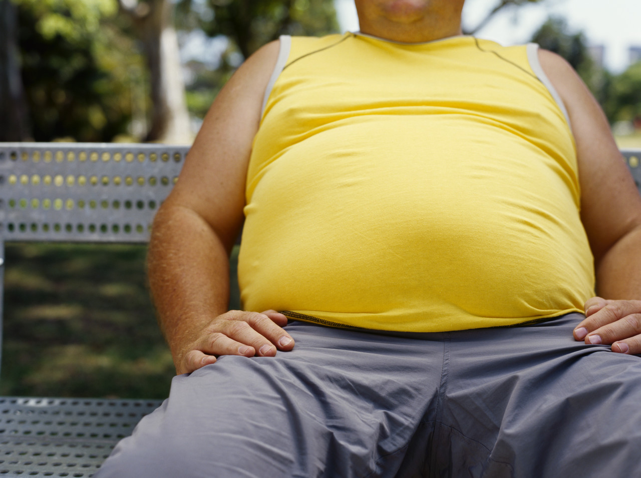
Circulation
Notes:
Evaluation of the Circulatory system for effectiveness can be a challenge.

Slide 20
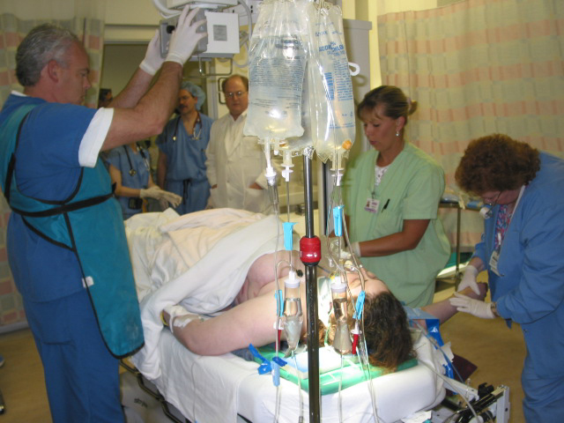
Circulation
Challenges
Adipose tissue
Lacking carotid and femoral pulse landmarks
Non-hypertension state
  Hypertension → CHF
  Normotension may be hypotension
  Pericardial tamponade
Notes:
Challenges to the assessment and interventions may include:
Excessive adipose tissue which hampers the ability to palpate pulses
Lack of landmarks for carotid and femoral pulses
Obese non-hypertensive individual:
Normal heart rate
Increased blood volume
Increased stroke volume
Increased cardiac output
Increased left ventricular volume
Decreased systemic vascular resistance
**hypertension augments the above resulting in CHF….thus rapid volume replacement is poorly tolerated (similar to geriatric trauma patients)
Normotensive blood pressure may be indicative of hypotension given the history of hypertension
Identification and treatment of pericardial tamponade may be challenging due to lost landmarks and thickness of fat tissues

Slide 21
Circulation
IV Access
Monitoring
Cardio-vascular Assessment
Considerations
Notes:
Considerations may include:
IV access
Use of 2” peripheral IV needles for IVF infusions and
6” spinal needles for Pericardiocentesis
Early central line insertion due to failure to secure peripheral access
Cutdowns
IO
Ultrasound assistance with line placemen
Increased awareness of the need for sterile line insertion because of skin folds
Monitoring
Early hemodynamic monitoring for cardiac response to volume resuscitation (a-line, CVP)
Close monitoring of rapid volume resuscitation
Non-aggressive volume challenges
Cardiovascular Assessment
Mark locations of pulses for future reference
Heart sounds can be best heard at:
the left lateral chest wall with the patient turned on their left side OR
over the aortic or pulmonic areas of the left or right sternal border at the second intercostal space
Other
DPL replaced with exploratory laparotomy

Slide 22
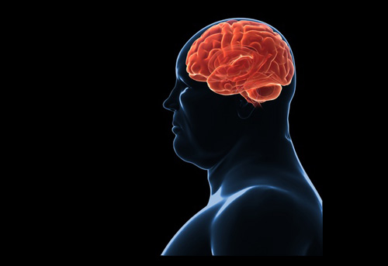
Disability
Notes:
Neurological assessment can be difficult.

Slide 23
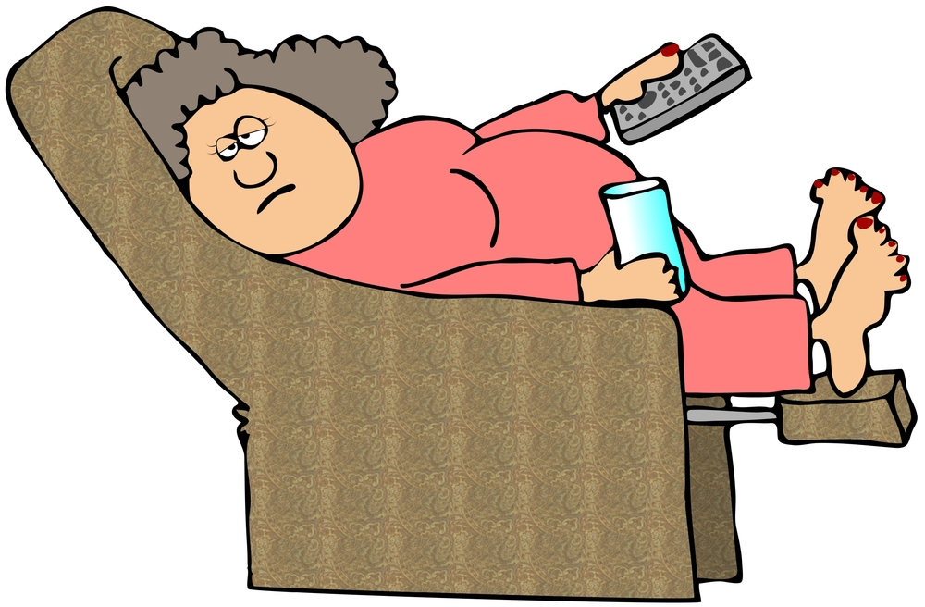
Disability
Challenges
Sleep apnea → somnolence
Difficult to determine GCS
Lack of mobility
Airway problems with less neurological impairment
Notes:
Challenges to determining an obese trauma patient’s neurological status may be due to underlying:
Sleep apnea leads to daytime somnolence resulting in falling asleep mid sentence (is this new or normal?)
Mobility limitations on the supine position may make determining the “best” motor response a bit difficult. Literature suggests assessment of symmetry may be more valuable. Asymmetry would warrant future investigation.
Ongoing monitoring of neurological status is essential to maintaining airway patency and breathing effectiveness. A small increase in neurological impairment may lead to a rapid loss of airway and breathing.

Slide 24
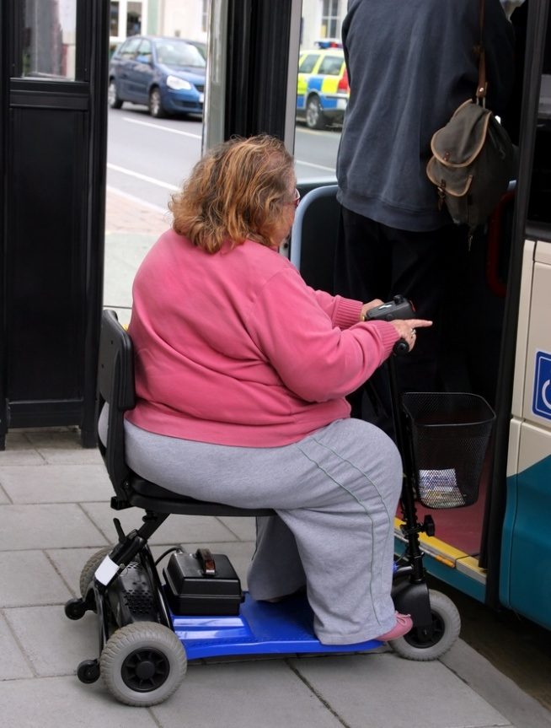
Disability
Considerations
Close monitoring of GCS
Early discharge planning
Establish baseline
marilyn barbone / Shutterstock.com
Notes:
Neurological disability assessment and management considerations would include:
Close monitoring of GCS and motor symmetry
What is the weight limit on your CT scanner, your MRI?
Discharge planning
Documenting ADL and ability to ambulate
What is the level of activity that he is normally involve in?
Is he able to stand?
Is he able to walk?
When was the last time that he walked around his home?
What aids to ambulation does the person use?

Slide 25
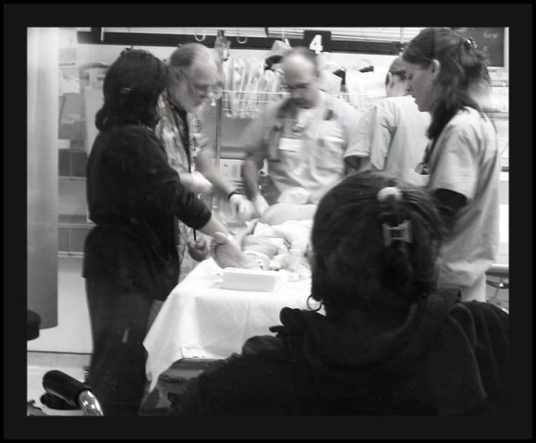
Exposure/Environment
Notes:
Exposure and environmental controls are essential to an accurate assessment.

Slide 26
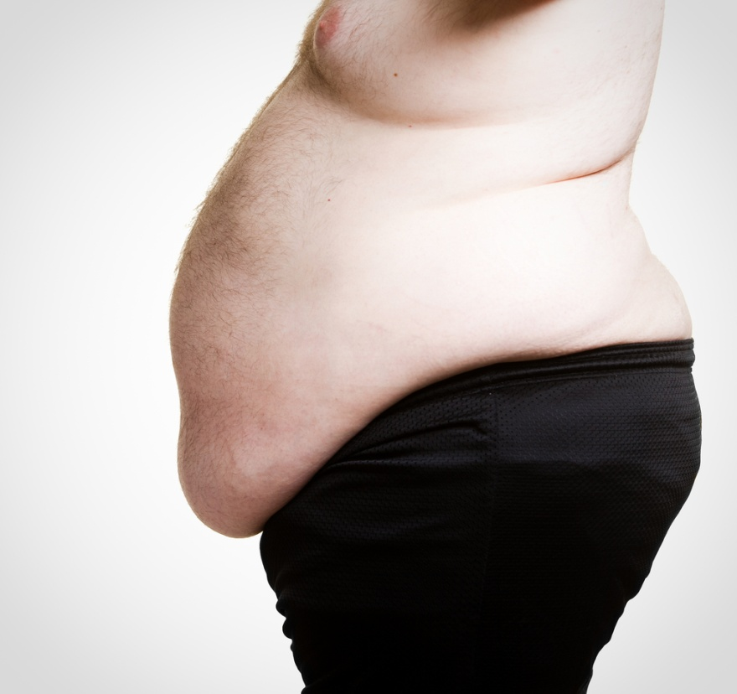
Exposure/Environment
Challenges
Skin shearing
Hypothermia
Longer entrapment times
Inspect for skin rashes, fungal infections, decubitus, wounds
Large pannus
Notes:
Removing clothing may cause skin sheering due to the weight of the body and pulling associated with clothing removal. Obese patients are prone to skin tears and breakdown.
With the increased surface area, the obese trauma patient is at risk for hypothermia. Hypothermia should be avoided as early as possible to prevent anti-coagulation processes.
Exposure to the environment may be a consideration due to longer extrication times due to the size and habitus of the patient’s body and difficulty in safely removing the patient.
Skin folds need to be examined for retained objects, fungal infections, wounds, and skin breakdown.
Large pannus may complicate the assessment and palpation of the abdomen and/or pulses. It is also a site for potential uncontrolled internal bleeding.

Slide 27
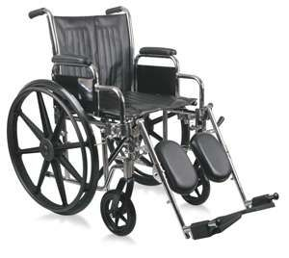
Exposure/Environment
Considerations
Larger patient gowns
Moving boards
Assistance
Stretchers/beds
Notes:
Special equipment and clothing may be needed to safely move the patient while minimizing exposure.
Use of additional personnel may also be needed to safely move and/or transport the patient.
Where do you get supplies and equipment? Do you have on site? Do you have to call a vendor?

Slide 28
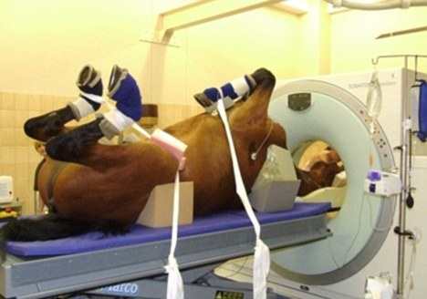
Primary Survey Adjuncts
Considerations
Penetration
Weight limits
Transport
Notes:
Routine exams and diagnostic studies are essential. However, they may be more difficult and may be limited due to patient size and weight.
Excess adipose tissue will require deeper penetration of x-rays to get an adequate CXR.
Weight and size limits may prohibit use of the CT scanner or MRI. Image is of CT scanner at zoo. (Due to rapidly growing epidemic of obesity, ED facilities and Trauma Centers rely on local zoos and/or veterinarian facilities to obtain CT images of patients with BMI greater than 40 kg/m2)
Safe transport of the obese patient must be considered. Additional staff and use of moving boards may be required to transport and transfer the patient for diagnostic studies.
Diagnostic peritoneal lavage and FAST may be difficult to perform due to the loss of anatomic landmarks needed.

Slide 29
Secondary Survey
Challenges
Large arms
ECG variations
  Low QRS voltage
  leftward shift of P wave,
  QRS wave, T wave axes
  Left ventricular hypertrophy
  Left atrial abnormalities
Thick fingers
Abdominal weight
Notes:
Patient size creates challenges and may alter the accuracy of vital signs.
Blood pressure cuffs may not be large enough resulting in inaccurate readings.
Landmarks for cardiac monitor pads may alter the accuracy of the cardiac strips.
The increase thickness of the finger pads can alter the reading of pulse oximeters.
The weight of the abdominal skin places the patient at increased risk for aspiration when in a supine position and cause urinary incontinences. Early insertion of gastric tube and urinary catheter need to be considered.

Slide 30
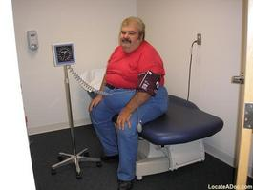
Secondary Survey
Considerations
Normotension may be hypotension
Mark cardiac probes
Pulse ox probe to earlobe
Need for gastric tube
Need for urinary catheter
Large BP cuff or CVP
Nosocomial infections
Use of doppler
Notes:
Considerations when caring for the obese patient:
Normotension may be “hypotension” for the obese patient
Marking the location of cardiac probes will assist to ensure probes are places in consistent areas
Pulse oximetry probes may need to be placed on the earlobe for a more accurate reading
Early gastric tube to prevent aspiration
Early insertion of urinary tube to ensure accurate readings of output and prevent incontinence
Use of size appropriate cuffs and lines. Transferring the patient with size-appropriate equipment
Increased awareness of potential sources of nosocomial infections to reduce morbidity.
Use of doppler to identify pulses.

Slide 31
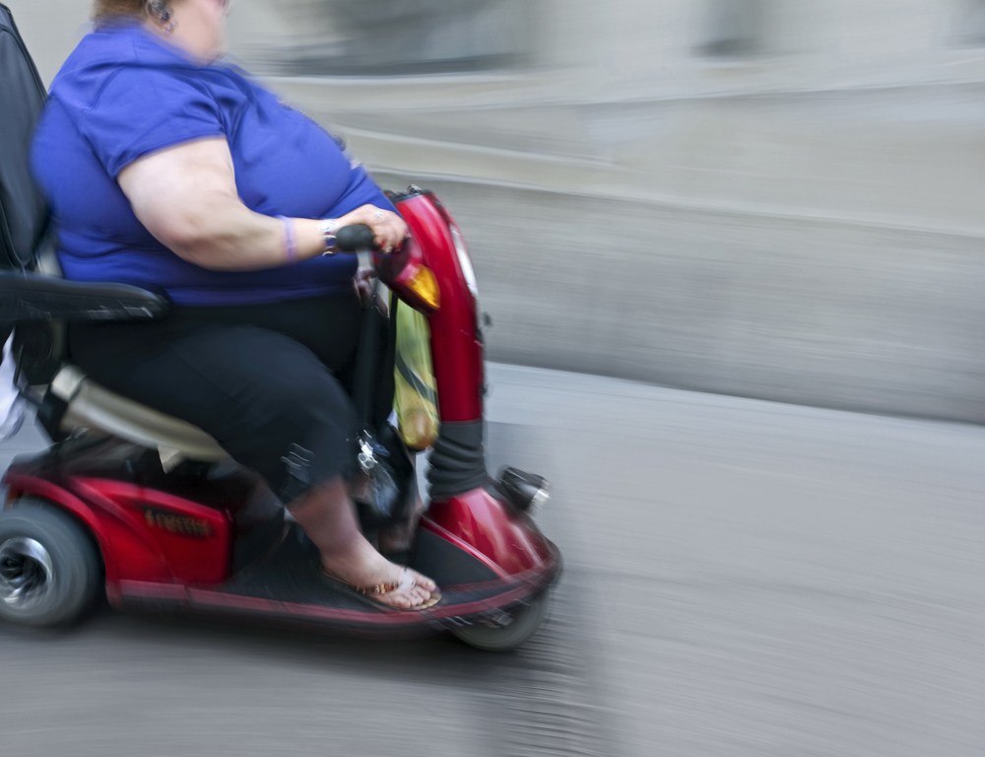
Give Comfort
Challenges
Patient size
Bias
Stigma
Psychosocial issues
Notes:
The size of the patient may require larger splints be used to stabilize fracture sites.
Placement of splints may require additional staff.
Checking and marking pulses are critical to proper splint placement and can be difficult with the obese patient.
In situations where appropriate sized equipment may not be available and/or additional staff is needed to apply splints, the compromising position the patient is placed in can effect their ability to adjust to the situation.
Issues with depression, low self esteem, anger

Slide 32
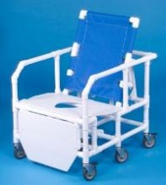
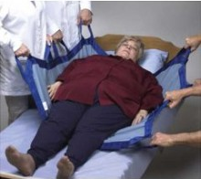
Give Comfort
Considerations
Addressing bias may be first step to improving outcomes
Medication doses
Specialized beds and equipment
Notes:
Healthcare provider bias and comments hamper effective patient care. It is important the healthcare provider recognizes their bias and is able to control it when caring for the obese trauma patient.
Pain medication doses may need to be examined to determine if it is weight dependent and providing adequate effects. Pain medication always needs to be administered IV not subcutaneously or intramuscular due to absorption rate concerns.
Equipment and bedding need to be specifically examined to ensure patient safety.
Also healthcare providers must think about personal safety when moving obese patients.

Slide 33
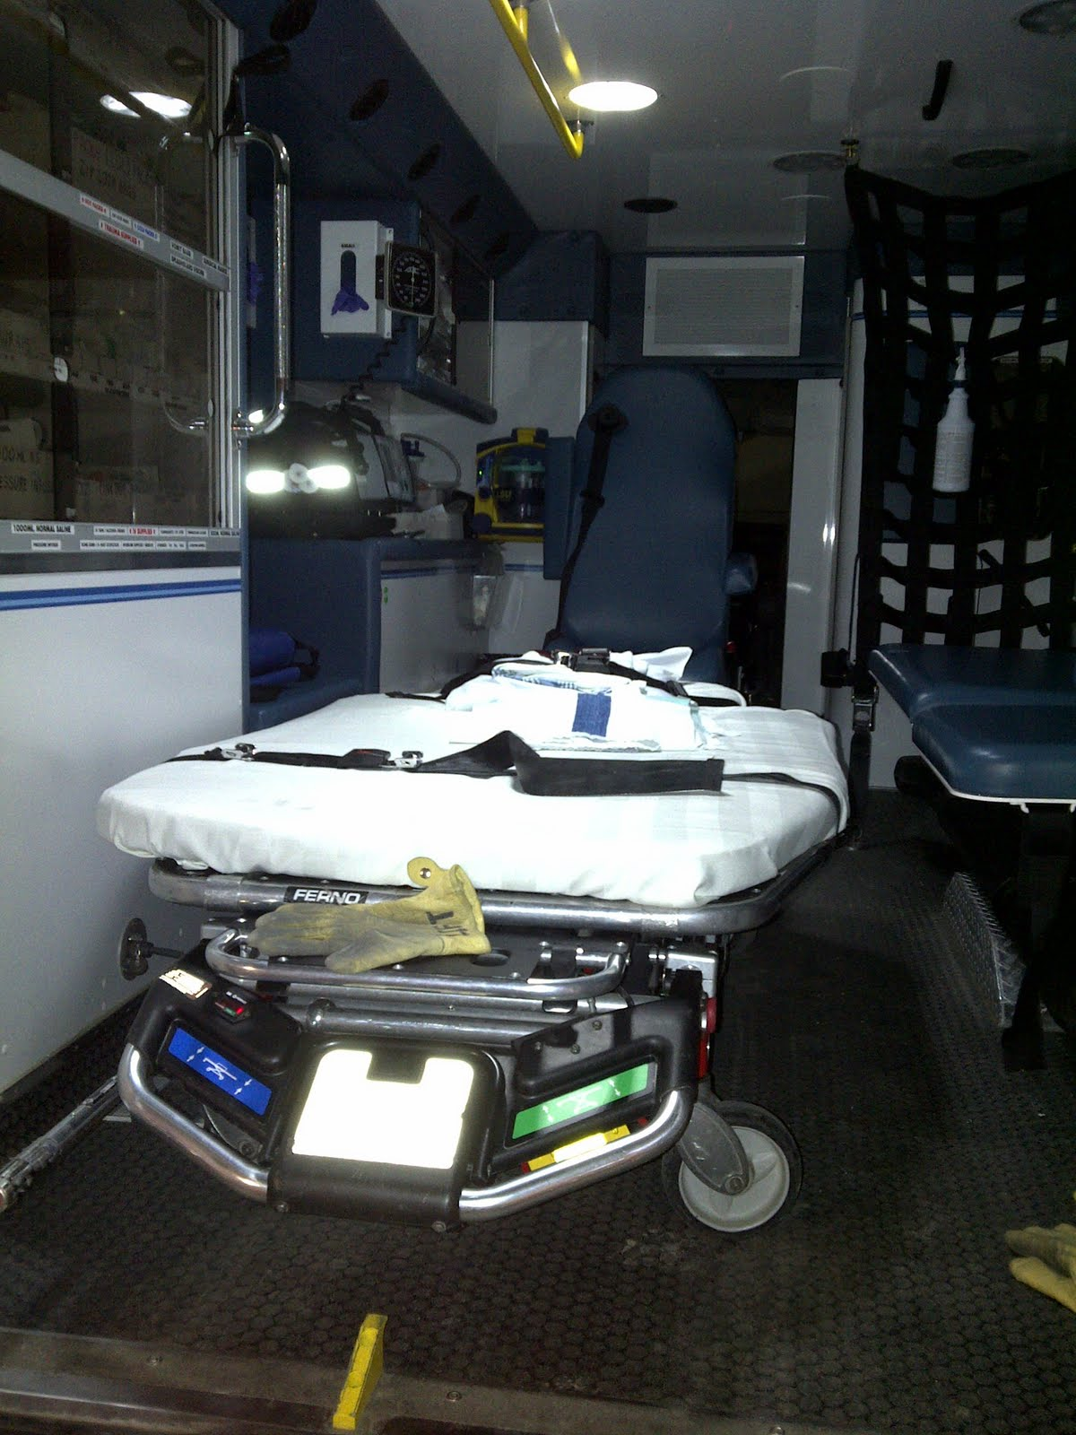
Inspect Posterior Surfaces
Challenges
Number of people needed to log roll
Patient safety
Bed width
Skin folds
Considerations
Additional staff
Interlock beds
Notes:
Challenges will include:
Need for additional staff to ensure patient safety
Consideration of the bed/stretcher width to accommodate logrolling the patient.
Moving skin folds to appropriately auscultate, palpate, and inspection the posterior surfaces.

Slide 34

Caveats
Disposition
Post-Operative Care
Missed Injuries
Fractures
Morbidity
Mortality
Pharmacology
Consultations
Notes:
The image denotes how hard and frustrating it can be to care for a morbidly obese patient.
Let’s look at some caveats to caring related to:
Disposition
Post-operative care
Missed injuries
Fractures
Morbidity
Mortality
Pharmacological considerations
Consultations

Slide 35
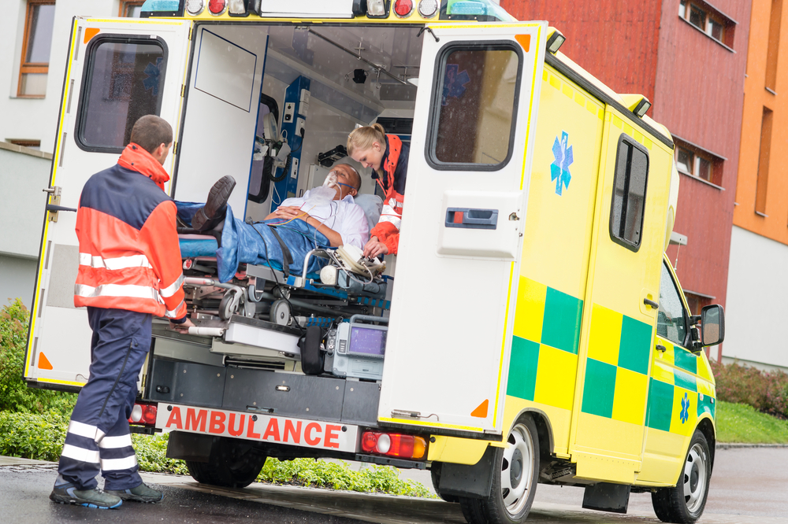
Disposition
Decide early
Interfacility transfers
Intrafacility transfers
Notes:
Patient disposition needs to be determined as early as possible in order to facilitate quick transfer and definitive care.
Interfacility transfer of patients will require coordination with the transporting agency to accommodate the size of the patient. Special equipment and/or additional personnel may be required to safely move the injured patient.
Intrafacility transfer of patients may require coordination of care with the various support services and receiving department.
For the patient going to the OR, additional staff may be needed to properly position the patient. Access to special equipment will need to be secured and moved as quickly as possible. Intubation equipment may need to be gathered.
For the ICU and/or floors, equipment such as beds, lifting equipment, bedside commodes, etc. will need to be identified and secured. Additional staff will be needed to move the patient routinely.

Slide 36
Post Op Care
Wound
Infection
Skin
Nutrition
Metabolic
LOS
Notes:
Post operative care is centered around the understanding that wound healing will take longer which places the patient at a higher risk for infections and sepsis. Limited mobility and injuries increases the likelihood of decubitus ulcers. Length of stay and ventilator time must be anticipated.
Wound dehiscence
Inability to close abdomen
Sepsis
Decubitus ulcers
Increased wound infection
Negative nitrogen balance
Decrease serum albumin
Malnutrition
Slow clearance of lactic acid
Increased LOS
Increased vent time
Glucose monitoring

Slide 37
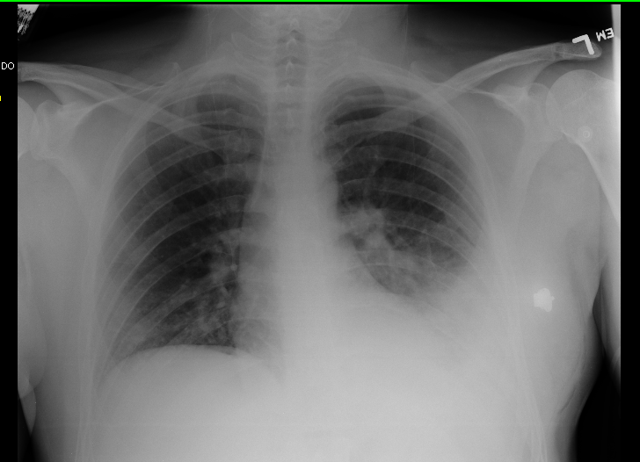
Missed Injuries
Sternal fractures
Flail chest
Pelvic fractures
Rib fractures
Pulmonary contusions
Notes:
Injuries to the chest and abdomen are difficult to assessment and diagnose due to increased adipose tissue, enlarged abdominal cavities, and poor ventilatory compliance. Most commonly missed injuries are:
Sternal fractures
Flail chest
Pelvic fractures
Rib fractures
And pulmonary contusions Note pulmonary contusion on left in the x-ray.

Slide 38
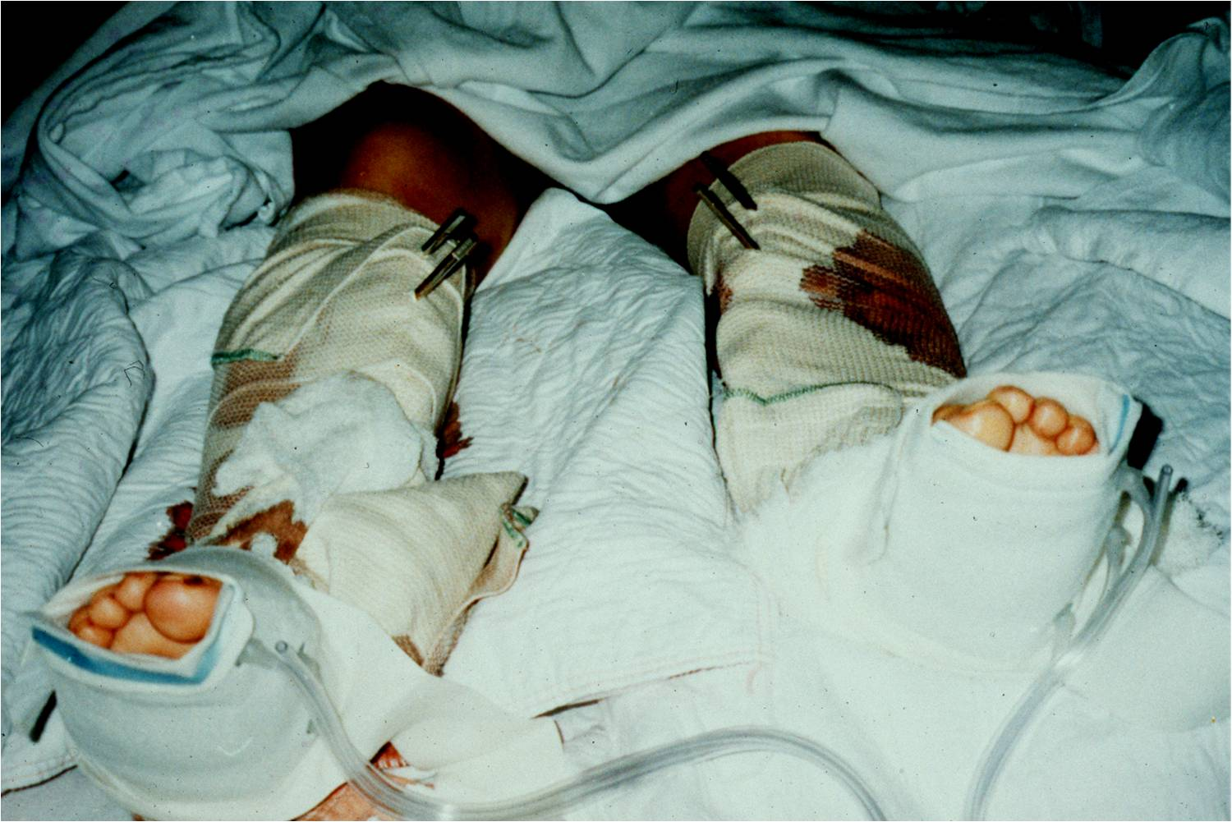
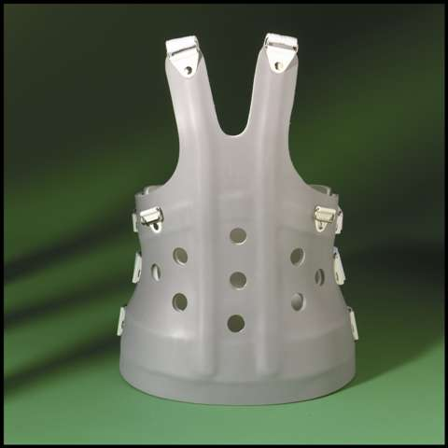
Fractures
Strength of rods
Compartment Syndrome
Casting more difficult
TLSO
Notes:
Treatment of fractures and post-operative care need to consider:
Use of stronger rods for lower extremity and pelvis injuries
Increase suspicion for compartment syndrome given the increase adipose tissue
Recognition that casting of larger extremities can be more difficult and require additional staff and closer monitoring.
TLSO usage may not be considered due to abdominal girth and increased limited mobility.

Slide 39
Morbidity and Mortality
Morbidity
Mortality
Lack of primary care
Isolation
Non-compliance
Multisystem organ failure
Traumatic brain injury
Cardiac failure
Respiratory arrest
Pulmonary embolism
Notes:
The patient’s health condition prior to the injury must be considered. Lack of primary care could be related to the patient’s inability to physically seek medical attention. As a result the patient may not be aware of co-morbidities.
Non-compliance may be a factor in cases of known health problems.
Mortality from traumatic injuries is higher in the obese patient as compared to the non-obese trauma patient. The rate is as high as 8%. Causes for death include :
Multisystem organ failure
Traumatic brain injury
Cardiac failure
Respiratory arrest
Pulmonary embolism

Slide 40
Pharmacology
Drug effect considerations:
  Distribution
  Renal clearance
  Hepatic metabolism
  Protein binding
Dose weight (DV)
Ideal body weight (IBW) ;Total body weight (TBW)
  DW = IBW + 0.3 (TBW – IBW)
  Common drugs
  Antibiotics
  Anti-thrombotics
  Pain control
Notes:
An understanding of the impact obesity has on pharmacological principles is essential for the healthcare provider. Drug effect MAY be altered due to:
Change in volume of distribution
Renal clearance
Hepatic metabolism
Protein binding
Underlying disease
Dosage may need to weight-based:
Dose weight (DW) = Ideal body weight (IBW) + 0.3 (total body weight – IBW)

Slide 41

Consultations
Consultations
  Nutrition
  Pharm D
  Primary care providers
  Case management
  Social work
  Sleep apnea
Notes:
Early nutrition consults are vital to facilitating wound healing.
Primary care providers may be consulted to assist with identification and managing underlying co-morbidities.
Discharge planning needs to begin upon arrival. Equipment and resources the obese patient will need at discharge may take time to identify and secure.
Sleep apnea testing may be needed to ensure adequate ventilatory support once the patient leaves the hospital.

Slide 42
Management:
Blunt Trauma TBI
Higher Mortality
Fewer Head Injuries
Cushion Effect
More Compli-cations
Notes:
Overall, obese suffer more complications (including TBI) vs. non-obese in severe blunt trauma. What are some potential pathophysiological causes of increased complications in the obese secondary to TBI? Ask what these complications may be; DVT? PE? Pneumonia? Decubiti? Wound infection?
Obese TBI Patient:
Tend to be older >45 y/o
Tend to have lower admission blood pressure 125 +/- 38
Head injuries tend to occur less frequently in this demographic.
Some research suggest the obese have higher propensity for head injuries vs. chest injuries in severe high-speed crashes secondary to the 'Cushion Effect'.
Higher mortality vs.. lean patients Ask why this may be so? Does it relate to the complications?
Higher mortality associated with adverse effects not with obesity
No difference in need for craniotomy

Slide 43
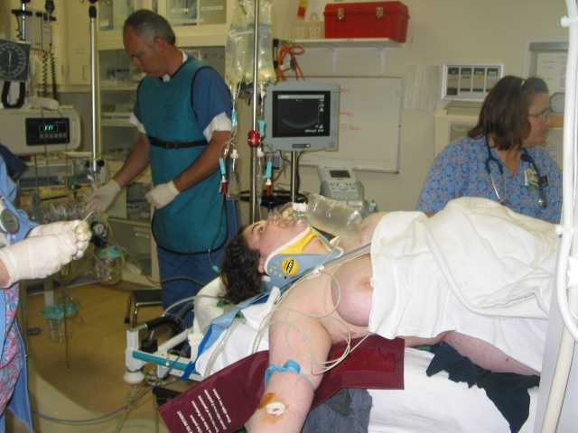
Management: Blunt Trauma
Chest
  Higher incidence of chest injuries
  Incidence of thoracotomy similar to lean counterparts
  Obesity-related injuries: [not found in lean]
Notes:
Higher incidence of chest injuries
33% higher incidence of thoracic trauma [frontal impacts]
Higher incidence in male and older obese patients w/ thoracic injuries
Thoracic injury higher for unbelted obese vs.. belted
Incidence of thoracotomy similar to lean counterparts
Obesity-related injuries: [not found in lean]
Major laceration thoracic aorta
Multiple cardiac lacerations
Bilateral flail chest

Slide 44
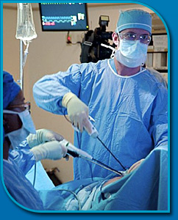
Management: Blunt Trauma
Abdomen
  Ultrasonography
  Damage Control Laparotomy (DCL)
  Laparoscopic Abdominal Repair
  “Cushion Effect”
  DPL
Notes:
Ultrasonography – limited visualization due to SQ abdominal fat
Excessive subcutaneous gas in abdominal fat limits views
The image is of diagnostic laparoscopy
Damage Control Laparotomy (DCL) – extended time to definitive closure vs.. lean counterparts
Laparoscopic Abdominal Repair – limited due to visualization and access secondary to increased abdominal fat
More likely repair open laparotomy
“Cushion Effect” – there is evidence that excess abdominal fat decreases maximal Abbreviated Injury Score (mAIS) in blunt trauma
More likely to require DPL due inability to obtain abdominal CT scanning with body weight > 450lbs

Slide 45
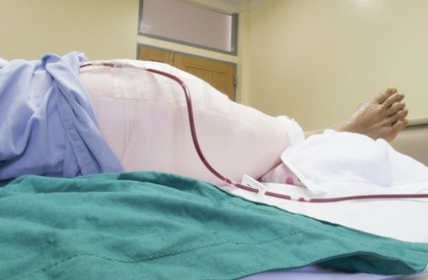
Management: Blunt Trauma
Notes:
MVC –related obese have greater % lower extremity injuries
Slightly higher incidence of pelvic fracture
Lower incidence cervical, thoracic and lumbar fractures
Slightly higher incidence of upper extremity fractures
Overall overwhelming incidence of lower extremity fractures
Image is post op total hip patient.

Slide 46
Management: Blunt Trauma
Musculoskeletal
  High-speed side impact MVC
    Obese less likely to sustain severe pelvic fractures vs.. lean counterparts
  Pelvic Fracture Operative Repair
    Complications
      19% Lean patients
      39% Obese patients
    Return to OR following initial operative repair
      16% Lean groups
      31% Obese groups
Notes:
Obese less likely to be ejected secondary to body habitus and inability to be ejected through windows.
Many pelvic repair operations are delayed in the obese secondary to limitations of OR due to size of the patient and lack of OR beds and equipment to accommodate obese patients.
What are some reasons the obese may require return OR trips for pelvic repair?

Slide 47
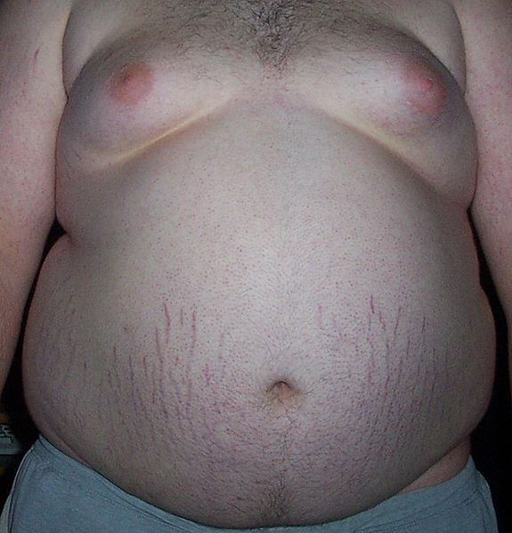
Management: Blunt Trauma
Spinal Cord/ Vertebral Column
  Literature suggest obese less likely to sustain column or cord injuries
Wikimedia.org
Notes:
Thought to be result of “Cushion Effect”
Increased abdominal fat may act as a cushion
Less likely to be ejected vs.. lean counterparts in MVC
Therefore, lower propensity for column injuries

Slide 48
Management: Blunt Trauma
Complications
  Overall obese patient 42% higher complication rate vs.. 32% lean population
  Require slightly higher total hospital LOS (24 vs.. 19 days)
  Higher ICU LOS (13 vs.. 10 days)
  Slightly higher ventilator days > 2 days vs.. lean
  No difference in incidence of pulmonary complications

Slide 49
Management: Blunt Trauma
Complications
  NIH / WHO: Obese vs.. Lean Severe Trauma
    Increased ICU LOS
    Increased propensity of:
      Cardiac arrest
      Acute Renal Failure
      Multisystem Organ Failure
    No difference in initial leukocyte inflammatory response
    However, resolution of initial inflammatory response appears to be lengthened in the obese population

Slide 50
Management: Penetrating Trauma
Current Clinical issues
  Similar to blunt trauma management
  Challenges related to body habitus similarly associated in blunt trauma
    Prohibitory radiological imaging due to body habitus
    Airway control in obese patient
    Prohibitive diagnostic ability (i.e. ultrasound, radiological imaging, laparoscopic intervention) all due to body habitus

Slide 51
Management: Burns
Increased surface area
Increased LOS
Increased complications
Notes:
Obese more likely to suffer a high-risk anatomic area (72% vs.. 60%)
LOS for burned obese patient significantly higher (9.3d vs.. 7.1)
Burn complications in Obese:
More frequent OR debridement
Higher rates of infection
Slower healing rates of affected areas
Greater permanent functional impairment

Slide 52
Summary
Obesity is an increasing epidemic
There are special physiological, social and emotional considerations in caring for critically injured patients that healthcare providers must understand
Intervention measures specific to the management of critically injured patients is paramount to optimal outcomes

