Slide 2
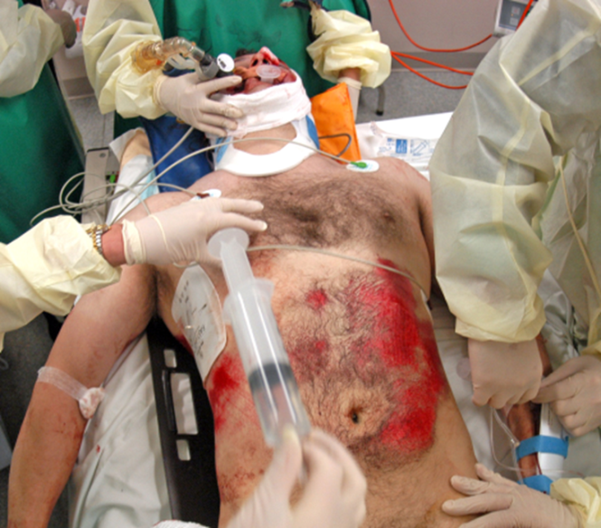
Abdominal Injuries

Slide 3
Objectives
At the conclusion of this presentation the participant will be able to:
  Describe common mechanisms of injury seen in abdominal trauma
  Discuss various injuries of the abdomen
  State appropriate assessment and diagnostic studies for the patient with abdominal trauma
  Describe abdominal compartment syndrome and the importance of its early recognition
Notes:
The abdomen contains numerous organs and related structures that can be injured. It is beyond the scope of the presentation to provide in-depth review of each potential injury and its detailed evaluation and surgical management, however, the most common injuries will be discussed as an overview with key points noted.
Note the objectives.

Slide 4
Epidemiology
Incidence
  Abdominal injuries rank 3rd as a cause of death
  Account for 13% to 15% of trauma deaths
  Seldom a single system injury
Notes:
Abdominal trauma ranks 3rd as a cause of death and is preceded only by head and chest injuries.
Death is primarily a result of hemorrhage, however, after 48 hours, sepsis and complications lead to higher incidence of morbidity and mortality.
Usually it is accompanied by other injuries and this leads to an increase in morbidity and mortality.
Whether it is the acute injury of the complication of the injury, the failure to diagnose and treat early increases the morbidity and mortality.

Slide 5
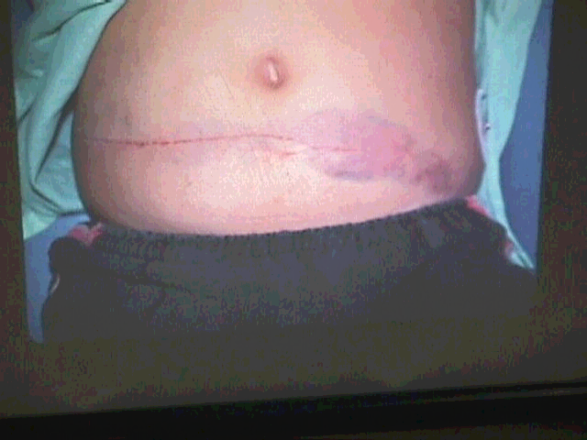
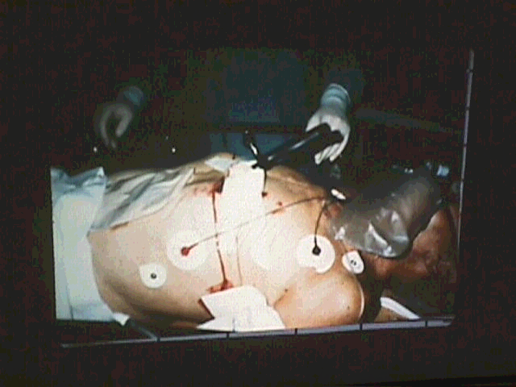
Mechanism of Injury
Blunt
Penetrating
Notes:
Abdominal injuries are divided into two broad categories based on the mechanism of injury, blunt and penetrating.
Blunt trauma is the most common injury pattern with motor vehicle crashes being the most common mechanism accounting for approximately 75%.
Diagnosing blunt abdominal trauma can be very challenging. It is often difficult to make a definitive diagnosis especially when there are either multiple organ injuries, competing injuries, and/or altered mental status from head injury or alcohol/drug intoxication that may cloud the clinician’s assessment. Regardless, the symptomology is often subtle and may gradually progress, necessitating serial assessment and alterations to the plan of care. Unrecognized, abdominal trauma is a frequent cause of preventable death.

Slide 6
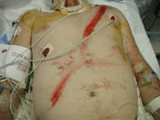
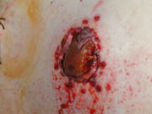
Mechanism of Injury
Heightens suspicion for certain injuries
Blunt injury and types of forces
Use of restraint devices
Penetrating trauma
Notes:
Acceleration and deceleration injuries are self explanatory.
Blunt forces compressing anteriorly on the abdomen compress the abdominal viscera against the posterior rib cage or vertebral column causes crushing type injuries. Solid organs are most susceptible to this mechanism.
Shearing forces caused by sudden deceleration can result in lacerations to both solid and hollow organs. These forces may also cause “stretch” injuries resulting in some intimal vessel tears with subsequent organ infarction.
The use of safety belts and air bags has helped decrease injuries and fatalities, but it cannot totally eliminate them.
The seat belt “sign” indicates intra-abdominal injury in about one third of patients.
Classic seat belt injuries include abdominal wall disruption, hollow viscus injuries, and flexion-distraction fracture of the lumbar vertebrae (Chance fracture).
Penetrating injuries result from stab, impalement, or missile incident.
The degree of penetration may be estimated by the length of the stabbing instrument.
Impalement injuries result in a higher mortality as they are considered a dirty wound and result in bacterial contamination leading to multiple organ involvement.
Missile injuries are difficult to assess, and it must be noted that the appearance of the wound may not compare to the magnitude of the destruction caused by a bullet. Bullets may ricochet off organs or bones and move throughout the body.
Hemorrhage and hollow viscus injuries with resultant chemical and bacterial peritonitis must be considered and promptly treated.

Slide 7
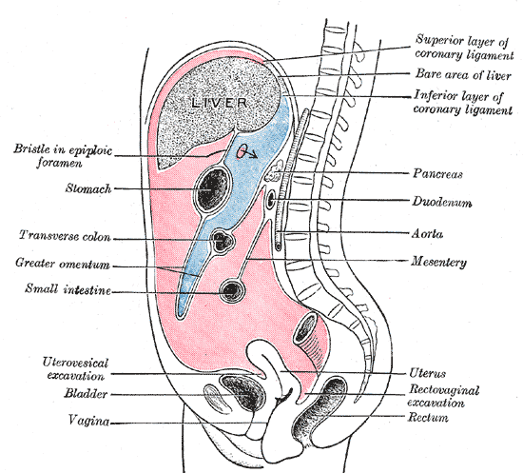
Anatomy and Physiology
Diaphragm
Abdominal and Iliac Muscles
Vertebral Column
Pelvis
Notes:
In review, the abdomen can be described as a contained structure that is bordered superiorly by the diaphragm, inferiorly by the pelvis, posteriorly by the vertebral column and anteriorly by the abdominal and iliac muscles.
Peritoneal Cavity Retroperitoneum
Stomach Ascending and descending colon
Liver Small intestine Gallbladder Kidneys
Spleen Pancreas
Transverse Colon Adrenal glands
Sigmoid Colon Aorta
Upper third of rectum Vena cava
Uterus in women Part of duodenum
Major vessels
The basic divisions include those structures located within the peritoneal cavity and those located within the retroperitoneum.
Injury to abdominal organs, especially those in the retroperitoneal space, can bleed as the space can hold a great deal of blood, up to four liters. Solid organs, such as the liver and spleen bleed profusely as do the major abdominal blood vessels, the aorta and vena cava.
Injury to hollow organs such as the stomach and bowel presents a serious risk of infection, especially if there is a delay in diagnosis.
One or more of the intra-abdominal organs may be injured in abdominal trauma given the close proximity and the typical associated pattern of injury.
Note: As part of the review, the esophagus has been mentioned as it passes through the diaphragm connecting to the stomach, however, it is also covered in the neck module. Genitourinary injuries are covered in a separate session and will not be addressed.

Slide 8
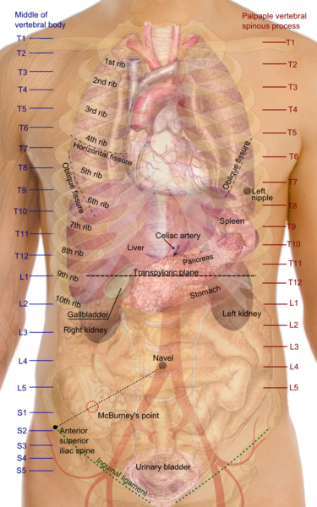
Notes:
There are four key abdominal sections with their related structures. Review anatomy on diagram.
The first section is the intrathoracic abdomen, or the portion of the upper abdomen that lies beneath the rib cage which makes the area inaccessible to palpate. Its contents include the diaphragm, liver, spleen, and stomach..
The second is the pelvic abdomen and is defined by the bony pelvis. Its contents include the urinary bladder, urethra, rectum, small intestine, and, in females, ovaries, fallopian tubes, and uterus. If injury occurs to these structures, diagnosis may be difficult as they are extraperitoneal in nature.
The third is the retroperitoneal abdomen containing the kidneys, ureters, pancreas, aorta, and vena cava. The findings on physical exam do not reveal specific injuries to these structures, and evaluation of the structures in this region may require radiologic tests to include computed tomography (CT) scanning and angiography.
The fourth is the “true” abdomen, which contains the small and large intestines, the uterus (if gravid), and the bladder (when distended). Perforation of these organs is associated with physical findings, and the patient usually complains of pain and tenderness from peritonitis.
Author released diagram into the public domain and grants anyone the right to use this work for any purpose, without any conditions, unless such conditions are required by law.

Slide 9
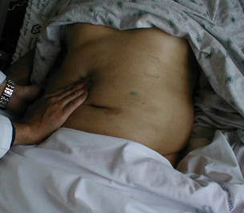

Abdominal Assessment
Inspection
Auscultation
Percussion
Palpation
Notes:
The appearance of the abdomen should be described with any abnormalities noted to include size, shape, and location. The back and flank areas should be included in the evaluation.
During the resuscitative phase, auscultation is difficult due to the noise level in the resuscitation room. This can be controlled somewhat with an organized team leader, both physician and nursing. Auscultation may be performed before percussion and palpation because vigorously touching the abdomen may disturb the intestines, and perhaps alter their activity and as a result, the bowel sounds. Serial auscultations that reveal absence of bowel sounds may indicate an ileus or peritonitis.
Percussion is rarely used in the resuscitative phase, however, the presence of air is indicated by tympanic sounds as found in hollow or air filled organs whereas a dull sound is elicited over abdominal solid organs or space filled with blood. Tenderness on percussion constitutes a peritoneal sign and mandates further evaluation.
To evaluate abdominal tenderness, all four quadrants are assessed using light to deep palpation. Guarding, distention, and signs of peritoneal irritation can indicate organ rupture. Kehr’s sign, pain in the left shoulder, secondary to irritation of the diaphragm via the phrenic nerve from a ruptured spleen is a common example of “referred pain”.

Slide 10

Four Quadrants
Right upper quadrant (RUQ)
Left upper quadrant (LUQ)
Right lower quadrant (RLQ)
Left lower quadrant (LLQ)
Notes:
For ease of examination and consistency in documentation, the abdomen is divided into four common quadrants, different from the previously described four AREAS. Point out the structures in each on the following slides.

Slide 11
RUQ
Liver
Gallbladder with biliary tree
Duodenum
Head of pancreas
Hepatic flexure of colon
LUQ
Stomach
Spleen
Left lobe liver
Left Kidney
Left adrenal gland
Splenic flexure of colon
Parts of transverse and descending colon
Notes:
Review locations

Slide 12
RLQ
Cecum
Appendix
Ascending colon
Right ovary and fallopian tube
Right ureter
LLQ
Descending colon
Sigmoid colon
Left ovary and fallopian tube
Left uterine tube
Notes:
Review Locations

Slide 13
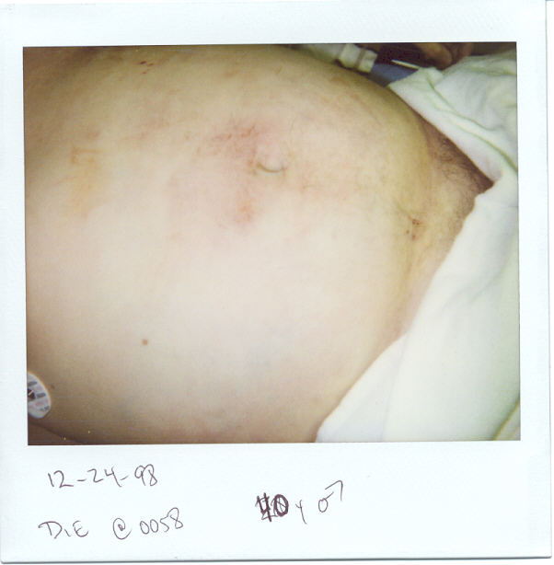
Ongoing Assessment
Delayed diagnosis or missed injuries
Frequent serial and systematic examinations
Tertiary exam
Notes:
The care of the trauma patient is demanding and requires rapid evaluation. This continues to be one of the most challenging and resource intensive aspects of trauma care. Some injuries may not manifest themselves until hours, days, or weeks following the injury, and therefore, repeat assessments are important as some injuries evolve over time.
Missed intra-abdominal injuries are causes of increased morbidity and mortality, especially in patients who survive the initial phase after an injury. The value of frequent serial examinations cannot be stressed enough. Tertiary exams are also important to ensure everything is followed and documented during the hospitalization.
Examples: Development of a chemical ileus secondary to late pancreatic rupture and/or small diaphragmatic tears missed during the initial assessment and/or surgery.
A good example of a complication to watch for is GI bleeding. GI bleeding can result from trauma causing gastric mucosal erosion over time.
Note seatbelt mark on image.

Slide 14
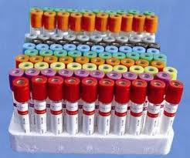
Diagnostic Labs
Are they necessary? Reliable?
Hematocrit
WBC
Electrolytes
Pancreatic enzymes
Liver function tests
Notes:
Another debated issue is that of labs needed in the trauma bay, what is necessary and what is not. What do you need to “ACT UPON” immediately? What labs can be done point of care, and which ones cannot. There are may labs and some that will be done based on local trauma center criteria. The ones noted here are those commonly associated with the abdomen and are is in no way an all inclusive list.
The hematocrit may be useful as a baseline, however, it must be interpreted in the clinical context related to extent of hemorrhage, time of injury, and the amount of fluid resuscitation. The initial hematocrit may be normal or falsely high in consideration of actual blood loss. It is most helpful when it is serially measured and trended.
The WBC is nonspecific and of little value. Elevated WBC count is the body’s normal response to trauma, and this value is of little significance in the acute setting. Epinephrine release may elevate the WBC to 12,000 to 20,000. Solid or hollow viscus injury can cause elevations as well, and serial evaluations noting neutrophilia may indicate an inflammatory process in the peritoneal cavity indicating peritonitis secondary to hollow viscus injury or splenic injury. During later phases of care, an elevated WBC may indicate a wound infection, pulmonary infection, sepsis, etc.
Serum electrolytes, BUN, and creatinine are sometime done for baseline values in patients with significant medical history of hypertension, diabetes and renal disease.

Slide 15
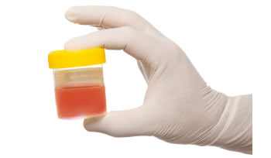
Diagnostic Labs
Coagulation studies
Urinalysis
ABGs
Notes:
Serum amylase and lipase levels alone are not diagnostic as they have poor negative and positive predictive value, meaning normal levels do not exclude pancreatic injury and elevated levels may be caused by extra-abdominal injuries. Routine amylase testing is not recommended in the resuscitation phase and should be individualized.
Serum transaminase may be elevated in liver injuries but does not distinguish between major or minor injury, and it is normally high in patients with co-morbidities such as alcohol induced liver disease.
PT, PTT, and INR are indicated in patients with history of coagulopathy, cirrhosis, or those on anticoagulation therapy. These are also important to monitor in patients receiving massive blood transfusions.
Gross hematuria is suggestive of renal injury, and since microscopic hematuria can be missed by visualization, a microscopic or dipstick urinalysis is recommended for all with blunt abdominal trauma.
Some believe that ABGs can provide most of the information needed early in the resuscitation of a patient. If injured and compensating, a metabolic acidosis will be noted. A moderate base deficit (e.g. more than –6) indicates the need for aggressive resuscitation and determination of the etiology. This is not only impacted by blood loss and the need for resuscitation but can be altered in the elderly and those with alcohol intoxication.

Slide 16
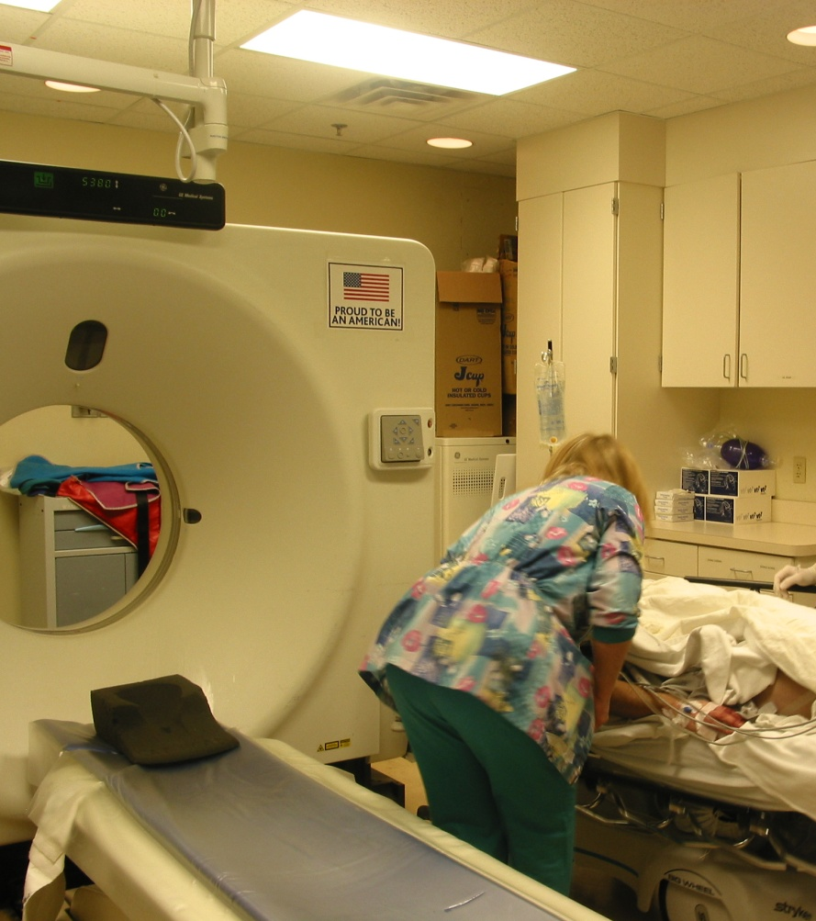
Diagnostic Modalities
Radiographs
Diagnostic peritoneal lavage (DPL)
Ultrasonography (US)
Computed tomography (CT) scan
Angiogram
Diagnostic laparoscopy
Notes:
The goal of initial evaluation is to determine if there is a serious injury that may require immediate operative intervention. We will review each briefly prior to discussing specific injuries.

Slide 17
Radiographic Films
CXR
  Concomitant pulmonary and cardiac injuries Displacement of abdominal organs
Pelvis
Plain abdominal films have limited if any role in the acute resuscitation
  AP and lateral films may identify fluid or air
  Upright film for free air; may disclose ruptured hollow viscus
Notes:
An initial CXR is really the most important tool providing useful info in the early minutes. It will provide valuable information and can identify other major sources of blood loss from injuries in the chest or elevated diaphragm with displacement of abdominal organs.
A pelvic film can be valuable in diagnosing pelvic fractures and determining the need for a pelvic binder, anticipation of blood transfusion, etc, especially, if CT scan is going to be delayed. However, many times the patient is rushed off to CT scan and this is not necessary.
Plain abdominal films have limited value in the acute resuscitation setting, but can reveal free air. This is in the ACUTE first few minutes…And, most patients will not be upright in the first few minutes following trauma.

Slide 18
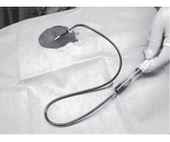
Diagnostic Peritoneal Lavage
Used to diagnose intra-abdominal bleeding
Indications
  Unexplained hypotension, decreased hematocrit, or shock
  CT or ultrasound not available
  Equivocal abdominal examination
  Altered mental status
  Spinal cord injury
  Distracting injuries
Notes:
Once considered the gold standard in unstable patients, this diagnostic procedure’s use has slowly declined with advances in ultrasonography and multidetector helical CT scan. It is still a useful tool for someone not trained in ultrasound or one that does not have US as a resource available to assist in the evaluation process. It is also useful in situations of multiple patients and the need for rapid triage. However, in these situations it is more of a DPA (Diagnostic Peritoneal Aspirate) ..a tiny stab wound is made in abdomen, a catheter such as a CVC catheter is used to penetrate the peritoneum. If 10 ml of gross blood is readily drawn back, the unstable patient goes to the OR.

Slide 19
DPL
Advantages
Quick, simple
Safe
Low cost
Relatively accurate
Grossly positive result
Disadvantages
Difficult to perform in some patients
Invasive procedure
Can miss certain injuries
Note: A urinary catheter and gastric tube should be in place prior to the procedure
Notes:
DPL is used to diagnose intra-abdominal bleeding and is sensitive and accurate. A grossly positive result in a hemodynamically unstable patient requires operative intervention without delay or further workup.
DPL is difficult to perform in the obese trauma patient, those with previous laparotomies, and those in the third trimester of pregnancy. The procedure does carry the risk of omental laceration and visceral or vascular perforation. It is most useful in patients who are at high risk for hollow viscus injury, however, it can miss certain injuries such as those to the bowel, diaphragm and retroperitoneum. Also, if the procedure is performed too early, injuries may have not manifested themselves as in the case of bowel or pancreatic injury.
Review pros and cons.
Note foley and gastric tube placement prior to procedure.

Slide 20
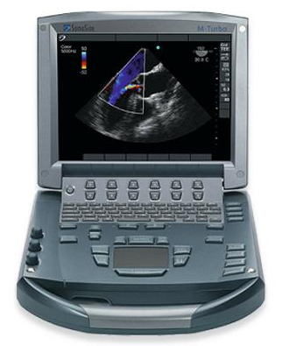
Ultrasound
FAST
Focused
Assessment
Sonography
Trauma
Ultrasound probe
locations and sequence
Epigastrium
RUQ
LUQ
Pelvis
M-Turbo Courtesy of Sonosite
Notes:
Focused Assessment with Sonography in Trauma (FAST). Bedside ultrasonography is useful in abdominal evaluation to detect free peritoneal fluid or hemoperitoneum. Free fluid appears “black” and a certain amount is required to be seen and quantifiable on the scan. Amounts range in the literature from 75 ml to 250 ml. It is not intended to replace other modalities. It is a rapid, portable, noninvasive, and accurate examination that can be performed to detect hemoperitoneum. In many medical centers, the FAST examination has virtually replaced DPL as the procedure of choice in the evaluation of hemodynamically unstable trauma patients.
Based upon Advanced Trauma Life Support (ATLS) principles, the hemodynamically unstable trauma patient with a positive FAST scan is taken to the OR for laparotomy.
If the patient has positive free fluid on US but is hemodynamically stable, a CT scan is done to determine location of injury and extent of hemorrhage. As long as the patient remains hemodynamically stable, it is highly likely that the patient will be managed nonoperatively.

Slide 21
Ultrasound
Advantages
Reliable, fast, safe
Cost effective
Noninvasive
Equipment portable
Performed simultaneously
Fast exam detects free fluid
Serial exams
Disadvantages
Clinician expertise variable
Lacks specificity
Not intended to replace DPL or CT scan
Reliability is questionable
May not reveal free fluid if performed too early
Notes:
US is fast, noninvasive, and may be performed simultaneously at the bedside while other interventions are ongoing, thus, eliminating the need for transporting the patient out of the department.
US does not detect injuries to the diaphragm, intestine and pancreas. It may not detect free fluid which would provide the clinician information to evaluate further. Reliability in some patients with obesity, ascites, and subcutaneous emphysema is questionable.
A certain amount of fluid is necessary to quantify and be visible for a positive US reading, so if performed too early, one may have a negative exam. Serial US should be performed on patients with significant mechanism of injury and on those for whom a high index of suspicion is indicated.

Slide 22
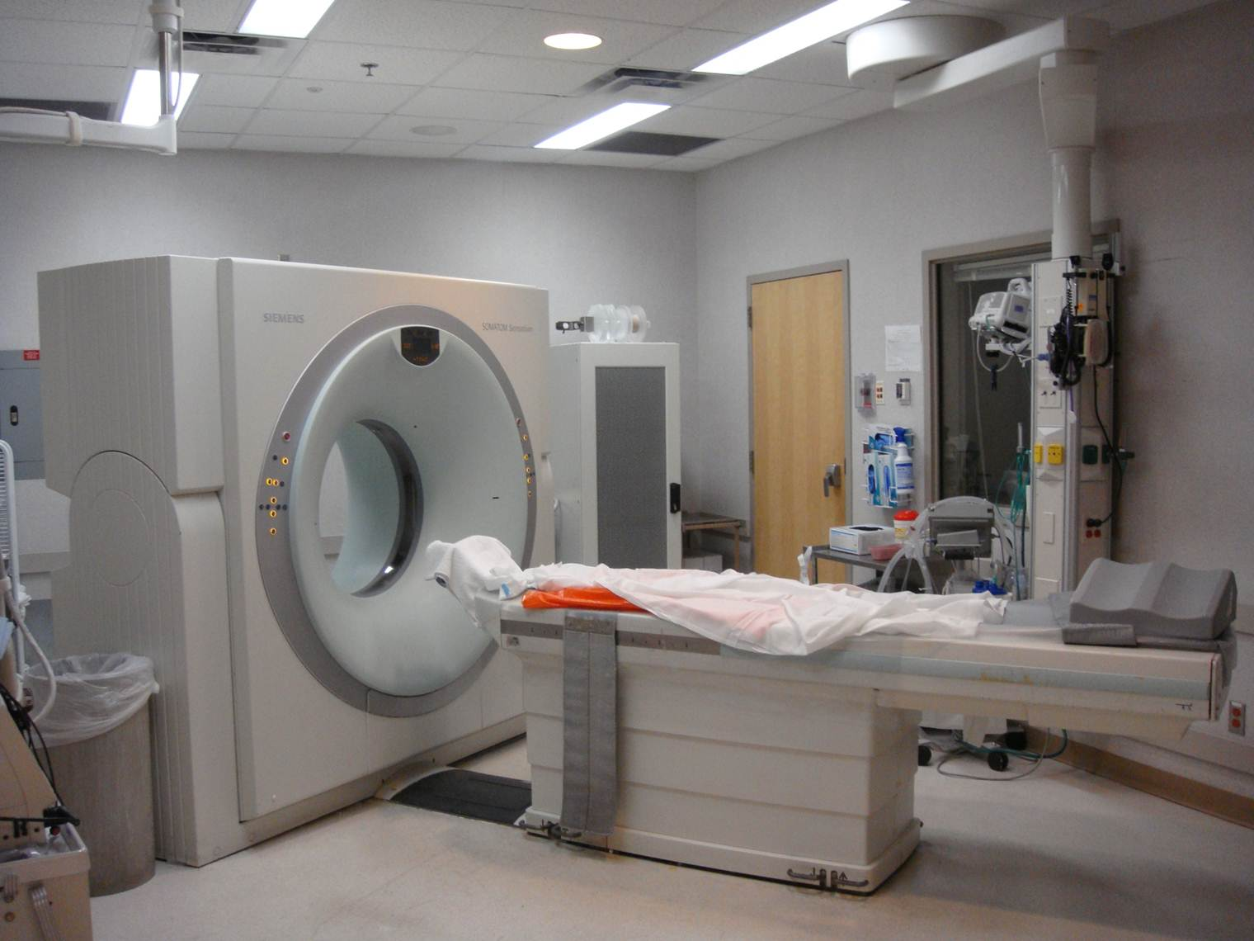
Computed Tomography
Used for hemodynamically stable patients
Advantages
  Noninvasive procedure
  Better defines organ injury
  Estimates amount of blood in spaces
  Retroperitoneum and vertebrae can be assessed
Helical scanners
Notes:
CT scan is the currently accepted standard of evaluation used in hemodynamically stable patients with abdominal trauma. Any unstable patient should be in the OR, and should not be taken to CT scan.
The information obtained with CT scan of the abdomen can provide surgeons and radiologists the ability to grade injuries thus assisting them in the decision of operative vs.. nonoperative management. Many institutions have implemented care guidelines based on certain grades of injury. One can refer to the www.aast.org for specific organ grading charts.
Abdominal computed tomography (CT) has better specificity than DPL for intra-abdominal injury in BAT but can be difficult to perform in hemodynamically unstable patients. As with any radiologic test that requires transport out of the resuscitation area, many things should be considered such as the ease and safety of transporting a patient with various lines, equipment, appropriate staff, etc. A patent airway is of utmost importance. The CT scan has been referred to as the “tunnel of death” due to suboptimal anticipation for what could occur while in CT scan.
IV contrast is utilized for the most accurate, detailed imaging. The use or nonuse of oral contrast has been debated. While those arguing that oral contrast is not necessary in the acute traumatically injured patient, others still believe in its value in diagnosing bowel injuries. Regardless, instillation of oral contrast adds additional time, puts the patient at increased risk for vomiting and aspiration, and carries a risk of an allergic reaction, hence it is usually not done in the acute resuscitative phase. In the elderly patient, administration of contrast of any route should be used prudently given their predisposition to renal problems.
New generation multidetector helical scanners have improved dramatically in terms of image quality and speed. Many “pan scan” trauma panels (head, cervical spine, chest/abdomen/pelvis) can be completed in minutes.
The use of a CT in a penetrating trauma is of limited value and should be carefully considered before performing. Trajectory can be determined utilizing CT. A triple contrast CT has been shown useful.

Slide 23
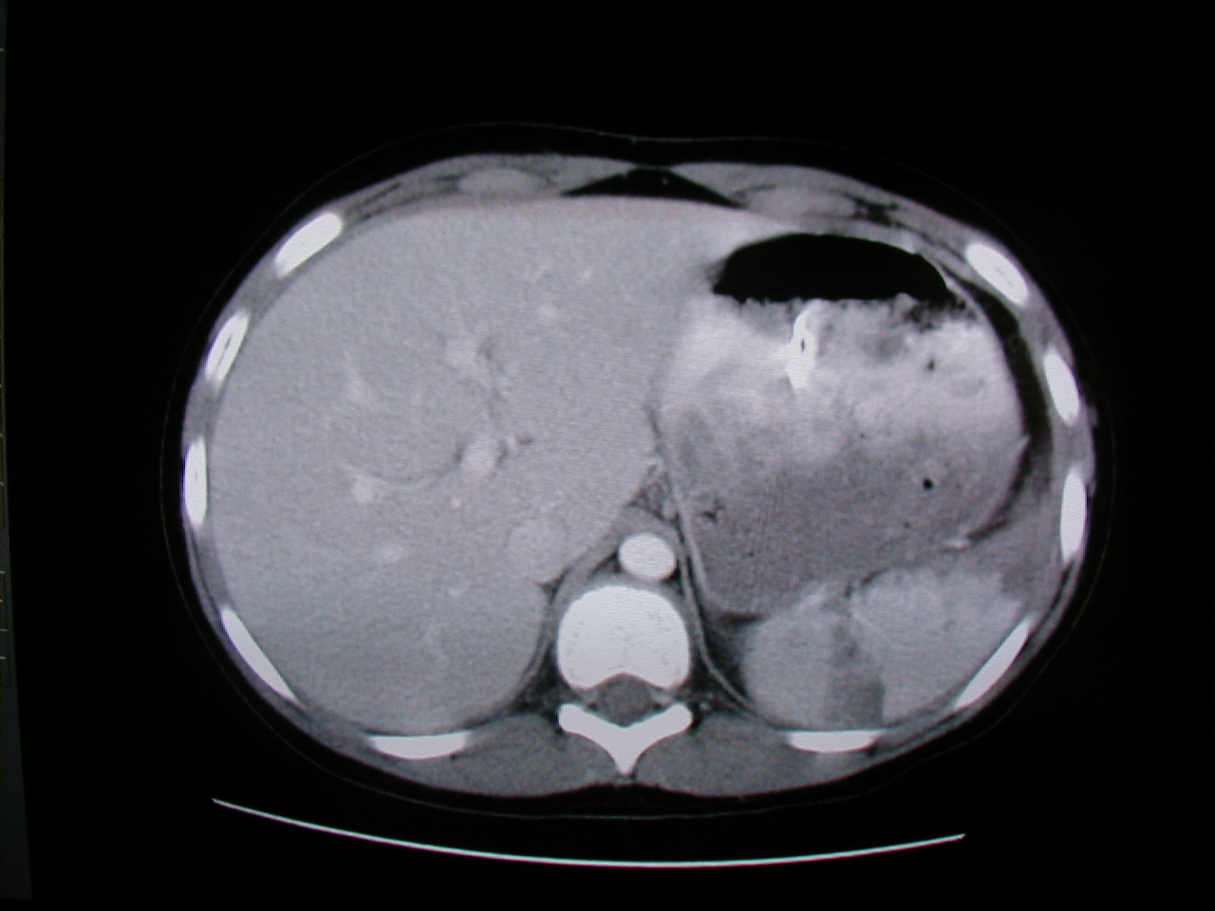
CT Scan in Trauma
Visualizes abdominal solid organs and vessels well
Does NOT see hollow viscus, duodenum, diaphragm, or omentum well
Whole body scans on all trauma
Radiation long term effects
Notes:
Some recent surgery literature advocates pan scanning while others call for a more judicial use in select patients.
What is the right answer?
Despite advances in multidetector helical scanners, they are still not perfect and some injuries are not as readily identifiable, although imaging has improved in recent years. For example, subtle findings such as bowel wall thickening or “stranding” may be the only subtle sign for a bowel injury.
Keep in mind that there is an increase in mortality related to cancer from CT scans. One should give careful consideration the diagnostic tests that are needed. There is still much debate over “pan scanning” versus a much more judicial approach in consideration of an increasing amount of literature reviewing the effects of radiation exposure.
As with any modality, there are advantages and disadvantages, and patient safety from a risk of injury (omitting) vs. a risk of radiation (committing) should be our guide.
Image is of a large splenic laceration

Slide 24
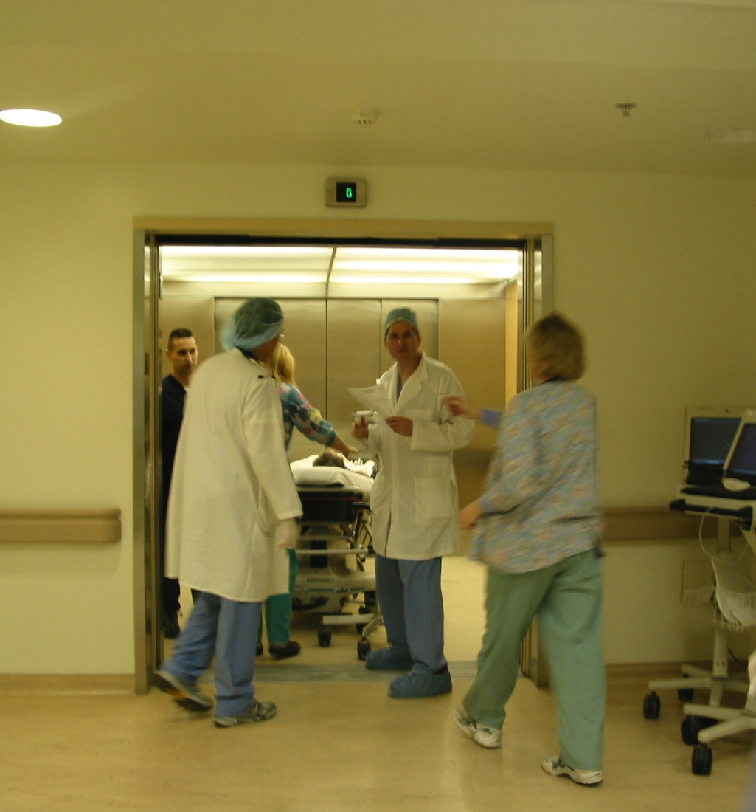
CT Scan Disadvantages
Takes time to perform
Cost
Transport of patient
Requires stable and cooperative patient
Less reliable in diagnosing some injuries
IV contrast
Radiation exposure

Slide 25
Angiography
Detects active bleeding in patients with vascular trauma
Embolizes specific structures within bleeding organs or the pelvis
Detects A-V fistulas and aneurysms in penetrating trauma
Notes:
In 1972, a publication described the first embolization of the internal iliac artery to control hemorrhage associated with pelvic fractures. Since that time, the role of interventional radiologists in trauma has evolved to include definitive treatment of injuries.
Interventional radiology continues to be particularly useful for embolization of unrelenting hemorrhage in patients with unstable pelvic fractures. Embolization can also be done for hemorrhaging in liver and splenic injuries. In fact, it is such an important tool in the armamentarium of treatment options, some centers are developing hybrid OR suites that can handle cases combining various specialties, (trauma, ortho, neuro, IR, etc) without having to move the patient.

Slide 26
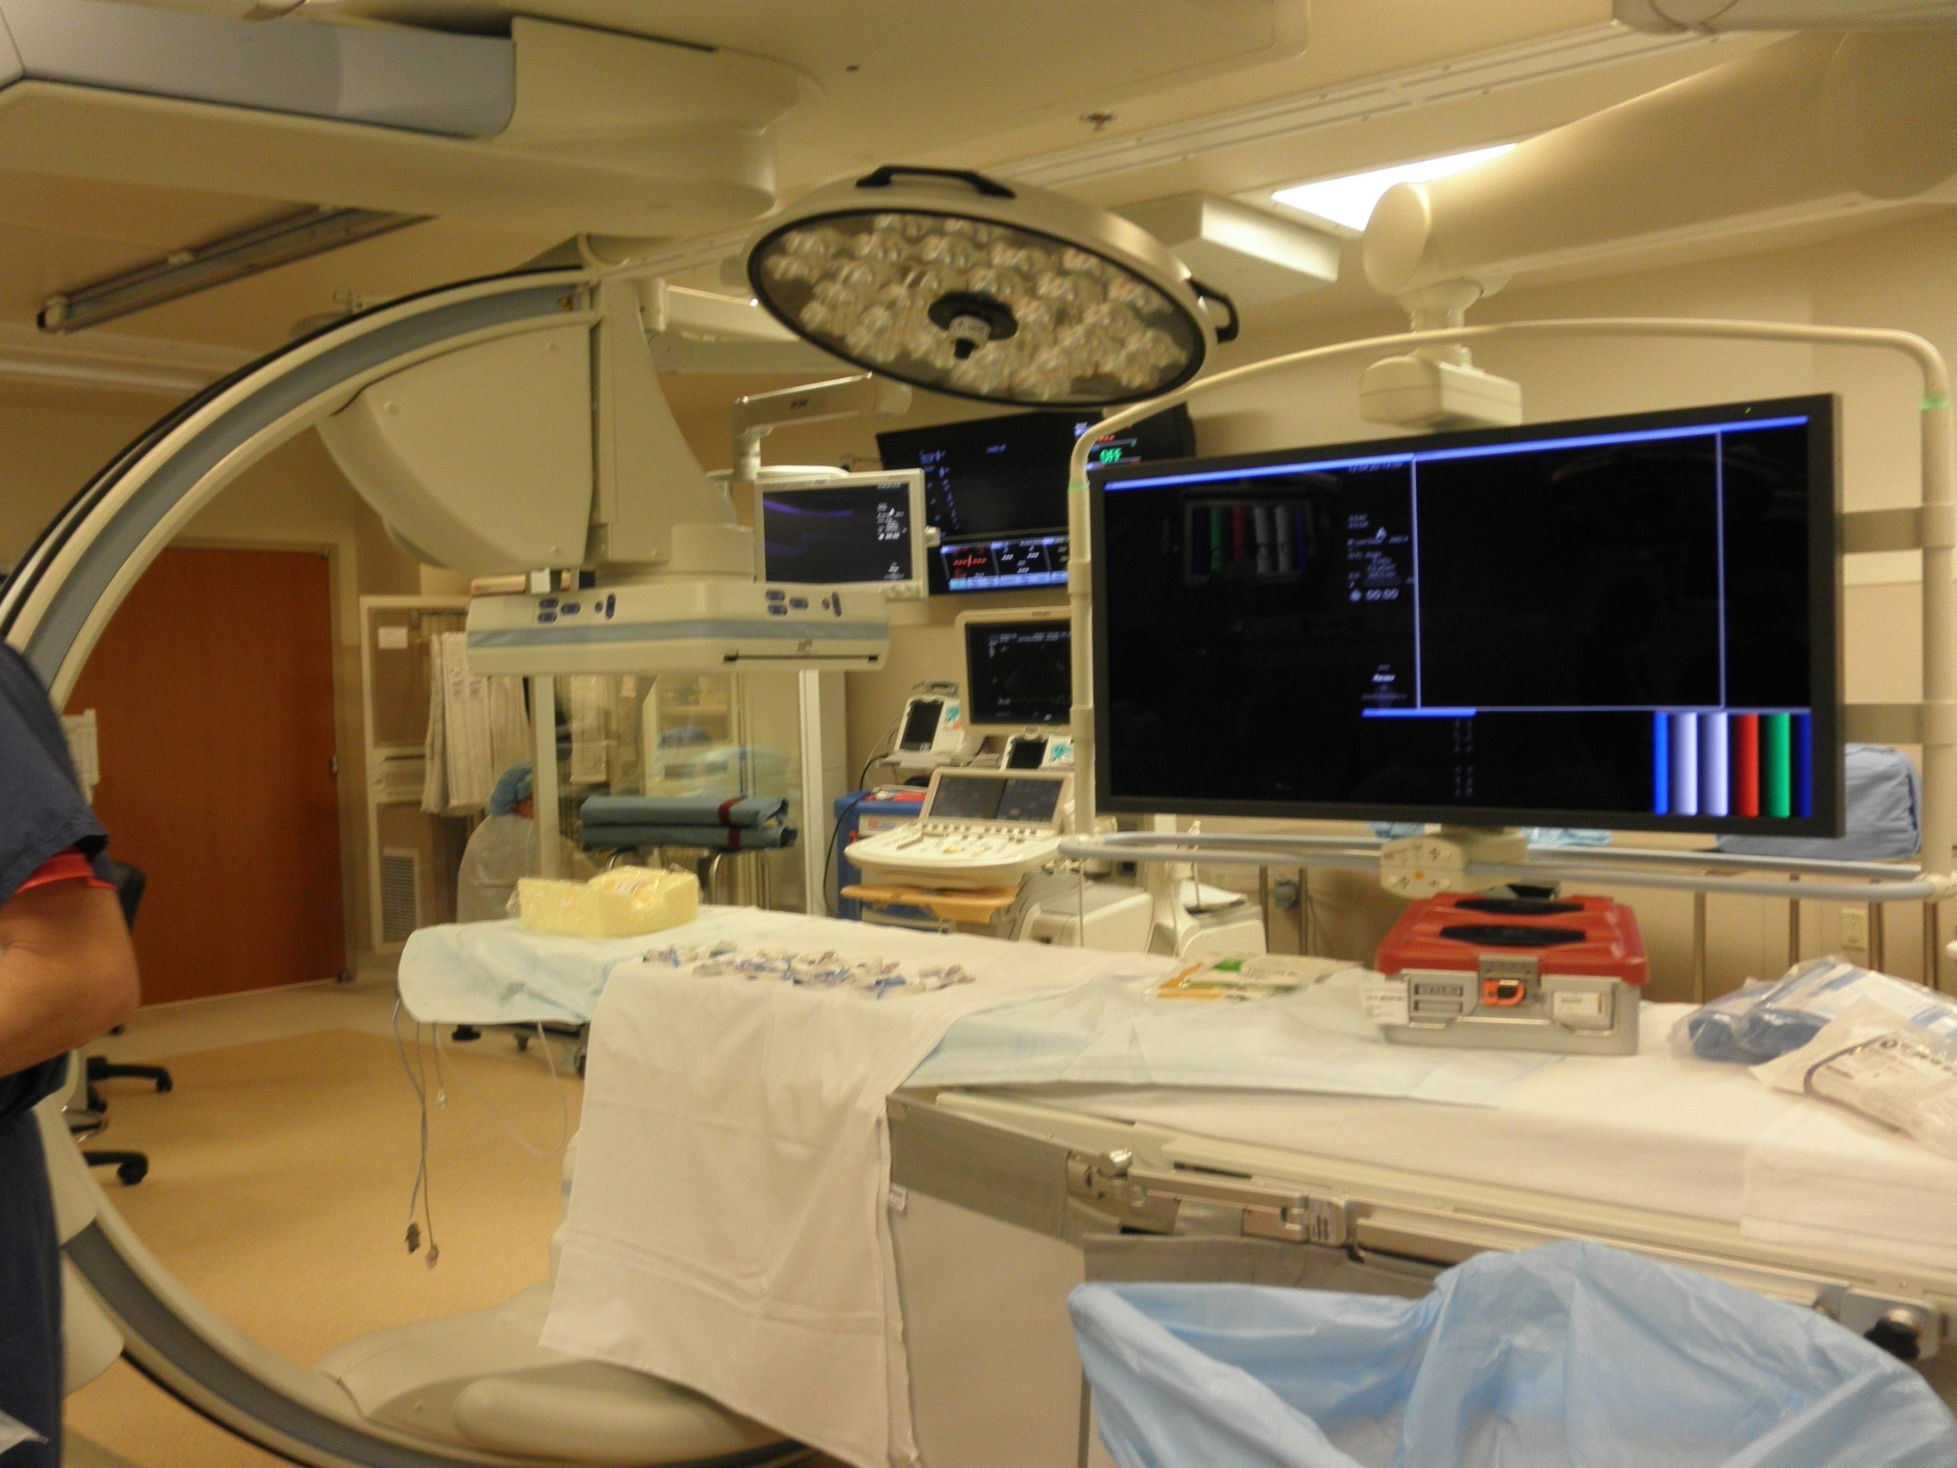
Notes:
Hybrid OR with all the technology.
Patient’s one stop for OR, Angio, etc. Does not require the patient to be moved. Teams rotate in / out.

Slide 27
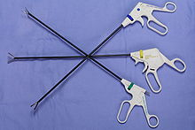
Diagnostic Laparoscopy (DL)
Screening or diagnostic tool
Invasive procedure with some limitations
Used to detect or exclude certain findings
May reduce the rate of negative laparotomies
Notes:
Diagnostic laparoscopy can be used to detect or exclude findings of hemoperitoneum, organ injury, intestinal spillage, or peritoneal penetration. There is limited visibility regarding the extent or depth of injury as well as injuries in the retroperitoneal space. However, diagnostic laparoscopy has been most useful in the evaluation of possible diaphragmatic injuries, especially in penetrating thoracoabdominal injuries on the left side. This is beneficial to reduce the rate of unnecessary laparotomies.

Slide 28
Other Studies
ERCP
May be indicated in the stable trauma patient suspected of having biliary tract or pancreatic duct injury
Most accurate test in the patient with hyperamylasemia and in those following pancreatic surgery
Notes:
Endoscopic retrograde cholangiopancreatography (ERCP) may complement CT scanning to rule out a ductal injury.

Slide 29
Other Studies
Gastrografin or barium studies
Helpful in diagnosing injuries to the esophagus, stomach, or bowel
Contrast enemas are used to diagnose rectal or colonic injury secondary to penetrating trauma

Slide 30
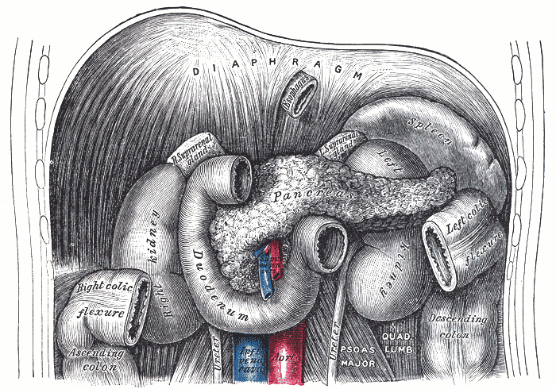
Specific Injuries

Slide 31
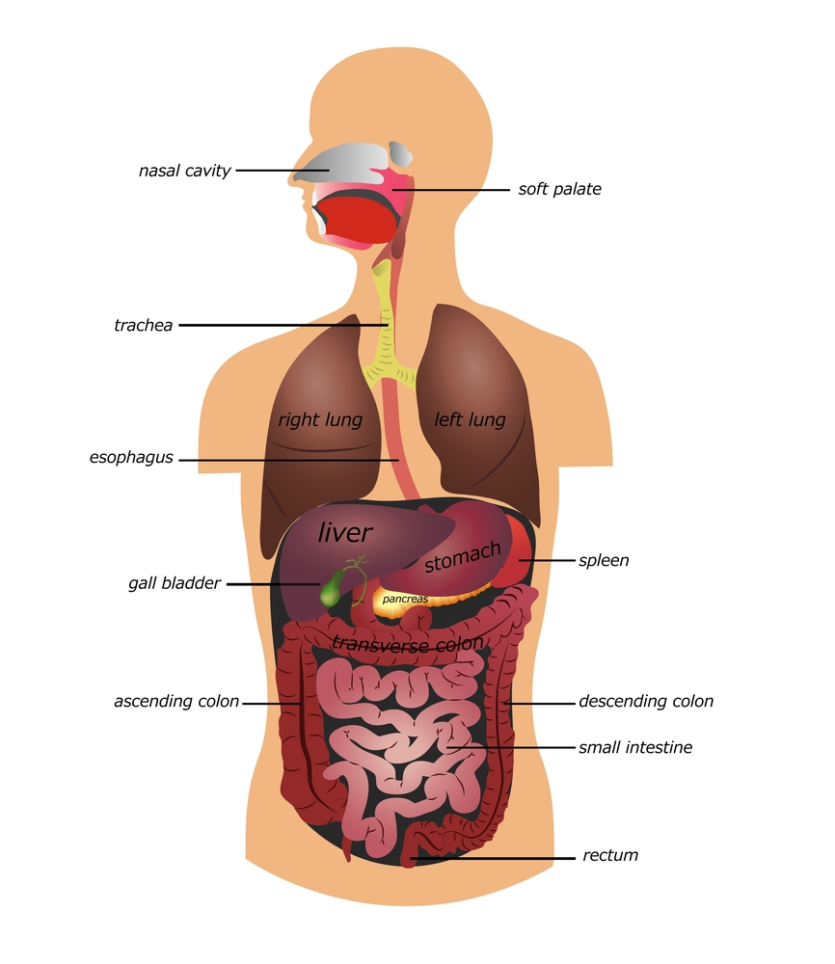
Esophageal Injuries
Notes:
We will first mention the esophagus. Note the location on the slide. There is the origin, neck section, the thoracic, and the abdominal section.
The origin of the esophagus and potential injuries are covered under the neck presentation, however, as part of the GI tract it connects to the stomach and will be reviewed.

Slide 32
Esophagus
Anatomy
Carries food from pharynx to the stomach
Joins the stomach at the level of T-10
Posterior surface overlies aorta
Anterior surface covered by peritoneum
Predisposing Injury Facts
Narrow at
  Cricoid cartilage
  Arch of aorta
  Esophagogastric junction
Lacks serosal layer
  Integrity of anastomoses
  Possible leak after surgical repair
Notes:
Blunt trauma patients rarely sustain esophageal rupture. Penetrating trauma is more likely.
Due to the narrowed areas of the esophagus, it is predisposed to injury. Not only is it predisposed to injury but due to the lack of a serosal layer, the integrity of surgical repairs can be affected and may cause leaks to occur.
Perforation may occur anywhere along the esophagus, but there is a tendency for rupture at three anatomical points of narrowing, the cricopharyngeus muscle, the broncho-aortic constriction, and the entry into diaphragm (esophagogastric junction).
An esophageal perforation is a surgical emergency. Leakage of esophageal and gastric contents into the mediastinum creates a necrotizing inflammatory process that can lead to sepsis, multiorgan failure, and death.

Slide 33
Esophageal Injury
Incidence
  Higher in cervical and thoracic areas
  Majority are due to penetrating trauma
  Blunt injury is rare
Early diagnosis essential
Can result in high morbidity and mortality
Sequelae
  Respiratory compromise
  Mediastinitis
  Paraesophageal abscess
  Empyema
  Esophageal fistula
  Peritonitis
Notes:
Incidence lower to the portion within abdominal cavity. The majority of injuries occur secondary to penetrating trauma and usually involve the cervical portion of the esophagus (95%)
Early diagnosis is key as damage is caused by digestive juices to the tissue and bacterial contamination at the site.
Prompt diagnosis and management is critical to minimizing mortality. A delay of greater than 24 hours in diagnosis and treatment of an esophageal perforation is associated with a higher mortality rate compared with an early diagnosis and treatment initiation
The mortality rate following operative management of an esophageal perforation is dependent on location of the perforation, with cervical perforations having the lowest mortality rate (6 percent) compared with thoracic perforations (27 to 34 percent), and intra-abdominal perforations (21 to 29 percent).
Fluid losses may cause respiratory compromise.
Injuries to the esophagus are rare but are significant due to the increase in morbidity and mortality that occurs with delayed treatment.
Esophageal injuries are often associated with severe concomitant injuries that may mask findings, delaying diagnosis until mediastinitis or an empyema develop

Slide 34
Esophageal Injury
Assessment
Symptoms of perforation include pain, fever, and dysphagia
Symptoms of abdominal esophageal tear include signs of peritoneal irritation followed by dyspnea and pleuritic pain
Diagnostic tests
Endoscopy/Esophagoscopy
CT
Notes:
Signs and symptoms vary according to location of injury and the amount of contamination. Perforation of the esophagus may cause pain at the site of injury or radiation of pain to then neck, chest, shoulders, or throughout the abdomen.
A tear in the abdominal portion of the esophagus shows signs of peritoneal irritation from the release of gastric contents. As these contents reflux into the pleural space, more air than fluid is appreciated producing dyspnea and pleuritic pain.
Plain x-ray may reveal pneumomediastinum, pleural effusion, mediastinal contour changes (which progress with inflammation), or a gas bubble in the nasogastric tube or esophagus
Diagnosis is made by endoscopy or esophagography using water-soluble contrast. CT may show subtle air leaks beside the site of perforation

Slide 35
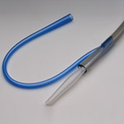
Esophageal Injury
Management
Initial assessment complex
Goal is to minimize the bacterial contamination and enzyme erosion
Gastric decompression
Antibiotic coverage
Drainage of wound
Surgical repair
Notes:
Evaluation is difficult as esophageal injuries are rare and usually occur in conjunction with other injuries. Depending on the extent of injury, different surgical techniques may be employed to repair esophageal tears.
The general principles for the management of an intra-abdominal esophageal perforation are the same as those of the cervical and thoracic esophagus. A primary repair is the gold standard of care and should be utilized for perforations of the thoracic and abdominal esophagus and for visualized perforations of the cervical esophagus.
These surgical principles include a careful dissection to isolate the esophagus without damaging vital structures, evacuation of debris and devitalized tissues, and debridement of the area of perforation.

Slide 36
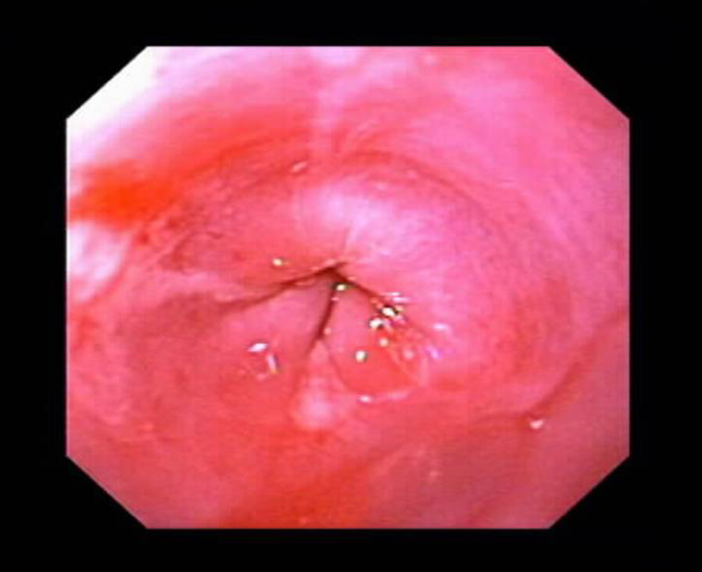
Esophageal Injury Management
Continuous monitoring for injury
Complications after repair
Notes:
Evaluation for signs of injury should be part of one’s assessment from critical care through rehab since these injuries are difficult to diagnose. Ongoing assessment is key as complications can occur at any time and one should be highly observant.
Monitor for
Peritoneal irritation
Respiratory compromise
Fistula formation
Potential complications after repair
Peritonitis
Mediastinitis
Intra-abdominal abscess
Esophageal stricture (as seen in image)
Esophageal fistula

Slide 37
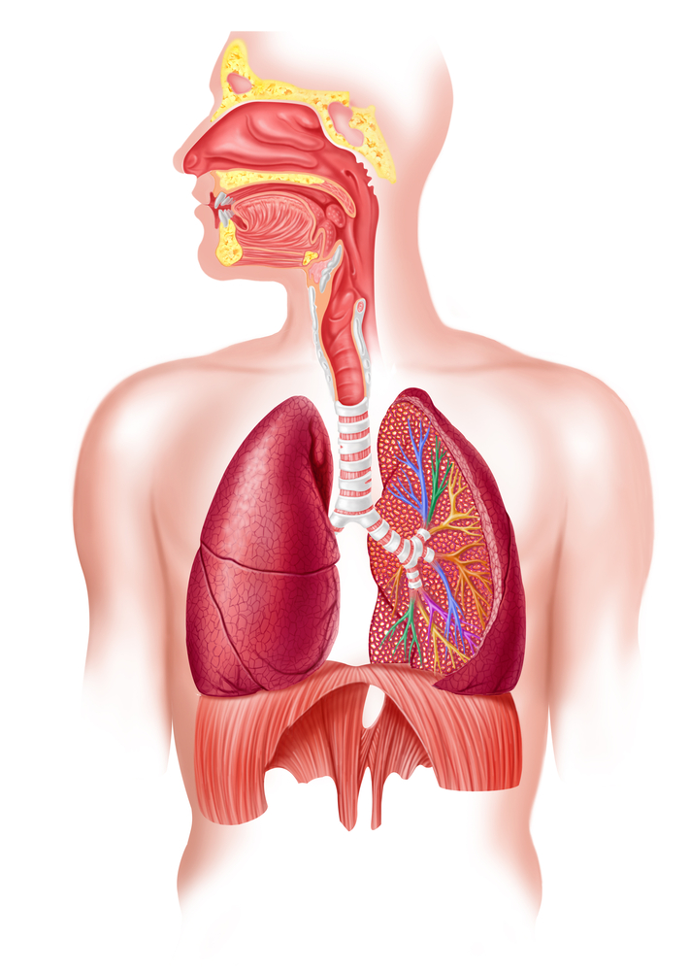
Diaphragm
Notes:
We will mention the diaphragm next since it is considered both part of the thorax as well as abdomen.
It is important to know that when assessing the spinal cord injured patient, any injury between the third and fifth cervical vertebrae may affect the ability of the patient to breathe due to its affect on the phrenic nerve and diaphragm.
The diaphragm is primarily innervated by the phrenic nerve, formed from cranial nerves C3, C4, and C5. A useful mnemonic to remember this is, "C-3, 4, 5 keep the diaphragm alive.“
The diaphragm is dome-shaped and attaches to the chest and abdominal walls circumferentially.
Diaphragmatic injuries are relatively rare and result from either blunt or penetrating trauma.

Slide 38
Diaphragmatic Injury
Incidence
Usually occurs with other injuries
Seen in < 5% of blunt trauma patients
Left side greater incidence than right side
Commonly associated with penetrating trauma
Injuries from blunt trauma caused by sudden rise in intrathoracic pressure
Notes:
Diaphragmatic injury in blunt trauma is relatively rare and is seen in fewer than 5% of all patients with blunt trauma. It is estimated that 80-90% of blunt diaphragmatic ruptures result from motor vehicle crashes and 80-90% of these occur on the left side.
A left hemidiaphragm injury is more common that a right because of the protective effect of the liver on the right side. If a right hemidiaphragmatic injury is present, suspect liver injury. Right-sided ruptures are less common and have more severe associated injuries and result in greater hemodynamic instability.
Some believe that the incidence is most likely equal for right and left sided injuries, however, due to the right side being associated with other injuries more often, these patients may not survive to actually be diagnosed.

Slide 39
Diaphragmatic Injury
Assessment
Auscultation of peristaltic sounds in chest
Delayed rupture - unexplained chest pain and increased respiratory rate
CXR is most important diagnostic study
  Elevation of hemidiaphragm
  Bowel pattern in the chest
  Gastric tube curls in chest
  Hemothorax – associated injury
Masked by positive pressure ventilation
Notes:
Symptoms of diaphragmatic injuries frequently are masked by associated injuries.
Penetrating trauma may produce a small tear not appreciated on initial exam. As intra-abdominal pressure rises, the defect increases and the possibility of herniation and intestinal strangulation may occur.
In 10-50% of patients, diagnosis is not made in the first 24 hours. Physical examination is limited in its utility in diagnosing this injury, but diaphragm injury may be identified by auscultation. Peristaltic sounds in the chest on auscultation indicate a diaphragm rupture.
With gross herniation of visceral contents into the chest, mediastinal structures shift resulting in respiratory distress and hemodynamic instability.
Monitoring for the possibility of delayed rupture should be included in the assessment.
If not made in the first 4 hours, the diagnosis may be delayed for months or years. Up to 50% of blunt trauma injuries to the diaphragm are diagnosed late. It can occur many years post trauma due to gradual weakening of the injured area leading to rupture.

Slide 40
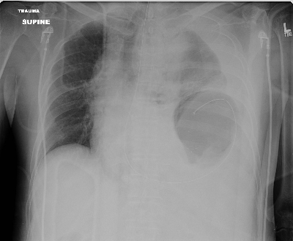
Notes:
What is wrong with this picture?
Elevation of left diaphragm; gastric tube curled; herniation of abdomen contents into chest

Slide 41
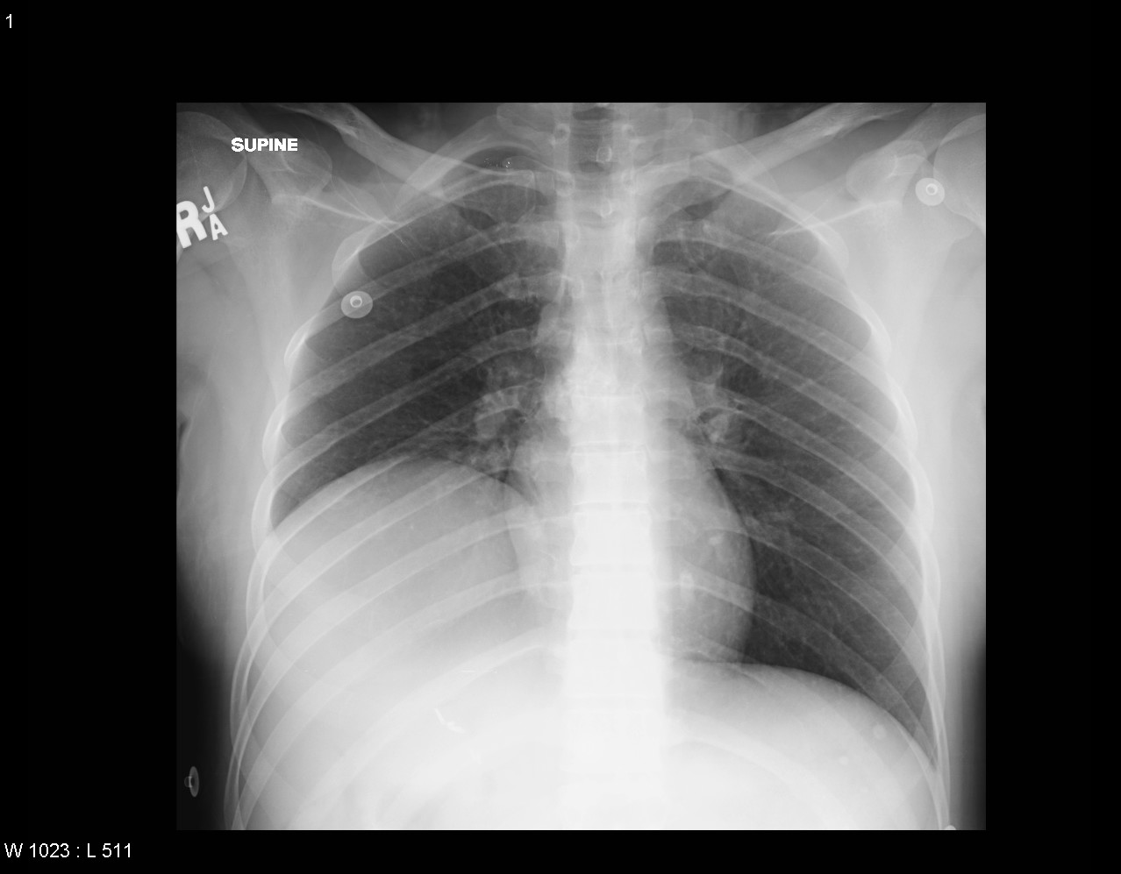
Notes:
Elevated right hemidiaphragm

Slide 42
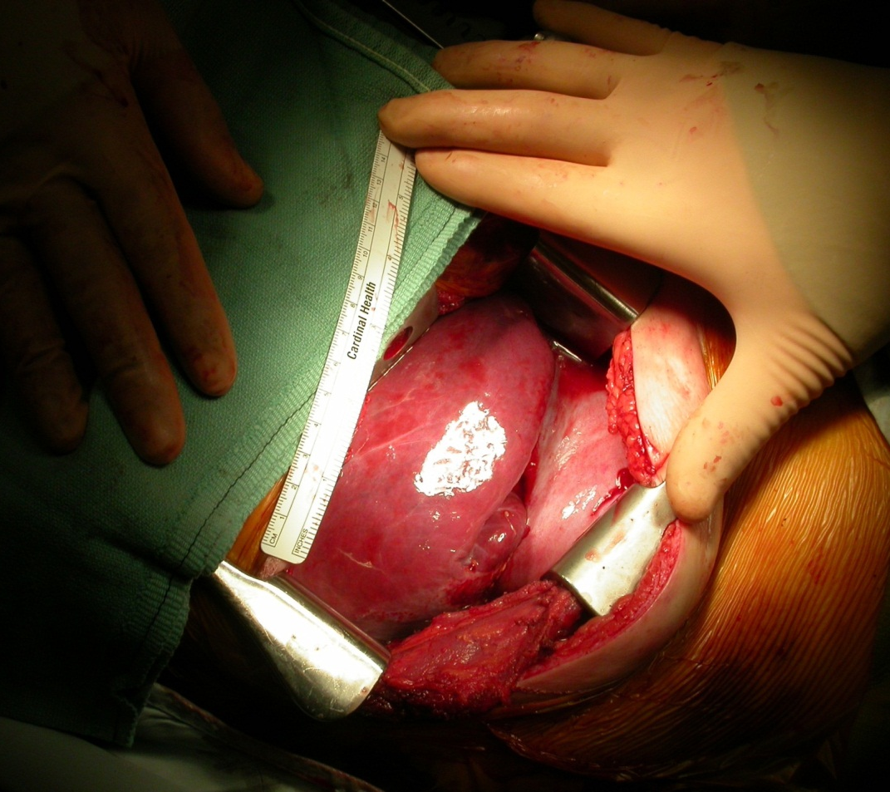
Diaphragmatic Injury
Management
Exploratory laparotomy
Diagnostic laparoscopy in penetrating trauma
Notes:
Operative repair is necessary because visceral herniation can occur even in small defects. Laparotomy is preferred for acute traumatic tears unless it is a penetrating trauma where the entrance wound is in the chest and a thoracic approach may be utilized.

Slide 43
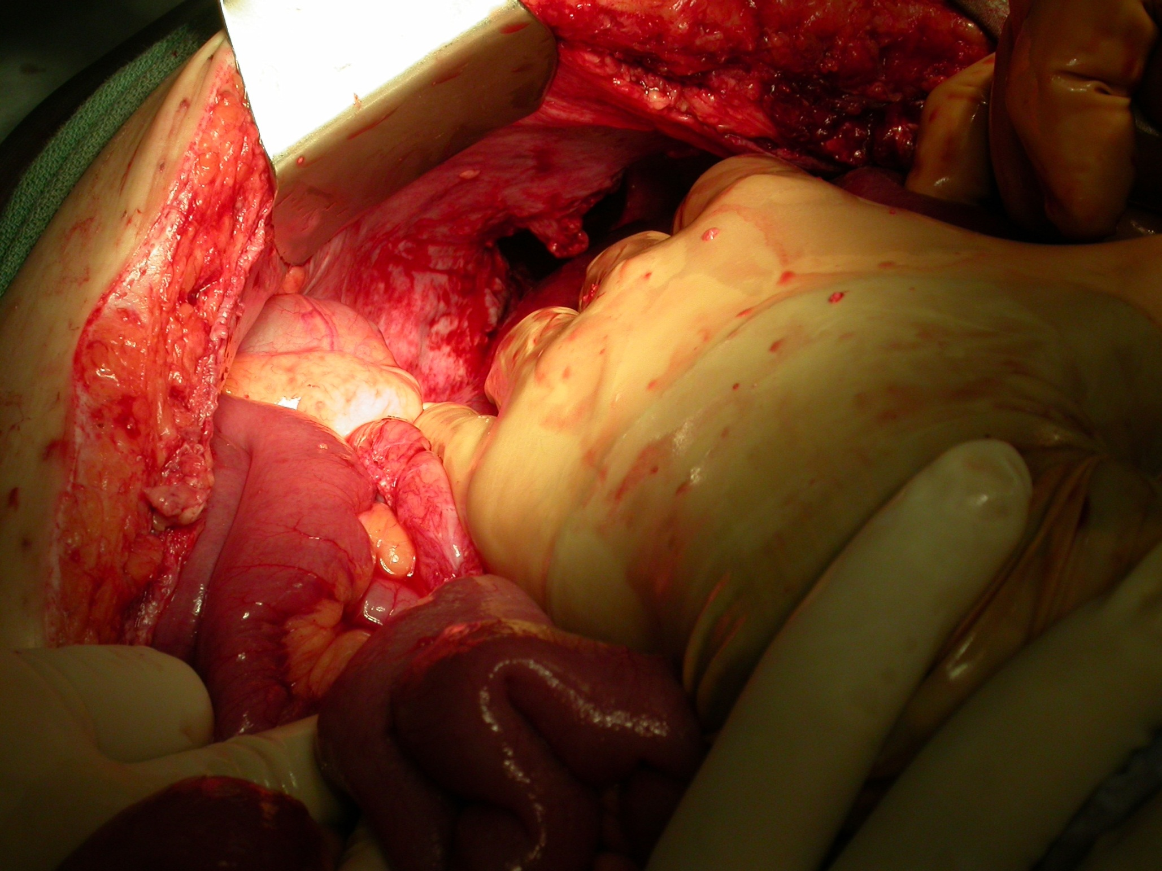
Notes:
Intraoperative
Note hole in diaphrqagm

Slide 44
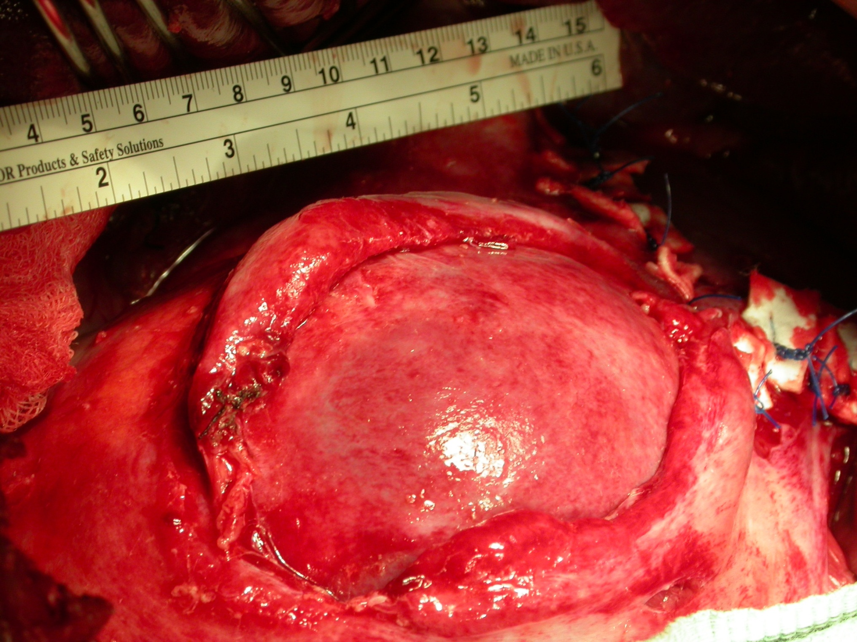
Notes:
Abdomen contents herniating through diaphragm.

Slide 45
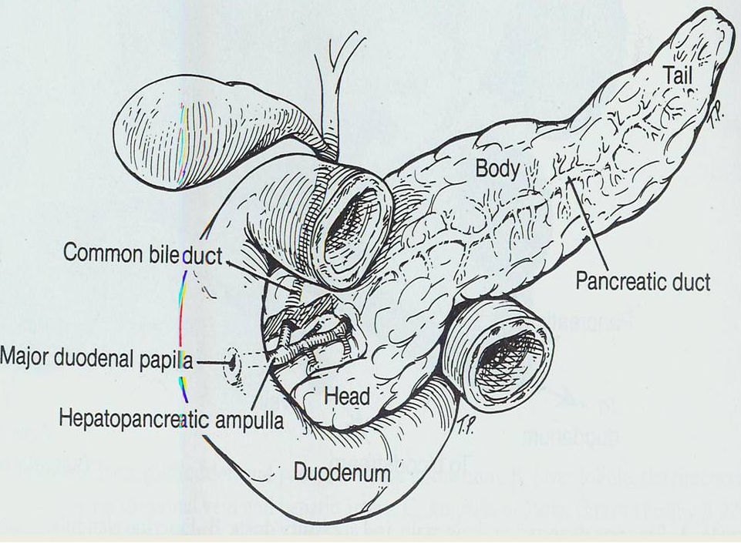
Pancreatic Injuries
Notes:
The illustration shows the location of pancreas to include head, body, and tail as well as ductal system. As well as the relationship to the duodenum.
Located retroperitoneally at the level of L-2
Extends from C-loop of duodenum to hilum of spleen
Rupture often tears ductal system and allows invasion of pancreatic juices
Blood supply is from the splenic artery and vein and the superior mesenteric artery and vein. Due to its location, a blunt trauma mechanism can force the pancreas against the vertebral column causing it to rupture. If rupture tears the ductal system, digestive enzymes invade
Whether minor or major injury, it is usually easy to diagnose but becomes a major therapeutic challenge for the clinical team and the patient, depending on extent of injury.

Slide 46
Pancreatic Injuries
Incidence
Uncommon
Associated with other abdominal injuries
Majority caused by penetrating trauma
Blunt trauma is usually a direct blow or compression type force
Mortality is variable
Notes:
Its location and proximity to other organs and vessels make multiorgan injury a frequent occurrence.
Over 90% of pancreatic injuries have an associated intra-abdominal injury.
GSW and stab wounds frequently include pancreatic injury, occurring in approximately 20-30% of all patients with penetrating traumas
Early deaths are secondary to hemorrhage. Late deaths result from infection.

Slide 47
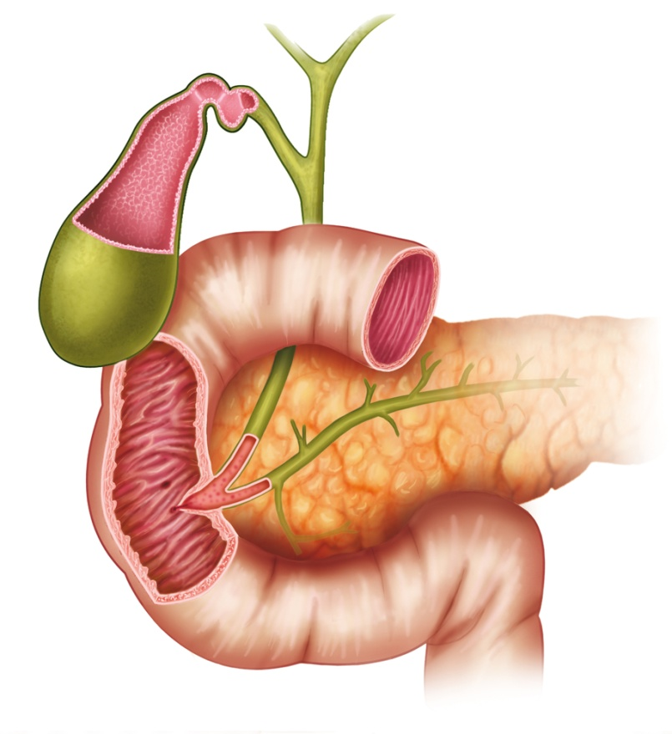
Duodenum
First part of small intestine
Location of most digestion and absorption
Divided into four sections with only the superior portion residing in the peritoneal cavity
Rapid deceleration may lead to rupture
Vulnerable to compression injuries
Notes:
Primarily a retroperitoneal organ and considered the first part of the small intestine. Significant portions of the duodenum lie directly over the spinal column, and it is bordered anteriorly by the liver, colon, and stomach. The duodenal sweep is bordered by the gallbladder laterally and the head of the pancreas medially.
The duodenum is the receiver of the highly acidic chyme from the stomach. Only the superior portion is located within the peritoneum. The descending, transverse, and ascending segments are located in the retroperitoneum.
Due to its location, rupture may occur between the anchored and free segments. Compression injuries are seen due to its location over the vertebral column.

Slide 48
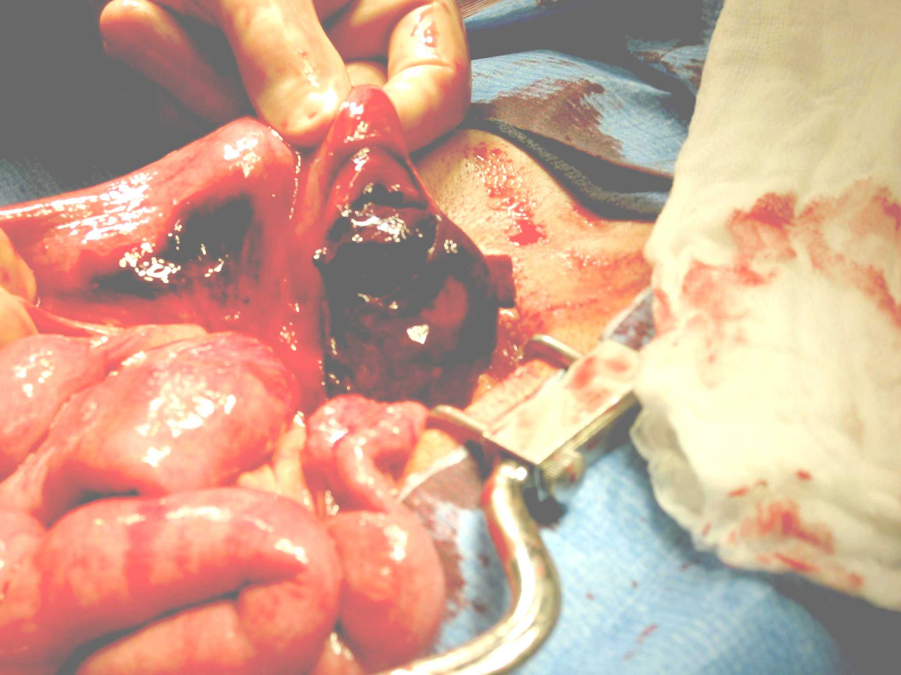
Duodenal Injuries
Incidence
Majority caused by penetrating trauma
Blunt trauma is usually compression type
Mortality is variable
Multi-organ injuries
Notes:
Its locations and proximity to other organs and vessels make multi-organ injury a frequent occurrence.
98% duodenal injuries have an associated intra-abdominal injury.
Due to the location of various segments of the duodenum, usually the second portion, vertebral column fractures are associated. Chance fracture, transverse process fractures, etc.
Image is from a compression injury (BMX rider vs. handlebars)

Slide 49
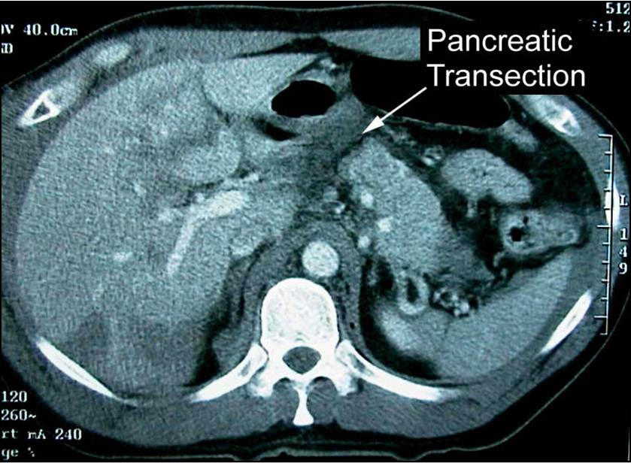
Pancreatic and Duodenal Injuries
Assessment
Peritoneal symptoms not evident but appear later
CT scan is the exam of choice
Injury usually found intraoperatively
Notes:
The pancreas is a retroperitoneal structure, and the duodenum is primarily a retroperitoneal structure so symptoms of the injury may not be evident for 24 to 72 hours.
Note pancreatic transection on image
If isolated, initial complaints are vague, however, within 6-24 hours after injury, the patient will complain of midepigastric or back pain with evolving peritoneal signs.
The head of the pancreas lies at the level of L2. This is why associated transverse process fractures or a Chance fracture may have an associated pancreatic injury.
Pancreas – Although CT scan is the exam of choice, and will identify contusions and hematomas of the pancreas early, it may not identify the actual pancreatic lacerations or transection initially.
Duodenal – CT scan findings include paraduodenal hemorrhage; air or oral contrast leak
Usually these injuries are found intraoperatively when other injuries are being repaired. Or, when peritoneal signs are apparent and CT scans are repeated.

Slide 50
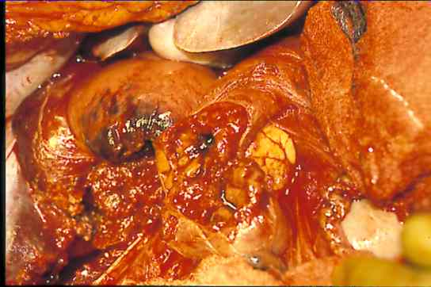
Pancreatic and Duodenal Injuries
Assessment
Blunt injury to duodenum can produce intramural hematoma
Perforation causes contamination
Notes:
Duodenal injuries are among the most commonly missed injury during exploratory laparotomy.
If diagnosis is made > 24h post injury, mortality is 40%. Complications occur in 64% of duodenal injuries.
Image is of a GSW to the pancreatoduodenal complex.

Slide 51
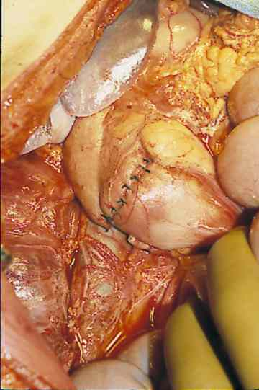
Pancreatic and Duodenal Injuries
Management
Options depend on site and severity
Primary closure
Simple external closed drainage
Distal pancreatectomy
Pancreatic duodenectomy
Notes:
Photo after repair.
Goals are to control hemorrhage, debride devitalized tissue, and provide drainage. Various management options depending on the site of injury, severity, and whether or not there is ductal involvement.
Removal of 90 percent of the mass of the pancreas can be performed without resulting in diabetes.

Slide 52
Pancreatic and Duodenal Injuries
Duodenal Management
Debridement and primary repair
Surgical procedure depends on hemodynamic stability and duct involvement
Nonoperative management requires close observation
Pancreatic Management
Primary cause of death is hemorrhage
Late deaths are due to sepsis, ARDS, multiple organ failure
Observe for complications
Notes:
Nonoperative management requires close observation for expanding or ruptured hematomas causing bleeding or peritoneal contamination.
Pancreatic injuries can be complex to manage. Complications include fistulas, pseudocyst formation, pancreatic abscess, recurrent hemorrhage and pancreatitis.

Slide 53
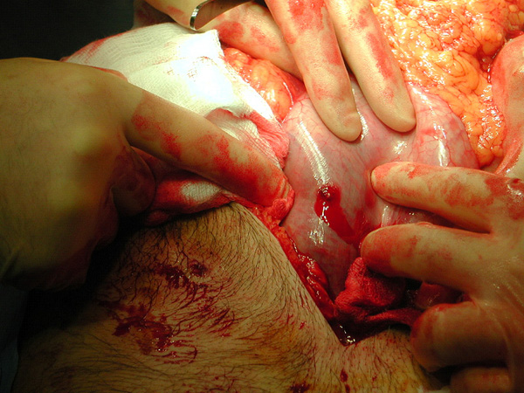
Injuries to the Stomach and Intestines
Trauma.org
Notes:
Image is of gunshot wound to the stomach

Slide 54
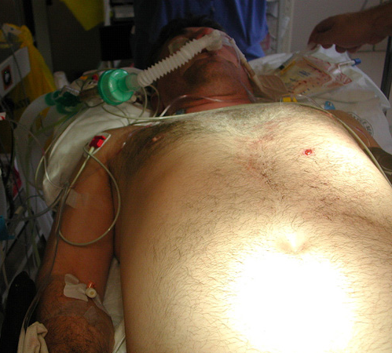
Stomach Injury
Incidence
Rare; more common in children
Commonly involves adjacent organs
Protected by location and mobility
Most common cause is penetrating injury
Notes:
Sometimes referred to as a gastric injury.
Injuries to the stomach are very rare in blunt abdominal trauma. The stomach has very strong walls and these are not torn by blunt trauma unless it is very severe or the stomach is full, or both.
Occurs in 10-15% of penetrating trauma.
Image is of GSW to stomach.

Slide 55
Stomach Injury
Assessment
Symptoms variable and nonspecific
May include severe epigastric or abdominal pain, tenderness, signs of peritonitis
Clouded by associated injuries
Bloody output from gastric tube
Free air on radiograph
Findings on CT or DPL
Notes:
The initial inflammatory response is due to chemical irritation rather than bacterial contamination. The stomach has a high acidic environment normally and is relatively free from bacteria
Bloody output from the gastric tube is seen in a third of patients with penetrating gastric wounds.
Free subdiaphragmatic air is seen in less than 50% of blunt gastric ruptures.

Slide 56
Stomach Injury
Management
Gastric decompression
Surgical intervention
If contamination exists, copious peritoneal irrigation and delayed primary closure
Monitor for postoperative complications
Notes:
The placement of a gastric tube is essential and should remain until gastric emptying returns to normal.
Surgery includes debridement, diligent irrigation to remove any contaminants, and primary closure. Obviously, appropriate timing and selection of antibiotics is important.
Complications are rare. Judicious irrigation is essential to prevent complications such as peritonitis intra-abdominal abscesses to include subphrenic, subhepatic, and pelvic as well as those of the lower sac, and formation of gastric fistulas.

Slide 57
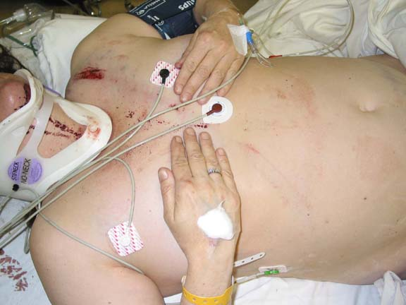
Small Intestine
Jejunum and Ileum
Responsible for nutrient absorption and fluid and electrolyte shifts
Jejunum lies in the umbilical region
Ileum lies in the hypogastric and pelvic regions
Vulnerable to seatbelt injury
Notes:
The small intestine is divided into three structural parts: the duodenum (already discussed) and the jejunum and ileum
The lap belt can cause the bowel to be crushed between the vertebrae and a solid object.
Note seat belt mark in the image.
Not always diagnosed on initial presentation, and this delay contributes to morbidity and mortality.

Slide 58
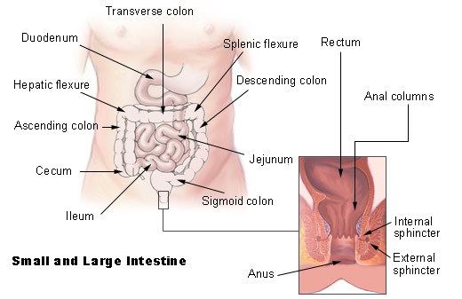
Hollow Viscus Injuries
Notes:
Review the anatomy of location of key structures.
Duodenum, Jejunum, Ileum

Slide 59
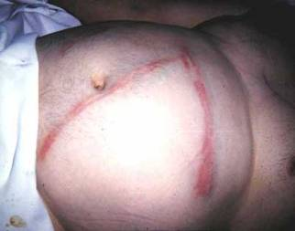
Notes:
What is wrong with this picture.
Obviously, a seatbelt sign in an obese abdomen. However, more importantly, one can see the incorrect wearing of the seat belt, high across the abdomen, which increases the chance for injury.

Slide 60
Small Bowel Injury
Incidence
Most frequently injured by penetrating trauma
Blunt injury is relatively uncommon
Presence of pancreatic and solid organ injury are predictive of increased risk for hollow viscus injury
Assessment
Clinical signs may not be apparent initially
Signs of peritonitis develop
Any blow to the abdomen or penetrating injury to the lower chest or abdomen should increase suspicion of injury
Notes:
Direct blows crush the intestine between the force and the vertebrae. Shearing forces occur in MVC.
It is the most commonly injured intra-abdominal organ in penetrating trauma.
The lack of specific symptoms initially should challenge the nurse to carefully evaluate all information provided from the scene until admission.
Spinal injury may occur with bowel trauma and may mask symptoms.

Slide 61
Small Bowel Injury
Management
Bleeding should be controlled prior to exploration
Debridement followed by primary closure and ligation of bleeders
Bowel resection for multiple defects
Gastric decompression and parenteral nutrition not usually required if isolated
Antibiotics recommended
Observe for complications such as wound infection and abscess
Notes:
Hemoperitoneum can be associated with injuries to the mesentery and ligation of bleeders is necessary as they can bleed massively.
Bowel resection will be performed for larger or multiple injuries with end-to-end anastomosis as indicated.
Antibiotics are given postoperatively to reduce the incidence of postoperative infections after contamination.
Complications are related to the extent of contamination.
There is a possibility for an anastomotic leak that will show up as a enterocutaneous fistula, peritonitis, or intra-abdominal abscess.

Slide 62
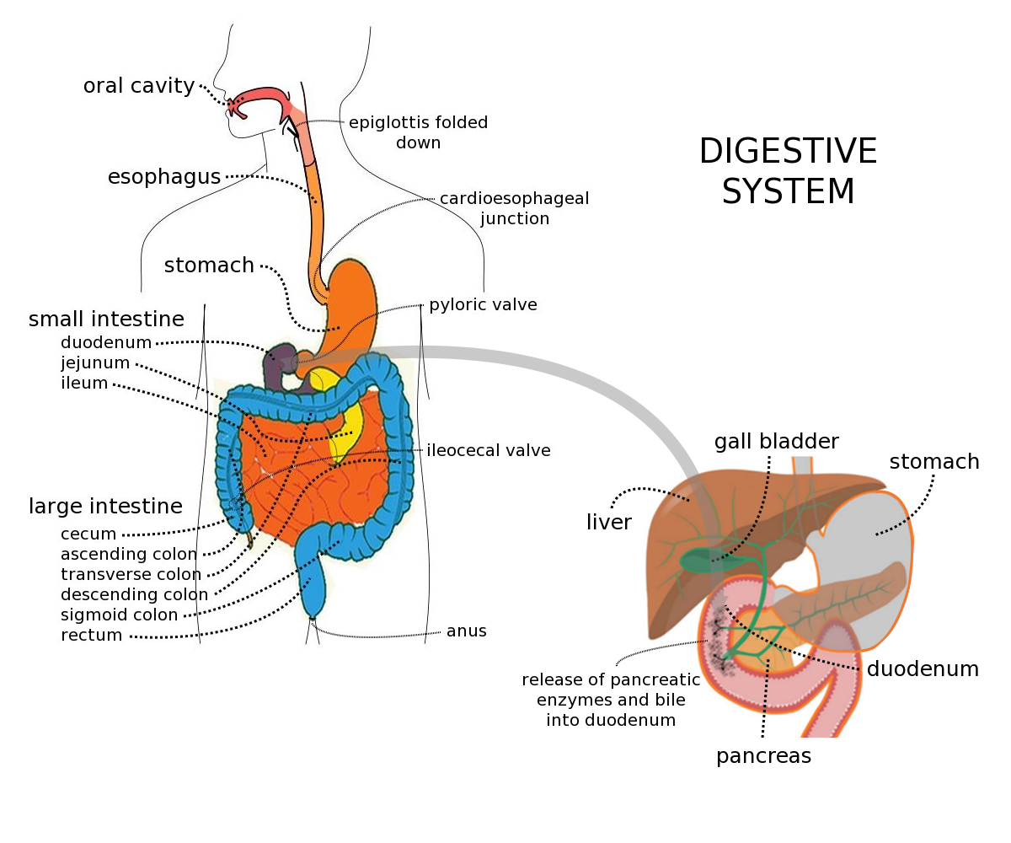
Large Intestine
Wikimedia.org
Notes:
Just completed review of the small intestines and now we will discuss the large intestines, comprised of the colon, cecum and rectum
Digestive functions
Absorption of water and electrolytes
Synthesis of certain vitamins
Temporary storage of intestinal waste
Elimination of body waste
Blood supply from superior and inferior mesenteric arteries
Bacteria such as E coli in the intestinal tract is natural and are important in the synthesis of vitamins K and B complex but it causes significant problems in the bloodstream and urinary system.
Rectal injuries may be associated with severe pelvic fractures.

Slide 63
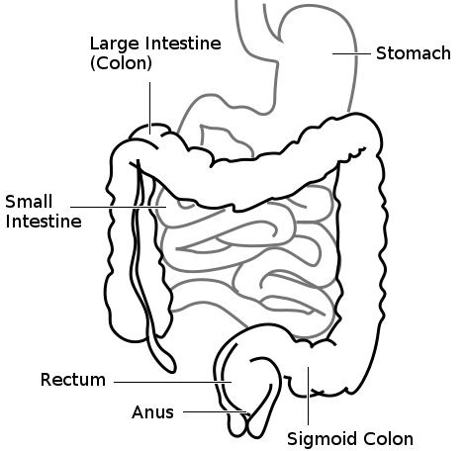
Colon
Ascending
Transverse
Descending
Notes:
The colon is made up of three sections: ascending, transverse and descending

Slide 64
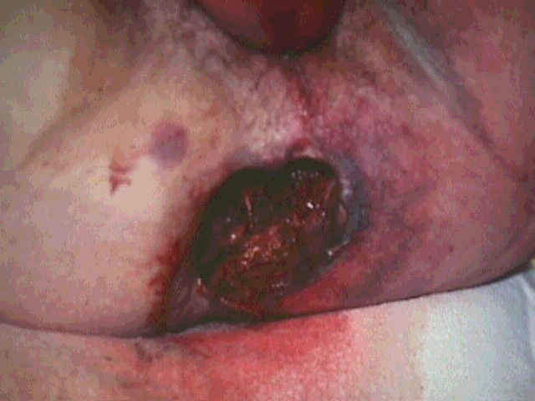
Notes:
Severe pelvic fractures with destroyed rectum.

Slide 65
Large Bowel Injury
Incidence
One of the most lethal abdominal injuries
Mortality affected by associated injuries
Penetrating injury is the most common
Management
Early recognition and control of contamination
Exploratory laparotomy with primary repair and colostomy
Preoperative antibiotics
Observe for complications
Notes:
Lethal due to the probability of sepsis related to fecal contamination.
96% of injuries to the colon and rectum are due to penetrating trauma. The transverse colon is most often injured.
Blunt trauma affects the sigmoid and transverse colon. Most injuries are contusions.
A laparotomy is performed when perforation to the colon or rectum is suspected. Operative management includes hemorrhage control, fecal contamination, and irrigation. If primary repair cannot be done, a colostomy may be needed.
Complications include incisional infection. Delayed skin closure is advocated in patients with major contamination. Intra-abdominal abscess is the most frequent complication.
Abscesses can be percutaneously drained.

Slide 66
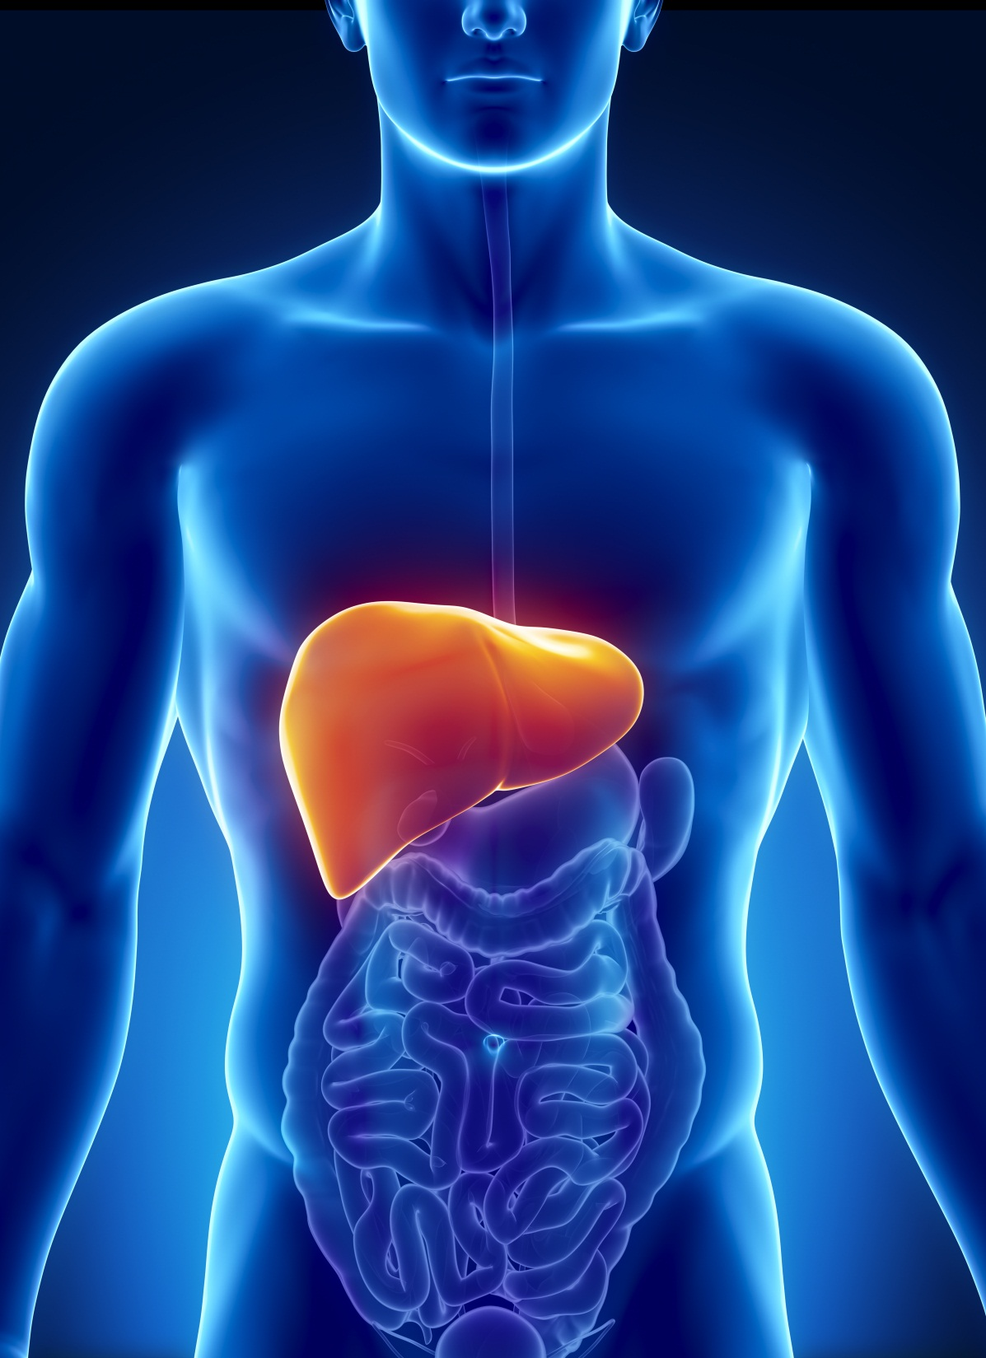
Liver Injuries
Notes:
Largest intra-abdominal organ in the body. It weighs approximately 3-4 pounds and lies in the RUQ. It is the most vulnerable to blunt injury because of its size and location
75% of blood to the liver is delivered by the portal vein
The porta hepatis is located between the two lobes and provides the entry and exit points of all vessels and nerves as well as bile ducts.
The majority of nutrient rich blood is delivered via the portal vein.
Additional nutrient rich arterial blood enters through the hepatic artery.
The right and left hepatic veins dump into the IVC. The mixture of blood occurs in the central vein of each lobule and is then channeled to the lobular veins which empty into the inferior vena cava.
The liver may be lacerated or contused, and it may leak bile without serious consequence. One can appreciate this rich vascular supply and the complicated surgical repair.
Uncontrolled hemorrhage is the primary cause of death

Slide 67
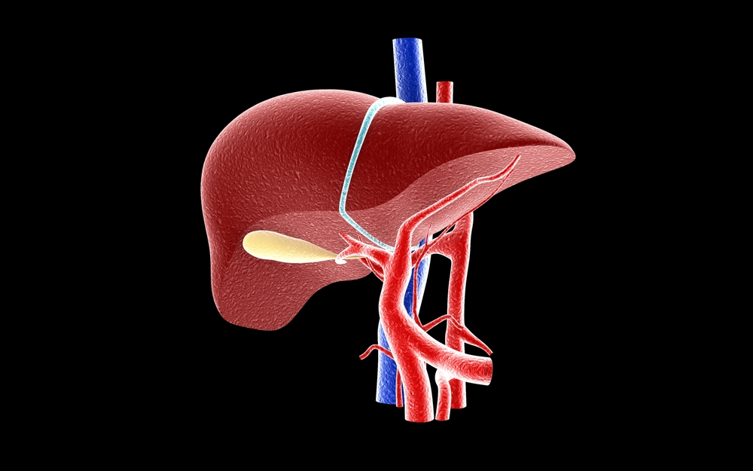
Liver Functions
Detoxification
Synthesis of plasma proteins
Storage of iron and vitamins
Metabolism of carbohydrates, protein, and fats
Phagocytization of bacteria
Notes:
The liver performs many vital functions.
It is responsible for detoxifying various substances to include alcohol and drugs.
By synthesizing plasma protein, the liver plays an important role in maintaining blood volume and controlling coagulation.
The liver provides storage of iron as well as certain vitamins, ADEK and vitamin B12.
It also serves as the site for metabolism of carbohydrates, fats, and proteins.
This results in regulation of blood glucose, synthesis of amino acids and conversion of nitrogen to urea for excretion, and synthesis of cholesterol and phospholipids as well as conversion of excess dietary protein and carbohydrates to fat.
Lastly, the Kupffer cells perform phagocytosis of bacteria.
Point out anatomical areas and the liver’s relationship to other abdominal organs.

Slide 68
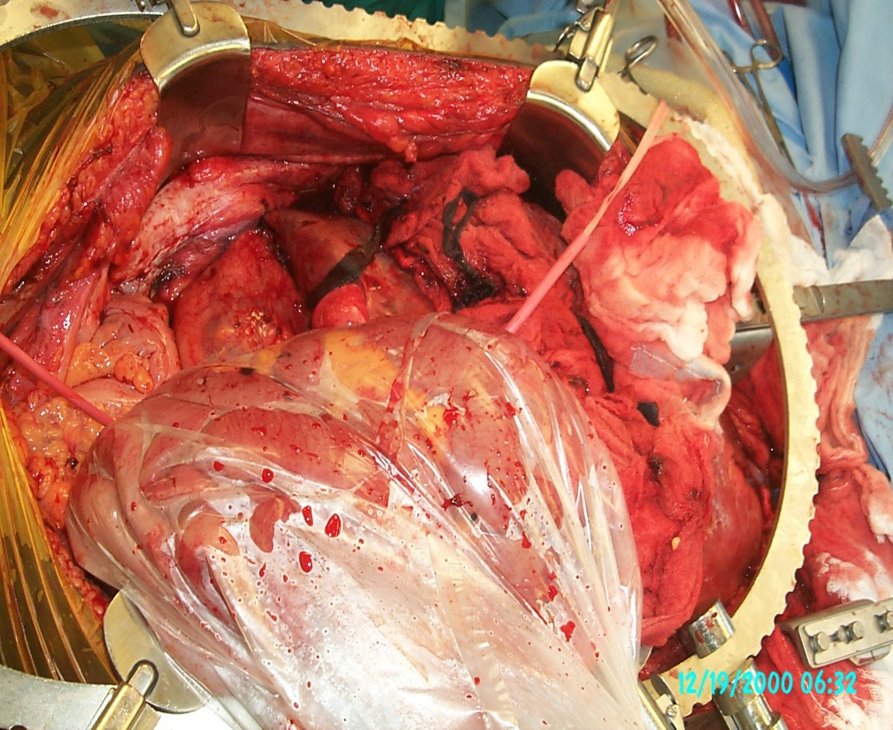
Liver Injury
Incidence
Commonly injured organ
MVC most common cause
Mortality 10% to 15%
Notes:
Size and location make it susceptible to injury from both blunt and penetrating trauma.
Either liver or spleen, depending on the reference.
Factors affecting mortality include associated injuries, the length of time from injury to treatment, and overall premorbid condition. The greatest risk following injury to the liver is severe hemorrhage.

Slide 69
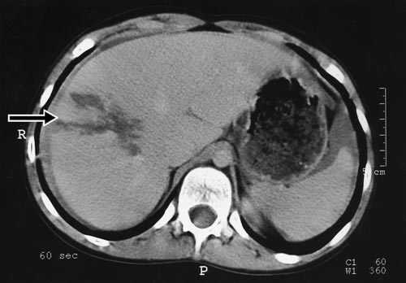
Liver Injury
Assessment
Suspect in any patient with blunt injury to right side
Penetrating trauma produces a range of injuries
FAST, CT scan
Grading system
Notes:
MVCs cause crushing of the liver between the ribs and vertebrae. Blunt injuries range from stellate lacerations or major fractures and are more lethal. Death results from exsanguination, and in later stages, sepsis.
Stab wounds and low velocity gunshots produce minor lacerations, but high velocity gunshot wounds produce more widespread damage that creates massive hemorrhage.
Obviously, the signs and symptoms are those associated with pain to the affected area and shock like symptoms if injury is serious.
FAST is commonly used initially to rule out free fluid.
CT scan is the preferred modality of choice in hemodynamically stable patients with blunt trauma and suspected injuries. Injuries can be graded from I to VI. Helical CT scanners offer better imaging and provide clinicians more information when determining operative vs. nonoperative management.
Many centers have established care guidelines for certain grades of injury. Reference www.aast.org for information on grading.
Note liver injury on CT.

Slide 70
Liver Injury
Management
Nonoperative management in select patients
OR for complex lacerations; arterial blush
Angioembolization
Aggressive intraoperative resuscitation
Possible damage control
Notes:
The trend in blunt hepatic trauma is nonoperative management for hemodynamically stable patients. Historically, liver trauma was explored and packed, however, the nontherapeutic laparotomy rate reached as high as 67%. The presence of hemoperitoneum does not mandate exploratory laparotomy in the stable patient. The selection of patients for nonoperative management involves those who are usually neurologically intact and hemodynamically stable. These patients can be managed nonoperatively with high success.
Arterial blush or contrast pooling indicates a more significant injury that requires further evaluation and potentially operative intervention and/or angioembolization. If operative intervention is indicated, packing may be required if bleeding persists, and the patient is not stable enough for additional surgical intervention. The patient is taken to the ICU for continued resuscitation and stabilization and will be taken back to the OR in 24 to 36 hours for removal of packing, definitive management of the liver, and possible closure.
Aggressive resuscitation with hemorrhage control is required to prevent hypothermia, coagulopathy, and maintain hemodynamic stability. The risk for abdominal compartment syndrome must be considered.
The nurse’s role is key in resuscitation and ongoing monitoring.

Slide 71
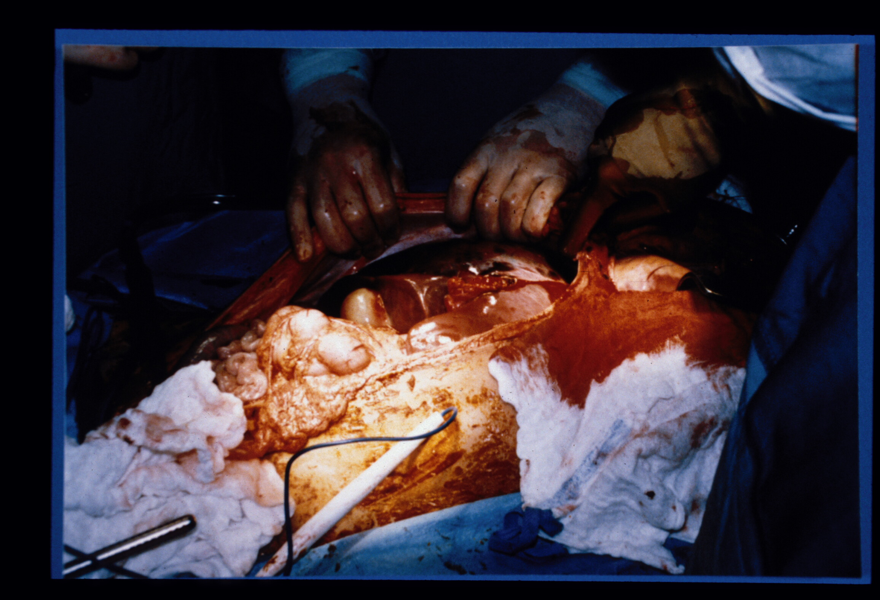
Notes:
Image shows a hemorrhagic liver injury intraoperatively.

Slide 72
Liver Injury
Observe for complications
  Recurrent bleeding
  Hemobilia
  Abscess
  Biliary fistula
  Arterial-portal venous fistula
  Sepsis
  Liver failure
Notes:
Occasionally, the patient must be returned to the OR for recurrent bleeding, usually as a result of inadequate hemostasis initially.
Hemobilia – RUQ pain with jaundice; may present days and weeks post injury so follow-up care is important.
Abscess – intrahepatic, perihepatic or biloma occur up between 7%-40% in the literature. Treated by percutaneous drain.
Biliary fistula –usually resolve nonoperatively. If output is high, >300ml per day, further investigation with a fistulogram, ERCP or transhepatic cholangiogram may be necessary. Ductal injury can be repair with stenting if necessary.

Slide 73
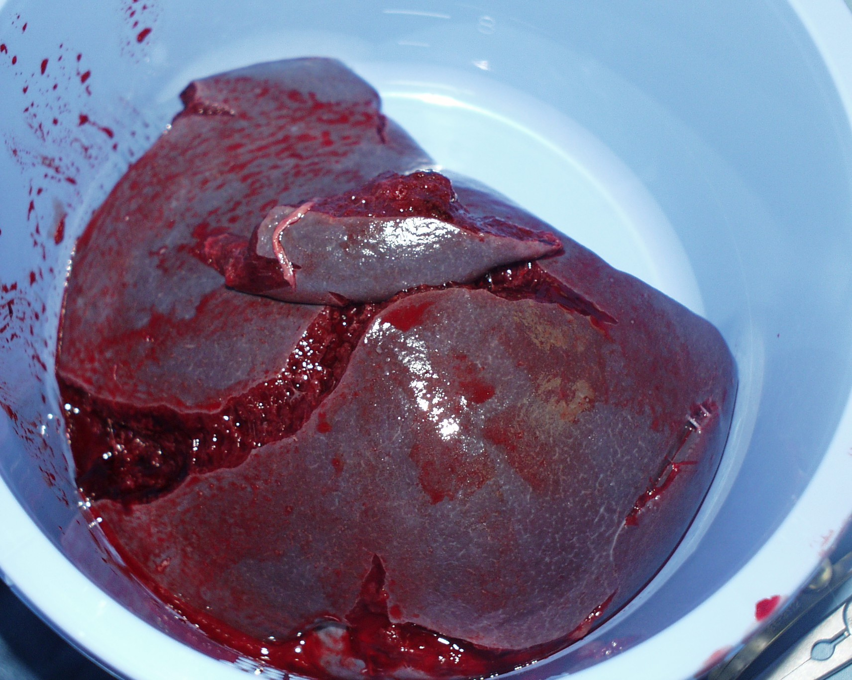
Injuries to the Spleen
Notes:
Image is a spleen in a bucket!

Slide 74
Spleen
Lymphoid organ
Reservoir for blood
Vulnerable to injury
Vascular supply
Primary immune defense organ
Notes:
The spleen is a lymphoid organ functioning in defense, hematopoiesis, and RBC and platelet destruction. Macrophages break apart the hemoglobin molecule from the destroyed RBCs and salvages the iron and globin and returns it to the bloodstream for storage in the bone marrow and liver. Approximately 90% of the splenic blood flow participates in the filtering process.
The spleen is a functionally complex organ occupying the left upper quadrant (LUQ) and is vulnerable to injury due to its proximity to left ribs 7-10. The spleen is the most vascular organ of the body, and approximately 350 L of blood passes through it per day. The spleen contains approximately 1 unit of blood at a given time, and injury poses a potentially life-threatening situation.
The blood supply is from the splenic artery which enters the spleen at the hilum and the splenic vein which originates outside the hilum. It joins the superior mesenteric vein to form the portal vein. It is extremely vascular and a source for profuse bleeding after injury.

Slide 75
Splenic Injury
Incidence
  Commonly injured abdominal organ
  Mortality depends on the type of trauma and associated injuries
  Mortality related to uncontrolled hemorrhage, delayed rupture, and sepsis
Notes:
Stated to be the most commonly injured intra-abdominal organ in most resources. However, depending on the resource, the spleen is either the most commonly injured organ or second most commonly injured organ, the liver being the other. Splenic injuries represent approximately 25% of all blunt injuries to the abdominal viscera.
The location of the spleen makes it vulnerable to penetrating trauma of the LUQ. The lower ribs in the LUQ provide some protection, however, can also cause injury due to penetration from fractures. Penetrating injuries also frequently involve the spleen along with other abdominal organs.
The diagnosis of penetrating splenic injury is made easily because patients will most likely go to surgery for a penetrating injury to the abdomen.

Slide 76
Splenic Injury
Assessment
Suspect in any patient with blunt injury to left side
Penetrating trauma can produce a range of injuries
FAST, CT scan, Angio
Grading system
Notes:
The most common finding associated with splenic injury is left lower rib fractures signifying adequate force has been transmitted to the LUQ . Left lower rib fractures are present in 44% of patients with splenic rupture.
As with other types of abdominal trauma, the signs and symptoms are those associated with pain to the affected area and shock like symptoms if injury is serious. In splenic injury, one may have referred pain to the left shoulder caused by the blood irritation to the phrenic nerve. This is called Kehr’s sign.
Initial evaluation of abdominal trauma is done with FAST to rule out free fluid. If positive, free fluid will usually be seen around the spleen or in Morrison’s pouch.
Nonoperative management should be considered for patients with splenic injury who are hemodynamically stable and who have no associated abdominal or CNS injuries that may preclude an accurate assessment of the abdomen by physical examination. CT scan is the preferred imaging modality of choice in hemodynamically stable blunt trauma. Injuries can be graded from I to VI. Helical CT scanners offer better imaging and provide clinicians more information when determining operative vs. nonoperative management. Active extravasation of contrast indicates ongoing bleeding and the need for urgent intervention.
The classic triad indicative of acute splenic rupture (i.e., left hemidiaphragm elevation, left lower lobe atelectasis, and pleural effusion) is not commonly present and should not be regarded as a reliable sign. However, any patient with apparent left hemidiaphragm elevation following blunt abdominal trauma should be considered to have splenic injury until proven otherwise.
More reliable signs of LUQ injury are medial displacement of the gastric bubble and inferior displacement of the splenic flexure gas pattern on radiology images.
Angioembolization may be utilized in select patients.
Many centers have established care guidelines for certain grades of injury. Reference www.aast.org for information on grading.

Slide 77
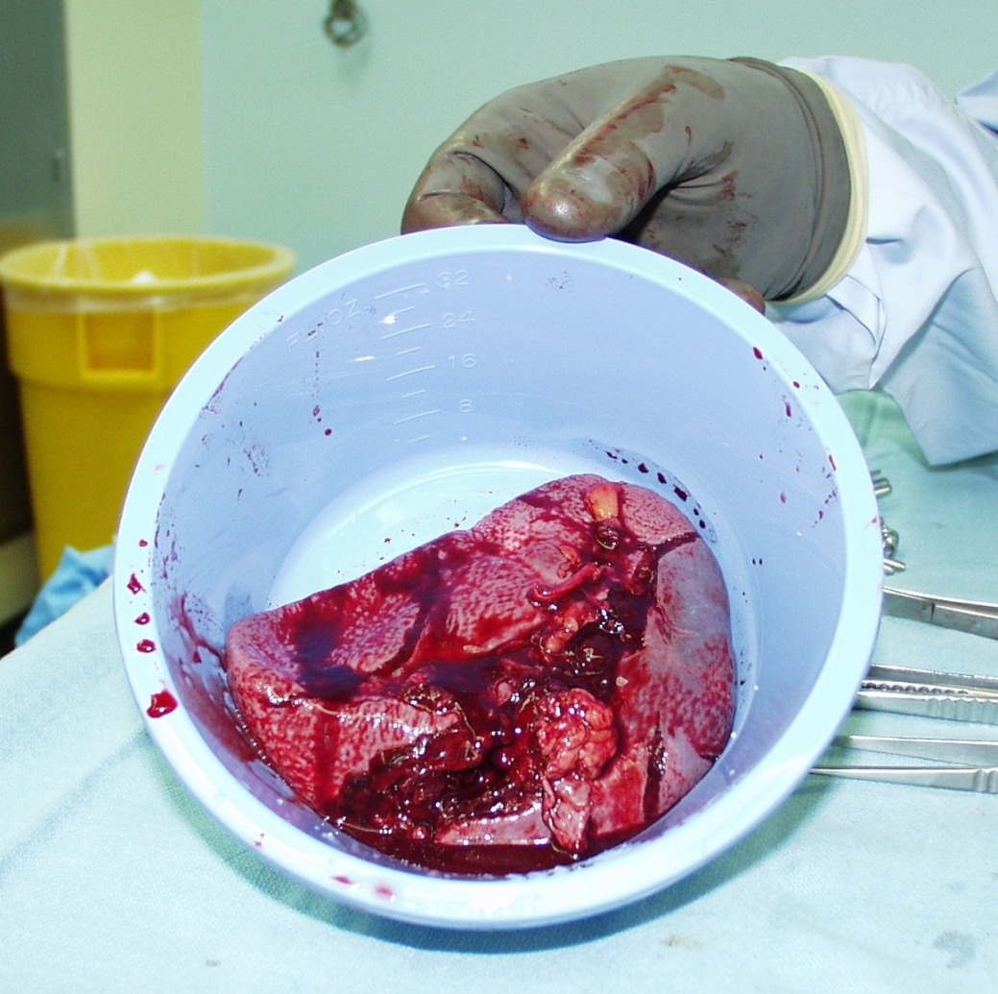
Splenic Injury
Management
Nonoperative in select patients
Splenorrhaphy and partial splenectomy
Splenectomy
Aggressive intraoperative resuscitation
Possible damage control
Notes:
The traditional treatment of blunt splenic trauma was splenectomy. However, more trauma surgeons are performing splenic salvage through nonoperative management as they recognize the important role the spleen plays in preventing overwhelming sepsis. When making nonoperative management decisions, the patient’s age, stability, associated injuries and type of splenic injury are evaluated.
If operative intervention is necessary, repair of the spleen or partial splenectomy is recommended when possible due to the role of the spleen in maintaining immunocompetence. Removal of the spleen is indicated for the patient with associated life-threatening injuries and shock. In cases of severe hemorrhage, resuscitation is aggressively performed with possible damage control procedure depending on patient’s stability.
.

Slide 78
Splenic Injury
Management
Monitor for failed observation
Observe for postoperative complications
  Bleeding
  Thrombocytosis
  Gastric distention
  Pancreatitis
  Infection
Ensure vaccines are given prior to discharge
Notes:
The nurse’s role is key to patient assessment. When observing a patient with known splenic injury, monitor signs and symptoms of increasing pain, shock like state, etc. This may indicate a failed attempt at nonoperative management. In the postoperative period, the nurse should observe for any complications and notify the appropriate surgeon as indicated.
Studies have shown that as many as 70% of patients may be treated nonoperatively, with success rates of up to 97%. Nonoperative management of splenic injuries is effective in more than 95% of children.
Again, the nurse’s role involves close observation for any complications, resuscitation, and after the acute period, ensuring vaccines are administered prior to discharge. Vaccinations include pneumococcal vaccine, H. influenza and meningococcal vaccines.
There is not a lot of good evidence regarding vaccine administration and few studies. The CDC still recommends all three vaccines to be given day 14 post splenectomy or just prior to discharge due to issues in follow-up. Current recommendations include repeated pneumococcal vaccine at 5 years.
Discharge instructions related to activity will need to be provided to patients who have had nonoperative management and are discharged home for continued recovery.

Slide 79
Overwhelming Postsplenectomy Sepsis (OPSI)
Rare
Can occur from 1 to 5 years after surgery
Illness presents with flu like symptoms, shock from sepsis, and DIC followed by death
Mortality is 50%
Preventative measures include vaccinations and education
Notes:
Rare; Few cases documented; less than 0.5%
More common in children

Slide 80
Retroperitoneal Hemorrhage
Management depends on the location
Penetrating trauma requires exploration
Blunt trauma –pelvic fractures
Hematoma – explore vs. leave alone
Notes:
70-80% retroperitoneal hemorrhage is due from blunt trauma involving pelvic fractures.
Much debate has occurred over the years as to how to intraoperatively manage a retroperitoneal hematoma. Most will advise to leave intact unless expanding, pulsatile, etc. The challenge is to gain control prior to exploring

Slide 81

Notes:
Note Yellow line – extravasation of contrast from artery in retroperitoneum

Slide 82

Abdominal Vascular Injuries

Slide 83
Abdominal Vascular Injury
Arterial injury
Can stop bleeding spontaneously
Usually occur with pelvic, thoracic, or visceral injury
Vascular signs may be obscured initially
Symptoms may include abdominal pain, back pain, hypoactive bowel sounds, tender abdominal mass
Notes:
More patients are surviving vascular injuries that previously caused them to exsanguinate before transport or in the ED. Injuries occur as a result of penetrating trauma primarily, however, blunt injury can also occur.
After a clean transection, arterial injuries secondary to penetrating injury can stop bleeding spontaneously.
Retroperitoneal hematoma in conjunction with pelvic or spine trauma may cause up to 4 liters of blood to collect.

Slide 84

Abdominal Vascular Injury
Arterial Injury Management
Volume replacement
Immediate surgery
End to end anastomosis or graft
Monitor for adequate volume status postoperatively
GSW to Infrarenal Aorta
Notes:
Restoration of volume may be impossible without surgical control.
The repair depends on the type and extent of injury.
Autogenous graft is preferred because many wounds are contaminated. Many injuries may require ligation if the site is contaminated.

Slide 85

Abdominal Vascular Injury
Venous Injury
Low pressure system capable of tamponade effect
Emergent operative repair for instability
Diagnostic tests for stable patients to determine extent of injury
Notes:
Shock unresponsive to fluid administration should cause one to suspect major injury.

Slide 86
Abdominal Vascular Injury
Venous Injury Management
Quick assessment
Massive fluid resuscitation
Pressure and packing
Operative repair to include ligation and grafting
Monitor for complications
Notes:
Some complicated repairs lead to stenosis of the vessel and increased risk of thrombosis or embolism. Others include dehiscence of the suture line and infection as well as bleeding.
Abdominal compartment syndrome can develop.

Slide 87

Damage Control !

Slide 88

Damage Control
Abbreviated laparotomy
Containment of bleeding and contamination
Temporary intra-abdominal packing
ICU for physiologic restoration
Definitive repair
Notes:
Damage control in a difference sense. This term was first coined in the early 90s to describe a “salvage” philosophy for patients with exsanguinating hemorrhage.
The approach arose out of the need to stop hemorrhage within the abdominal cavity, stage resuscitation, and correct coagulopathy, acidosis, and hypothermia….The Triad of Death. A move away from the traditional approach in which the surgeon “completed” the laparotomy which often led to the triad of death.
Note open abdomen with VacPak

Slide 89
Damage Control
Three phases
Control hemorrhage and contamination
Continued resuscitation in ICU
Planned reoperation for removal of packing; definitive repair with attempted closure
Notes:
In the ICU: Optimization of hemodynamics and oxygen delivery/consumption, clearance of lactate, core rewarming, correction of coagulopathy, ventilatory support, monitoring for abdominal compartment syndrome, and identification of additional injuries.
Key points:
Involves the placement of multiple laparotomy pads within the abdominal cavities.
OR reports in the chart should reflect that “the sponge count was incorrect.”
Any dressing changes and re-packing that occur in the Operating Room or in the ICU, must include lap sponges removed and replaced; all notes should indicate “sponges were left in the abdomen.”

Slide 90
Did you know?
A retained sponge at any time during the period which the abdomen is “open” with a VacPak™ or Whitman patch™ is not considered an adverse event and is simply part of the management of “Damage Control” and the open abdomen.
Notes:
At the time of definitive abdominal closure, a series of x-rays must be obtained in the OR prior to closure showing the entire body cavity
The dictated sponge count is “incorrect” must be included in the operative reports

Slide 91

Surgical Counts
X-ray detectable sponges
Count “incorrect” on operative record
Obtain an x-ray at end of permanent closure
Document when x-ray is done in lieu of count
Notes:
What is Your Policy?
As a matter of process, one should check their hospital policy to ensure Damage Control is included.
X-ray detectable sponges may be used as packing to facilitate removal at a later date e.g. “Damage Control.”
Count- When counted sponges are used as packing, they should be documented/dictated as incorrect.
An x-ray should always be done at the end of the permanent closure to fully evaluate cavity and validate that all sponges have been removed.

Slide 92
Complications of Abdominal Trauma
Abdominal compartment syndrome
Increased intra-abdominal pressure
Affects cardiac, pulmonary, and renal systems
Greater than 20 mm Hg causes adverse effects on various body systems
Notes:
The extent of organ involvement, level of injury, and time of injury until treatment affect the morbidity.
Increased intra-abd pressure prevents venous return (preload reduction) and impedes arterial outflow (increase in afterload). Transmitted backpressure from the abdominal cavity falsely elevates CVP, PAP, PCWP, PVR, and SVR.
Due to decreased preload and venous stasis, patients may develop DVTs; once IAH resolved, pulmonary emboli may occur.
Renal parenchyma is compressed reducing blood flow and urinary output.
Increased intrathoracic pressure (sec to abd) limits diaphragmatic excursion resulting in hypoventilation and hypoxia. Increased PIP; decreases tidal volume
It also impedes venous outflow from the brain increasing cerebral congestion so there is increased ICP but decreased CPP.
Decreased perfusion to gut exhibited by decreased intramucosal pH (pHi)
Occurs when the pressure within a closed anatomic space increases to the point that vascular flow into the area is compromised and the function and viability of the tissues within the compartment are threatened
How? Within any closed body cavity when the size of the compartment is restricted; when the volume of the contents in the compartment is increased
What you see:
Tense distended abdomen
Failure of ventilation: high PIP, high pCO2
Oliguria

Slide 93
Abdominal Compartment Syndrome
Primary Causes
Resuscitation edema
Bowel edema
Postoperative hemorrhage
Bowel obstruction
Closure of abdomen under tension
Abdominal packing
Notes:
Abdominal compartment syndrome (ACS), also referred to as intra-abdominal hypertension, is a clinical condition in which elevated intra-abdominal pressure leads to impaired end-organ perfusion.
Causes… It can be caused primarily by the above. Fluid resuscitation is a known risk factor.
Intra-abdominal hypertension (IAH) is when the abdominal pressure is sustained at 12 mm Hg or greater
Abdominal compartment syndrome (ACS) pressure greater than 20 mm Hg produces physiological effects.
There are two types of ACS, primary and secondary, as defined by a consensus statement from the World Congress of ACS.
Primary ACS is caused by a condition associated with injury in the abdominopelvic region requiring early surgical or radiological intervention, or a condition that develops following abdominal surgery e.g. surgical repair of abdominal organs, damage control surgery, bleeding pelvic fractures. It may also result from continuing hemorrhage from either a missed injury (surgical hemorrhage) or hypothermia/coagulopathy (non-surgical). Visceral edema from third spacing is also a consideration.
Secondary ACS is caused from other conditions that do not originate in the abdomen and appear to be fluid sequestered in the viscera due to a reperfusion injury and increased capillary permeability.
Patient with open abdomen.

Slide 94

Abdominal Compartment Syndrome
Secondary Causes
Intra-abdominal
infection
Ascites
Ileus
Pancreatitis
Sepsis
Major burns
Notes:
Some of the secondary causes are listed above.

Slide 95

Abviser Courtesy of Wolfe Tory
Notes:
Discuss values for Intra-Abdominal Hypertension: Sustained 12 mm Hg or more
Abdominal Compartment Syndrome: Sustained pressures > 20 mm Hg; clearly an indication for decompression; Consideration should be given for pressures between 15 and 20 with signs of organ failure
. When pressure increases above 20 mm Hg and oliguria is present, the abdomen should be re-explored.
Other signs that the nurse should monitor include increasing abdominal girth, increasing tenseness, decreased I & O, increased peak inspiratory pressures, and worsening lung compliance.
Any patient that has had massive fluid/blood resuscitation within a 24-hour period should have bladder pressure monitoring.
Recommendation: Check bladder pressures when volumes approach 10 liters of fluid or 10 units of packed cells
There are a few ways this can be done, however, the most simple and user friendly method is to use a commercially available kit called the ABVISOR.

Slide 96

Abviser Courtesy of Wolfe Tory
Notes:
Review the slide and all the changes that affect each body system as a result of abdominal compartment syndrome.
CV - Decreased cardiac output; Decreased preload; Increased afterload (SVR); Increased CVP and PCWP
Pulmonary - Increased peak inspiratory pressures; Increased airway pressure; Hypoxemia, hypercarbia; Decreased compliance
Renal - Decreased renal plasma flow; Decreased GFR; Oliguria, anuria
Neurologic - Increased ICP; Decreased CPP
Intestinal and Mucosa - Decreased blood flow to all abdominal organs; Decreased mesenteric and mucosal blood flow
Abdominal wall abnormalities - Actual defects; Large, open wound; Repair
Increased pressure; Reduces blood flow to abdominal wall; Leads to local ischemia and edema; Ischemia of muscle and fascia; Contributes to wound complications such as infection, dehiscence, herniation, and necrotizing fasciitis; Wall becomes less compliant and less capable of stretching to accommodate additional increases in pressure

Slide 97

Fasciitis
Notes:
Fasciitis as mentioned in previous slide

Slide 98
Reperfusion Phenomenon
Decompression
  Release of accumulated acids, metabolites (byproducts of anaerobic metabolism)
  Profound cardiac depression and hypotension
To blunt effects
  50 mEq Bicarb – may give 2-4 amps
  Volume resuscitation
Notes:
Review with the surgeon and staff the need for volume loading before abdominal decompression advocated as a means of controlling hypotension after acute reduction in SVR caused by a decrease in IAP or from ischemia-reperfusion phenomenon after decompression.
Some advocate giving the patient Bicarb to counter the influx of acids.

Slide 99
Complications of Abdominal Trauma
Acute acalculous cholecystitis (AAC)
Acute inflammation of gallbladder
Masked by concomitant injuries and interventions
Contributing factors include decreased oral intake, TPN, use of narcotics and gallbladder ischemia may occur due to hypotension
Diagnosis assisted by US, elevated WBC
Requires surgical intervention
Notes:
Cause of ACC is uncertain and most likely multifactorial.
Does not differ from calculous type except there is a higher rate of gangrene and perforation.
It is a diagnostic challenge because it can be masked by many things to include narcotic administration, incisional abdominal pain, other injuries or disease processes.
US is helpful in the diagnosis and an elevated WBC in found in 70% of cases.
The gallbladder can by removed by cholecystectomy or laparoscopic cholecystectomy.

Slide 100
Common Pitfalls
Failure to suspect intra-abdominal injury from the mechanism of injury
Failure to fully evaluate abdominal pain after sustaining blunt abdominal injury
Failure to perform timely operative intervention
Failure to recognize hemodynamic compromise and delay surgery for additional diagnostic testing
Notes:
There are some common pitfalls in evaluating the patient with abdominal trauma.

Slide 101
General Nursing Considerations
Preparation of patient
Current knowledge of resuscitation
Administer blood and blood products
Prevent hypothermia
Ongoing monitoring of patients
Monitor intake and output
Evidenced based practice
Notes:
Throughout all procedures, nursing staff must closely monitor the patient, continuously re-evaluating the ABCs.
The potential for bleeding and fluid volume deficit exists in patients with abdominal trauma.
A thorough understanding of shock and resuscitation is essential in managing the critically injured trauma patient.
Continuous monitoring is essential in minimizing the effects of hypovolemic shock.
Blood and blood products should be administered as indicated.
Warming measures to prevent hypothermia are essential and include the use of warm fluids/blood, warm blankets, warming lights, and heated respiratory gas applications.
Note: Preventing hypothermia is important to continue in the radiology suites as most are kept at a cool temperature due to the machinery operational requirements.
Frequent evaluations and the detection of changes in patients admitted for nonoperative management of solid organ injuries are essential. These patients may require serial exams and possible surgical intervention should nonoperative management fail.
The level of monitoring depends on the physiological and clinical needs of the patient. The use of cardiac monitoring, pulse oximetry, and arterial monitoring are usually sufficient for the uncomplicated patient, however, more complex patients may require the insertion of special monitoring devices utilizing advances in fluid monitoring and hemodynamic status.
Once the patient has been stabilized, the nurse’s focus transitions to continued resuscitation as indicated and prevention of complications.
Nutrition, mobility, pain control, and wound care are just a few of the responsibilities throughout the continuum of care.
Due to the potential effects of multiple tests requiring contrast on the renal system, monitoring of intake, output, creatinine levels is essential, especially in the elderly patient.

Slide 102
Summary
Abdominal trauma presents challenges
Not all injuries are easy to diagnose
Not all diagnostic modalities are useful in certain injuries
Nursing staff must be astute in assessment skills and injury management
Teamwork is essential
Optimizing outcomes is important

