Slide 2
Maxillofacial and Ocular Injuries

Slide 3
Objectives
At the conclusion of this presentation the participant will be able to:
  Identify the key anatomical structures of the face and eye and the impact of force on those structures
  Discuss assessment priorities for a patient with maxillofacial and ocular injuries
  Prioritize the care of a patient with facial and ocular injuries
  Discuss psychosocial support for a patient with maxillofacial and ocular injuries

Slide 4

Mechanism of Injury
Low velocity
High velocity
Notes:
Magnitude of maxillofacial injury is directly proportionate to the velocity at impact when the face makes contact with an object.
Low velocity
Soft tissue
Contusions, abrasions, lacerations
High velocity
Extensive soft tissue
Bony disruption of facial structures
Common predictable fault lines

Slide 5
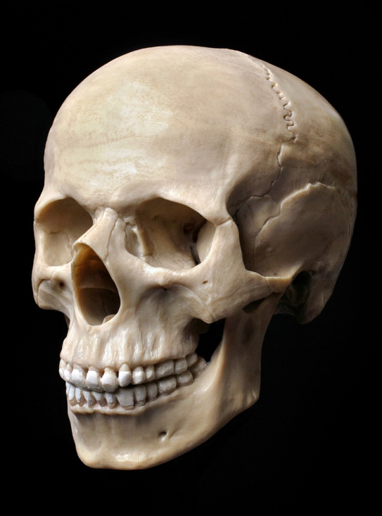
Pathophysiology
Bones of face make up the most complex skeletal area of the body
Maxillofacial fractures result from either blunt or penetrating trauma
Notes:
Maxillofacial fractures result from either blunt or penetrating trauma.
Penetrating injuries are more common in city hospitals.
--------Midfacial and zygomatic injuries.
Blunt injuries are more frequently seen in community hospitals.
--------Nose and mandibular injuries.

Slide 6
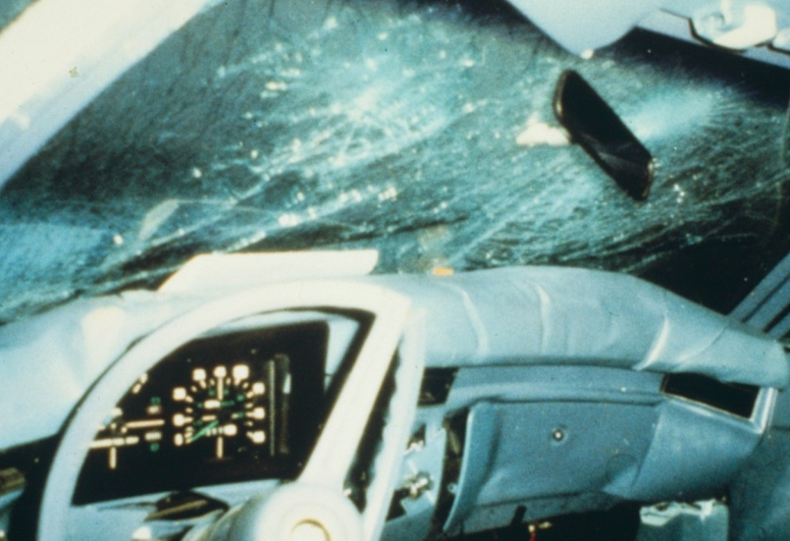
Pathophysiology
‘G’ force is a measure of acceleration not produced by gravity
High Impact:
  Supraorbital rim – 200 G
  Symphysis Mandible –100 G
  Frontal – 100 G
  Angle mandible – 70 G
Low Impact:
  Zygoma – 50 G
  Nasal bone – 30 G
Notes:
The amount of force to fracture different facial bones have been studied and have been divided into High impact (greater then 50 times gravity) and Low Impact (less then 50 times gravity).
High Impact:
Supraorbital rim – 200 G
Symphysis of the Mandible –100 G
Frontal – 100 G
Angle of the mandible – 70 G
Low Impact:
Zygoma – 50 G
Nasal bone – 30 G

Slide 7
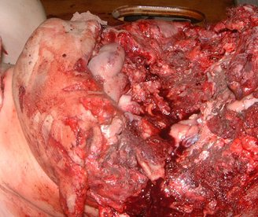
Notes:
Image is of high impact to face. Arrow pointing to chin.

Slide 8
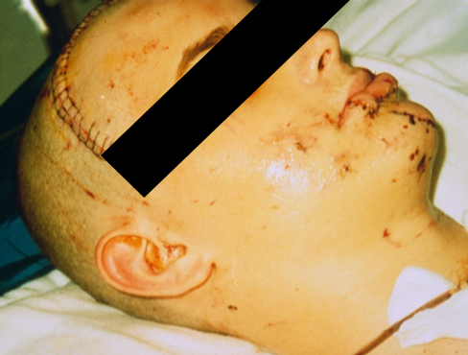
Etiology
60% of patients with severe facial trauma have multisystem trauma and the potential for airway compromise
Notes:
60% of patients with severe facial trauma have multisystem trauma and the potential for airway compromise.
As many as 20-50% of the patients with facial trauma sustain concurrent brain injury, especially those with upper face and midface fractures.
1-4% of these patients have cervical spine injuries. Remember to always r/o cervical spine injuries clinically and radiographically in such patients.
Blindness can occur in .5-3% of these trauma pts and are mostly seen in patients with LeFort 3 (2.2%) and LeFort 2 (.64%).

Slide 9

Etiology
25% of women with facial trauma are victims of domestic violence
  Increases to 30% if an orbital wall fx is present
25% of patients with severe facial trauma will develop Post Traumatic Stress Disorder
Notes:
As many as one fourth of women with facial trauma are victims of domestic violence. If a women has an orbital fracture, the likelihood of sexual assault or domestic violence increases to more then 30%.
In addition to physical consequences of facial trauma, there are psychological costs as well. More then a one quarter of patients with severe facial trauma will develop Post Traumatic Stress Disorder.

Slide 10
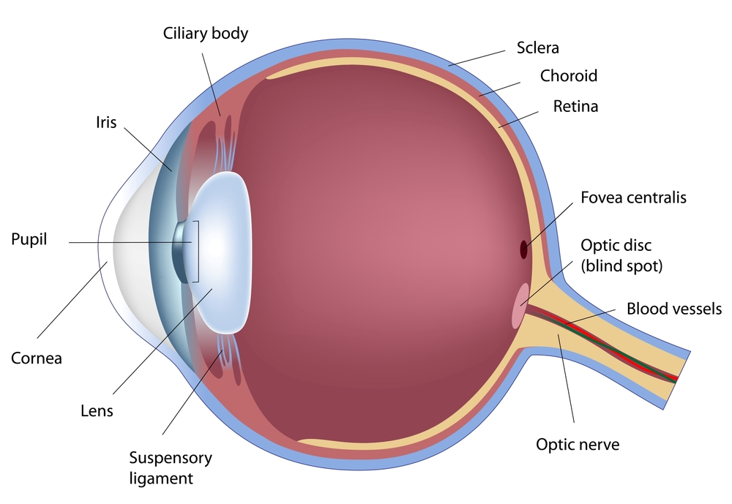
Ocular Structures
Human Eye Anatomy
Notes:
Light enters the eye through the cornea, pupil and lens then falls on the retina activating rods and cones. Rods and cones transmit light messages through retinal ganglia to the optic nerve which connects which extends to the optic chiasm in the brain.
The sclera is a tough connective tissue layer that acts as the structural skeleton for the globe and protects internal ocular structures.
The lens lies anterior to the vitreous and is suspended behind the iris by fibers connected to the ciliary body. The ciliary body is responsible for changing the shape of the lens from biconvex for near vision and for distance vision, the lens flattens
The anterior chamber lies in front of the iris and contains aqueous humor which is produced by the ciliary body. Aqueous humor is continually produced and drains through Schlemm’s canal.
The cornea is an avascular structure that blends with the sclera. It becomes contiguous with the conjunctiva.

Slide 11
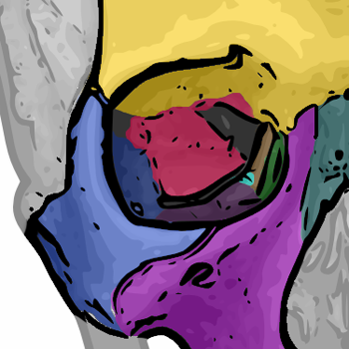
Bony Orbit
Roof
  Frontal bone
  Sphenoid
Medial wall
    Maxilla,
    lacrimal, ethmoid
    body of sphenoid
Floor
    Maxilla
    Palatine
    Zygoma
Lateral
    Zygoma and greater sphenoid
Frontal
Sphenoid
Zygoma
Maxilla
Notes:
The bony orbit is pyramid in shape with the apex positioned posterior.
The orbits protect the globe and contain the extraocular muscles.

Slide 12
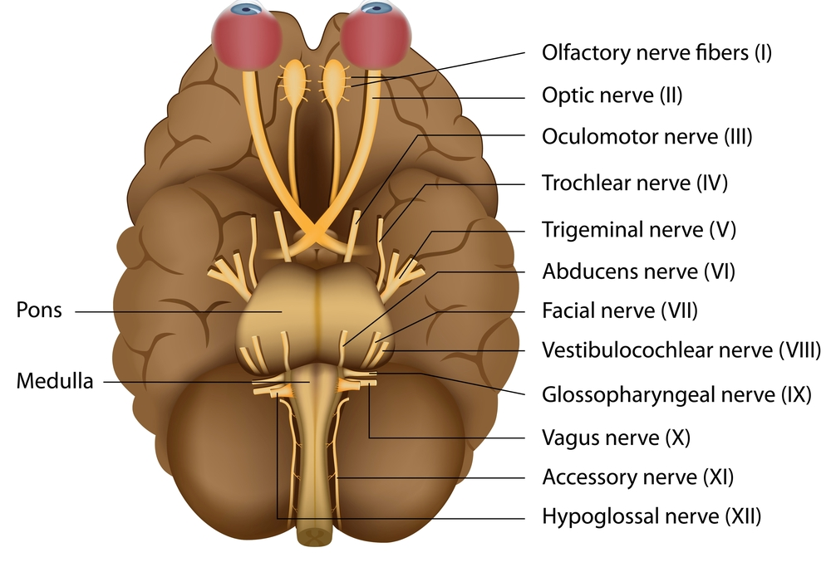
Cranial Nerves
Notes:
Eyelids protect the globe and facilitate distribution of tear film across the cornea
Lid opening and elevation occurs from sympathetic stimulation if Muller’s muscle, and CN III innervation of the levator muscle.
The orbicularis muscle is responsible for eyelid closure. This muscle is innervated by CN VII.
Extraocular muscles are innervated by CN III, IV, and VI.
Sensory innervation to the ocular structures is provided by CN V.

Slide 13
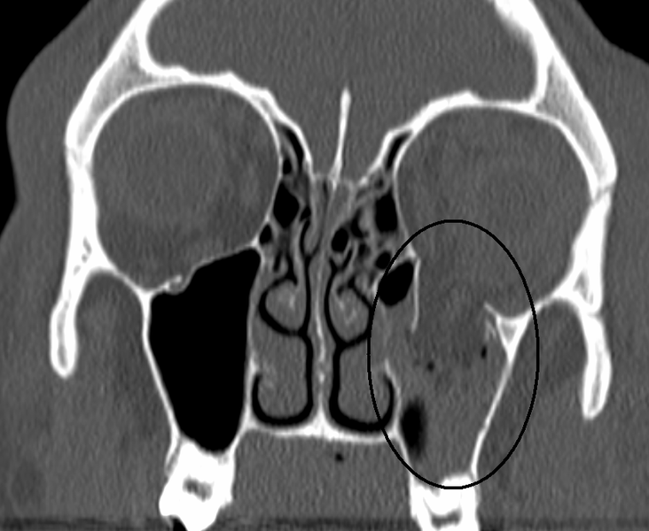
Orbital Fractures
Image found on Wikimedia.com
Notes:
Orbital fractures frequently occur in the floor of the orbit due to the thinness of the bone and underlying maxillary sinus.
Blowout fractures result from blunt force to the globe itself or to the inferior orbital rim causing compression and buckling of the orbital floor.

Slide 14
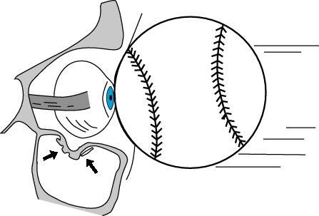
Orbital Fractures
Orbital Fractures
  Usually through floor or medial wall
  Enophthalmos
  Anesthesia
  Diplopia
  Infraorbital stepoff deformity
  Subcutaneous emphysema
Image found on Rad.washington.edu
Notes:
Image can be found at http://www.rad.washington.edu/academics/academic-sections/msk/teaching-materials/online-musculoskeletal-radiology-book/facial-and-mandibular-fractures?searchterm=orbital+fracture

Slide 15
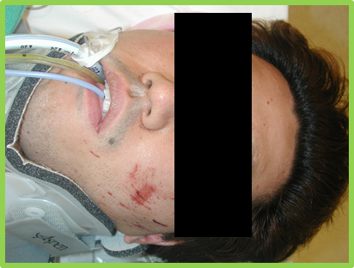
Orbital Fractures
Symptoms
  Periorbital swelling
  Crepitus
  Proptosis
  Ophthalmoplegia
  Enophthalmos
  Palpable defects
Assess for globe injury
Avoid nose blowing
Assess for entrapment
Notes:
Symptoms include periorbital swelling, crepitus around the orbital rim, proptosis, ophthalmoplegia (decrease movement of the globe) and possibly enophthalmos if the orbital contents have herniated through the bony defect.
Optic nerve injury or globe rupture is an associated finding and requires urgent intervention to prevent vision loss.
Extraocular muscles must be evaluated for entrapment.
Teach patient to avoid nose blowing to prevent intraorbital air and proptosis.
Image is a 28 year old male involved in an MVC with left orbit fracture and globe injury.

Slide 16
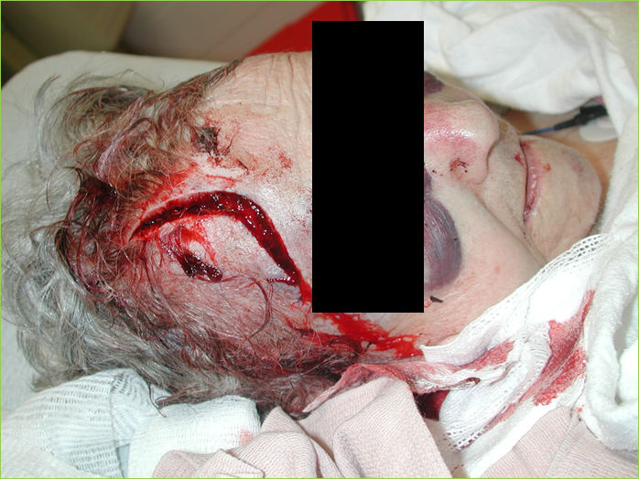
Notes:
This 73 yr old female fell down the stairs sustaining this large laceration of her forehead but also sustained orbital wall fractures.

Slide 17
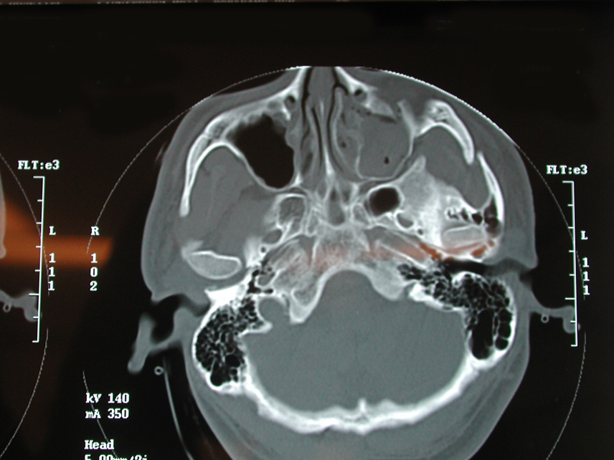
Notes:
CT scan of orbit fracture

Slide 18
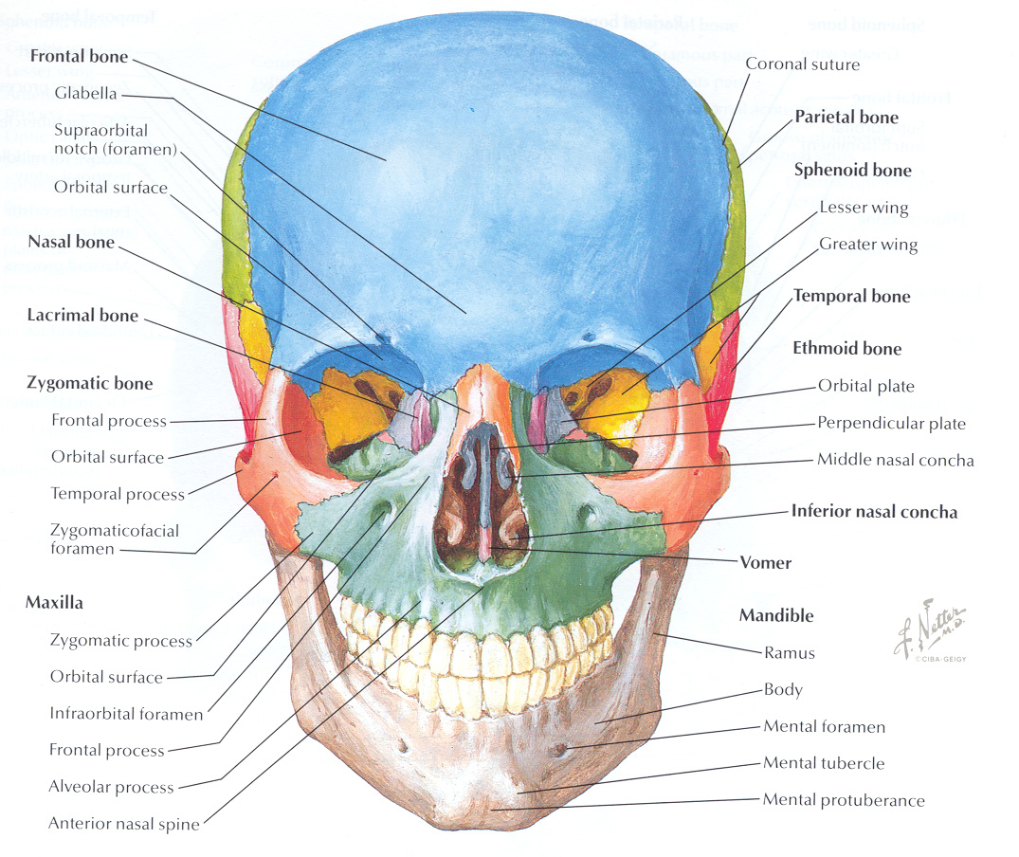
Facial Structures
Notes:
The face can be divided into thirds
Upper third
Injury to the upper third of the face includes frontal bone fractures, frontal sinus fractures, and upper nasal fractures.
Injuries may result in epistaxis, CSF rhinorrhea, injury to the upper branch of the Trigeminal nerve and facial paresthesias.
Fractures of the orbital roof may communicate with the supraorbital fissure through which branches of CN III, IV, VI pass through the orbit and a resultant Superior Orbital Fissure Syndrome (absent V1 sensation, pupillary fixation and dilation, loss of extraocular movement, down and out positioning of the eye, & ptosis.
Intracranial injuries are common.
Middle third
Common injures include nasal and orbit fractures. Severe fractures may cause loss of sense of smell. LeFort fractures (will be discussed later).
Most midface fractures communicate with the orbit and require a complete ocular assessment including vision, visual acuity and extraocular muscle movement.
Lower third
Injuries to the lower third of the face include maxilla and mandible fractures.
Injuries frequently result in malocclusion and or inability to completely open the mouth, injury to the V3 branch of the trigeminal nerve and paresthesias as well as injury to CN VII result in abnormal facial expression.

Slide 19
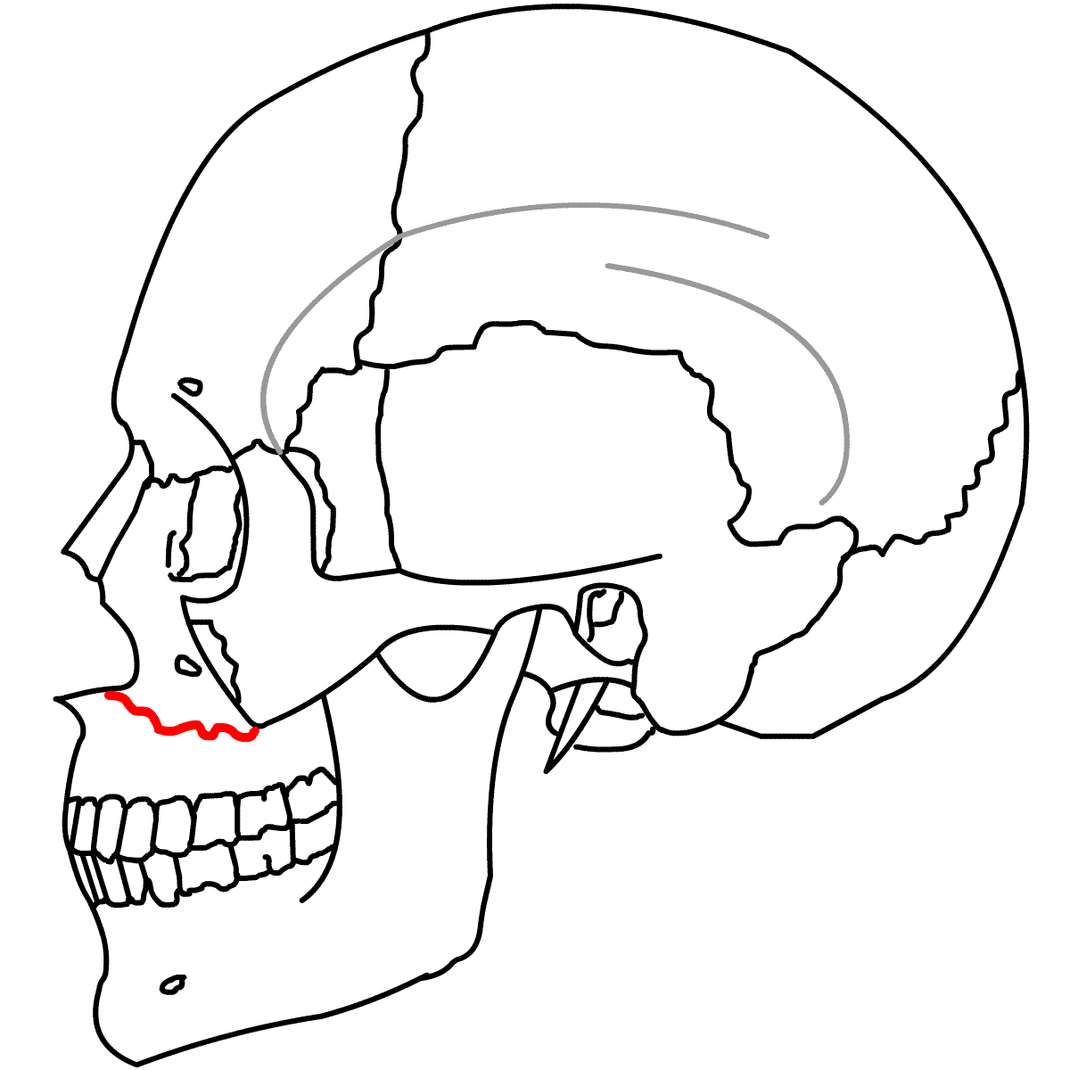
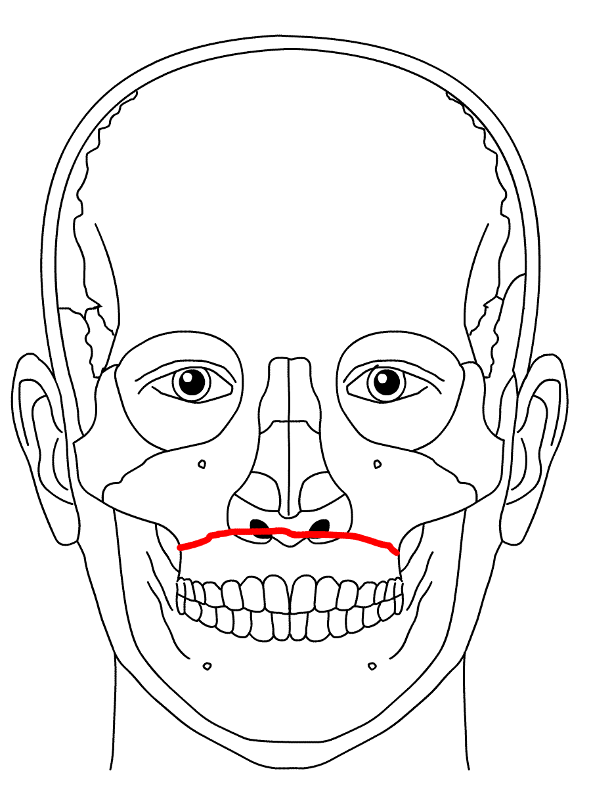
LeFort I Fracture
Image found on Wikimedia.com
Notes:
LeFort I fracture is a transverse fracture that runs between the maxillary floor and orbital floor just below the nasal septum. It may involve the medial and lateral walls of the maxillary sinuses.
Results from forces of injury directed on the lower maxillary alveolar rim in a downward direction.
Clinically, the lower maxilla and teeth are mobile or floating but the nose and remaining midface are stable.
Patient will likely have malocclusion, may have trismus.
Assess the patient for a mandible fracture as well.

Slide 20
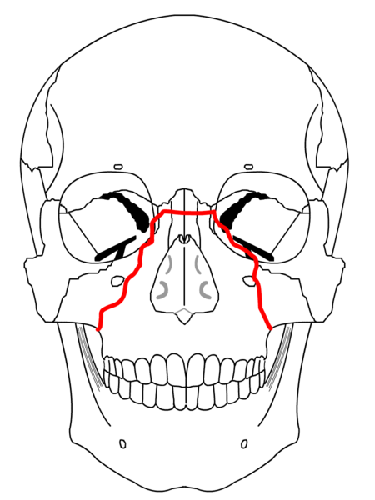
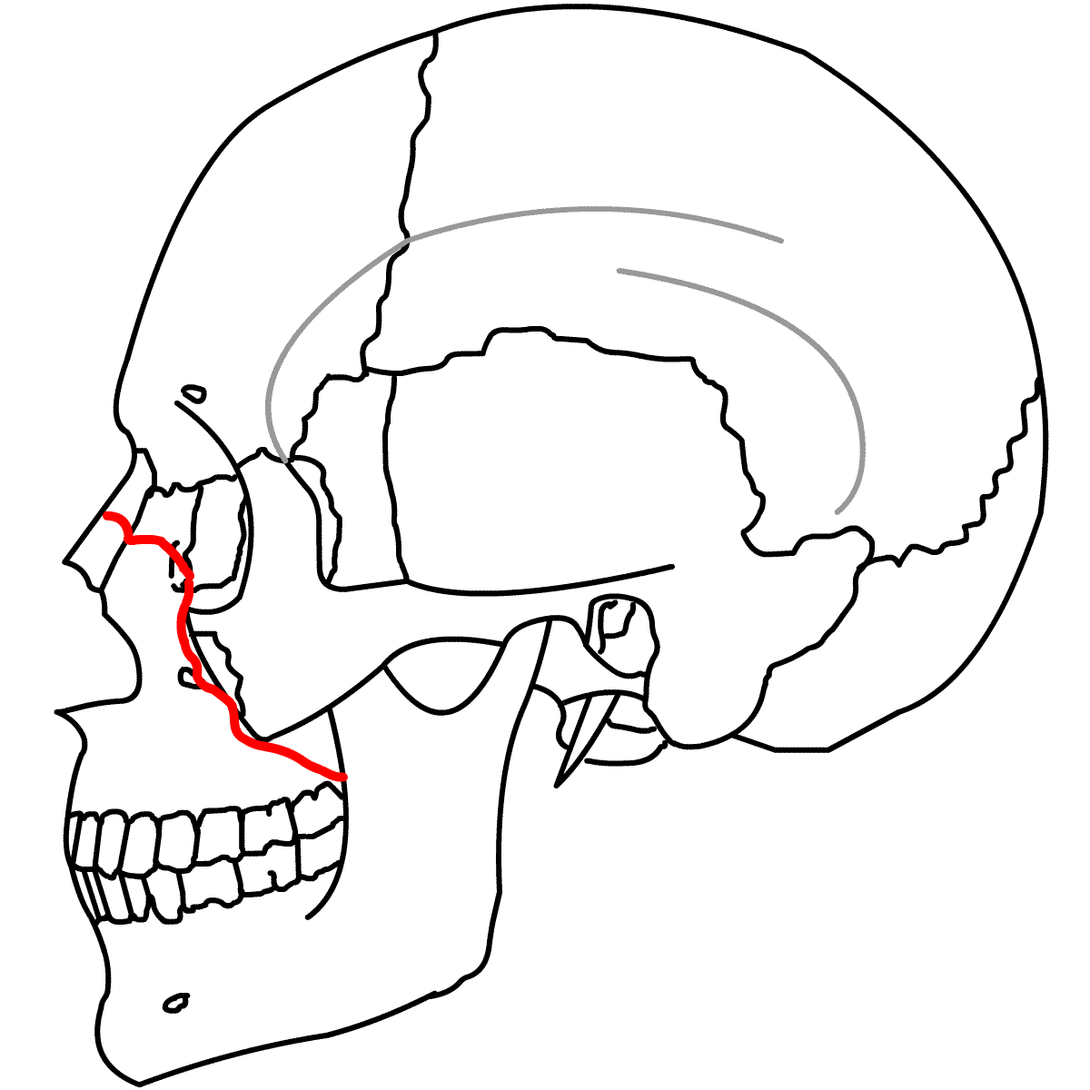
LeFort II Fracture
Image found on Wikimedia.com
Notes:
LeFort II or middle third fracture involves the pyramidal area including the central maxilla, nasal area, and ethmoid bones. This portion of the face is a tripod shape with the apex at the nose. Grasping the front teeth and palate causes movement of the nose and upper lip with no movement of the orbital complex.
Significant force is required to fracture this area so the patient should be carefully evaluated for other injures.
Patients may have a “caved-in” appearance of face.
May appear to have widening between the eyes (telecanthus).
May have paresthesias of the V2 branch of the trigeminal nerve.
Will complain of malocclusion.
The nose, lips and eyes are usually edematous with subconjunctival hemorrhage and epistaxis.
Anticipate need for early intubation to protect airway due to facial edema.
The presence of CSF rhinorrhea suggests an open skull fracture.

Slide 21
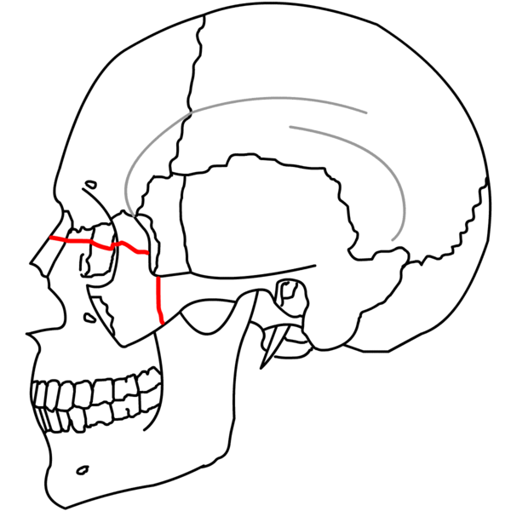
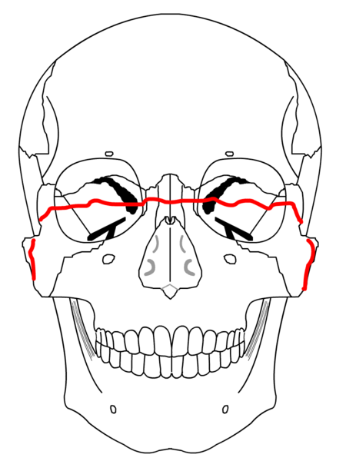
LeFort III Fracture
Image found on Wiimedia.com
Notes:
Characterized by complete craniofacial dysjunction (can be hemi-LeFort III).
Severe injury often associated with massive soft tissue injury, ocular injuries, traumatic brain injury and other skull injuries.
Because the nasoethmoid complex is fractured, there is a high incidence of cribriform plate fractures and dural tears.
Rocking the maxilla moves the entire face.

Slide 22
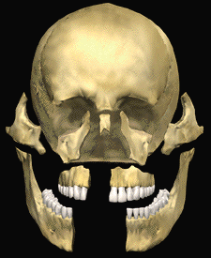
Le Fort Fractures

Slide 23
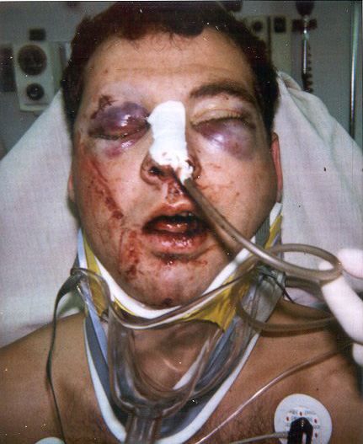
Le Fort III Fracture
Periorbital hematoma
Racoon eyes suggestive of basal skull fracture.
Inappropriate placement of nasogastric tube
Notes:
Ask the question why the NG tube is inappropriately placed

Slide 24
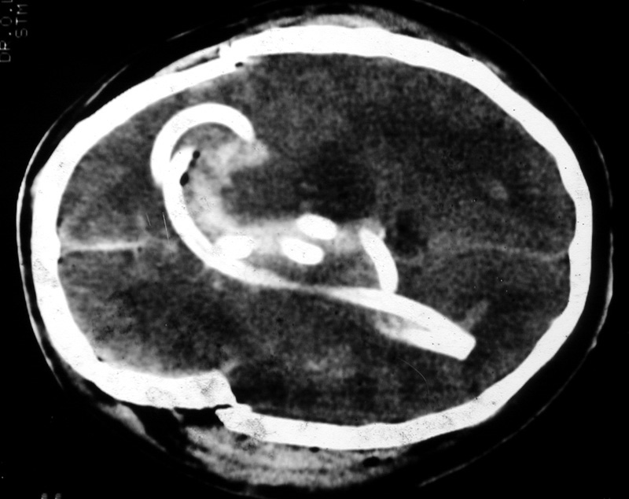
Notes:
Classic image of NG in Brain

Slide 25
Notes:
Another classic image.

Slide 26
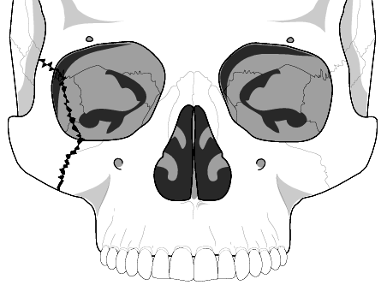
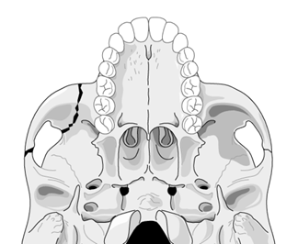
Tripod Fracture
Image found on Rad.washington.edu
Notes:
Probably the most common facial fracture is the tripod or zygomaticomaxillary complex fracture, so called because it involves separation of all three major attachments of the zygoma to the rest of the face.
Image found at http://www.rad.washington.edu/academics/academic-sections/msk/teaching-materials/online-musculoskeletal-radiology-book/facial-and-mandibular-fractures?searchterm=tripod

Slide 27
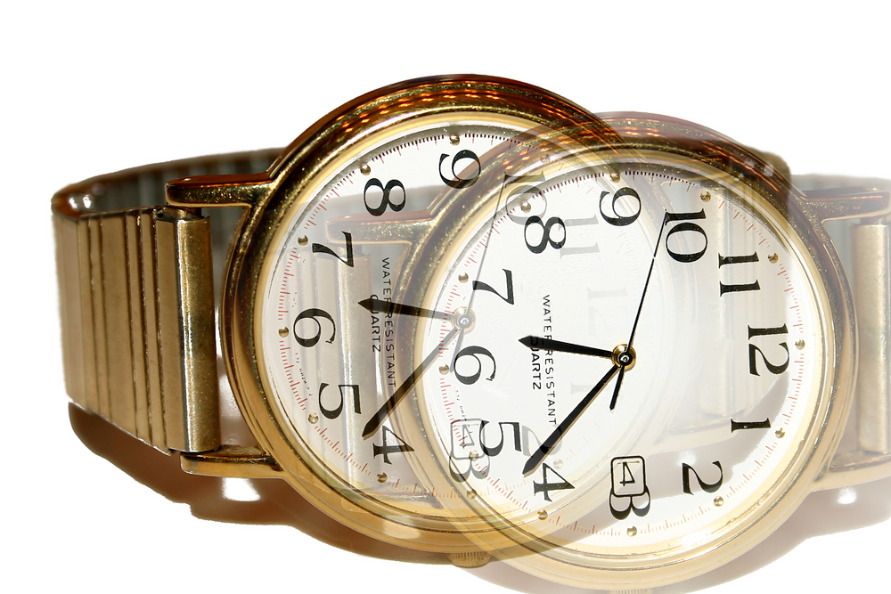
Orbitozygomatic Fractures
Complex fractures of the zygoma and orbital floor
May have double vision, ocular proptosis or enophthalmos
Must assess for entrapment of extraocular muscles
Surgical management directed at decompression of entrapped muscles and anatomic realignment of zygoma
Notes:
Orbitozygomatic fractures are extensive fracture of the zygomatic process. It consists of a fracture through the frontozygomatic suture and the maxillary process of the zygoma. Fracture lines pass through the inferior orbital floor, the inferior orbital rim and the lateral wall of the maxillary sinus, and the zygomatic arch.
Symptoms include pain, trismus, diplopia, numb upper lip, lower lid and bilateral nasal area.
Swelling ecchymosis of malar and periorbital areas, palpable infraorbital rim “step-off” entrapment of extraocular muscles with disconjugate gaze.
Surgical management is directed at decompressing the entrapped tissues and restoring the orbital structure to prevent diplopia and enophthalmos.
The zygomatic arch is repositioned to give proper midface alignment and symmetrical midface projection.

Slide 28
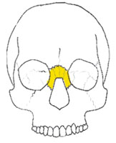
Naso-Ethmoidal-Orbital Fracture
Fractures that extend into the nose through the ethmoid bones.
Associated with lacrimal disruption and dural tears.
Suspect if there is trauma to the nose or medial orbit.
Patients complain of pain on eye movement.
Notes:
NEO fracture is defined as a fracture that extends into the nose through the ethmoid bones. These fractures are associated with lacrimal disruption and dural tears.
Suspect this type of a fracture if there is trauma to the nose or medial orbit. Patients typically complain of pain on eye movement.

Slide 29
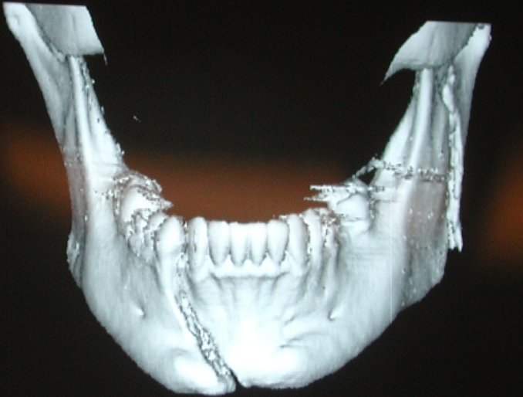
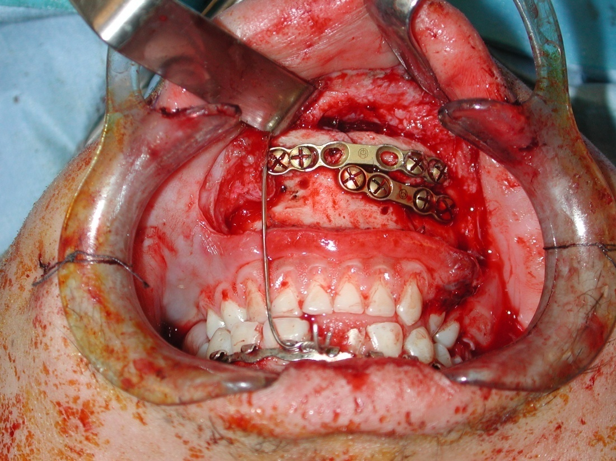
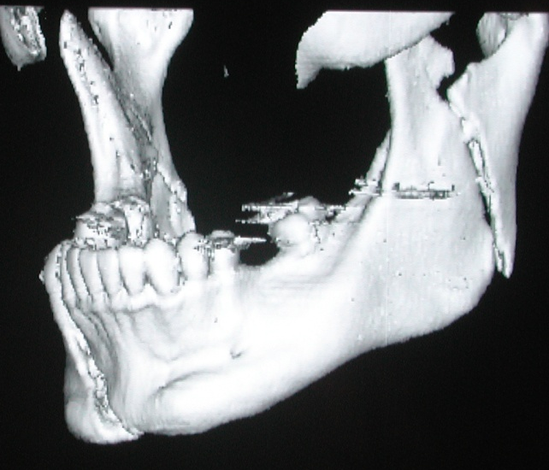
Mandibular Fractures
Notes:
Mandible is a commonly fractured bone both as an isolated fracture due to direct blows as well as in combination with other fractures as seen with MVC’s.
Common sites of mandibular fractures are body (~ 30-40%), angle(~25-30%), and condyles (~ 15%).
Double fractures are common and usually occur on contralateral sides.
The mandible may also be dislocated without fracture as may occur with a large yawn.

Slide 30
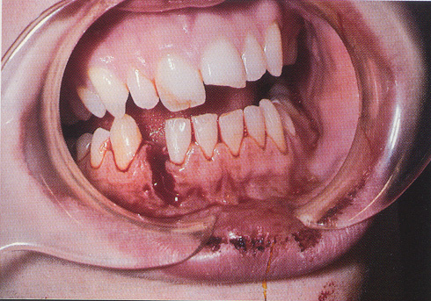
Mandible Fractures
Pain
Malocclusion
Separation
Inability to open mouth
Tongue blade test
Notes:
These fractures manifest clinically with
Mandibular pain.
Malocclusion of the teeth
Separation of teeth with intraoral bleeding
Inability to fully open mouth.
Preauricular pain with biting.
Tongue blade test.
A screening maneuver for mandibular fractures is the “tongue blade test.” Most patients with mandibular fractures will not be able to exert much bite force because of pain. The masseters are considered the strongest muscles in the body, and normal adults can usually easily bend and break a tongue blade, which is clenched between their teeth. Patients with mandible fractures are unable to perform this task without extreme discomfort, and difficulty performing this task should be considered at high risk for a mandible fracture.
A step off in the dental line or ecchymosis to the floor of the mouth are often present and is highly suggested of a mandibular fracture. Patients are unable to fully open their mouth.
Patients may have preauricular pain with biting when there is a fracture of the condyle.
The open fracture line is evident clinically. There is slight mal-alignment of the teeth.

Slide 31
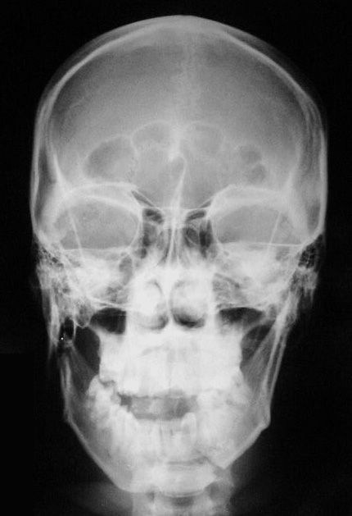
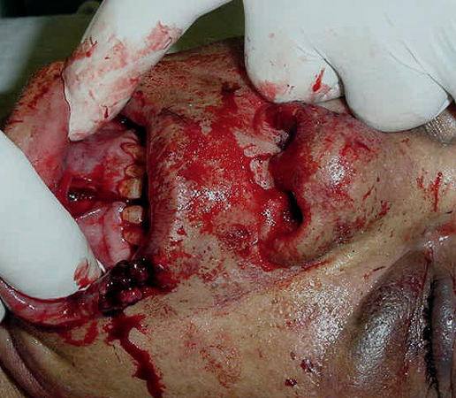
Mandibular Fracture
Direct frontal trauma with jaw fracture

Slide 32
Mandibular Fractures Treatment
Nondisplaced fractures:
  Analgesics
  Soft diet
  oral surgery referral in 1-2 days
Displaced fractures, open fractures and fractures with associated dental trauma
  Urgent oral surgery consultation
All fractures should be treated with antibiotics and tetanus prophylaxis.
Notes:
Nondisplaced fractures:
Analgesics
Soft diet
Oral surgery referral in 1-2 days
Displaced fractures, open fractures and fractures with associated dental trauma
Urgent oral surgery consultation, these patients are usually admitted.
These patients either need closed reduction with occlusion fixation or open reduction.
All patients with mandibular fractures should be treated with antibiotics and tetanus prophylaxis.
Antibiotics of choice are PCN, clindamycin or a 1st generation cephalisporin.

Slide 33
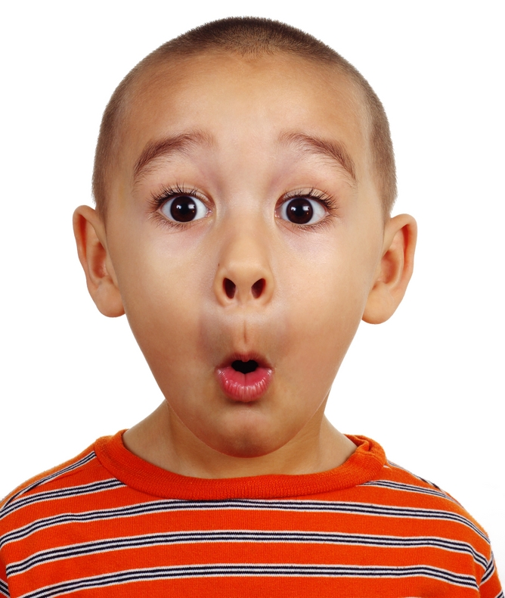
Maxillofacial Injuries General Assessment
ABC’s
Assess for symmetry of facial structures
  Assess for paresthesias
  Assess symmetry of facial movements
Assess the ears, nose and oral cavity for occult lacerations, hematomas
Palpate for crepitus, tenderness or deformity
Assess sense of smell
Notes:
Initial assessment and stabilization of the patient’s airway, breathing and circulation should be highest priority. High velocity blunt forces frequently cause concomitant intracranial, thoracic and abdominal injuries.
Patients with maxillofacial trauma have a greater risk for airway compromise from edema, bleeding and disruption of the bony structures.
Assess for symmetry of facial structures from a frontal view and a profile view.
Assess for paresthesia along the three branches of cranial nerve V.
Assess for symmetry of facial movements (cranial nerve VII) by having the patient puff out cheeks, smile, show teeth, frown, raise eyebrows and close eyes tightly.
In the unconscious patient, testing corneal reflex will assess the integrity of CN V and CN VII.
Inspect the ears, nose, oral cavity and oropharynx for laceration, contusions, hematomas or other soft tissue defects.
Septal hematoma should be drained urgently to avoid necrosis of the septum.
Assess any drainage for CSF.
Loosely apply gauze at the base of the nose to absorb drainage.
Battle’s sign or raccoon’s eyes.
Assess sense of smell--Tests cranial nerve I; have the patient identify a familiar odor.

Slide 34
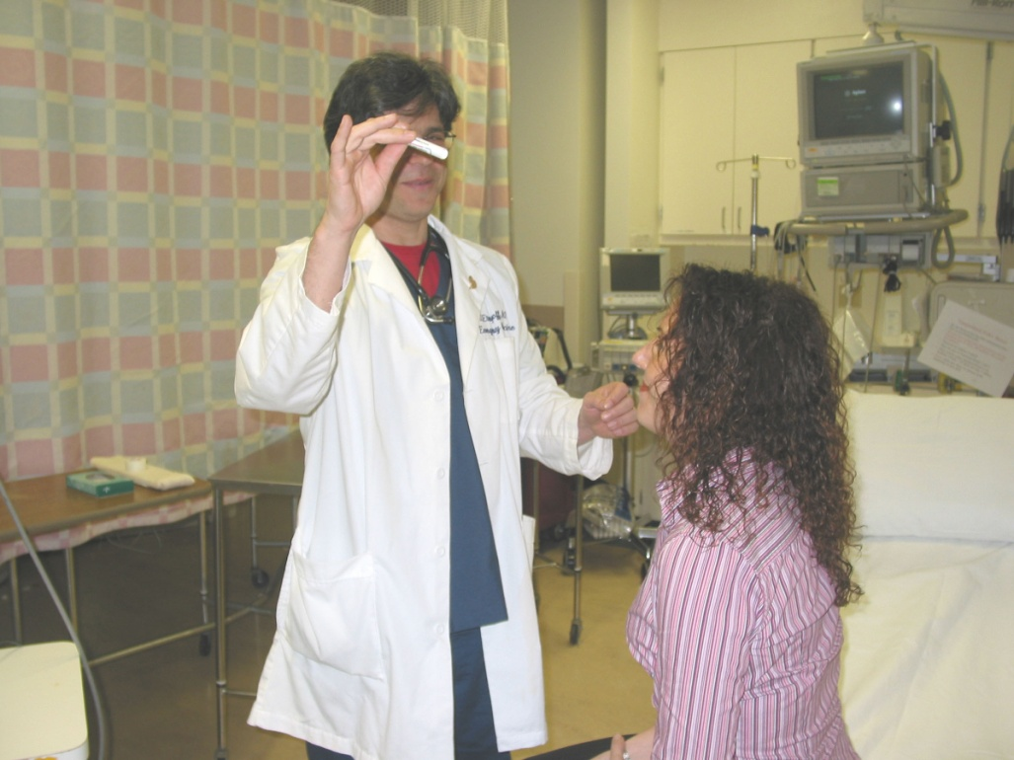
Ocular Assessment
Visual acuity
Pupil assessment
Extraocular movements
Eye position and movement
Intraocular pressure
Fundoscopic exam
Notes:
Visual acuity
Assess each eye separately.
If the patient cannot see any letters or symbols on Snellen or Allen chart, assess the patient’s ability to perceive light and the direction of the light.
Pupil assessment
Assesses cranial nerves II and III.
CN II—direct pupillary response to light and CN III the consensual response to light.
Swinging light test for Marcus Gunn pupil.
Marcus Gunn pupil— the pupil will constrict when a light is shone in the opposite eye. When the light is quickly moved to the diseased eye, the pupil dilates.
Extraocular movements
Assesses cranial nerves III, IV and VI.
Abnormal findings may be caused by orbital edema, entrapment or direct injury to one or more cranial nerves.
Eye position and movement
Exophthalmos (globe pushed out) may be seen in orbital edema, retrobulbar hemorrhage, orbital abscess.
Enophthalmos (sunken globe) is common with orbital fractures.
Eyes lying in different horizontal planes should consider an orbital floor fracture.
Intraocular pressure: Normal pressure is 10-22mmHg.

Slide 35
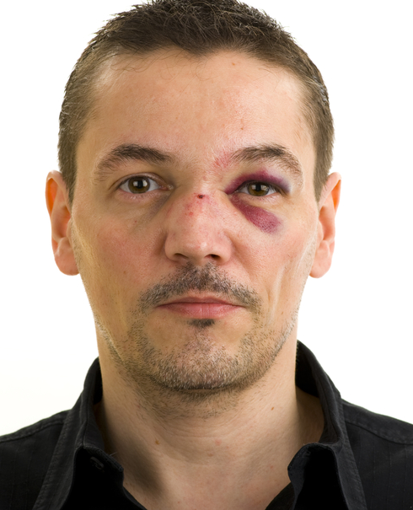
Physical Examination
Inspect open wounds for foreign bodies
Palpate the entire face
  Supraorbital and Infraorbital rim
  Zygomatic-frontal suture
  Zygomatic arches
Notes:
Inspection of the face for asymmetry. Best done at the head of the bed.
Ask the patient to smile, frown, whistle, raise their eyebrows, close their eyes. Inspect open wounds for foreign bodies.
Palpate the entire face.
Supraorbital and Infraorbital rim
Zygomatic-frontal suture
Zygomatic arches
Note ecchymosis (Battle’s sign, Raccoon eyes)

Slide 36
Physical Examination
Inspect the nose for asymmetry, telecanthus, widening of the nasal bridge
Inspect nasal septum for septal hematoma, CSF or blood
Palpate nose for crepitus, deformity and subcutaneous air
Palpate the zygoma along its arch and its articulations with the maxilla, frontal and temporal bone
Notes:
Inspect the nose for asymmetry, telecanthus, widening of the nasal bridge. Measure the distance between the medial canthi. In normal patients the distance is 35-40mm. If its greater then 40 mm you should suspect nasoethmoid-orbital trauma.
Inspect nasal septum for septal hematoma, CSF or blood. (place a drop of blood on a paper towel and look for a halo sign, nonspecific).
Palpate nose for crepitus, deformity and subcutaneous air.
Palpate the zygoma along its arch and its articulations with the maxilla, frontal and temporal bone.

Slide 37
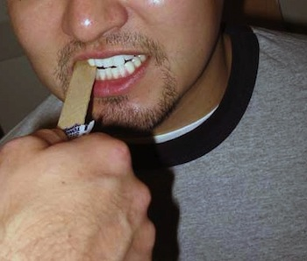
Physical Examination
Check facial stability
Inspect the teeth
Intraoral examination:
  Manipulation of each tooth
  Check for lacerations
  Stress the mandible
  Tongue blade test
Palpate the mandible for tenderness, swelling and step-off.
Notes:
Open pts mouth and grasp the maxilla arch, place the other hand on the forehead. Push back and forth, up and down and check for movement. Inspect the teeth for malocclusions, bleeding and step-off.
If teeth are missing, account for to be sure they have not been aspirated.
Intraoral exam: Manipulate each tooth, check for lacerations, stress the mandible, tongue blade test. (Bite down on the tongue blade, Twist the blade to try to break it. Patients with broken jaw will reflexively open their mouth.) 95% sensitive and 65% specific.
Palpate the mandible for tenderness, swelling and step-off.

Slide 38
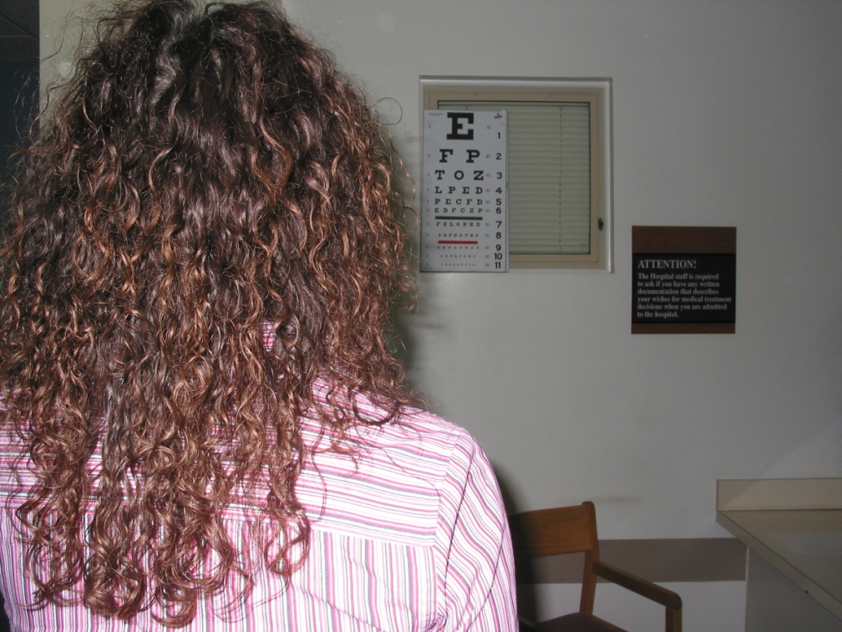
Physical Examination
Check visual acuity
Check pupils for roundness and reactivity
Examine the eyelids for lacerations
Test extra ocular muscles
Palpate around the entire orbits
Notes:
Check visual acuity. Snell chart, finger counting or presence or absence of light perception.
Check pupils for roundness and reactivity. Tear drop pupil – ruptured or penetrated globe injury. Examine for exopthalmos or enopthalmos
Examine the lids for lacerations. Check for injuries to the medial 3rd of the eyelids for damage to the lacrimal apparatus. Check for disruption of the levator palpebral muscles.
Test extra ocular muscles. Testing for restriction. Restriction of upward gaze can be seen with zygomatic or infra orbital wall fx’s.
Palpate around the entire orbits. Tenderness, subcutaneous air and deformity. Palpate the medial orbit area to r/o naso ethmoidal orbital fx. (place a Q tip inside the nose to the medial canthus, place your finger outside the medial canthus. If the bone moves NEO fx.)

Slide 39
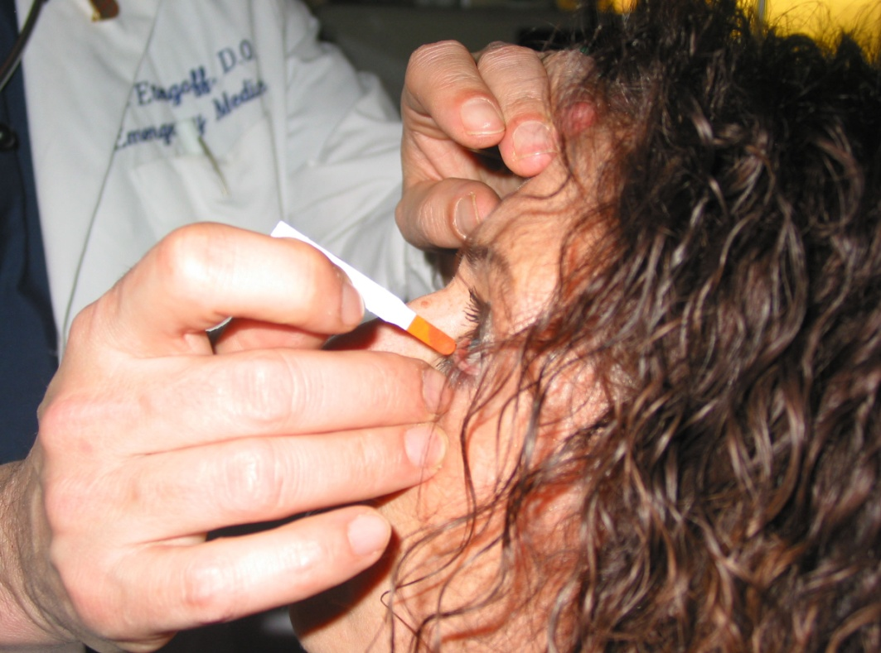
Physical Examination
Examine the cornea for abrasions and lacerations
Examine the anterior chamber for blood or hyphema
Perform fundoscopic exam and examine the posterior chamber and the retina
Notes:
Examine the cornea for abrasions and lacerations. Fluorescein if needed.
Examine the anterior chamber for blood or hyphema. When the patient is stable try to do a slit lamp examination.
Perform fundoscopic exam and examine the posterior chamber and the retina. Looking for retinal detachment.

Slide 40
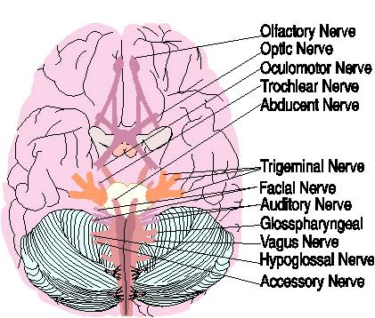
Cranial Nerve Hints
Cranial nerve I - loss of smell, taste (basilar skull fracture hallmark)
Cranial nerve II - blindness, visual defects
Cranial nerve III - Ipsilateral, dilated fixed pupil
Cranial nerve VII - immediate or delayed facial paralysis (basilar skull or LeFort)
Cranial nerve VIII - deafness (basilar skull fx)
Notes:
May not be helpful in obtunded patients

Slide 41
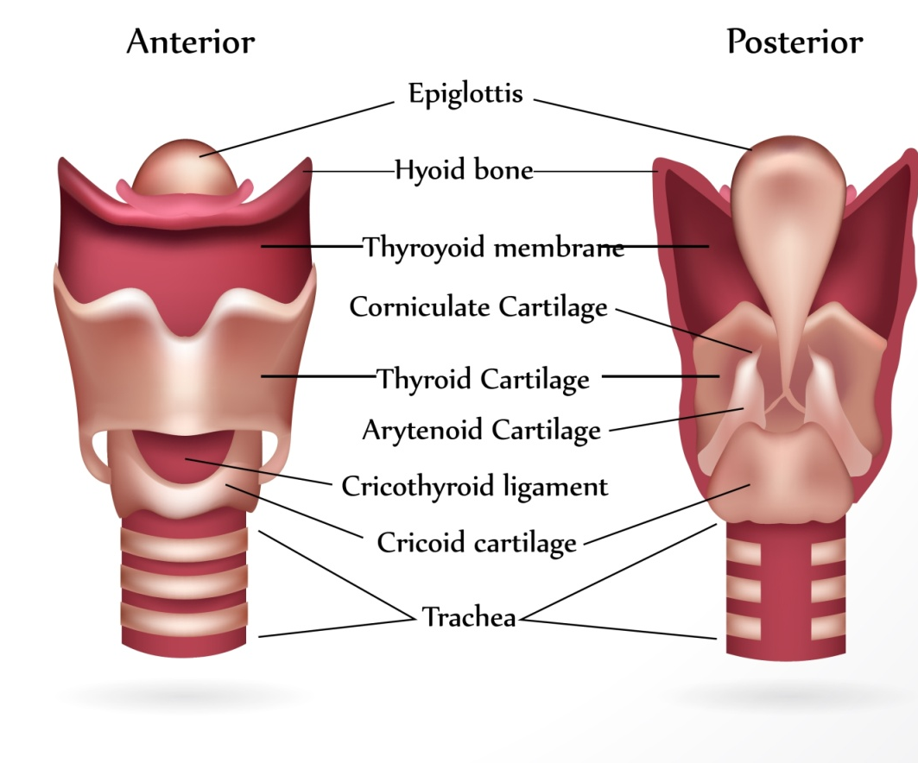
Airway Management
Protect and maintain airway
  Pull tongue forward with padded forceps or sutures
  Endotracheal intubation
  Anticipate need for cricothyroidotomy
Prevent aspiration
Ensure adequate oxygenation and ventilation
Notes:
Airway is easily obstructed from edema, secretions, blood, vomitus, avulsed teeth.
Tongue may obstruct the airway with mandible fractures and loss of bony support.
Oral intubation is preferred particularly in mid face fractures.
Cribriform plate fractures are frequently associated with LeFort III fractures.
Avoid inserting ETT, NP airways or gastric tubes into the nares.
Surgical airways may be necessary in patients with massive facial injuries and distortion of landmarks.
Prevent Aspiration
Frequent suctioning of the mouth and oropharynx and endotracheal suctioning.
Gastric decompression via orogastric tube.
Ensure Adequate Ventilation
Supplemental humidified oxygen.
Assess spontaneous respiratory effort—what other associated injuries will compromise ventilation.
Bag-valve mask ventilation or mechanical ventilation – may be difficult.
Assess for concomitant injuries that compromise oxygenation and ventilation.

Slide 42
Airway Management
Protection of airway
Keep HOB elevated
Aggressive pulmonary toilet
Frequent suctioning
Notes:
Many of these patients will require prolonged endotracheal intubation or tracheostomy due to facial and airway edema, need for multiple trips to the operating room for repeat debridement and phased fixation/reconstruction.
Patients may also have other injuries that necessitate the need for prolonged airway protection or mechanical ventilation.
Once the spine is cleared and there are no other contraindications, keeping the HOB elevated helps to reduce facial swelling.
Intubated and mechanically ventilated patients will require chest physiotherapy.
Non-intubated patients should be encouraged to use an incentive spirometer at frequent intervals.
Suctioning the mouth and oropharynx and teaching the patient to suction the mouth minimizes the risk of aspiration.

Slide 43
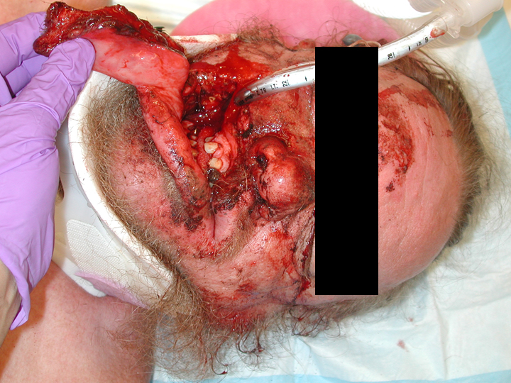
Notes:
This is a 45 year old male struck by a car with significant avulsion injury of the right side of his face.
He sustained a maxilla fracture and right orbit fracture but no mandible fracture.
Prehospital providers were unable to intubate him in the field due to the facial trauma. He was alert but combative on arrival to the ED and was quickly intubated by an anesthesiologist via RSI.

Slide 44
Management
Control hemorrhage
  Direct pressure
  Nasal and oral packing
  Reduce fractures
Restore intravascular volume
Anticipate intracranial injury and need for intervention
  Serial neurologic exams
Notes:
Hemorrhage control
Direct pressure to bleeding vessels.
Pack the nares with 30cc balloon or petroleum gauze.
Fracture reduction may reduce bleeding.
Anticipate need for angiography and embolization when bleeding remains uncontrolled.
Restore intravascular volume
Volume replacement is achieved with administration of crystalloids and blood products as needed.
Serial monitoring of hemoglobin and hematocrit.
Blood loss may be from other sources in the multiply injured patient.
Continuous monitoring of Base Deficit, Lactate levels, blood pressure, heart rate, level of consciousness and urine output help guide resuscitation.
Ongoing neurologic status
Traumatic brain injury is a common associated injury. Serial assessment of level of consciousness, motor function, pupil reaction and cranial nerve function.
Interventions to minimize increases in intracranial pressure i.e. mannitol, maximize oxygenation, ensure adequate cerebral perfusion.
Ongoing monitoring if intracranial pressure and cerebral perfusion pressure in the patient with a concomitant traumatic brain injury.
In patients who can cooperate with an exam but are unable to open eyes or speak, develop signals for yes and no (i.e. thumbs up for yes, thumbs down for no).
Watch for ECF leaks.

Slide 45
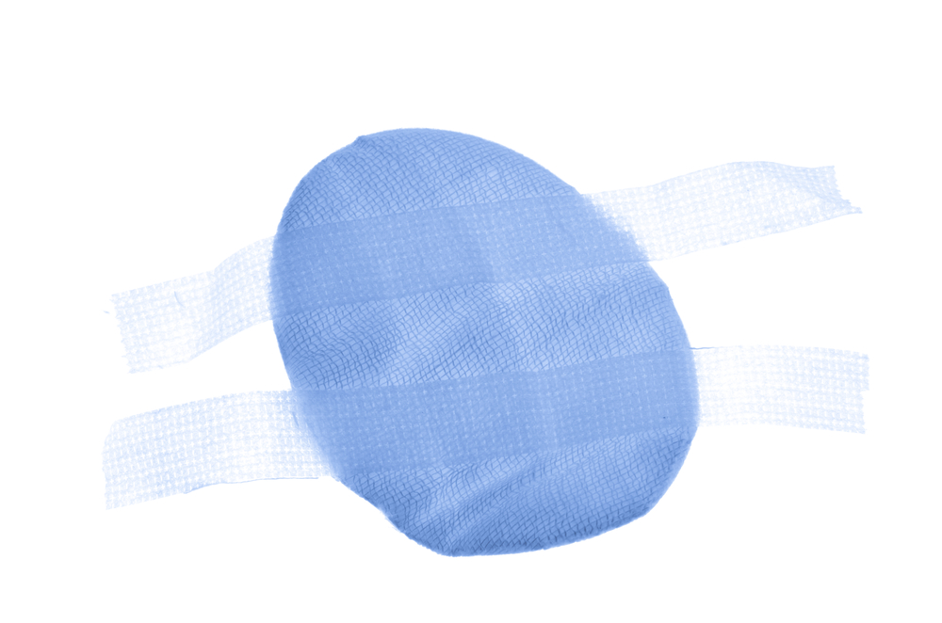
Management
Protect eyes from further injury
Pain management
Early Rehab Consult
Notes:
Protect eyes from further injury
Shield the eye from further injury as patients frequently have more life threatening injuries that take priority in management.
Anticipate need for early/immediate ophthalmologic examination.
Avoid manipulation of the orbit, eyelids or facial structures if there is suspicion of globe perforation.
Pain Management
In the first 24 hours after injury and operative management, ice compress to the eyes and face may reduce swelling and pain.
Intubated patients may require scheduled boluses of narcotic analgesics and benzodiazepines for sedation.
Important to assess for signs of pain (hypertension, tachycardia, agitation) in the patient who is intubated and unable to speak or in patients with significant facial swelling who may be unable to see visual analog scales used for pain assessment.
Liquid forms of analgesic agents may be given orally in the patient with intermaxillary fixation or with gastric tubes or small bore feeding tubes.
Physical Medicine and rehabilitation consults should be made early in the acute phase of care to assist the patient who will require adaptations to ADL’s due to vision loss, abnormal speech mechanisms, and associated brain injuries. Cognitive evaluations should be performed on any patient with a traumatic brain injury.

Slide 46
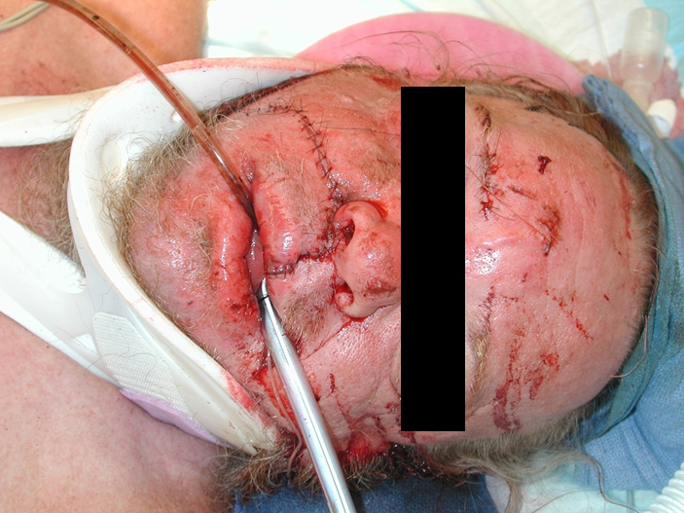
Notes:
This is the 45 year old male struck by a car with the facial avulsion after closure of the soft tissue injury.

Slide 47
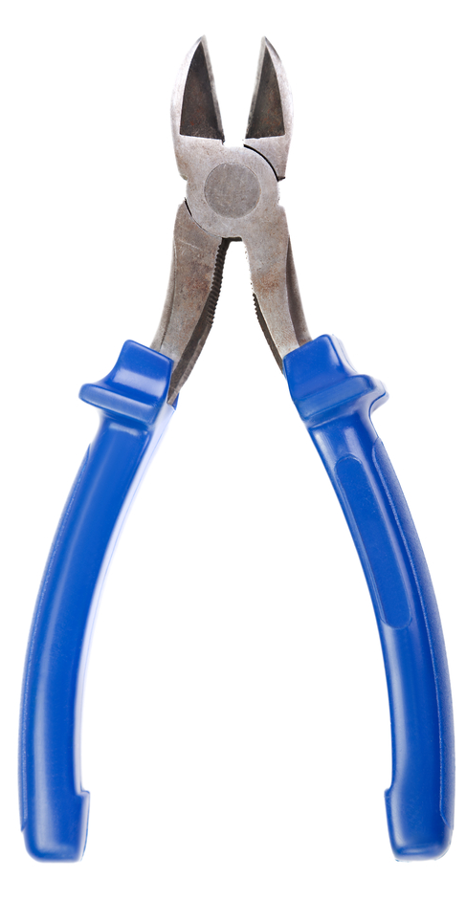
Management
Nutrition management
  Early initiation of enteral feeding
  Keep HOB elevated
  Evaluate for swallowing dysfunction prior to oral feeding
  Wire cutters at bedside at all times
Notes:
Nutrition management
Nutrition consult for “wired-jaw”/blenderized diet
Consultation with dieticians can help determine the patient’s total caloric requirements.
They can also provide patient and family education related to blenderized foods for patients in intermaxillary fixation.
Patient who have been intubated for a prolonged period, patients with tracheostomies or those with significant oral/facial trauma should undergo evaluation for swallowing dysfunction with a speech therapist prior to initiating and oral diet.
Patients receiving enteral feedings should have the HOB elevated at least 30º to prevent aspiration, promote gastric emptying.

Slide 48
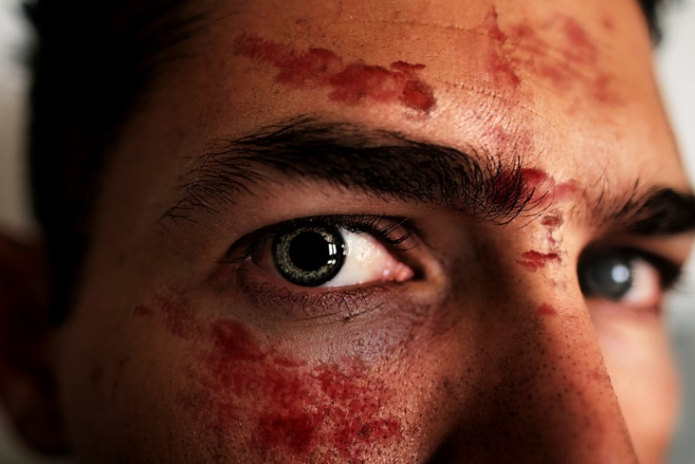
Management
Prevention of infection
  Perioperative antibiotics
  Frequent oral lavage
  Minimize nasal packing and tubes
  Decongestants
  Avoid blowing nose
  Avoid foreign bodies or instrumentation in nares or ear canal
Notes:
Prevention of infection
Antibiotic ointments over incision sites when prescribed.
Perioperative antibiotics.
Aggressive dental hygiene with commercially prepared oral rinses (Peridex) or a solution of normal saline and hydrogen peroxide at least 4-6 times a day.

Slide 49
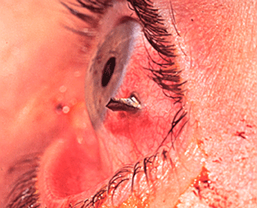
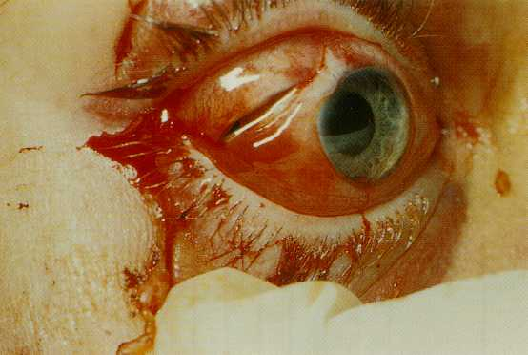
Direct Eye Trauma
Notes:
Foreign bodies and lacerations can be caused by
Blast
Work related
Wind storms/leaf blowers
Air guns
Paint ball guns
Heat
Other varied mechanisms

Slide 50
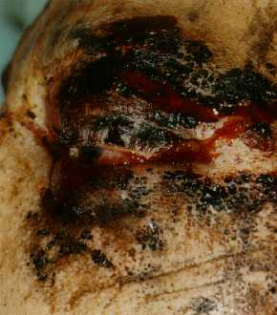
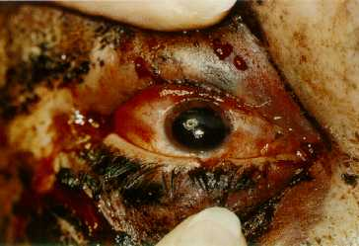
Blast Injury: Thermal Injury
Notes:
Combination blast and thermal injury

Slide 51
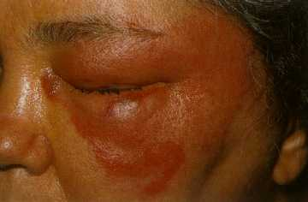
Thermal Injury
Eye is usually spared
Corneal exposure may occur as burn heals and skin contracts

Slide 52


Corneal Abrasion
Notes:
On the left is a corneal abrasion with fluorescein stain
Corneal abrasions are due to disruption in the integrity of the corneal epithelium, scraping or denudation of the corneal surface as a result of physical external forces. The diagnosis may be confirmed with fluorescein instillation and use of a cobalt blue light, which can be found on some direct ophthalmoscopes or on a slit lamp.
The eyelids must be everted and checked for the presence of foreign material.
Topical antibiotics such as polysporin drops can be prescribed to prevent infection. In addition, patching of the eye in contact-lens wearers is contraindicated.
Although some deep abrasions can lead to scarring and vision loss, prognosis is often excellent with full recovery within 24-48 hours.

Slide 53


Chemical Burns
Notes:
Chemical burns are the only exceptions in ocular trauma where treatment begins prior to vision testing. The affected eye must be irrigated with copious amounts of fluid, and a cotton swab used to sweep the fornices of any retained particulate matter. Water or normal saline solutions are preferred, but any nontoxic and unpolluted solutions can be used in an emergency setting. Irrigation should continue until the pH is normalized (pH of 7). This can be monitored with any pH test strips. A thorough ophthalmologic examination is mandatory after irrigation.
Acid (battery fluid, chemistry labs) coagulates protein, limiting depth of injury. Image on your right is scarring from an acid burn.
Alkali (household cleaning fluids, fertilizers and pesticides), has severe penetration, causing damage to deep structures within minutes. Image on your left is an alkali burn.
Chemical burns are contraindications for patching. The chemical agent may not have been thoroughly lavaged from the eye. Patching will allow extended exposure to the agent under closed lids and is strongly contraindicated.
This is a great link to a PowerPoint on Ocular Trauma http://home.smh.com/sections/services-procedures/medlib/education/podcasts/documents/okeefe_09-11-09.pdf

Slide 54

Traumatic Hyphema
Image courtesy of EyeMac Development

Slide 55
Traumatic Hyphema
Limit activity
Keep HOB elevated
Protect the eye
Cycloplegic agents
Monitor for re-bleeding
Avoid NSAIDS and anticoagulants
Aminocaproic acid
Notes:
Hyphema is blood in the anterior chamber of the eye.
Management directed at prevention of re-bleeding.
Bedrest or limited activity. Non-compliant patients may require hospitalization.
Elevating the HOB encourages settling of blood to the bottom of the anterior chamber.
Cycloplegic agents (such as atropine drops) immobilize the iris and ciliary body thus preventing additional trauma to the damaged blood vessels in the angle is prevented. Cycloplegic agents also help to stabilize the blood-aqueous barrier, preventing further leakage of inflammatory cells and proteins. Finally, dilation diminishes the risk of pupillary block or synechia (iris adheres to cornea) secondary to hyphema.
Re-bleeding is the most common complication.
Rate is from 2%-38%.
Occurs most commonly 3-5 days after injury when the initial clot begins to lyse and injured vessels rebleed.
Aminocaproic acid (50mg/kg orally every 4 hours) is an antifibrinolytic agent used to stabilize the clot and prevent rebleeding.
Paracentesis may be required if the bleeding is significant and intraocular pressure is high.
Controversy: There are studies provide evidence that no statistically significant difference exists in most areas of comparison between patients treated with bed rest, bilateral patches, and sedation and those treated with ambulation, a patch and shield on the injured eye only, and no sedation and recommend ambulation and a patch and shield for the injured eye. Sedation is recommended only in the extremely apprehensive individual. Hospitalization may be warranted in cases of severe trauma and rebleeding

Slide 56

Lid Lacerations

Slide 57

Lid Laceration
REFER for
  Depth
  Extensive tissue loss
REFER for location
  medial
  margin
Notes:
Lid laceration repair
Conserve tissue
May be delayed up to 72 hrs
6-0 silk or nylon
Sutures out 5 days

Slide 58

Open Globe
Globe laceration
Tetanus
Antibiotics
REFER
  24 hours
  no altitude restrictions
Notes:
Administer antiemetics (e.g., ondansetron) to prevent Valsalva maneuvers.
Administer sedation and analgesics as needed.
Avoid any topical eye solutions (e.g., fluorescein, tetracaine, cycloplegics).

Slide 59

Open Globe
Minimize additional damage
  Make sure a shield is used
  Do not use a patch which
  applies pressure
  Avoid bearing down
  Be prepared for patient to go to the OR
  NPO
Notes:
A Fox eye shield or other rigid device (bottom of a polystyrene foam cup) should be placed over the affected eye. Avoid any eye manipulation that may increase intraocular pressure with potential extrusion of intraocular contents.
Eye patches are contraindicated.

Slide 60
Complications
Sympathetic Ophthalmia
Inflammatory condition
Common after penetrating injury or ruptured globe
Occurs 5 days to many years after injury
Results in loss of vision of uninjured eye
Prevented by early enucleation of injured eye
Notes:
Sympathetic Ophthalmia is a rare condition that results from severe penetrating or perforating injury.
This is the primary indication for early enucleation of a nonrepairable globe.
The condition is characterized by diffuse bilateral granulomatous uveitis and loss of the uveal tract or uveal prolapse.
The condition is thought to be autoimmune in nature and occurs from several days to many years after the original injury.
Treatment includes systemic and topical steroids and immunosuppressive agents.

Slide 61
Psychosocial Support
Provide communication aids
Frequent positive reinforcement
Early referrals to psychiatric liaisons or counselors
Early referrals to community agencies for the blind
Referrals for home safety evaluations
Referrals to local and state agencies for financial assistance
Notes:
Provide communication aids
Blind patients need frequent orientation to time and place.
If patients have lost sight in only one eye or now has limited sight, ensure that the patient can see you when speaking to him.
Describe colors and physical characteristics of the environment to the newly blind patient.
Frequent positive reinforcement
Focus on the positive attributes and accomplishments of patient’s progress.
Early referrals to psychiatric liaisons or counselors.
Early referrals to community agencies for the blind and to rehabilitation facilities.
Referrals for home safety evaluations.
Referrals to local and state agencies for financial assistance.

Slide 62
Patient and Family Education
Reinforce surgical plan of care
Medications
Nutrition management
Wound care
Tracheostomy care
Avoid direct sunlight for 6-12 months
Use of cosmetics
Notes:
Reinforce surgical plan of care
Provide realistic outlook, avoid false reassurances
Surgical sites will appear red and elevated for up to six months
Medications
Correct method of eye drop/ointment instillation
Oral rinses
Nutrition management
Avoid very hot or cold foods, avoid carbonated liquids
Instill small amounts of liquid into buccal pouch
Wound care
Correctly demonstrates use of eye shields
Cleansing of wounds
Use of ointments or OTC creams/lotions
How to remove IMF in an emergency
Tracheostomy care and suctioning
Avoid direct sunlight for 6-12 months
Use strong sunscreens or avoid sunlight to prevent hyperpigmentation
Use of cosmetics

Slide 63
Summary
Facial and ocular trauma requires a comprehensive multidisciplinary team to maximize outcomes
Early incorporation of rehabilitation services is necessary for functional recovery
Overall prognosis of reconstruction may take months or years
Notes:
Patients with facial trauma may present with life-threatening insults.
Airway compromise is a primary concern and the development of hypovolemic shock due to blood loss cannot be overlooked.
Once the patient is stabilized, early involvement of the multidisciplinary team including plastic surgeons, ENT and/or oral surgeons is required to maximize the patient’s outcome.

