Slide 2
Burn and Inhalation Injury

Slide 3
Objectives
At the conclusion of this presentation the participant will be able to:
Identify types of burn injury
Describe assessment of the burn patient
Evaluate treatment options
Identify patients requiring transfer to a burn center
Notes:
The objectives for this presentation include:
Identify the different types of burn injury including mechanism of injury and the varying degrees of burn depth.
Describe the assessment priorities of the burn patient during initial management.
Evaluate and initiate treatment and identify when burn patients need to be transferred to a burn center.
Instructor note: picture of burn dressing to the leg.

Slide 4
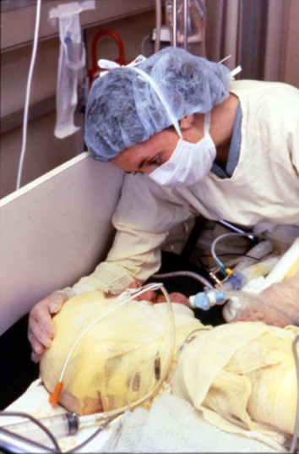
Epidemiology
In the United States:
> 1 million burns per year
Roughly half receive medical treatment
70% male
Average age: 32 years
18% are Children <5 years
12% are Elderly >60 years
Notes:
Over 1 million burn injuries occur per year.
About 450,000 burns per year receive medical treatment
Nearly 70 % are men with a mean age of 32 years old
Children under age 5 account for 18% of the total and patients over 60 account for 12% of the cases.
Source: American Burn Association, 2011 National Burn Repository – Report of Data from 2001-2010
Instructor note: care and support for the burn patient

Slide 5
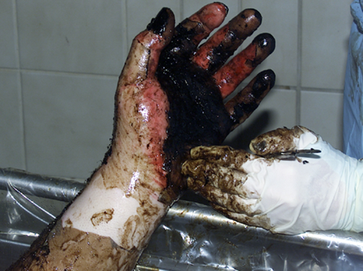
Epidemiology
Majority are <10% total body surface area (TBSA)
Mortality rate ~4%
Deaths increase with age, TBSA and inhalation injury
Most post burn morbidity and mortality due to infection
Notes:
Majority of burns are less than 10% TBSA (70%) and have a low mortality rate (0.6%)
Mortality rate for all cases is roughly 3.9%. Deaths from burn injury increase with advancing age, burn size and inhalation injury.
Cause of most post burn morbidity and mortality continues to be infection.
Source: American Burn Association, 2011 National Burn Repository – Report of Data from 2001-2010
Instructor note: tar burn to the left hand. Tar burns special consideration emulsify tar with mineral oil product.

Slide 6
Length of Stay
Percentage Body Surface Area Burned | Length of Stay (Days) | Number of Patients
<20 | 6-17 | 1295
20-39 | 17-45 | 187
40-89 | 38-94 | 104
>90 | 129-237 | 12

Slide 7
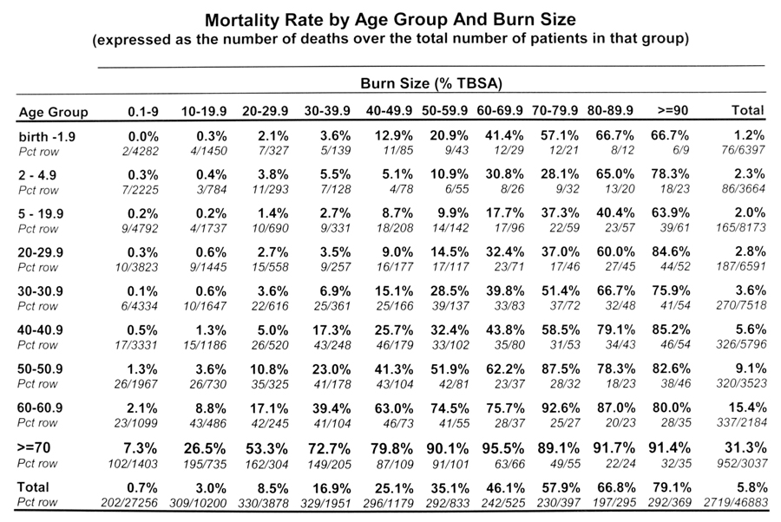
Notes:
Over the past several decades tremendous advances in the medical and surgical management of burn injuries.
Injuries uniformly fatal as recently as 25-30 years ago are now typically survivable.
Palmieri TL, Klein MB. Burn research state of the science: Introduction. Journal of Burn Care & Research. 2007; 28 (4): 544-545.
This chart shows the significance of age, total body surface area burned and mortality rates.
Children less than two and the elderly > age 60 are compromised.
A 30% burn in a 60 year old patient is associated with a 40% mortality rate.
Source: American Burn Association, 2011 National Burn Repository – Report of Data from 2001-2010

Slide 8
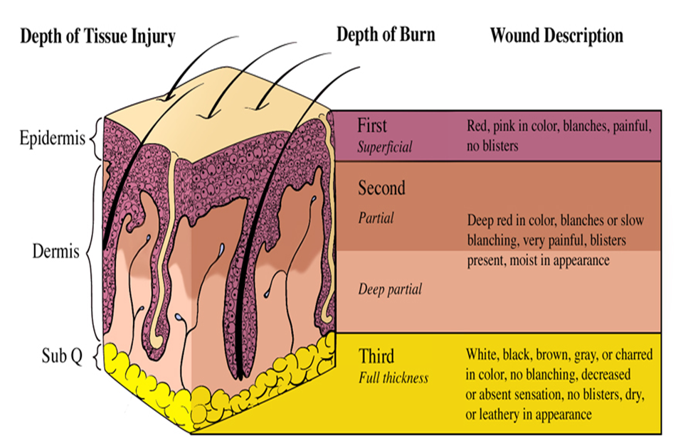
Anatomy of the Skin
Sensation and t
Illustration courtesy University of Michigan Trauma Burn Center
Notes:
The skin is the body’s largest organ.
Bilayer, consisting of the epidermis and the dermis and ranges in thickness from .04 inches (1 mm) to .2 inches (6 mm) on the palms or soles of the feet.
The epidermis is the outer non-vascular layer that consists of mostly keratinocytes.
Acts as barrier against the hazards of the environment.
Damage to the epidermal layer is considered a first degree (or superficial) burn. The skin is pink to red in color, painful and blanches; there are no blisters present. A sunburn is an example of a first degree burn.
The next layer is the dermis.
Thickest part of the skin and houses the structures necessary for survival- sweat and sebaceous glands, hair follicles, capillaries, and nerve endings.
Damage to the epidermis into the dermis results in a second degree burn (partial or deep partial) injury.
Wound is painful, moist in appearance and blisters are present.
The subcutaneous tissue lies between the dermis and the muscles
Made up of connective tissue and fat.
Damage through the epidermal and dermal layer to the subcutaneous tissue is a third degree or full thickness burn.
Tissue is dry and leathery in appearance and often white in color.
Instructor note: skin diagram showing layers of skin and depth of injury.

Slide 9
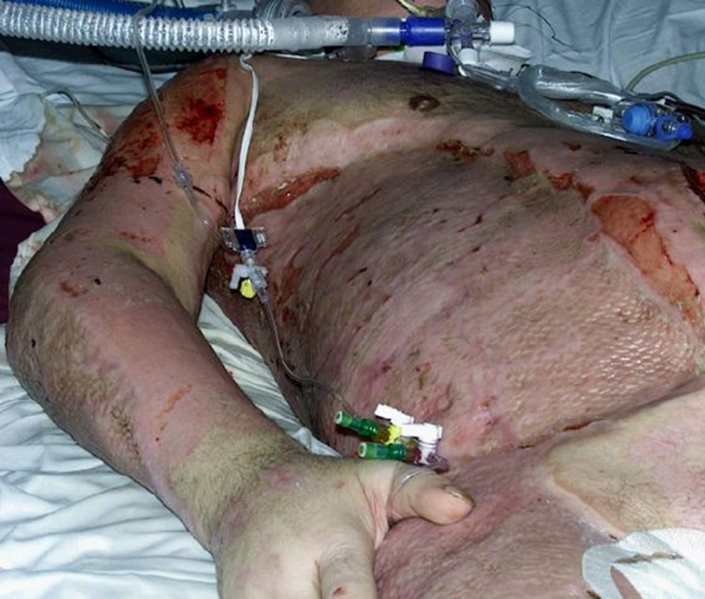
Functions of the Skin
Prevention of infection
Conserve body fluids
Temperature regulation
Cosmetic appearance
Sensation and touch
Notes:
Functions of the skin include:
Prevention from infection (i.e. the job of the epidermis)
Conservation of body fluids and temperature maintenance.
High risk for hypothermia once the skin is damaged. It is important to keep them warm and dry.
Lifelong- damage to the integument system can involve scarring and contractures.
Areas of third degree burn can lead to impaired sensation and touch due to damaged nerve endings.

Slide 10
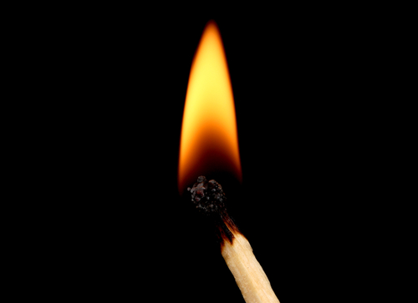
Burn Pathophysiology
Inflammatory mediators
Shock
Hypovolemia
Increased pulmonary and vascular resistance
Myocardial depression
Notes:
Burn injury causes release of inflammatory mediators at the cellular level. This has a systemic effect. Inflammatory mediators affect the heart, large vessels and lungs.
Shock ensues as a result of increased vascular permeability; fluid leaks from the intravascular space to the interstitial space.
Increases in pulmonary and systemic vascular resistance and myocardial depression occur.
Edema formation occurs from fluid and protein translocation into both burned and non-burned tissues.
Increased hematocrit occurs soon after the injury due to plasma volume deficit.

Slide 11
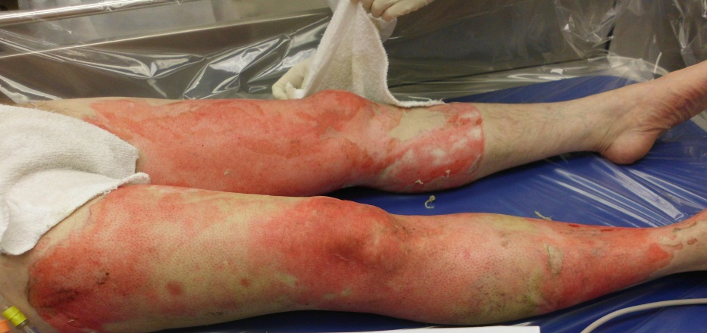
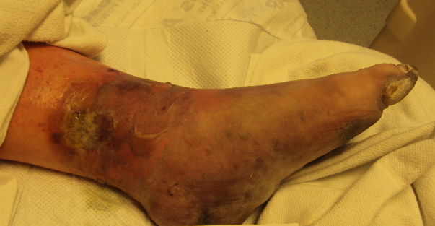
Etiology
Thermal
Frostbite
Inhalation
Notes:
Three categories of burn mechanism of injury:
Thermal injury is the most common type of etiology and involves contact with heat sources such as fire, steam, hot liquids or objects.
Majority of admissions are due to thermal injury.
Frostbite causes extracellular and intracellular ice to form leading to cell dehydration and shrinkage.
Treatment regimens can be different than thermal injuries.
Inhalation injury can be divided into injuries above the glottis and below the glottis and is associated with high mortality.
Above the glottis involves thermal injury to the nose, throat and mouth. Swelling can occur within minutes to hours of injury and requires prompt intubation due to possible airway obstruction.
Below the glottis is often due to inhaled chemicals and smoke particles.
Current standard for diagnosis of burn inhalation injury is fiberoptic bronchoscopy. Chest x-rays often appear normal early on.
Instructor note: top picture thermal injury to the legs. Bottom picture frostbite.

Slide 12
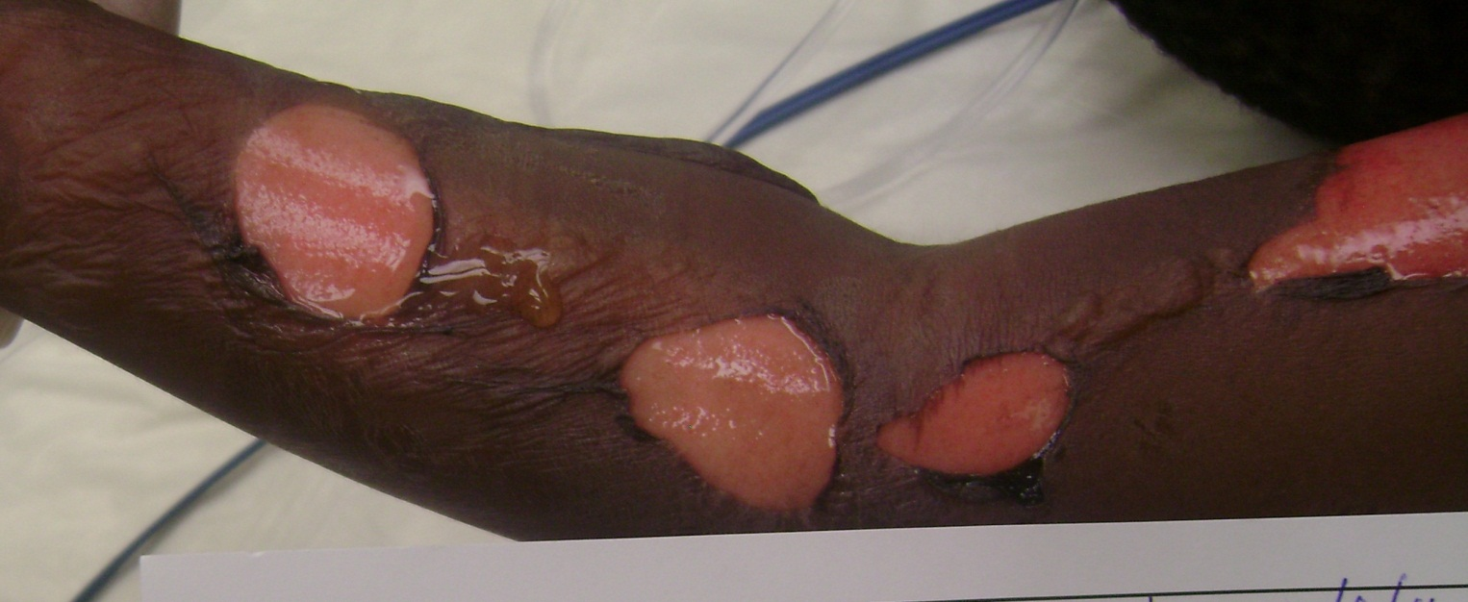
Mechanism of Injury
Types of burn injury
Scald
Electrical
Chemical
Notes:
Next, let’s review the various types of injury more in depth.
Instructor note: second degree burn with blisters

Slide 13
Chemical Injury
Alkali
Acid
Organic
Treatment
Remove clothing
Brush off powder
Copious irrigation
Splash injury common
Check eyes
Notes:
3 categories of chemicals Alkali, Acid and Organic.
Alkali (NaOH, KOH, Ammoniuum ;found in cement and fertilizers)
Acids are commonly found in bathroom cleaners
Organic chemicals are often phenol, petroleum based products.
Chemical injuries are insidious and continue to burn the tissue until the chemical is removed.
Many of these areas can be full thickness.
Splash injuries common
Severity of injury depends on: amount of chemical, concentration of chemical, duration of contact with chemical
Treatment:
It is important to remove clothing and brush off any powders prior to irrigation or the chemical may intensify.
Copious irrigation is the treatment of choice after removing clothing.
The eyes should be flushed and checked for corneal abrasions.
Hydrofluoric acid burns cause hypocalcemia as fluoride binds fee serum calcium. Treat with topical calcium gluconate gel as it leaches calcium from the cells.
Reminder: Always remember universal precautions to protect yourself and the rest of the staff.

Slide 14
Chemical Burn Pattern
Notes:
Chemical burns often have areas of full thickness centrally surrounded by areas of partial thickness on the periphery.
Instructor note: picture of chemical injury

Slide 15
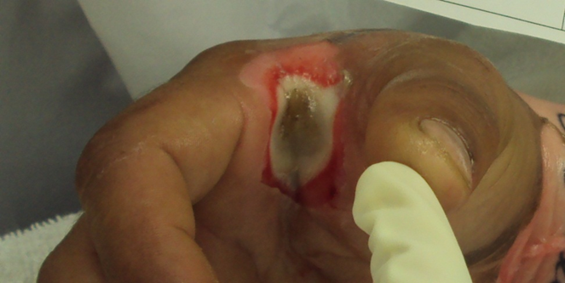
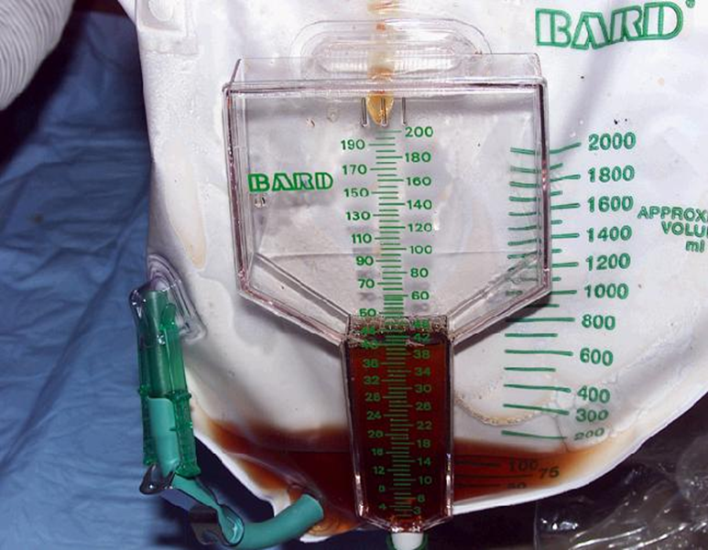
Electrical Injury
Often work related
Extent difficult to determine
Cardiac monitoring
Observe for:
hemoglobinuria
(port wine) color urine
compartment syndrome
Fluid resuscitation with goal of 75-100 cc/urine/hour
Notes:
Electrical injuries are often work related.
The skin is the most resistant organ in the body. Once this resistance is overcome, electricity travels the path of least resistance; along the bone surface through blood vessels and nerves generating heat and causing damage to muscles.
The extent of the injury is difficult to ascertain, what you see is not what you get, as much of the damage lies under the surface.
Many electrical injuries have an entrance and exit site depending on the voltage involved.
High voltage exit wounds produce “blow out” injury or may cause loss of an extremity.
Assessment:
Assess the patient for hemoglobinuria (port wine colored urine) due to the break down of muscle tissue. If present, patients require fluid resuscitation with a goal of 75-100 cc of urine output per hour.
Patients may have cardiac dysrhythmias and require monitoring.
Monitor extremities for compartment syndrome; fasciotomy may be required.
Instructor note: top picture of electrical injury to hand. Bottom picture hemoglobinuria – dark port wine colored urine

Slide 16
Severity of Injury
Depth
first, second and third degree
Extent of burn
Rule of 9’s, palm equals 1%
Age
<2 and >60 at increased risk
Past Medical History (PMH)
Location of burn
Notes:
Severity of injury is determined by the extent of burn, depth of burn, age of the patient, previous health status and location of the burn.
Patients less than 2 and greater than 60 are at increased risk due to immature immune system and comorbidities respectively.
Burns to the perineum are at increased risk of infection.

Slide 17
Depth: First Degree Burn
Pink in color
Damage to epidermis
Do not count in TBSA calculation
No resuscitation fluid necessary
Heals on its own
Notes:
First Degree Burn:
Damage to the epidermal layer is considered a first degree (or superficial) burn.
The skin is pink to red in color, painful and blanches; there are no blisters present.
A sunburn is an example of a first degree burn.
First degree burns are not included in the fluid resuscitation calculation and will heal on its own.
Instructor note: sunburn, first degree burn. Will heal without operative intervention.

Slide 18
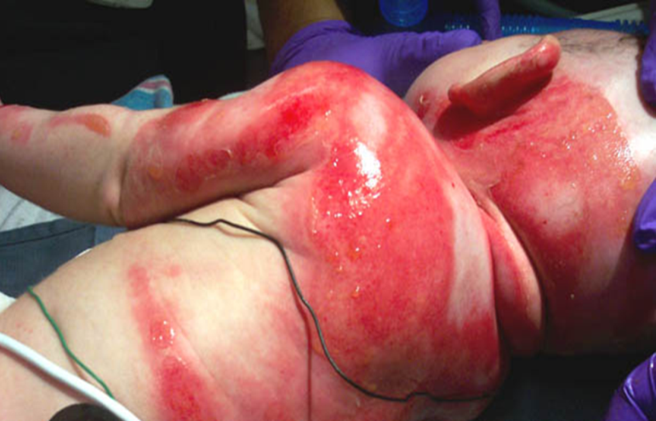
Depth: Second Degree Burn
Partial thickness injury
Damage to epidermis & part of the dermis
Superficial Second Degree: Pink to red, wet appearance, painful, will heal on its own
Deep Second Degree: Mottled red/white with slow blanching. May convert to full thickness. May require operative intervention
Notes:
Second Degree Burn / Partial Thickness:
Involves damage through the epidermis into the dermal layer.
A partial thickness burn can be divided into a superficial second degree burn and a deep second degree burn.
The difference is the depth of tissue necrosis into the dermis.
A superficial second degree is red/pink in color and shiny due to blister fluid.
Capillary refill is normal and the wound is very painful. Superficial second degree will heal on its own.
Deep second degree is red/white and mottled in appearance.
It has slower capillary refill and potentially can convert to third degree.
Deep second may or may not require operative intervention.
Instructor note: top picture of second degree burn – pink /red shiny we appearance. Bottom picture deep second degree burn – more mottled in appearance.

Slide 19
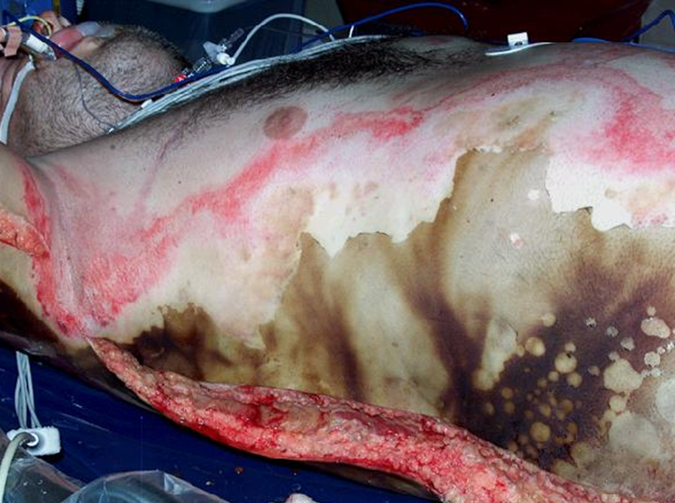
Depth: Third Degree Burn
Third degree or full thickness.
White, black, brown in color, dry, leathery in appearance.
Burn skin non-pliable
Circumferential third degree may require escharotomy.
Skin grafting required.
Notes:
Third degree burn / Full thickness burn:
Destroys the epidermis and dermis.
White, brown or charred in appearance and dry and leathery.
The necrotic tissue is known as burn eschar.
Skin grafting is required.
The wound is not painful as the nerve endings are destroyed and there is no blanching present.
Assessment:
Careful ongoing assessment of circumferential third degree burn is necessary as patients may need an escharotomy.
Instructor note: top picture of third degree burns to chest an abdomen. White dray leathery appearance. Will require grafting. Bottom picture again white dry leathery appearance – third degree burns to back, side and arm.

Slide 20
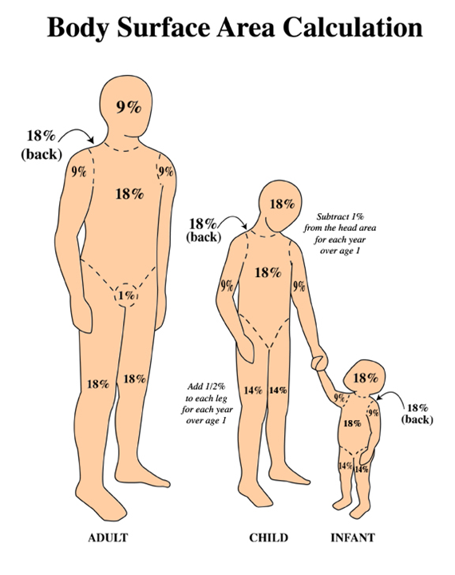
Extent of Burn: Rule of 9’s
TBSA calculation
Rule of 9’s
Peds vs. adults
Palm is equal to 1%
$$©$$
Notes:
Estimating burn size: Percent Total Body Surface Area (TBSA)
RULE OF NINES
Divides each body region into a percentage.
Note: the difference between adults and children.
The child’s head is larger in relation to the rest of their body; the head increases in percentage and the percentage decreases in the legs.
In the adult, the head (circumferential) is 9% and each arm is 9%, each leg is 18% and the posterior and anterior torso are each 18%.
The palmar surface of the patient’s hand from base of palm to finger tips is roughly 1% TBSA. This is helpful when estimating scattered burns.

Slide 21
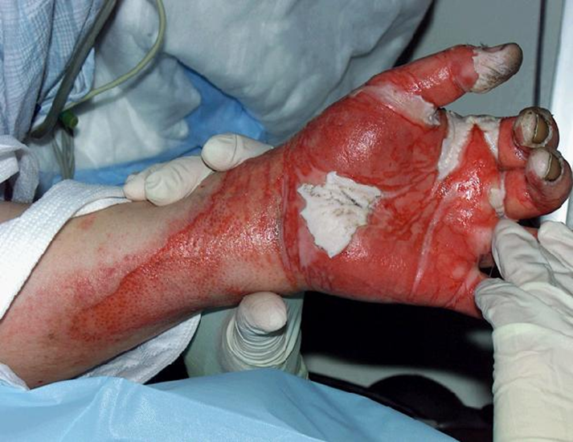
Initial Management
Stop the burning
Airway and breathing
Circulation
Extent of burn
Depth of burn
Begin resuscitation
Limb threat injuries
Transfer to burn center
Notes:
Initial management priorities:
Stop the burning process- remove all clothing and jewelry.
Assess ABC’s
Determine if the patient can maintain their airway.
Is breathing adequate?
Begin fluid resuscitation.
Assess whether the patient should be transferred to a burn center.
What are your guidelines for transferring to a burn center?
Instructor note: picture of burn to left hand, several days post injury.

Slide 22
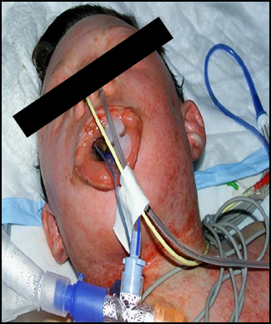
Inhalation Injury (Airway)
Assessment
History
Singed hair
Carbonaceous sputum
Hypoxia, SOB
Stridor, hoarseness
Oropharyngeal erythema
Treat with 100% Oxygen
20% of burns involve inhalation injury
Notes:
Incidence:
Smoke inhalation is present in approximately 10-20% of all reported cases
Identified in 60-70% of patients who die in burn centers (American Burn Association: Advanced Burn Life Support Course).
The most recent report from the National Burn Repository reported incidence of 18%.
A inhalation injury increases the ICU length of stay, hospital length of stay, and mortality rate.
Mortality increases 7 fold with an associated inhalation injury.
Inhalation injuries are more common and more severe with age.
Assessment:
History of event: Closed space fire (house fires, car fires, etc)
Singed facial or nasal hair
Carbonaceous sputum
Stridor, hoarseness
Shortness of breath or difficulty breathing
Treatment:
100 % oxygen
Early intubation
For patients suspected of having an inhalation injury do not wait to intubate as with ongoing fluid resuscitation swelling will increase and it will be difficult to pass an endotracheal tube. Stridor or hoarseness is a late sign!

Slide 23
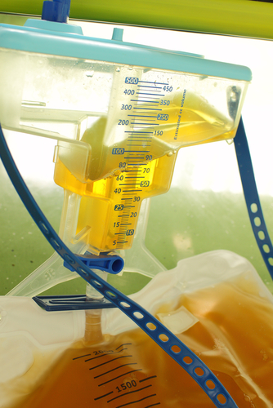
Resuscitation (Circulation)
Initial Fluid Resuscitation- Burns >20-25% TBSA
LR infusion
Monitor urine output
Adults 30ml/hour
Pediatric <30kg: 1 ml/kg/hour
Complications:
Shock
Acute renal failure
Notes:
Circulation:
Place 2 large bore IV’s in non burned tissue if at all possible.
Burn resuscitation formula determines an estimate of fluid needs over the first 24 hours and is recommended for burn patients with TBSA >20%.
Most commonly used formula is the Burn Consensus formula by the American Burn Association.
In the early phases of care, pre-hospital and early hospital setting prior to calculating the TBSA start fluids using the following recommendations:
Initial fluid resuscitation – starting point. Prior to figuring the TBSA.
≤ 5 y/o – LR – 125 ml per hour
6-13 y/o – LR - 250 ml per hour
≥ 14 y/o - LR – 500 ml per hour
Use the rule of 9’s to determine the TBSA.
Resuscitation Formula: (explained on next slide)
Monitor urine output to determine effectiveness of resuscitation.
Adequate urine output: Adults 30ml/hr; children 1mL/kg/hr for children < 30kg
Shock and acute renal failure are consequences of hypovolemia.
Pham TN, Cancio LC, Gibran NS, American Burn Association Practice Guidelines Burn Shock Resuscitation. J Burn Care Research. Volume 29 (1); 257-266.

Slide 24
Burn Resuscitation Formula
Adult and Chemical Burns:
2 ml LR X kg X %TBSA (2nd & 3rd degree)
Pediatric (14 years and under and less than 40kgs):
3 ml LR X kg X %TBSA (2nd & 3rd degree)
Adult High Voltage Electric Injuries:
4 ml LR X kg X %TBSA (2nd & 3rd degree)
Pediatric High Voltage Electric Injuries
Notes:
New guidelines from the ABA from ABLS 2010 - breakdown the fluid resuscitation formula and age:
Research indicated that resuscitation based upon using higher starting points commonly result in excessive edema formation and over-resuscitation. Fluid rates have been adjusted according to this information as follows:
Adult and Chemical Burns:
2 ml LR X kg X %TBSA (2nd & 3rd degree)
Pediatric (14 years and under and less than 40kgs):
3 ml LR X kg X %TBSA (2nd & 3rd degree)
Adult High Voltage Electric Injuries:
4 ml LR X kg X %TBSA (2nd & 3rd degree)
Pediatric High Voltage Electric Injures:
Consult a burn center
Example on next page:
Instructor note: picture of a severely burn injured patient in the ICU

Slide 25
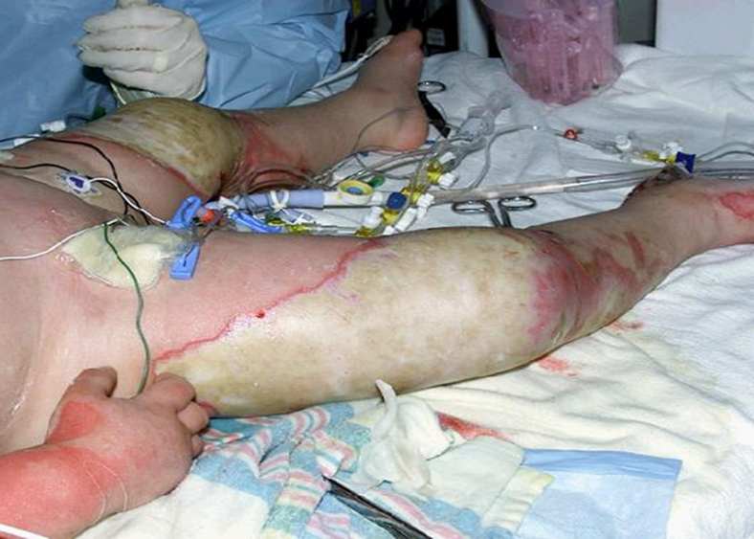
Example Resuscitation Formula
50 % TBSA (2nd and 3rd degree burns only)
Age 28
Mechanism explosion
70 kg patient
2 ml X 70kg X 50 % TBSA = 7,000 cc
Give 3,500 ml over the 1st 8 hours
Give the other 3,500 ml over the next 16 hours
Notes:
Example of fluid resuscitation calculation.
Determine the total body surface area using the rule of 9’s; only include second and third degree burns (not first degree).
We calculate 50% TBSA and 70 kg for weight.
2ml x 70 kg x 50% equals 7,000 ml/kg/% TBSA of Lactated Ringers.
Divide this in half and give the first half over 8 hours and the next half over 16 hours.

Slide 26
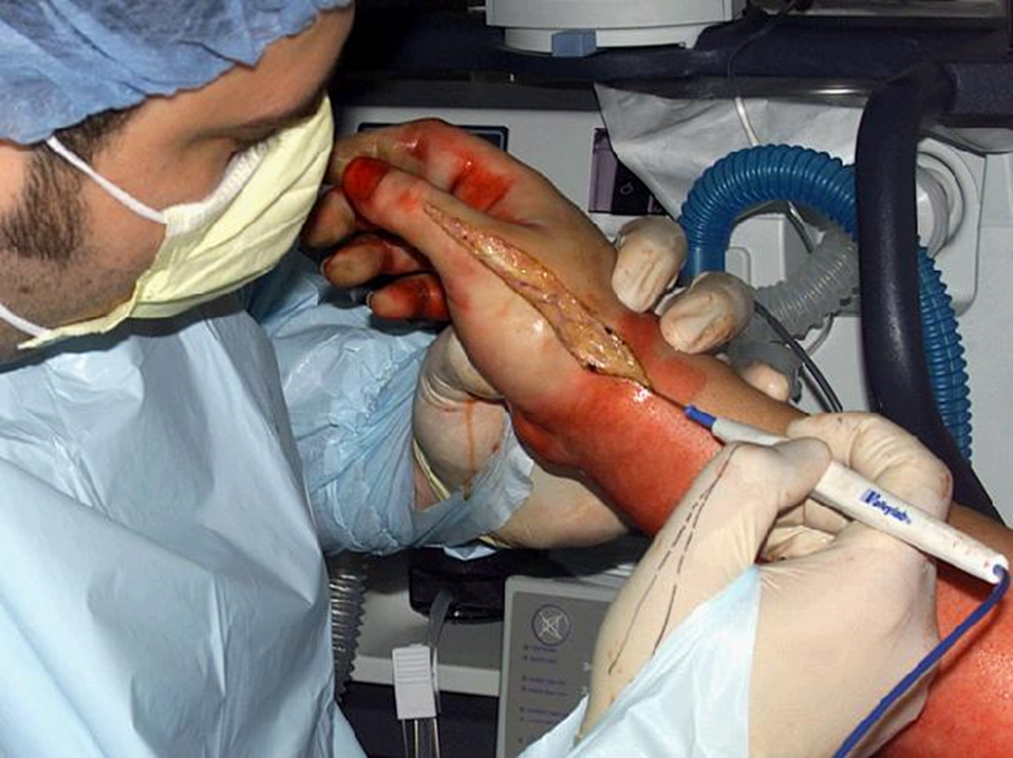
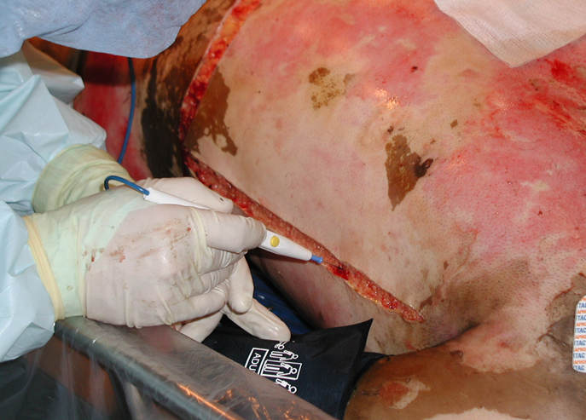
Escharotomy
Circumferential injury
Third degree
Check pulses often
Notes:
Limb threatening complications can result when a full thickness circumferential injury is present.
Assessment of pulses is paramount (particularly in the digits with hand burns).
If necessary an escharotomy must be performed to release the burn eschar which is encumbering blood flow to the distal extremities.
If the burn is deep and extends to muscle, a fasciotomy may need to be performed.
Escharotomies of the chest wall may also be necessary with a circumferential burn.
Signs will include peak pressures on the ventilator and decreasing tidal volumes.

Slide 27
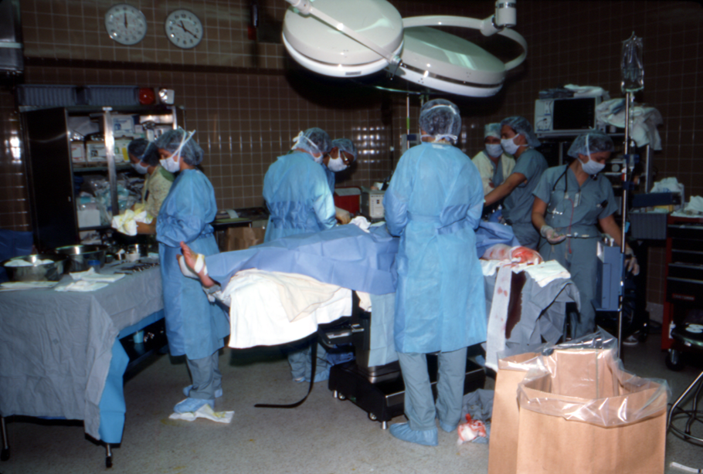
Special Considerations
Trauma Combined with Burn Injury
Assess ABC’s, administer fluid resuscitation
Don’t be distracted by burn
Treat life threatening injuries first
2-3 fold increase in inhalation injury, increased mortality
Notes:
Trauma and burn injury combination:
Assess airway, breathing, circulation first and attend to any life threatening injuries.
It is easy to be distracted by burn injuries.
Treat as a trauma first, administer fluid resuscitation as calculated by consensus formula, do not spare if patient has head injury.
Burns combined with Trauma presents a rare injury pattern that has a synergistic effect on mortality.
2-3 fold increase in the incidence of inhalation injury in this population and increased mortality despite similar TBSA burned when compared with patients with burn as the sole mechanism;
ISS appears to be an independent predictor of mortality in this combined injury pattern.
Santaniello, JM, Luchette FA, Esposito TJ, et al. Ten Year Experience of Burn, Trauma and Combined Burn/Trauma Injuries Comparing Outcomes. Journal of Trauma. 2004;57(4);696-701.

Slide 28
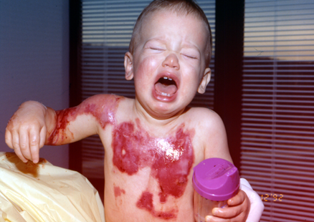
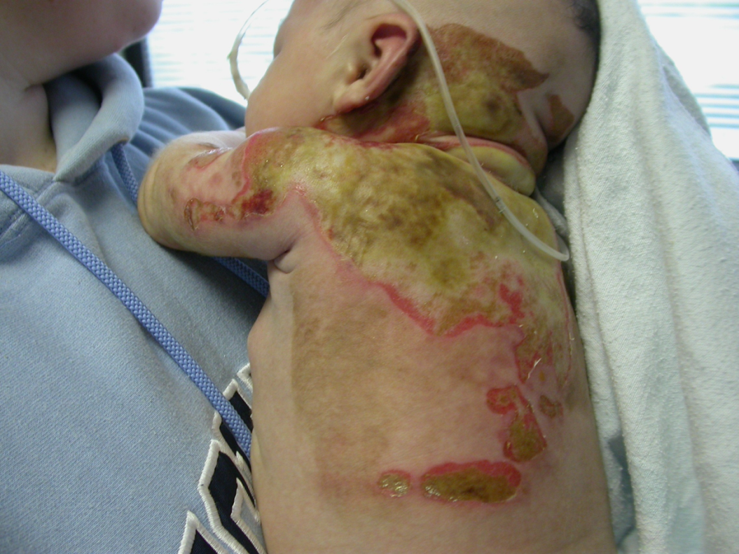
Special Considerations: Pediatric Burns
Psychosocial issues
Abuse, neglect
Pattern of injury
Airway
Airway size and shape
Breathing
Chest wall more compliant
Circulation
Children < 10kg should have D5LR for resuscitation
Notes:
Pediatric Burns
Special patient population with notable differences.
Majority of scald injuries occur in children <2 years of age.
Children’s injuries are often the result of abuse or neglect.
Important to listen to the history and compare the pattern of injury to determine if the story is accurate.
Involve social work and/or child protective services if there is any doubt.
Pediatric ABC’s have their own characteristics:
Peds airway is funnel shaped and angled, more cephalad, making intubation more challenging.
Can gauge tube size by the diameter of the small finger.
Peds have compliant chest walls and will not tolerate restriction by a circumferential torso burn, may need escharotomies.
May require more fluid resuscitation.
Circulation:
Children less than 10 kilograms should have their resuscitation with D5LR.

Slide 29
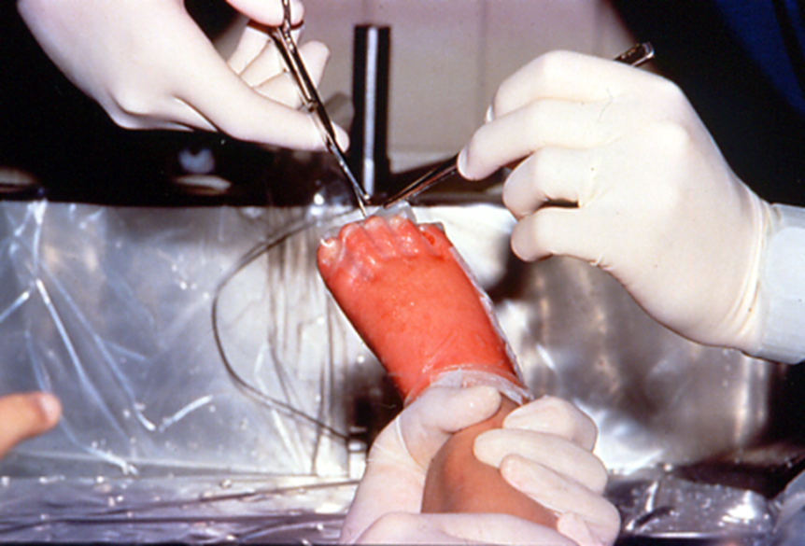
Special Considerations: Pediatric Burns
Circulation
Larger surface area
Increased volume needs
Hypothermia risk
Thinner skin depth
Notes:
Larger body surface area thus requiring more resuscitation fluid.
Due to the larger surface area, more prone to hypothermia given exposure to the environment.
Children less than 2 years have thinner skin and will have full thickness injuries whereas adults will have partial thickness burns given the same exposure to the heat source.
Careful volume resuscitation
Consider psychosocial issues if abuse or neglect case.
Pain management issues
Prefer IV medication administration for all burns due to malabsorption.

Slide 30
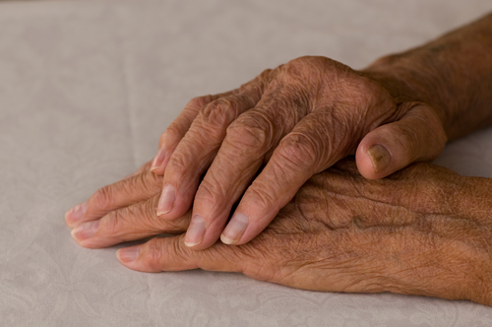
Special Considerations: Geriatric Burns
Pre-injury health status- pre-existing conditions
Abuse or neglect
Skin is thin, burn can be deep
Decreased reserves to stress response
May need additional monitoring to guide resuscitation.
Notes:
Geriatric burns:
Increased mortality rate
Affected by pre-injury health status, pre-existing conditions, and current medication
Stress response to burns not easily tolerated
Assess for signs of abuse and/or neglect
Skin is often then with decreased vascularity → more susceptible to deep burns when exposed to similar mechanism of injury
May require increased monitoring to guide fluid resuscitation such as Pulmonary Artery catheter

Slide 31
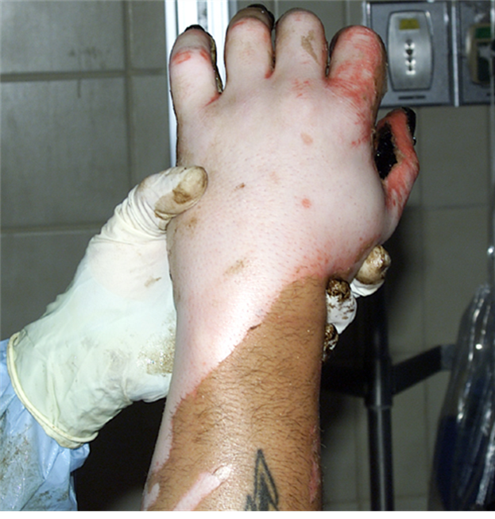
Initial Management
Monitor urine output and adequacy of resuscitation
Keep patient warm and dry
Wound care
Pain med
Consider need for transfer
Notes:
Continue to monitor urine output and adequacy of resuscitation.
Keep the patient warm and dry.
Cover the wounds with a clean sheet.
It is not recommended to place antimicrobial creams on the wound as the burn center will wash, debride and dress the wound.
Additionally some creams may interfere with biotechnology dressings.
Give morphine IV for pain. (small doses titrate to affect)
Avoid IM injections due to malabsorption.
Consider transfer to a burn center.

Slide 32
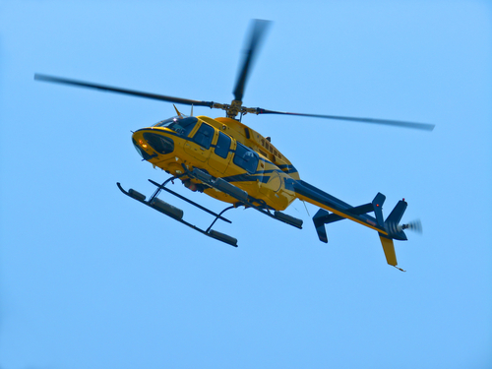
ABA Burn Center Referral Criteria
Partial thickness burns >10%
Burns to face, hands, feet, genitalia, perineum, or major joints
3rd degree burns any age
Electrical burns
Chemical burns
Inhalation injury
Patients with pre-existing medical conditions
Patients with burns & concomitant trauma
Pediatric burns
Patients who will require special social, emotional, or long-term rehab intervention
Notes:
Some burns have special considerations that should be treated at a burn center.
The American Burn Association has developed general guidelines for burn center transfer.
Some burn centers treat adults only, pediatric only or both adults and pediatrics.
All pediatric burns, inhalation injuries, third degree burns and burns to areas of function (i.e. the face, hands, feet, major joints) must be transferred.
Source: American College of Surgeons Committee on Trauma, Resources for the Optimal Care of the Injured Patient: 2006

Slide 33
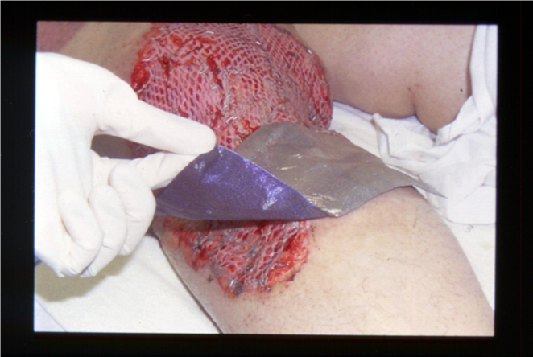
US Burn Centers
Only 55% of US burns admitted to burn centers
Burn Center’s average 200 admits per year
Non burn acute care hospitals average <3 per year
Specialized nursing and medical team including OT, PT, Social Work and more…
Notes:
About 55% of the estimated 45,000 United States acute hospitalizations for burn injury are admitted to 125 hospitals with specialized facilities for burn care.
Percentage admitted to burn centers has increased steadily in recent decades, with growing recognition of the special needs of burn patients and continuing advances in the technical resources and skills of those who refer, transport and treat them.
Burn centers now average 200 annual admissions, while the other 4,700 U.S. acute care hospitals average less than 3.
Specialized burn nursing is an important component of burn center expertise and contributes to improved patient outcomes.
Education is key to cultivating and maintaining burn nursing competency.
Burn Centers offer functional and cosmetic outcomes as well as a specialized team that includes, OT, PT and social work.
Burn Incidence and Treatment in the United State: 2011 Fact Sheet. www.ameriburn.org; accessed 6-15-11.

Slide 34
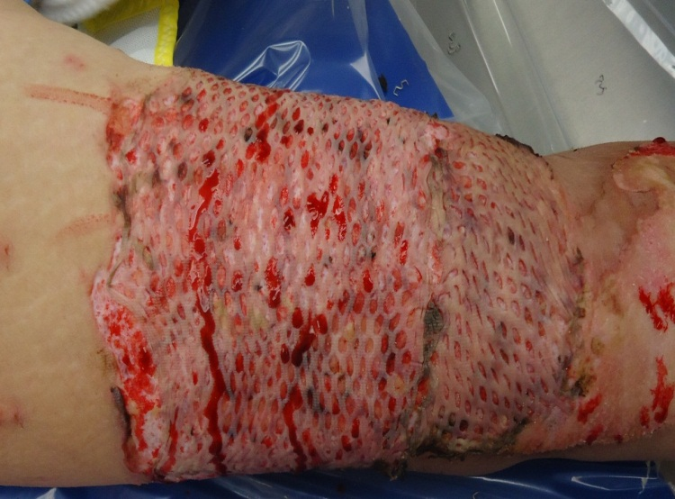
Skin Grafting
Split Thickness Skin Graft (STSG)
Third degree burns
Donor site must be flat surface
Partial thickness into dermis
Increase risk of infection
Notes:
Skin graft: STSG – split thickness skin graft
Required for third degree burns, sometimes used for deep partial second degree burns due to issues with scarring and cosmetic outcomes.
Donor site: Partial thickness donor contains viable dermis; taken from a non-burned area of the body.
Donor site must be flat area (not all areas of body are suitable for donor site which can be an issue with very large burns)
Be mindful of total body percent affected and increase risk of infection with addition of donor sites.
Clarification of terms: Autograft (from the patient – permanent placement) versus homograft (cadaver skin, used as temporary placement until autografts available or to prep site for autograft application).

Slide 35
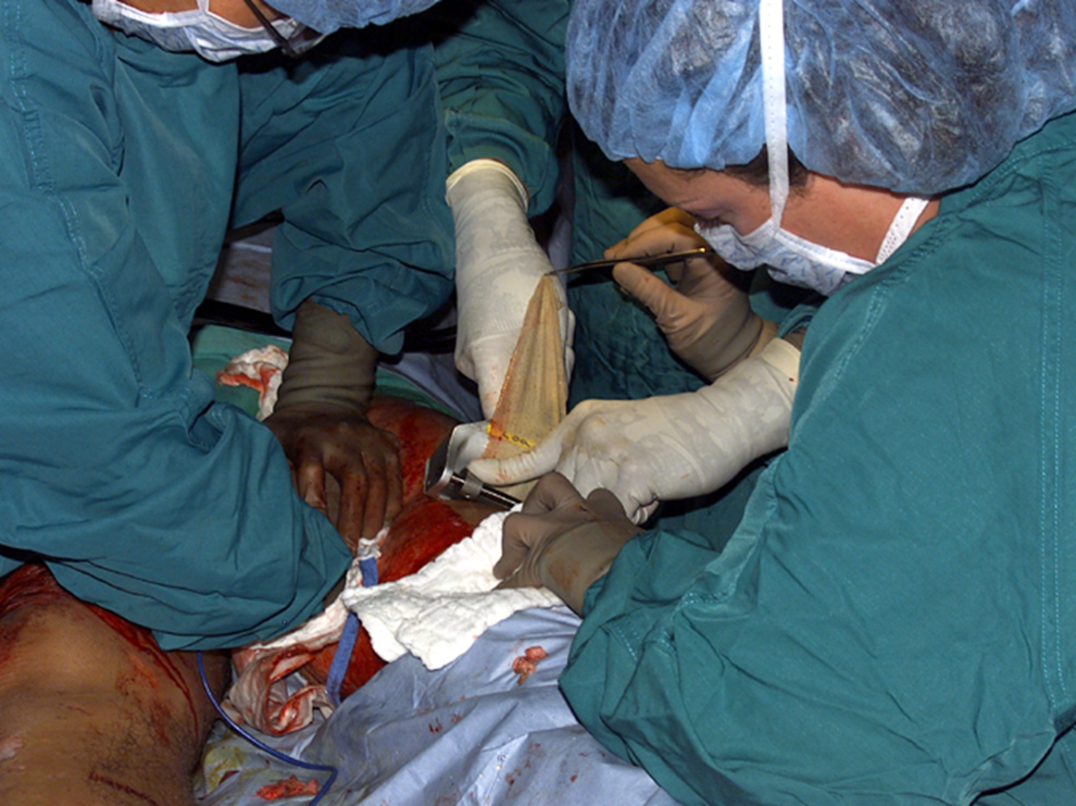
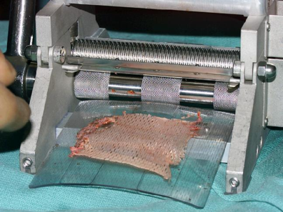
Meshed Versus Sheet Autograft
Notes:
Picture of harvesting donor site in the OR with a dermatome (long blade, needs flat surface area)
Harvested skin is put through a skin mesher in order to poke holes in the skin (mesh size is varied depending on how much donor site a patient has available)
Meshed skin can cover more surface area, allows for draining of exudate
Will heal looking “bumpy” (like a waffle iron), not cosmetically appealing
Sheet grafts are autografts not run through the mesher
Used for areas that will be seen more readily- face, hands etc.
Much better cosmetic outcome
Patient must have plenty of donor site (large burns often can not afford to use that much skin)
Skin grafting over joints require specialized OT/PT care, often placed in splints for a period of time

Slide 36
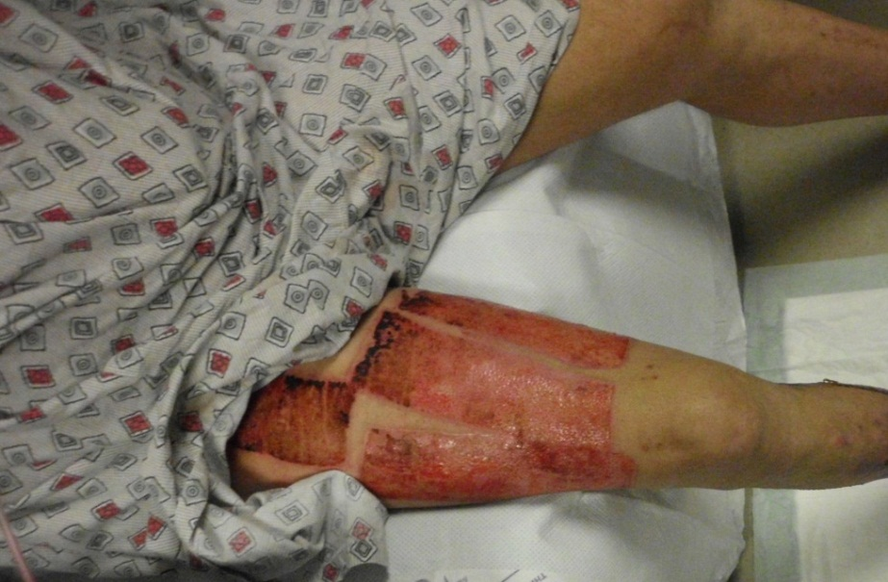
Donor Sites
Painful
Heal on their own
STSG donor sites maybe re-harvested
Notes:
Donor sites:
Very painful
Heal on their own
With STSG donor sites maybe re-harvested for future skin grafting. (Used in large burns)
Many different types of dressings for donor sites, burn community still struggling to find “the best donor dressing”

Slide 37
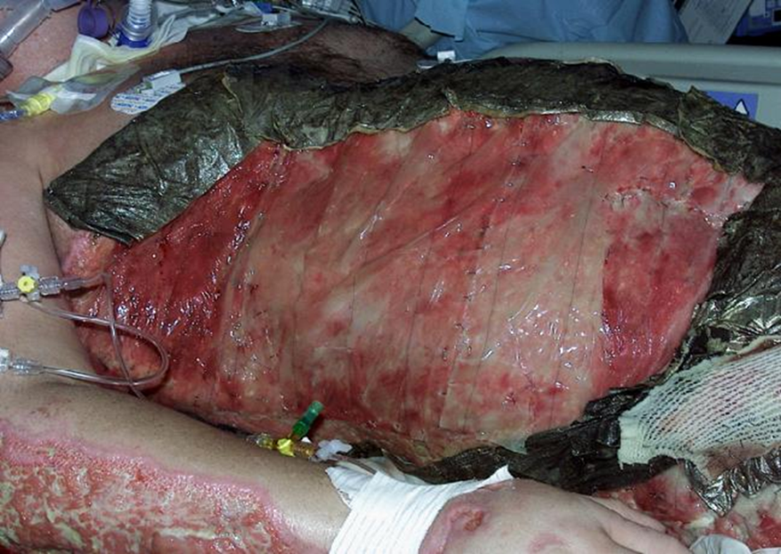
Wound Care
Silver Dressing
Cleanse wound with antibacterial agent
Major advancement in burns
Topical antimicrobial creams
Biotechnology dressings
Silver dressings
Wound biopsy guides therapy
Biotech Dressing
Notes:
Wound care:
Clean burn wound with antibacterial agent (soap and water)
Major advancements in the last 10- 15 years (biotech and silver dressings), has changed burn care
Continue to use topical antimicrobial creams
Choose topical based on effectiveness against different types of infection
Silver sulfadiazene is mainstay and often stocked in most ER’s
Biotechnology
Skin substitutes
Come in a variety of forms such as acellular matrices or bilayer laminates (a popular skin substitute uses shark glycosaminoglycans and bovine tendon collagen matrix to provide coverage and closure for very large TBSA burns)
Technology continues to advance.
Silver dressings
Very broad spectrum
Variety of forms: non stick dressings, foams, absorbent materials, sponges
Able to leave silver dressing in place for extended period of time (some 5-7 days).
Decreased number of dressings for patients (used to be BID with topical creams) and associated pain.
Decreased nurse staffing necessary for dressing changes.
Easier to care for at home
Wound tissue biopsy guides choice of dressing or topical based on type of infection present

Slide 38
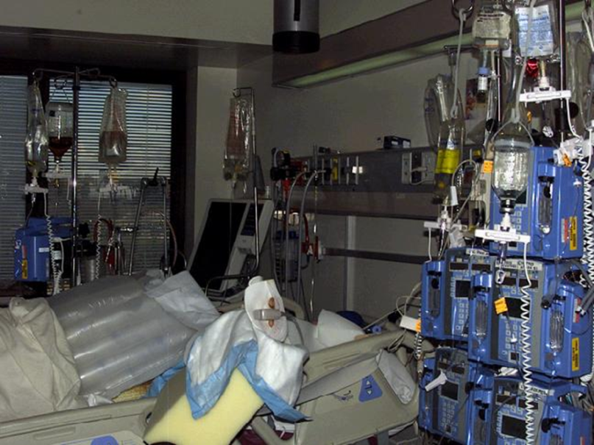
Complications
Inadequate resuscitation
Renal Failure
Over resuscitation
Abdominal compartment syndrome
And controversy….
Continue to debate resuscitation endpoints
Notes:
Aim of resuscitation is to support vital organ perfusion with the minimum amount of fluid necessary.
Resuscitation is a balancing act with under resuscitation causing renal failure and over resuscitation potentially causing abdominal compartment syndrome, pleural effusions and/or increased edema in non-burned areas.
Controversy continues about exact composition and timing of “ideal” resuscitation as well as resuscitation endpoints (there is a lack of class 1 evidence to guide therapies).
Traditional resuscitation often fails to normalize lactic acid and base deficit and may be associated with over resuscitation when used as goal directed therapy.
Increase in preload and cardiac index via aggressive resuscitation guided by Central venous catheters and PA catheters did not show any benefits. Therefore a preload driven strategy for burn resuscitation is not advisable. Invasive monitoring with a CVC or PA catheter is however, indicated in special circumstances such as elderly burns or patients with inadequate response to standard treatment.
Initial literature from military experience and some US burn centers detail use of nurse driven protocols to diminish variations along with early use of albumin.
Jeng JC, Lee K, Jablonski K, Jordan MH. Serum lactate and base deficit suggest inadequate resuscitation of patients with burn injuries: application of a point-of-care laboratory instrument. J Burn Care Rehabil. 1997; 18:402-5.
Pham TN, Cancio LC, Gibran NS, American Burn Association Practice Guidelines Burn Shock Resuscitation. J Burn Care Research. Volume 29 (1); 257-266.

Slide 39
Controversies
Lack of evidence based practice
Small number of large burns
Burn centers geographically isolated
Lack of standards for training
Perpetuates apprenticeship mindset
Few rigorous multi-center trials
Opposing techniques/philosophies
Burn State of the Science
Develop national research agenda
Notes:
Even though there have been amazing advances in the management of burns over the last few decades, there continue to be incongruities throughout the care continuum.
The majority of evidence is class 2 and class 3.
The reason for this is there are only a small number of burns each year and few rigorous multicenter trials.
Burn centers are geographically isolated and there is an apprentice mindset when it comes to training.
Many centers have opposing techniques and philosophies.
In response to the variation in burn center practices, a Burn State of the Science conference was convened in 2007 with the goal to develop a comprehensive national research agenda covering all aspects of burn care from the acute phase through the rehabilitative phase.
Palmieri TL, Klein MB. Burn research state of the science: Introduction. Journal of Burn Care & Research. 2007; 28 (4): 544-545.

Slide 40
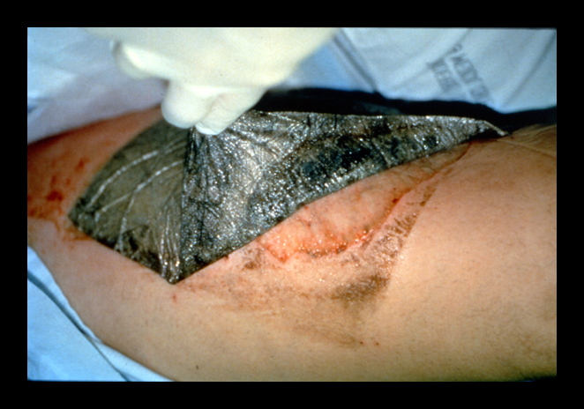
Future Considerations
Biotechnology
Dermal replacement
Stem cells
Resuscitation endpoints
Methods to stop capillary leak
Notes:
Future considerations include:
Continuous advances in biotechnological dressings
Current skin substitute coverage lacks an adequate dermal layer. Research continues to find a dermal layer that will hold up over time. Ultimate goals include ability to grow hair follicles, sweat and sebaceous glands and nerve endings.
Research to find stem cells to augment epithelialization and attenuate systemic inflammatory response.
Resuscitation endpoints remain elusive.
Research focus on methods to stop the capillary leak during burn shock.

Slide 41
Summary
Initial burn management priorities include
Maintain adequate airway
Adequate fluid resuscitation
Calculate TBSA and use the Burn Consensus Formula
Transfer patient to a burn center if necessary
Special considerations when caring for pediatric or elderly
A national burn research agenda is needed to develop standards of care & evidence based practice

